Slide 1

CCSDS System Engineering
Area (SEA): System Architecture WG (SAWG)
RASDS++ Update Views
Peter Shames, Systems Engineering Area Director
Fred Slane, Ramon Krosley, Costin Radulescu, Shelbun Cheng, Christian Stangl
8 Apr 2024
(“Word” version, edited for easy use as figures)
Updated post 8 Apr 24 WG review

Slide 2
Revision of the Reference Architecture for
Space Data Systems (RASDS)
Reference Architecture for Space Data Systems (RASDS) CCSDS 311.0-M-1 (ISO 13537) was published in Sept 2008
  RASDS has been leveraged by a number of CCSDS documents and also by several mission design projects.
  The document is consistently in the top 20-30 documents downloaded from the CCSDS web site, it is being used and referenced.
  RASDS is (over)due for a refresh, the question has been just what to do, and when.
The extensions to RASDS developed in producing the ASL ADD (CCSDS 371.0-G) and the SCCS-ARD and ADD, should be incorporated into the RASDS revision
  ASL ADD and SCCS-ADD examples may be adopted to improve graphics.
  Additional descriptive text on viewpoint & view construction should be added.
  In keeping with current MBSE best practices, an annex should be provided with a set of SysML representations. Published papers, and other CCSDS examples, addressing this already exist.
ISO TC20/SC14 wishes to make use of RASDS and is adopting it as a framework for describing their standards
  A liaison agreement has been agreed by the CMC, CMC-P-2020-03-003, dated 4-7-2020.
  A plan for these revisions has been outlined. See the following pages …

Slide 3
Terminology, Taxonomy, Ontology
Terminology: Terminology is a group of specialized words and respective meanings in a particular field. A term is a word, compound word, or multi-word expressions that in specific contexts is given specific meanings—these may deviate from the meanings the same words have in other contexts and in everyday language.
Taxonomy: Taxonomy is the practice and science of categorization or classification. A taxonomy (or taxonomical classification) is a scheme of classification, especially a hierarchical classification, in which things are organized into groups or types. Many taxonomies are hierarchies (and thus, have an intrinsic tree structure), but not all are.
Ontology: In computer science and information science, an ontology encompasses a representation, formal naming, and definition of the categories, properties, and relations between the concepts, data, and entities that substantiate one, many, or all domains of discourse. More simply, an ontology is a way of showing the properties of a subject area and how they are related, by defining a set of concepts and categories that represent the subject.

Slide 4
System Architecture Model Objectives
"Modeling, in the broadest sense, is the cost-effective use of something in place of something else for some cognitive purpose. It allows us to use something that is simpler, safer or cheaper than reality instead of reality for some purpose.
A model represents reality for the given purpose; the model is an abstraction of reality in the sense that it cannot represent all aspects of reality. This allows us to deal with the world in a simplified manner, avoiding the complexity, danger and irreversibility of reality."
  Rothenberg, Jeff. “The Nature of Modeling”, RAND, https://www.rand.org/content/dam/rand/pubs/notes/2007/N3027.pdf
Notes:
4

Slide 5
Relationship of ASL & SCCS-ARD/ADD to RASDS++ Evolution
Two documents, the ASL ADD and the SCCS-ARD/ADD, both use the Reference Architecture for Space Data Systems (RASDS) framework
Each used a consistent set of viewpoints and views based on RASDS method and representations
  RASDS provided the baseline set of viewpoints (Enterprise, Functional, Connectivity (deployment), Protocol, and Information.
  The ASL ADD added some useful extensions for describing the functional viewpoint, improved representation for the information viewpoint, and added a tabular services viewpoint.
  The SCCS-ARD/ADD developed a representative set of physical elements (nodes), extensively used the Connectivity viewpoint featuring deployed functions and protocol stacks, and developed a set of protocol stack building blocks that could be used to describe end-to-end architectures.
  These extensions, and others needed to meet SC14 needs, are being incorporated into the RASDS++ update.

Slide 6
Proposed RASDS++ Extensions
(SC 14 Collaboration)
Service Viewpoint
  Already introduced in CCSDS SCCS-ARD/ADD & ASL
  Covers exposed system service interfaces and interface bindings, hardware, software, and Persons
  Tabular representation, ties to protocol stacks and interface bindings
Physical / Structural Viewpoint
  Extracted from present Connectivity Viewpoint, defining Components and Connectors, to add new attributes & types
  Add support for physical aspects of elements, structures, energetic flows, position, attachment, field of view, power, thermal, radiation, other energetic views
Operations Viewpoint
  Create new Operations Viewpoint
  Add support to describe Operations processes, procedures, and related behavior
  Propose correlation to / derivation from from UML activity / sequence diagrams

Slide 7
RASDS Concept Model
… and Proposed TC20/SC14 extensions
Services Viewpoint
Tabular views of functions, operations, and related standards
Support system Design & Construction - realization
Correspondence to Protocol stacks and interface bindings
RASDS++ as Architectural Framework *
Functional allocation and distribution of functions and trade-offs (correspondence)
Engineering Viewpoint
System Design & Construction - realization
Functional allocation
Distribution of functions and trade-offs
Development
Validation & verification & engineering processes
Enterprise Viewpoint (15288)
Organizations
Persons
Use Case
Contracts Agreements (CONFERS)
Glossary
Connectivity / Deployment Viewpoint
Connectivity
Components & connectors
RF & optical
Physics of Motion
End to End Views
External Forces
Performance
Functional Viewpoint
Functional Structure - abstract
Functional Behavior & abstract interfaces
End to End View
Cross Support Services
Information Viewpoint
Information & information management
Data structures, syntax & semantics
Attributes & constraints (ASN, FRM, EDS)
Communications Viewpoint
Protocols & comm standards
End to end Information Transfer Mechanisms
Cross Support Services
Service interface bindings
State & Sequence charts ?
Just use 15288 or agency specs
Mission Assurance Viewpoint ??
Enterprise Risks
Cost
Validation & verification
Safety
Reliability & quality
Augment to Capture:
Capabilities
Mission Design & Drivers (OV-1?)
Requirements
Phases
Physical Viewpoint -Structures:
Power
Mass
Thermal
Orbit
Propulsion
Operations Viewpoint
Processes
Procedures
Activities, tasks, actions
Scenarios, Events
Modes & states
New Viewpoint
Modified Viewpoint
Just use 15288 or agency specs
De-selected Viewpoint
* Reference Architecture for Space Data Systems (RASDS)
** Reference Model Open Distributed Processing (RMODP, ISO 10746 spec)
Notes:
7

Slide 8
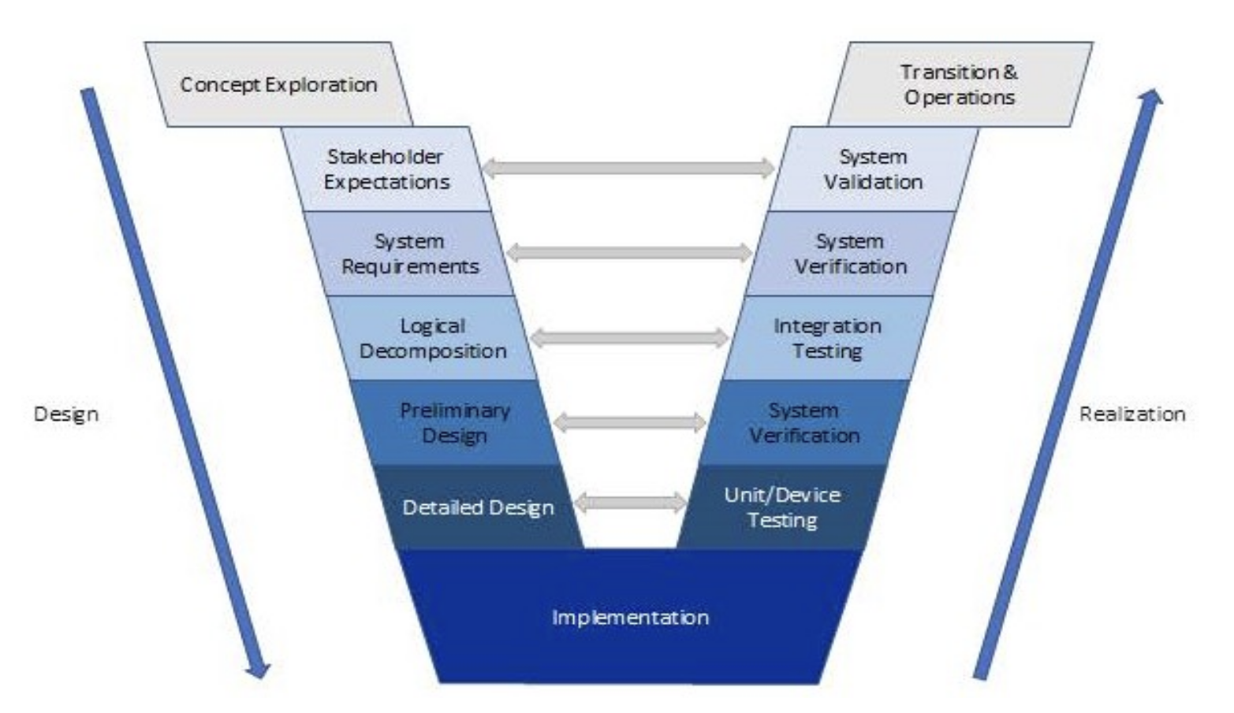
Relationship to System Engineering “Vee”
Questions:
- Where does systems architecture occur in this process?
- What process is recommended to create a systems architecture?
- How does systems architecture relate to the rest of this process?
Answer:
- “Logical decomposition” and “Preliminary Design” is what systems architecture is associated with.
- The process is described as “logical decomposition”.
- “Logical decomposition” is often convolved with requirements decomposition and design evolution.
Observations:
- There is no definition of “Architecture”, but there is one for Logical Decomposition: “The decomposition of the defined technical requirements by functions, time, and behaviors to determine the appropriate set of logical and data architecture models and related derived technical requirements. Models may include functional flow block diagrams, timelines, data control flow, states and modes, behavior diagrams, operator tasks, system data, metadata, data standards, taxonomy, and functional failure modes.“
- There is no stated methodology, but DoDAF is mentioned in the NASA SE Handbook
- This “Vee”, and variations on it, “Dual V”, “W”, appear in many related processes, including Agile development
- Sometimes they actually show “Architecture” and model based processes
- ISO 15288 has a more complete Architecture Design Process in Sec 5.5.4
Copied from: NASA SE Process NPR 7123.1D
Called the “SE Vee”, or the “SE Engine”
Fig 2-1

Slide 9
Relationship of Systems Architecting to Systems Engineering
The systems architect is an information and communications technology professional. Systems architects define the architecture of a computerized system (i.e., a system composed of software and hardware) in order to fulfill certain requirements. Such definitions include: a breakdown of the system into components, the component interactions and interfaces (including with the environment, especially the user), and the technologies and resources to be used in its design and implementation.
The systems architect's work should seek to avoid implementation issues and readily permit unanticipated extensions/modifications in future stages. Because of the extensive experience required for this, the systems architect is typically a very senior technologist with substantial, but general, knowledge of hardware, software, and similar (user) systems.
Wikipedia: https://en.wikipedia.org/wiki/Systems_architect
Systems engineering is an interdisciplinary field of engineering and engineering management that focuses on how to design, integrate, and manage complex systems over their life cycles. At its core, systems engineering utilizes systems thinking principles to organize this body of knowledge. The individual outcome of such efforts, an engineered system, can be defined as a combination of components that work in synergy to collectively perform a useful function.
Issues such as requirements engineering, reliability, logistics, coordination of different teams, testing and evaluation, maintainability and many other disciplines necessary for successful system design, development, implementation, and ultimate decommission become more difficult when dealing with large or complex projects. Systems engineering deals with work-processes, optimization methods, and risk management tools in such projects.
Wikipedia: https://en.wikipedia.org/wiki/Systems_engineering
Enterprise Architecting
Iteration (when necessary)
Systems Architecting
Systems Engineering
Time:
Fig 2-2

Slide 10
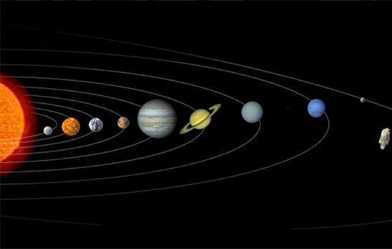
Reference Architecture
for Space Data Systems
Enterprise
Business Concerns
Capabilities, Organizations, Governance
Functional
Computational Concerns
Functional composition
Physical Concerns
Component & Connector perspective
Physical
Connectivity Derived Viewpoint
Structural Derived Viewpoint
Communications
Protocol Concerns
Communications stack perspective
Information
Data Concerns
Relationships and transformations
Services
System Service Concerns
Interfaces, protocols, and data exchanged
Operations
Operations Concerns
Processes, Activities, Products
Derived from: RM-ODP, ISO 10746
Compliant with ISO 42010 and IEEE 1471
Fig 2-3
Notes:
10

Slide 11
Comments on Engineering and Mission Assurance Viewpoints
Engineering viewpoint concerns are already thoroughly covered by ISO 15288.
  The SE “V”
  Processes and steps, including Systems Architecture even if it may not be explicit
  There are also various agency specific standards
Mission Assurance processes are well covered by ISO 15288 and agency standards.
  Since both of these are process oriented in nature, and these processes are well documented, no added Viewpoint in RASDS is required.
What RASDS++ does, however, is provide a standardized method to create and document the system architectures.
  This is a capability that these standards implicitly require, but do not provide

Slide 12
Revised RASDS++ (DRAFT)
Top Level Object Ontology
ComposedOf
Operations
Enterprise
Meta-model
(each Viewpoint)
Scenarios
Performs
Processes
Mission
Defines Objects
Activities
Requirements
Defines Relations
Invokes
Tasks
Objectives
Defines Rules
Modes/states
Governance
Defines Correspondences
FulfilledBy
Use Cases
Exposes Concerns
ComposedOf
Resources
Develops / Owns
Meets
Calls
Function
Produces
Information
Offers
Logical structure
Consumes
Data
Behavior
IsImplementedBy
ComposedOf
Metadata
Constraints
Rules
Service
Interfaces
ContainsInstances
Standards
Component
(Node)
Svc Behavior
ProvidesService
Environment
Interface Binding
Uses
Type
Affects
Svc Constraints
ImplementedOn
Attributes
(comm, power,
thermal, prop,
other)
ConnectVia
Physical Environs
DefinedBy
Communication
Attributes
Protocol stack
Attachment
Connector
(Link)
Comm standards
Location
AssociatedWith
Type
Flows
(comm, power,
thermal, prop,
other)
Fig 2-4

Slide 13
RASDS++ Viewpoint Specifications
Each RASDS++ Viewpoint addresses:
  Stakeholder concerns: What does the stakeholder care about (what must views address)
  Objects: The fundamental kinds of objects (functions, data, organizations, physical elements, protocols, etc)
  Relationships: The descriptions of object attributes and how they relate, including correspondences to other objects
  Representation: How objects and relationships of different types may be represented in diagrams
MBSE adaptations:
  The primary work that must be done to use RASDS++ with MBSE tools is to:
    Define profiles to accurately represent the different classes of objects and relationships
    Create stereotypes that can be used consistently in the tools
    Use the profiles and methods to develop the MBSE style representations

Slide 14

RASDS++ Representations
(with ASL and SC14 extensions)
Data
Store
Physical Node
Data Store
Organizational Element
Organizational Domain
Service
Consumer
Service
Provider
DATA
Physical or
Functional Connection
Logical Link
between Elements
Link Layer
Service Access Point
Peering
Arrangement
Functional
Element
InformationObject
Communications Protocol
Router
Color Key for Example Diagrams (from SCCS-ARD):
User Node
Application
Link Layer function
Earth Routing Node
Element Management
Routing function
Space Routing Node
Network Management
Forwarding function
WAN Node
Network Layer function
Data Store
Fig 3-1
Notes:
ASL Fig 3-1, trim headers & footers

Slide 15
Unified Set of Object Features Representation
Management Interfaces:
How objects are configured
controlled, and monitored
Object
Service Interfaces:
How services are
requested & supplied
External Interfaces:
How external elements
are controlled
Core Functions
What the object
does
Concerns:
Issues
Resources
Policies
Fig 3-2

Slide 16
RASDS Relationship Types
(UML derived)
Read as sentence with subject = start of arrow, verb = label, and object = end of arrow
Inheritance
Composition
Aggregation
Association (other relationship, labelled)
Directional Association
Correspondence
Inheritance: The ability of one class (child class) to inherit the identical functionality of another class (super class), and then add new functionality of its own. E.g. super class: “round ball”, child classes: “baseball”, “soccer ball”, “basketball”, but not “football”
Composition: A special case of association that describes a relationship between a whole and its existential parts. E.g. a person, with head, arms, legs. Note that the parts cannot exist separate from the rest of the person.
Aggregation: a special type of association in which objects are assembled or configured together to create a more complex object. E.g. a car is assembled from a body, wheels, and an engine. Note that the engine can exist apart from the rest of the car
Association (other relationship, labelled): Association is a relationship between classifiers which is used to show that instances of classifiers could be either linked to each other or combined logically.
Directional Association: Associations that are navigable in only one direction. A directed association indicates that control flows from one classifier to another; for example an actor to a use case.
Fig 3-3

Slide 17
Example Ontology - Formalized Relationships among Terms
(Functional Viewpoint example with added Correspondences)
System
Implemented by 1.. (corr)
Composed of …
Service
Interface
Exposes 0..
Main Object
Processes ..
Implements
Specified by .. (corr)
Has …
Data
Behavior
Function : The set of actions or activities performed by some object to achieve a goal; the transformation of inputs to outputs that may include the creation, modification, monitoring, or destruction of elements.
Correspondence: A function such that for elements in one viewpoint there is a related element in another viewpoint; the condition of being in conformity from elements in one viewpoint to elements in another.
  Correspondence (corr): Colored objects shown with dashed lines are formally defined in other viewpoints and are referenced by correspondence
Fig 3-4

Slide 18
Technical Architecture Definitions
System
  A System is a group of interacting or interrelated Elements that act according to a set of rules to form a unified whole. A System, surrounded and influenced by its environment, is described by its boundaries, structure and purpose and expressed in its functioning.
  A collection of interacting components organized to accomplish a specific function or set of functions. A System is composed of Elements, which may be any of: Hardware, Software, Persons, and Procedures.
Function
  A Function is the purpose for which an Element is intended. This can be an activity performed by the Element or the usage of this Element by other parts of the system.
  A Function is interpreted as a specific process, action or task that a System is able to perform.
Service
  A mechanism to enable access to a set of one or more functions of an Element, where the access is provided using a prescribed interface and is exercised consistent with constraints and policies as specified by the service description.
  A Service is an exposed interface of a Function.
Interface
  An Interface represents a set of mechanical, electrical, signal, or other properties that describe some aspect of a Element’s connection to or interaction with another Element.
  An interface is formed of the ports on two or more elements and the junction that joins them.

Slide 19
Enterprise Viewpoint - Revised
The Enterprise Viewpoint focuses on the purpose, scope, and policies for the space data system. It describes the organizational entities and relationships; their roles, requirements, goals, objectives, scenarios, constraints; and how to meet them.
Stakeholder Concerns:
  the purpose, scope, and policies for the system;
  the objectives, operations concepts, and scenarios for the system;
  the requirements and constraints on the system;
  roles played by the system elements;
  activities undertaken by the system.
Enterprise Objects:
  Types: Organizations, both formal and informal (missions, projects, communities, with their roles and responsibilities), and Resources (facilities or other elements having enterprise operational or service roles);
  Attributes: name, role, objectives, point of contact, location, members, resources, provided services, types, interfaces and data, interaction modes, requirements, constraints;
Domains (boundaries of responsibility or ownership, includes requirements, system elements);
Relationships (ownership, membership, participation, roles, contractual);
Correspondences to Information objects (defined instances of documents, agreements, contracts, policies, requirements, objectives, goals, scenarios, membership lists, interface specifications, where formal specifications of the data to be exchanged are found in the Information Viewpoint).

Slide 20
Enterprise Viewpoint - Enterprise Object
(Organizational Entity Features)
Management Interfaces:
Scope
Requirements
Policies
Governance
Purpose / Mission / mission types
Funding / Resources
Enterprise
Object
Service Interfaces:
Requirements
Agreements
Contracts
Funding
Attributes:
Identifier
Organization
Assets & Resources (Persons, Systems, Budget)
Roles
Objectives
Use cases
Requirements
Capabilities
Risk Management
Agreements / contracts
External Interfaces:
Scope
Requirements
Policies
Governance
Agreements / Contracts
Funding / Resources
Fig 4-1

Slide 21
Enterprise Viewpoint - Enterprise Object
(Organizational Entity Features)
Notes
Enterprise Concerns:
  Objectives
  Roles
  Requirements
  Policies
  Risk Management
  Lifecycle / Phases
  Configuration
  Contracts
Enterprise Object Notes:
Interfaces of Enterprise Objects are often described as document exchanges
Specific Enterprise Objects may own / implement / operate a set of Functions or Components
* An “Application” is a set of functions deployed (somehow) on a server as part of a system
  Enterprise Ontology Notes
  Assets: Devices, system components, applications, infrastructure components
  Resource: Anything available to a system that can support the achievement of objectives; any physical or virtual element that may be of limited availability within a system. In the Enterprise Viewpoint a resource is an entity that has some role, offers services, and performs some action within a system.
  Ref: TOGAF, NIST 800-207
  An enterprise capability denotes the “What” an enterprise can do, whereas an enterprise process outlines “how” a particular activity gets done.
  An enterprise process is defined as a set of activities and tasks that, once completed, will accomplish an organizational goal.

Slide 22
Formalized Relationships among Terms
(Enterprise Viewpoint ontology)
Superior
Enterprise
Provides: Mission, Scope, Requirements, Governance, Resources …
Specifies…
Persons
Requirements
Composed of …
Any of 1..
System Elements
Constrain …
Consumes / Expends ..
Enterprise
(Organization)
Values…
Assets
Resources
Data
Artifact
Controls / Operates in 1..*
Possess set of 1..*
Services
Perform ..
Create ..
Domain
Capabilities
Operations
Produce ..
Products
Fig 4-2

Slide 23
RASDS Enterprise View Representation
Logical Link:
Node to Node interface
Organization Object
(Org, Project, Business)
Include Use Case in Enterprise view tie to Services view
Org A
Org B
DATA
Sub-Org B1
Function A
Function B
Organizations (Agency, Project, Business) will explicitly connect via a Logical Link. May show the organization domain of control or ownership, or containment (sub-org).
May show allocation of Functions that an organization carries out (tied by correspondence to the Functional View where they are defined).
May explicitly identify the information objects (such as contracts, requirements, agreements) exchanged between organizations (tied by correspondence to the Information View where they are defined).
Information Object
(optional)
Domain Boundary
(optional)
Specific and Generic Object Types and Containment:
Denotes a specific Organization (org, project, business), may have embedded components
Denotes a function an organization carries out (optional, see Functional Viewpoint)
Denotes a Logical Link (information flow of some sort) between two Organizations
Denotes an information object (optional, allows data to be characterized, see Information Viewpoint)
Denotes an organization / domain boundary (ownership / responsibility)
DATA
Fig 4-3
Notes:
ASL Fig 3-4, trim headers & footers

Slide 24


Simple Enterprise View
Single Agency Mission Domain & Enterprise Objects
Operations Planning Phase
Agency A
Operations
Domain
Agency A
Mission &
Support
Organizations
Mission A
Spacecraft
Mission A
Instrument
Control
Team C
Instrument
C
Comm Link
Modes
Agency B
Ground
Tracking Network
Instrument
Support
Agreement
Mission A
Spacecraft
Control Team
Tracking
Configurations
Long range
Tracking Plan
Fig 4-4

Slide 25
Enterprise View - Mars Exploration Program
Example
Instrument
Integration
Agreement
Instr Org S
Cross- Support
Agreements
Science
PI Org
MEx Proj
MSL Proj
DSN
ExoMars Prog
MMO
MRO Proj
NASA/
JPL
Tracking
Agreements
Operations
Agreements
ICDs
Prog S
Svc Org Z
ESA
MRO Ops
Mars Exploration
Program Federation
S/C Contractor
Fig 4-5

Slide 26
Enterprise View
Multi-Agency Mission Domain & Enterprise Objects Launch Operations Phase
Mission Z Operations Domain
Post-Launch Flight Telemetry
Agency WXY
Operations
Domain
Agency WXY
Launch Tracking
Network
Agency WXY
Launch Vehicle
Agency WXY
Launch Facility
Mission Z
Spacecraft (stowed configuration)
Pre-Launch Vehicle Health
Spacecraft Mode and State Change
Agency ABC
Operations
Domain
Instrument
Observation
Request
Agency ABC
Space Relay
Network Ops
Mission Z
Spacecraft
Agency QRS
Flight
Operations
Domain
Agency ABC
Ground Tracking
Network Ops
Comm Link
Configs
Tracking
Requests
Instrument
ABC
Agency ABC
Instrument
Control Team
Mission Z
Spacecraft Control
Team
Instrument
Observation
Request
Agency ABC
Science Team
Agency QRS
Science Team
Science Planning
Coordination
Fig 4-6

Slide 27
Enterprise Behavior Modelling Ontology - Formalized Relationships
(Enterprise Capability / Process ontology, from TOGAF)
Enterprise
Possess set of 1..
Capability
Organizational Goal
Uses
Accomplishes
Enterprise Process
Performed
by
Persons
Member
of
Department
Uses …
Uses …
Helps Provide …
Enterprise
Service
Application
Information
Services …
Accesses
Implemented by 1..
Data Artifact
Application
Fig 4-7

Slide 28
“Enterprise Architecture” Definitions
Enterprise Capability
  An expression of what an enterprise does and can do. An enterprise capability denotes the “What” an enterprise can do and has responsibility for, whereas an enterprise process outlines how a particular activity gets performed by enterprise systems.
  At an elemental level, an enterprise capability is the encapsulation of the underlying functionality expressed abstractly, in general and high-level terms, requiring a combination of organization, Persons, processes, and technology to achieve.
Asset
  An item of value to stakeholders. An asset may be tangible (e.g., a physical item such as hardware, firmware, computing platform, network device, or other technology component) or intangible (e.g., humans, data, information, software, capability, function, service, trademark, copyright, patent, intellectual property, image, or reputation). NIST 800-160

Slide 29
“Enterprise Architecture” Definitions, contd
Enterprise Process
  An enterprise process is defined as a set of activities and tasks that, once completed, will accomplish an organizational goal.
Activity
  Work, not specific to a single organization, operational system or individual that transforms inputs (Resources) into outputs (Resources) or changes their state. (DoDAF, edited)
Actor
  An actor specifies a role played by a user or any other system that interacts with the subject. It may represent roles played by human users, software, external hardware, or other subjects. (UML)
Application
  An application (app), application program or application software is a computer program designed to help Persons perform an activity (Wikipedia)
Data
  The representation forms of information that may be stored and/or exchanged by systems and users thereof. (Information)
  Not completely clear what a “data artifact” might be. In some contexts it is defined like this:
    A data artifact is a data flaw caused by equipment, techniques or conditions. Common sources of data flaws include hardware or software errors, conditions such as electromagnetic interference and flawed designs such as an algorithm prone to miscalculations.

Slide 30
Formalized Relationships between Enterprise & Technical Architecture
(Recolored for the Viewpoint the objects are defined in)
Business
Possess set of 1..
Capability
Uses
“Logical” Enterprise System Boundary
Business Process
Performed
by
Persons
Member
of
Department
Supports the Enterprise
The “Enterprise Architecture”, in actuality, is implemented by the Technical Architecture
Uses …
Uses …
The “Technical Architecture” implements the systems, services, and processes.
(Business) Service
Application
Business
Information
Services …
Hardware
Composed of 1..
Accesses
Process is an ordered set of Functions
Software
Data Artifact
Application
Implemented by 1..
Implemented by …
Implement 1..
System
Persons
(System)
Service
Function
Affects
Procedures
Technical System Boundary
Function offers 0.. Service Interfaces
Process
Action
Task
Environment
Fig 4-8

Slide 31
Formalized Relationships among Terms
(System Viewpoint aspects, related to Capability)
Remove, but include back reference to Connectivity VP with combo VP slide
Capability
Provides 1…
Hardware
System**
Has 1..
Environment
Affects
Software
Composed of 1..
Offers 1..
(Transitive)
System
Element
Implements 1..
Persons
Service
Offers 0..
Function
Procedures
Technical Process
Action
Task
** A “System” may be de-composed into System Elements.
  System: A collection of interacting components organized to accomplish a specific function or set of functions.
  A System is composed of Elements, which may be any of: Hardware, Software, Person, and Procedures.

Slide 32
Formalized Relationships between Enterprise & Technical Architecture
(Recolored for the Viewpoint the objects are defined in)
(Notes)
  The Enterprise Architecture defines processes, services, and applications, all of which are implemented by the Technical Architecture, but without directly addressing the technical details or relationships among functions, HW, SW, and Persons that are defined in the Technical Architecture.
** The technical aspects of the “Enterprise System” may not be defined as part of the Enterprise Architecture. It may stop at the Service, Application, and Data level.
* An “Application” is Software, a set of functions deployed (somehow) on a hardware platform or a server as part of a system, with defined interfaces

Slide 33
Functional Viewpoint
The Functional Viewpoint describes the functional decomposition of the space data system into abstract objects that interact at interfaces.
Stakeholder Concerns:
  a functional decomposition of the system into objects that interact at interfaces;
  the abstract behavior of the system, its interactions and constraints.
Functional Objects (abstract set of functions, their behaviors, interfaces and configurations);
  Types: data source, data sink, data transformation, control, planning, monitoring, analysis;
  Attributes: role, name, type, behavior, interface types, data types handled, interaction modes, constraints, allocated requirements;
Logical Links (connections between Functional Objects, connected to associated logical behavior and properties);
Relationships (configuration, precedence, control and data flows, management flows, allocations);
Information (representations of data that are exchanged among Functional Objects, where formal specifications for the information objects are found (by correspondence) in the Information Viewpoint).

Slide 34
Functional Viewpoint
(Abstract Functional Object Features)
Management Interfaces:
How function is configured,
controlled, and monitored
Functional Object
Service Interfaces:
How services are
requested by & supplied
to other Functional Objects
External Interfaces:
How other Functional Objects are used to support the performance of this Object
Attributes
Identifier
Type
Behavior
Data
Concerns:
Performance constraints
Resource requirements
Constraints
Fig 5-1

Slide 35
Formalized Relationships among Terms
(Functional Viewpoint ontology)
Requirement
System
Element
Fulfilled by 1.. (corr)
Implemented by 1.. (corr)
Implemented by 1.. (corr)
Composed of …
Uses to communicate
Protocol
Stack
Service
Offers 0..
Function
Produces /
Consumes ..
Implements
Has …
Specified by .. (corr)
Data
Behavior
Function : The set of actions or activities performed by some object to achieve a goal; the transformation of inputs to outputs that may include the creation, modification, monitoring, or destruction of elements.
Behavior: A set of actions performed by an object for some purpose.
Fig 5-2

Slide 36
Extended RASDS Functional View Representation*
Logical Link:
end-to-end interface between functions
Service Consumer
(required I/F, optional arrowhead)
Functional Objects are abstract representations of behavior. They may be instantiated or realized in different logical or physical constructs.
Functions may themselves be decomposed into lower level functions, shown by containment.
Different deployments or realizations of the same Functional Object may be expressed in other views and referenced by correspondence.
Functional Objects may explicitly define a service providing interface, but this is not required.
They may explicitly identify the information objects that are exchanged (tied by correspondence to the Information View where they are defined).
Function A
Function B
DATA
Sub-Function B1
Data Object
(optional)
Service Provider
(provided I/F, optional)
Specific and Generic Data Types and Containment:
DATA
Denotes a specific Data Type subject to standardisation by CCSDS / SC14
Italics denotes an Abstract or Generic Data Type
Faded Colour: Data contained within another Data item (to which it is attached)
DATA
DATA
Standardisation Status:
DATA
Unspecified Status (typically used for aggregated or grouped data/services)
Published CCSDS / SC14 Standard (Blue or Magenta Book)
[Future]: CCSDS / SC14 Standard Under Development
[Prospective]: Proposed CCSDS / SC14 Standard (Green Book – future road map)
No CCSDS / SC14 Standard Identified
DATA
DATA
DATA
DATA
* Revisions from ASL
Fig 5-3
Notes:
ASL Fig 3-4, trim headers & footers

Slide 37
Simple Alternative Functional VP
representation examples
Two different simple Functional Object views, one just showing data flow directions, the other explicitly showing provided interfaces and data objects.
Directive
Generation
Directive
Management
Directive
Execution
Data flow directions
SCEP
Directive
Generation
Directive
Management
Directive
Execution
SCD
SCD
SCC
Data Object Key:
SCEP - S/C Event Plans
SCD - S/C Directives
SCC - S/C Commands
Provided interfaces and data objects
Fig 5-4

Slide 38
Simplified functional VP example
Monitor &
Control
Mission
Planning
Directive
Generation
Directive
Management
Directive
Execution
Data
Repository
Data
Acquisition
Mission
Analysis
Spacecraft
Analysis
LT Data
Repository
Orbit
Determ
Tracking
Radiometric
Data Collect
Insert as new Fig 5-5???
See revised fig 5-6 …

Slide 39
Example: MO top-level Functional Decomposition,
Data and Services (from ASL)
MD-CSTS
User Support
Planning & Scheduling
SC-CSTS
TT&C
MPS
CSSM
NAVT
CSSM-ES
MCS
MPS
MPS
TD-CSTS
NAVT
SLE-Ret
TRM
MCS
NAVT
Mission
Control
Navigation & Timing
MCS
NAVT
MCS
MCS
NAVT
OPD
MCS
MCS
MPS
NAVT
OPD
MPS
MPS
Data Storage and Archiving
Operations
Preparation
NAVT
MDP
OPD
MDP
MCS
OPD
NAVT
Spacecraft Development & Maintenance
Mission Data
Processing
MDP
MCS
NAVT
Functions and Data Colour Coded: Data in Rectangles; Services indicated at Provider End by Circle
MDP = Mission Data Product
Fig 5-5
Notes:
ASL Figure 4-2, trim top & bottom
The 5 MOIMS Areas are colour coded.
Each application level interaction is annotated with the Data exchanged. At this level all Data generated by each Function is grouped as a single type (the abbreviation reflects the function name).
Potential service interfaces identified by MO are indicated by a colour-coded circle representing the Service Provider
Data formats may be separately defined [NAV, MPS] or specified in the context of the service [MO M&C, MPS].
File Handling is a bit different – there are special services for File Management and File Transfer [the latter delegated to a lower level protocol, such as CFDP or FTP], but the file content my be associated with any of the other Functional Areas. It essentially provides the transport layer for bulk transfer of service messages or data formats. Mission Data Products may also be transferred as files.
Note Planning/Scheduling interactions with the GSTS are greyed out as they are outside the scope of MOIMS standardisation [CSS boundary agreement].

Slide 40
Functional Objects and Information Management Infrastructure Elements redrawn 8 Feb 24
Monitor &
Control
Representative Functional Objects
Mission
Planning
Directive
Generation
Directive
Management
Directive
Execution
Data
Acquisition
Information
Management
Service
Interfaces
Data Objects
Query / Results
Metadata / Resources
Query
Service
Registry
Service
Common Schema & Dictionaries
Domain Data Models
Information Management Functional Objects
Repository
Service
Product
Service
Local Data Models
Fig 5-6

Slide 41
Physical Viewpoint - New
The Physical Viewpoint describes the engineered decomposition of the space system into physical Components (Nodes) that connect physically or energetically to other Components. The Physical Viewpoint describes the physical aspects of the space system and the external environment within which it operates, the physical connections and behavior (fixity or motion) of the Components, and their physical composition.
Stakeholder Concerns:
  The physical Components that compose the system;
  The physical connections among the physical elements in the system and the structural or energetic flows and junctions required to support these connections among objects in the system;
  The characterization of these different physical aspects in their own views, with tailored language for connection modalities: mechanical, electrical, thermal, electro-magnetic, gravitational, propulsive, ..;
  The selected allocation of physical functions to the Components of the system, including their implementation choices and constraints on implementation, connections, configuration, and features imposed by the nature of the physical connections and the environment;
  The behavior and performance of elements in the system, including their capabilities, fixity or physical motion, and their interactions with the physical environment.
  The impacts and constraints on connections, energy flows, motion, ….

Slide 42
Physical / Structural Viewpoint - New, contd
Engineering Objects (Components, Connectors, Applications):
  Nodes (hardware Engineering Objects, provide mechanical, power, thermal and other structural or physical resources, connection points, performance and other associated physical behavior):
    Types: hardware objects, composite hardware objects;
    Attributes: name, type, mass/power/orientation, location (place, trajectory, orbit), laws of motion, physical interfaces, capabilities (e.g., attachment type, fixity / motion, connection properties, etc.), allocated functions, constraints;
  Connections between Components (associated physical flows, behaviors, and properties);
    Types: connectors / weldments / mating surfaces, joints, waveguides, heat pipes, cables, free-space radiation, …
    Attributes: name, type, end-points (connected nodes), physical interfaces, performance (e.g., capacity, flows, range of motion), constraints, environmental effects, etc.);
Relationships (composition, interfaces/connections, constraints, configurations, allocation);
  Environment (physical environs, physical forces [gravity, electromagnetic, radiation, and others], physical interactions and effects);
  Flows (defined representations of energetic flows that are exchanged among Engineering Objects, where formal descriptions of flows are found in the Information Viewpoint).
NOTE – Physical Components and Connectors in any given space system may include many more aspects and many more attributes than those shown here. The Data Communications aspects of Components (Nodes) and Connectors (Links) are covered in the Connectivity Viewpoint.

Slide 43
Physical Base Viewpoint - Physical Object
(Hardware Component Representation)
Management Interfaces:
How Components are configured,
controlled, and reported upon
Physical Environment
Laws of Motion
Other energetic inputs, gravity, Solar, radiation,…
Physical Component
Service Interfaces:
Physical Connections
from other Components
External Interfaces:
Physical Connections
to other Components
Attributes:
Name/identifier
Composition (engineering objects)
Physical environment
Extensions
Physical Attributes (mass, power, moment of inertia, thermal, Distribution / frame of reference)
Connection types (flows, energetic, structural,…)
Constraints
Fig 6-1

Slide 44
Relationships among Terms
(Physical Viewpoint ontology - redrawn)
Composed of 1..
Hardware
Environment
System
Element
Software
Location / Motion
Affects
Person
Has
Is a …
Composed of …
Service
Offers 0..
Component
Implements 1..
Has Provided / Required 1…
Attachment
(Interface)
Function
Connect via 1…
Defines
Connector
Interface Standard
Provides / Conveys
Flow
Fig 6-2

Slide 45
RASDS Physical View Representation
Service Consumer
(consumer, optional)
Related to the Connectivity Viewpoint, but focus here is on physical characterization, connections and energetic flow, not data.
Nodes (Components) will explicitly connect via some Physical Link. Nodes will have mass, power, thermal, and other properties. A Node may explicitly define a physical interface, but this is not required.
Physical connection (represents energetic constraint). This may be dynamic or static, structural / rigid, flexible, or other energetic (electro-magnetic, thrust, gravitational, thermal radiation).
May show allocation of implemented Functions, in hardware (a sub-node) tied by correspondence to the Functional View where they are defined.
May explicitly identify the flows exchanged by the objects using the link (defined in these views).
May explicitly identify the physical interface or connection type.
Physical Connection:
Component to Component connection
Energy Flow
(0..n, optional)
Component A
Component B
Flow
Sub-Component B1
Function A
Connection
Function B
Physical Connection *
Physical I/Fs *
(compatibility, optional)
Service Provider
(provider, optional)
Specific and Generic Object Types and Containment:
Denotes a specific physical component, may have embedded components
Denotes an implementation of a defined function, may be software or hardware (optional, see Functional Viewpoint)
Denotes a Physical Connector of some sort between two Nodes
Denotes a physical interface (optional, allows interface type to be characterized)
Not shown are Information Objects describing these interfaces or connectors, which may be described in the Information Viewpoint and referenced by correspondence
*
Fig 6-3
Notes:
ASL Fig 3-4, trim headers & footers

Slide 46
Figure 6-4
Recreated original
Servicing Spacecraft
Fluid Storage & Delivery
Spacecraft
Conduit
Fluid Tanks
Fluid Pump
Fluid Flow
Fig 6-4

Slide 47
Simple Physical View Example
Components & Connectors
Science Spacecraft
Science
Instrument
Attitude
Control
Computer
Command &
Data Handling
Computer
Physical elements
- Mass
- Position
- Center of Gravity
S/C
Transceiver
RF Antenna
Fig 6-5

Slide 48
Connectivity Viewpoint
The Connectivity Viewpoint describes the engineered decomposition of a space data system into components (nodes) that exchange data across connectors (links). The Connectivity Viewpoint describes the physical aspects of space data systems communications and the external environment within which they operate, the physical behavior (and motion) of the nodes, and their physical decomposition into communicating elements.
Stakeholder Concerns:
  The mechanisms and functions required to support distributed communications between objects in the system;
  The selected allocation of functions to the nodes of the system, including their implementation choices and constraints on implementation, connections, configuration, and operations imposed by the communication links and the environment;
  The behavior and performance of elements in the system, including their communications capabilities, physical motion, and their interactions with the physical environment.
Engineering Objects (Nodes, Links, Applications):
  Nodes (hardware Engineering Objects, provide communications, processing and other computing and data resources, ports, performance and other associated physical behavior):
    Types: hardware objects, composite hardware objects, ports;
    Attributes: name, type, location (place, trajectory, orbit), laws of motion, available resources, physical interfaces, capabilities (e.g., processor speed, throughput, bandwidth, storage capacity, aperture size, etc.), allocated functions, constraints;

Slide 49
Connectivity Viewpoint, contd
Engineering Objects (Nodes, Links, Applications), contd:
  Links (communications connections between Nodes, associated physical behavior and properties);
    Types: space link (RF or optical), physical link (e.g., point-to-point, bus, network, copper, fiber, etc.);
    Attributes: name, type, end-points (port on node), physical interfaces, performance (e.g., throughput, bandwidth, frequency band, Round Trip Light Time (RTLT), pointing and view periods, signal attenuation, constraints, environmental effects, etc.), access and ownership;
  Applications (software Engineering Objects, behavior, and processing/resource requirements, may be layered):
    Types: software Engineering Objects, composite software Engineering Objects;
    Attributes: name, type, algorithms, implemented functions, allocation/ deployment to nodes, required resources (e.g., memory, CPU, storage), implemented interfaces (provided and required), implementation language, Operating System (OS)/framework dependencies, constraints;
Relationships (composition, interfaces, constraints, configurations, allocation);
  Environment (physical environs, physical forces [gravity and others], physical interactions and effects);
  Information correspondences (defined representations of data that are exchanged among Engineering Objects, where formal specifications of data architecture are found in the Information Viewpoint).
NOTE – Physical Nodes and Links in any given space system may include many more aspects (physical structures, connections, and flows), types (power, propulsion, thermal) and many more attributes than those shown here. The physical, structural, and energetic flow aspects of Nodes and Links are covered in the new Physical / Structural Viewpoint.

Slide 50
Connectivity Viewpoint - Physical Object
(Node / Component Features)
Management Interfaces:
How Nodes are configured,
controlled, and monitored
Physical Environment
Laws of Motion
Communications Geometry
Node
(Component)
Service Interfaces:
Communication links from other Nodes
External Interfaces:
Communication links to other Nodes
Attributes:
Name/identifier
Address
Composition (engineering objects)
Performance
Distribution / frame of reference
Sub-nodes
Communication links and Ports
Physical environment
Configuration
Constraints
Fig 7-1

Slide 51
Connectivity Viewpoint - Physical Object
(Node / Component Features)
Notes
Node/Component Notes:
Interfaces of Components may be described by an EDS.
Specific Components may implement a set of Functions.
  Connectivity Viewpoint Aspect notes
  Node: A model of a space data system physical entity operating in a physical environment. A Node is a configuration of Engineering Objects forming a single unit for the purpose of location in space, and embodying a set of processing, storage and communication functions.
  Link: A Link provides interconnections between Nodes for communication and coordination. A Link may be implemented by a wired connection or with some RF or optical communications media.

Slide 52
Formalized Relationships among Terms
(Connectivity Viewpoint aspects)
Composed of 1..
Hardware
Environment
System
Element
Software
Location / Motion
Affects
Persons
Has
Is a …
Composed of / Aggregation of …
Service
Offers 0..
Node
(Component)
Implements 1..
Has 1…
Offers 0..
Function
Port
(Interface)
Connect via 1…
Link
(Connector)
Documents …
Defines
ICD
Protocol
(Stack)
References 1..
Fig 7-2

Slide 53
Relationships among Terms
(Connectivity Viewpoint ontology - redrawn)
Composed of 1..
Hardware
Environment
System
Element
Software
Location / Motion
Affects
Person
Has
Is a …
Composed of …
Service
Offers 0..
Node
Implements 1..
Has Provided / Required 1…
Communication Protocol
Function
Connect via 1…
Link
Provides / Conveys
Flow

Slide 54
RASDS Connectivity View Representation
Physical Link:
Node to Node connection
Service Consumer I/F
(required I/F, optional)
Related to the Physical Viewpoint, but focus is on data connections not physical connections or energetic flows.
Nodes (Components) will explicitly connect via some Physical Link. This may be free space (RF or optical) or it may be a hardware connection of some sort (cable, twisted pair, fiber optic).
A Node may explicitly define a physical interface, but this is not required. Nodes may have a provider/consumer relationship or they may be peers.
May show allocation of implemented Functions, in hardware (as a sub-node) or in software. These are tied by correspondence to the Functional View where they are defined.
May explicitly identify the information objects exchanged over the link (tied by correspondence to the Information View where they are defined).
May explicitly identify the protocol stack at an interface (tied by correspondence to the Communications View where they are defined).
Node A
Node B
DATA
Sub-Node B1
Function A
Function B
Information Object
(optional)
Function Deployment
(optional)
Service Provider I/F *
(provided I/F, optional)
Specific and Generic Object Types and Containment:
Denotes a specific Node (physical component), may have embedded components
Denotes an implementation of a defined function, may be software or hardware (optional, see Functional Viewpoint)
Denotes a Physical Link (Connector of some sort) between two Nodes
Denotes a physical interface (optional, allows interface type to be characterized)
Denotes a protocol layer at an interface (not shown here, optional, allows interface binding to be characterized, see Communications Viewpoint)
Not shown are Information Objects describing interfaces or connectors which may be described in the Information Viewpoint and referenced by correspondence
*
Fig 7-3
Notes:
ASL Fig 3-4, trim headers & footers

Slide 55
Simple Connectivity View Example
Nodes & Links
Science Spacecraft
Science
Institute
Spacecraft
Control Center
Tracking
Station
Fig 7-4

Slide 56
Connectivity View w/ Node Details
Nodes & Links
Science
Institute
Science
Processing
Science Spacecraft
Science
Instrument
Mission
Planning
Computer
Attitude
Control
Computer
Command &
Data Handling
Computer
Data
Management
Computer
S/C
Transceiver
Monitor &
Control
Computer
Flight
Dynamics
Computer
Tracking
Computer
RF & Ant
Systems
Spacecraft
Control
Computer
Predict
Generation
Computer
Tracking Station
Spacecraft Control Center
Fig 7-5

Slide 57
ASL Connectivity View: Simple ABA Mission example showing application layer function deployment to Nodes
Science Spacecraft
Tracking Station
Spacecraft Control Center
Science Institute
TT&C
Spacecraft Development & Maintenance
ODM
TD-CSTS
TDM
Time/Pos Det
SLE-Ret
TRM
Navigation & Timing
TRP
XTCE
SDB
TDM
CSSM
APD
MD-CSTS
OBSW
Plan Execution
PLN
SC-CSTS
Planning & Scheduling
PEC
M&C
Automation
OBCM
M&C
Mission
Control
AUT
OBPM
OBSM
OB File Store
FTM
Data Storage & Archiving
MDP
MDP
MCS
MCS
NAVT
MPS
NAVT
Operations
Preparation
Fig 7-6
Notes:
ASL Fig 9-2, trim headers & footers
ABA: Spacecraft, ESLT, MOC and SMC (ignore NOC)
On-board Functions: Basic M&C; On-board Procedures; On-board Scheduler
Tracking done by Dedicated ESLT
S/C DB, OBSW and OBCPs from S/C Manufacturer, also supporting performance monitoring and fault diagnosis
All other functions in MOC

Slide 58
Functional View Example for Image Compression (section 6)
Data
Source
Image Data
Compression
Function
Compressed Data
Data Management
Function
Stored Compressed Data
Fig 7-7

Slide 59
Connectivity View Example for Software Image Compression (section 6)
C&DH Processor
Data
Source
Flight Data Recorder
Image Data
Compression
Software
Compressed Data
Data Management
Software
Compressed Data
Data Repository
Subnetwork
Fig 7-8a

Slide 60
Connectivity View Example for Hardware Image Compression (section 6)
C&DH Processor
Flight Data Recorder
Data
Source
Compression Hardware
Image Data
Data Management
Software
Compressed Data
Data Repository
Subnetwork
Fig 7-8b

Slide 61
Is this exactly the same as Physical VP, fig 6-1???
Structural Base Viewpoint - Physical Object
(Hardware Component Representation)
Fig 8-

Slide 62
Relationships among Terms
(Structural Viewpoint ontology - redrawn)
Composed of 1..
Hardware
Environment
System
Element
Software
Location / Motion
Affects
Person
Has
Is a …
Composed of …
Service
Offers 0..
Structural Component
Has Provided / Required 1…
Implements 1..
Function
Attachment
(Interface)
Connect via 1…
Documents …
Structural Connector
ICD
Defines
Interface Standard
Provides / Conveys
References 1..
Flow of Heat , Torque, Vibration, etc.
Fig 8-1

Slide 63
RASDS Physical (Structural) View Representation
Service Consumer
(consumer, optional)
Related to the Connectivity Viewpoint, but focus here is on physical characterization, connections and energetic flow, not data.
Nodes (Components) will explicitly connect via some Physical Link. Nodes will have mass, power, thermal, and other properties. A Node may explicitly define a physical interface, but this is not required.
Physical connection (represents energetic constraint). This may be dynamic or static, structural / rigid, flexible, or other energetic (electro-magnetic, thrust, gravitational, thermal radiation).
May show allocation of implemented Functions, in hardware (a sub-node) tied by correspondence to the Functional View where they are defined.
May explicitly identify the flows exchanged by the objects using the link (defined in these views).
May explicitly identify the physical interface or connection type.
Physical Link:
Node to Node connection
Energy Flow
(0..n, optional)
Node A
Node B
Flow
Sub-Node B1
Function A
Connection
Function B
Physical Connection *
Physical I/Fs *
(compatibility, optional)
Service Provider
(provider, optional)
Specific and Generic Object Types and Containment:
Denotes a specific Node (physical component), may have embedded components
Denotes an implementation of a defined function, may be software or hardware (optional, see Functional Viewpoint)
Denotes a Physical Link (Connector of some sort) between two Nodes
Denotes a physical interface (optional, allows interface type to be characterized)
Not shown are Information Objects describing these interfaces or connectors, which may be described in the Information Viewpoint and referenced by correspondence
*
Fig 8-2
Notes:
ASL Fig 3-4, trim headers & footers

Slide 64
Physical Base Viewpoint - Physical Object
(Hardware Component Representation)
(Notes)
Physical Object Ontology Notes
Component (Node): A model of a space data system physical entity operating in a physical environment. A Node is a configuration of Engineering Objects forming a single unit for the purpose of location in space, and embodying a set of processing, storage and communication functions.
Interface: A set of interactions performed by an object for participation with another object for some purpose, along with constraints on how they can occur. An interface is therefore where the behavior of an object is exposed.
Physical Object Notes:
Different Connection types will be treated as different aspects of the Nodes.
They may require different descriptors and attributes for the different flows and Connections.

Slide 65
Structural View – Hinge Assembly
Controller
Angle Command
Mounting Pattern
Hinge
Radiator
Location and Orientation
Heat
Heat
Articulation
Hinge Mount
Heat Radiation
Hinge Base
Fig 8-3

Slide 66
Physical Viewpoint -
Component / Connector Derived VP Examples
Structural
  Components (S/C bus, physical link, arm/articulation, structural attributes of other components)
  Connectors (joint, bolt (incl explosive), weld)
Power
  Components (solar panel, battery, RTG, switches, power attributes of other components)
  Connectors (power bus, rotational power connectors)
Thermal
  Components (cooler, heater, thermal attributes of other components)
  Connectors (heat pipe, duct, free space radiation)
Propulsion
  Components (motor, wheel, thruster, gyro)
  Connectors (contact patch, gravity, radiation pressure)
Notes:
66

Slide 67
RASDS Simple Structural View Simple Example
This diagram represents connection for on-orbit servicing using structural conduit and fluid flow information to “client”.
Flexible Conduit described in spacecraft manifest
Physical interface of Conduit to spacecraft
OOS Servicing Spacecraft
Conduit
OOS Client
Spacecraft
Fluid Storage & Delivery
Fluid Pump
Fluid Flow
Fluid Tanks
Dynamics of Fluid Flow between elements
Physical Link:
Servicing Spacecraft to “Client” connection
Fig 8-4

Slide 68
Physical - Derived Structural View
SPACECRAFT
Command &
Data Handling
Computer
Spacecraft
Transceiver
S/C Bus
Articulated
RF Antenna
Power
Subsystem
ACS
Computer
Science
Instrument
Fig 8-5

Slide 69
Connectivity View Example
Nodes & Links _ rework
Thermal VP and ??? Fred
Science
Institute
Science
Processing
Science Spacecraft
Science
Instrument
Mission
Planning
Computer
Attitude
Control
Computer
Command &
Data Handling
Computer
Data
Management
Computer
S/C
Transceiver
Monitor &
Control
Computer
Flight
Dynamics
Computer
Tracking
Computer
RF & Ant
Systems
Spacecraft
Control
Computer
Predict
Generation
Computer
Tracking Station
Spacecraft Control Center

Slide 70
Physical Viewpoint: Some Aspects
Concern | Aspect | Service
DeltaV | Propulsion | Linear Thrust
Temperature Range | Thermal | Heat Flow
Agility, Pointing Accuracy, Mass Expulsion Control Capacity | Attitude Control | Torque
Power Storage Capacity, Voltage Range, Power Consumption | Electrical | Amperage Supply, Electrical Load
Device Orientation, Device Articulation, Keep Out Zone, Field of View | Structural | Mounting, Articulation Control

Slide 71
Comments on Physical View
(and deriving other Views)
Structural / Mechanical View can be directly derived from Physical View
  Same sets of Components, different Connector types, different flows (energetic), different attributes
  The same representation may be used (for crude mechanical drawings)
  The Mechanical Engineering world has its own preferred representations and specialized analyses
Thermal & Power views may also be similarly modeled using PPT diagrams
  Nodes are the same, but different attributes are relevant
  Value of these specific representations, except as a way to relate the different views seems questionable
Physical / Propulsion, Magnetic, Gravitational and other views also require different views of these energetic processes

Slide 72
Proposal for Physical View
(and deriving Connectivity View)
Architecture diagrams that relate Connectivity view objects, essential for communications & protocols, can only weakly support engineering and other detailed Physical views
  Recommend using a common set of simplified 3-D architecture diagrams, where useful, to tie these viewpoints together logically
  Expect to use engineering domain specific representations that are able to support detailed analyses
    Identify that there are some engineering disciplines that are now coupling various physical aspects, such as thermal and electrical flow from spot welding, or finite element analysis that connects structural, thermal, and other flows.
  Recommend using a single, common, underlying information model, with suitable attribute sets, to model these elements and tie these different aspects together
    Use RASDS Information VP approach, with semi-formal ontologies

Slide 73
Communications Viewpoint
The Communications Viewpoint focuses on the mechanisms and functions required to engineer and implement the protocols and communications standards for the space data system, including implementation choices and specifications, and relationships among elements in different protocol layers.
Stakeholder Concerns:
  the choice of communications and data transfer standards in the system;
  the end-to-end communications protocol functionality and reliability;
  implementation of the protocol specifications and the services they provide;
  the relevant protocol stacks, interface bindings, and interactions;
  interaction of protocol design with environmental constraints;
  support for design, evaluation of suitability, and integration into the rest of the system.
Protocol Entities (elements that implement specific protocols, protocol stacks, with Service Access Point (SAP) and peer interactions optionally shown):
  Types: protocol purpose (e.g., coding, modulation, link, network, transport, middleware, application service);
  Attributes: name, type, capabilities (e.g., in order, once only, bandwidth efficient, error correcting, delay tolerant), applicability (e.g., deep space, near Earth, in situ), constraints, services (offered, required), service access point (requests, indications, responses, confirmations), API (where appropriate), standard reference identifier, standards organization;
Protocol design specification elements (PDU description), behavior (state machine or table description), reliability (acknowledged, unacknowledged, selectively acknowledged), other design views of the communications protocol or protocol stack;
Correspondences to Nodes and Links (representations of physical elements from the Connectivity Viewpoint, for context);
Correspondences to Software Engineering Objects (representations of implemented functions from the Connectivity Viewpoint, for context).

Slide 74
Communications Viewpoint
(Protocol Entity Representation)
Provided interface (service access point):
How protocol services are requested of & supplied by this layer (SAP, Layer n-1 SDU)
Core Functions
Peer behaviors
PDUs
Signaling
Protocol Entity
Management Interfaces
(may be represented by a MIB):
How protocol is configured
controlled, and monitored
Required Interface (SAP):
How protocol services are requested from & supplied to this layer by lower layers (Layer n SDU)
Attributes:
Standards
Functionality
Technology
Applicability
Fig 9-1

Slide 75
Communications Viewpoint
(Protocol Entity Representation)
Notes
Protocol Entity Note
Each protocol entity represents a standard
Protocol Entities are usually shown in a stack
Protocol stack at an interface may be described by an EDS
  Protocol Viewpoint ontology note
  Protocol: A set of rules and formats (semantic and syntactic) used to determine the communication behavior of (N-layer)-protocol-entities in the performance of (N-layer)- functions; the description of the state machines within a Protocol Entity and the PDUs that are exchanged between these entities.

Slide 76
Formalized Relationships among Terms
(Protocol Viewpoint ontology)
Interface
Binding
Standard
Specifies (corr)
Provides Normative
Specification
Protocol
Stack
Participates in …
Defines (corr)
Protocol
Behavior
Specifies 1..
Protocol
Port
(Interface)
Provides /
requires 1…
Formalizes PDUs …
Protocol Data Units
Provided/required
Service
Interfaces
Formalizes
SDUs …
Service Data Units
8 Mar 2024
Fig 9-2
Fig 9-2

Slide 77
RASDS Protocol View Representation
Protocol behavior (may be described by state machine or other)
Service Provided Interface (n SAP, optional)
PDUs may be simplex or bi-directional
Protocol Layer n
Protocol PDUs
(logical flow)
Protocol Layer n peer
Service Required Interface (of n-1 SAP, optional)
Protocol SDUs
(data flow)
Protocol Layer n-1
Protocol Layer n-1 peer
physical layer flow
Flow direction arrows (optional)
Standardisation Status (if required):
Proto
Unspecified Status (typically used for unknown protocols)
Published CCSDS / SC14 Standard (Blue or Magenta Book)
[Future]: CCSDS / SC14 Standard Under Development
[Prospective]: Proposed CCSDS / SC14 Standard (some future road map)
No CCSDS / SC14 Standard Identified
Proto
Proto
Proto
Proto
Fig 9-3
Notes:
ASL Fig 3-6, trim headers & footers

Slide 78
RASDS Protocol View Representation
(Notes)
Notes from Protocol Representation
Layer type and naming usually follows ISO / IEC 7498 Basic Reference Model (BRM).
PDUs get exchanged between peer entities at the same layer. Service Data Units (SDU) get exchanged between upper layer and lower layer protocol entities.
Each protocol must have defined behavior, PDUs, and required / provided interfaces. If there is an inter-layer interface mismatch a “shim” or adapter may be required, and this may be complicated enough to be treated as a separate protocol.
Behavior may be defined using a state machine, state table, or narrative form. Usually only defines behavior of sending side, but may define both ends.
May (optionally) formalize the SAP definitions and show Requests and Indications at the SAPs. SAPs, APIs, and implementations of protocols are language and deployment specific.

Slide 79
Simple Communications View example
Basic ABA End-to-End Forward CLTU Protocols
ABA Space User Node
ABA Earth-Space
Link Terminal
ABA Earth User Node
User TC SLP
Application
Space TC SLP
Application
TC
To VC X
F-CLTU
Production
From VC X
VC X
C & S
TC
F-CLTU
F-CLTU
C & S
TCP
TCP
RF & Mod
RF & Mod
IP
IP
Ground-Space
CCSDS Protocols
Terrestrial
WAN
C & S = Coding & Synchronization
Fig 9-4
Notes:
12/12/12: Updated Peter’s version so all lines were the same width, alignment within text boxes was center, general alignment adjustments. Added “C & S” definition to bottom.
79

Slide 80
Simple E2E protocol diagram
(… something more real, a simple ABA Return one)
ABA
ABA
ABA
ABA Space User Node
ABA Earth-Space
Link Terminal
ABA Earth User Node
Space USLP
Application
User USLP
Application
R-AF
Production
From VC Z
To VC Z
VC Z
USLP
USLP
R-CF
R-CF
C & S
C & S
TCP
TCP
RF & Mod
RF & Mod
IP
IP
Ground-Space
CCSDS Protocols
Terrestrial
WAN
C & S = Coding & Synchronization
Fig 9-5

Slide 81
CCSDS – “Full Stack” with Relay assets Forward, SSI Class 2 ESLT
(no security shown)
SSI
SSI
SSI
SSI
SSI
SSI
Space
User Node
Space
Routing Node - B
Space
Routing Node - A
Earth-Space
Link Terminal
Space Routing Node MOC
Earth
User Node
Space File Application
From
VC X
CFDP
Bundle Agent
(Router/S&F)
Space File Application
BP
BP
CFDP
Bundle Agent
(Router/S&F)
Bundle Agent
(Router/S&F)
LTP
To
VC X&Z
To
VC X
To
VC Z
BP
BP
BP
BP
BP
ENCAP
From
VC Z
USLP
User File Application
User File Application
LTP
LTP
LTP
CSTS F-Frame
Production
CFDP
ENCAP
ENCAP
ENCAP
CFDP
Xyz Link
Xyz Link
USLP
USLP
USLP
CSTS-FF
BP
BP
C & S
C & S
C & S
C & S
C & S
C & S
TCP
TCP
TCP
Xyz Phy
Xyz Phy
X-Band
X-Band
RF & Mod
RF & Mod
IP
IP
IP
Space to Planet
Relay Link
Inter Satellite
Link
Space-Ground
CCSDS Protocols
Terrestrial
WAN
IP-based Network
Terrestrial
WAN
Fig 9-6
Notes:
12/12/12: Figure title here is from document; in original PPT file, the title is “ABCBPA PSLT Return -
SSI Agency supported by SSI Agency”
81

Slide 82
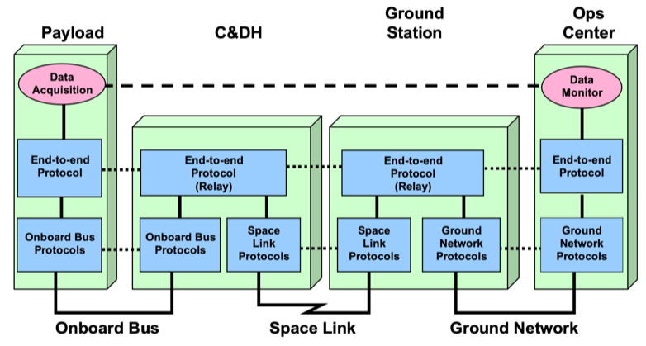
Simple E2E protocol diagram
(Replace with something more real, or even two, a simple one (ABA) and a relay one???)

Slide 83
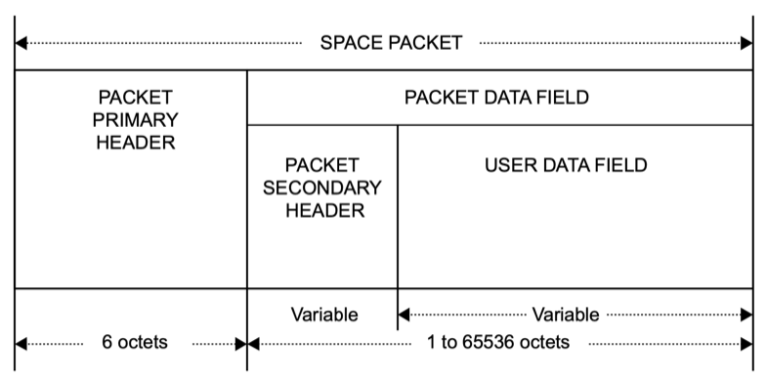
Fig 9-7: SPP PDU diagram
Fig 9-7

Slide 84
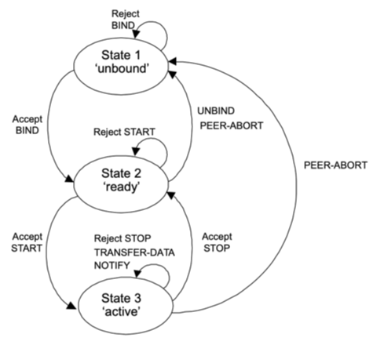
Fig 9-8 SLE Bind state chart
Fig 9-8

Slide 85
SCCS example: SSI Secure End-to-End Forward Protocol Deployment - SSI Agency Supporting SSI Agency
SSI
SSI
SSI
Space
User Node
Earth-Space
Link Terminal
Earth
User Node
CMD
Space File Application
Bundle Agent
(Router/S&F)
Space Msg
Application
BP/BPSec
BP/BPSec
File Secure
CMD
AMS
CFDP
LTP
User File Application
BP
VC X
ENCAP
User Msg
Application
BPSec
USLP
File Secure
LTP
Mux F-Frame
Production
AMS
CFDP
ENCAP
USLP
VC X
BP
To VC X
F-Frame
BPSec
C & S
C & S
TCP
TCP
RF & Mod
RF & Mod
IP
IP
Ground-Space
CCSDS Protocols
Terrestrial
WAN
Fig 9-9
Notes:
ASL Fig 9-16, trim headers & footers
12/12/12: New slide from Peter. Figure title in document is shown above. PPT original figure title is “SSI Secure Single Link Cross Support – Forward
(File, Frame & Message all DTN)
85

Slide 86
Information Viewpoint
The Information Viewpoint focuses on the kinds of information handled by the system, the syntax and semantics of the information, and the interpretation of that information.
Stakeholder Concerns:
  the structure and semantics of information and information management in a system;
  the rules and constraints on information transformations and permanence in a system.
Information Objects (abstract definitions of information elements, structures, semantics, schema):
  Types: data, metadata, information, package, schema, model, meta-model;
  Attributes: name, type, length, structure, syntax, semantics, permanence, provenance, realized by, rules, policies;
Relationships (information object aggregates, transformations);
Constraints (type checking rules, permanence, policies).

Slide 87
Information Viewpoint
(Information Object Features)
Management Interfaces:
Rules (transformations, access)
Schema
Permanence
Element types
Constraints
Information Object
Core Capabilities:
Type
Identifier
Structure
Semantics
Relationships
Concerns:
Rules & Constraints
Resource requirements
Type conversion
Access / security
Fig 10-1

Slide 88
Formalized Relationships among Terms
(Information Viewpoint ontology)
Function
Produces / Consumes (corr)
Relationships …
Data
Artifact
Realizes 0.. (corr)
Information
Constrained by ..
Specifies
Has …
Rules
Representation
  Information: Data, along with the necessary structure and syntax to allow interpretation and use of that data; may also have associated metadata, including the relationships among Data Objects, rules for their use and transformation, and policies on access.
Fig 10-2

Slide 89
Information Representation (ASL version)
(Relationships derived from UML)
Optional multiplicity specifier
Information Objects are abstract representations of information and data structures. They may be referenced in many other views.
The explicit definitions of Information Objects in this Viewpoint are tied by correspondence to the Functional or other Views where they are referenced.
Information objects may themselves be decomposed into lower level objects, shown by containment or relationships.
Specific information object structures will typically be instantiated during design and realized in different forms during development.
Different instantiations or realizations of the same Information Object may occur in different deployments.
Optional relationship type label
Information Class A
0..1
Relationship
*
Information Class B
Relationship Types (UML derived): Read as sentence with subject = start of arrow, verb = label, and object = end of arrow
Inheritance
Composition
Aggregation
Association (other relationship, labelled)
Directional Association
Standardisation Status:
DATA
Unspecified Status (typically used for aggregated or grouped data/services)
Published CCSDS / SC14 Standard (Blue or Magenta Book)
[Future]: CCSDS / SC14 Standard Under Development
[Prospective]: Proposed CCSDS / SC14 Standard (Green Book – future road map)
No CCSDS / SC14 Standard Identified
DATA
DATA
DATA
DATA
Fig 10-3
Notes:
ASL Fig 3-6, trim headers & footers

Slide 90
Information Architecture Definitions
Ontology
  an ontology encompasses a representation, formal naming, and definitions of the categories, properties, and relations between the concepts, data, or entities that pertain to one, many, or all domains of discourse, Wikipedia
Taxonomy
  a hierarchical classification or categorization system in which all the terms belong to a single hierarchical structure and have parent/child or broader/narrower relationships to other terms.
Information
  Any communication or representation of knowledge such as facts, data, or opinions in any medium or form, including textual, numerical, graphic, cartographic, narrative, or audiovisual. NIST
Data
Data Type
Metadata
Range
Domain
Encoding
Structure
Schema

Slide 91
Simple Information Viewpoint
Abstract Information Structures
Information
0..*
0..*
association
Data Type
described by
Representation
0..*
Name
Name
Range
0..1
Encoding
0..*
Structure
ordered
Fig 10-4

Slide 92
Information Viewpoint Objects
Showing Instantiation & Realization
Abstract
Information
Architecture
Data
Models
Actual
Data
Objects
Information
association
0..*
described by
0..*
0..*
Schema &
Structure
Definitions
Data Type
Representation
Concrete
Data
Object
Name
Name
Range
0..1
Encoding
0..*
Structure
Conceptualization
ordered
Instantiation
Realization
Abstract description of information objects
Instantiated description of specific data models
Realized actual data objects
Fig 10-5

Slide 93
Fig 10-6, Functional View with Representation of Information Objects
T
rack
S/C Event
Observation
Operation
Plans
Plans
Directive
Directive
Generation
Execution
Instrument
Commands
S/C
Commands
Fig 10-6

Slide 94
ASL Info model example: SOIS System Model: Concept Diagram
Rounded rectangles represent elements define by SOIS.
Solid lines represent structural relationships between elements.
Dashed lines represent other relationships, pointing from subject to object.
Dotted lines represent references, pointing to referenced object.
Dash-dotted lines represent aggregation, pointing to aggregated object.
describes
Mission Application Interfaces
PackageFIle
SO Model
describes
Application Support Service Interfaces
references
specifies
Device Service Interfaces
Datasheet
describes
Device
DoT
references
references
references
specifies
Management Service Interfaces
Deployment Description
describes
Subnetwork
Fig 10-7
Notes:
ASL Figure 5-15, trim top & bottom

Slide 95
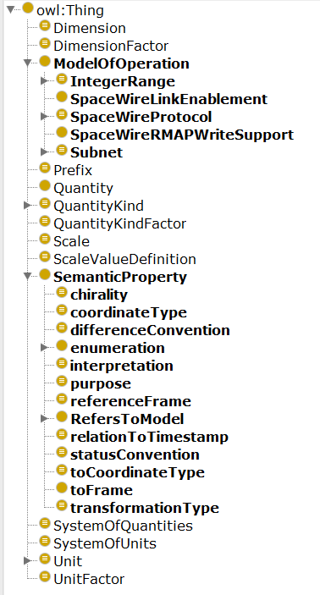
ASL example: SOIS System Model -
OWL Dictionary of Terms Diagram
Dictionary of Terms (DOT) Diagram from Protégé using OWL
Inheritance tree for classes of objects
Fig 10-8
Notes:
ASL Figure 5-16, trim top & bottom

Slide 96
Changes for SC14 Perspectives/Viewpoints
  Functional, Enterprise, Physical and Operations: Physical has Hardware and Software Development as sub-viewpoints
  From a non-exhaustive list including:
  Functional Viewpoint: The identification of various abstract functions and their allocation to space domain physical objects (Note: adopt CCSDS RASDS Viewpoint)
  Connectivity Viewpoint: How space domain physical objects are deployed and are connected for communications (RF, optical, cabling) (Note: Adopt CCSDS RASDS Viewpoint)
  Enterprise Viewpoint: How organizations are structured to produce & operate space domain objects, requirements and agreements, governance including laws, regulations, policy, and industry guidance or rules for other Viewpoints
  Physical (Hardware) Viewpoint: How space domain physical objects are deployed and connected from a physical / structural perspective (attachment, mating, umbilicals) (Note: Adapted from CCSDS RASDS Connectivity Viewpoint)
  Operations Viewpoint: How space domain systems objects are operated, tasks, procedures & processes. This Viewpoint also includes end-of-life disposal. (Note: new CCSDS RASDS Viewpoint)
  Communications Viewpoint: How space domain physical and software objects communicate, protocols and end-to-end views (Note: adopt CCSDS RASDS Viewpoint)
  Hardware Development Viewpoint: The development and V&V processes for space domain physical objects
  Software Development Viewpoint: The development and V&V processes for space domain software and firmware objects (Note: uses new CCSDS RASDS Operations/ Process Viewpoints)
  Information Viewpoint: This Viewpoint includes information and data definitions, data structures and relationships, best practices, or a library of Voluntary Consensus Standards. (Note: adopt CCSDS RASDS Viewpoint)

Slide 97
Proposed RASDS++ Extensions
(including TC20 / SC 14 Joint Effort)
New Service Viewpoint
  As introduced in CCSDS SCCS-ARD/ADD and ASL
  Covers system service interfaces and interface bindings
  Possibly leverage TOGAF, DODAF SV, or other service models
New Operations Viewpoint
  Add support for organizational tasks, activities, processes, procedures, and related behavior
  Effectively extends existing Enterprise Viewpoint, uses Systems
  Possibly leverage DODAF OV’s or other process models
Adapted Physical Object viewpoint
  Leverage existing Connectivity Viewpoint (Nodes & Links) to cover all sorts of physical & energetic aspects, using Components (Nodes) & Connectors (Links) as starting point
  Add new aspects for physical elements (structures, articulation, power, thermal views, propulsion, electro-magnetic) perhaps each with their own View attributes

Slide 98
Services Viewpoint - New
The Services Viewpoint focuses on the exposed services offered by a space system, formalized by functions and interfaces. It describes the interfaces of systems entities (hardware, software, Persons, and/or procedures), how to request and provide services, and their operations and interface bindings.
Stakeholder Concerns:
  The services provided by the system (H/W, SW, Persons);
  The interfaces, access points, and protocols for the system;
  The requirements and constraints on the services;
  The required and provided data for the services;
  Any contractual arrangements or agreements for services.
Service Objects:
  Types: Service types, both formal and informal (systems, Persons, software, etc), data types, and Resources (access to elements having service roles);
  Attributes: service name, type, operations, point of contact, interfaces, interface bindings, and data, interaction modes, policies, constraints;
Domains (boundaries of responsibility or ownership);
Relationships (ownership, membership, participation, roles, contractual);
Information (defined instances of services, functions, and data specifications, along with documents, agreements, contracts, policies, requirements, objectives, goals, scenarios, membership lists, where formal specifications of all of the data to be exchanged are found in Information Views).

Slide 99
Service Viewpoint - Service Object
(Specialized Functional Entity Features)
Management Interfaces:
How service is configured,
controlled, and monitored
Service
Object
Service Interfaces:
How services are
requested by & supplied
to “user” Objects
External Interfaces:
How other Functional Objects are used to support the performance of this Object
Attributes
Identifier
Type
Behavior
Data
Fig 11-1

Slide 100
Formalized Relationships among Terms
(Service Viewpoint aspects)
System
Element
Implemented by 1..
Composed of …
Operations
Service
Interface
Offers 0..
Service
Supports ..
Processes ..
Data
Artifacts
Accessed using 1..
Has …
Interface
Binding
Service
Behavior
Implements ..
Function
Implemented by (corr)
Protocol
Stack
Fig 11-2

Slide 101
RASDS Service Protocol Representation
Service Protocol behavior (may be described by state machine or other)
Service Provided Protocol Interface (Service SAP)
Service User I/F
Service
Provider
Service PDUs may be simplex or bi-directional
Svc Access Authorization (optional)
Authorization
Service Protocol
Service Protocol PDUs
(logical flow)
Service Protocol peer
Service Required Interface (of comm protocol SAP)
Service Protocol SDUs
(data flow)
Protocol Layer n
Protocol Layer n peer
physical layer flow
Interface Binding Protocol Stack
(multiple layers)
Flow direction arrows (optional)
Standardisation Status (if required):
Svc
Unspecified Status (typically used for unknown protocols)
Published CCSDS / SC14 Standard (Blue or Magenta Book)
[Future]: CCSDS / SC14 Standard Under Development
[Prospective]: Proposed CCSDS / SC14 Standard (Green Book – future road map)
No CCSDS / SC14 Standard Identified
Proto
Svc
Svc
Svc
Fig 11-3
Notes:
ASL Fig 3-6, trim headers & footers

Slide 102
Simple Service View with Protocol Layer
(showing corresponding Function and protocol stack deployments)
Svc Provider Node
Deployment Node
Svc User Node
End-to-end Service
Monitor Data
(Provider)
Monitor Function
(Consumer)
DATA
Service Access Point
MD-CSTS Provider
MD-CSTS User
CSTS Messages
CSTS Messages
TCP/IP Technology Binding
Service Logical Link
TCP/IP Technology Binding
Stack of Application Layer Protocols
TCP Transport Protocol
TCP Transport Protocol
IP Network Protocol
IP Network Protocol
Link Layer
Link Layer
Physical Link
Stack of Communications Layer Protocols
Fig 11-4
Notes:
ASL Fig 3-7, trim headers & footers

Slide 103
Formalized Relationships among Terms
(Service Viewpoint aspects)
Notes
Service Object Notes:
Interfaces of Service Objects may involve an app (thick or thin client), or expose a service protocol, or they may have their own UI, or they may be deployed in the cloud and use HTTP/REST and a web browser.
Service Protocol Notes
ISO /IEC 7498 Basic Reference Model (BRM) treats all of this as “Application Layer”. Server, web/cloud, or virtualized deployments fit this same pattern.
Service protocol must have defined behavior, PDUs, and required / provided interfaces. Behavior may be defined in a state machine, state table, or narrative form. Usually only defines behavior of sending side, but may define both ends.
Service Protocol may be built upon a standard protocol such as HTTP/REST, or a protocol like AMS, or accessed via a defined API with a bespoke protocol. Underlying protocol stacks follow normal Communication View rules.
Services may use externally supplied Authentication mechanisms. They may also rely upon security mechanisms (encryption, authentication of data payloads) implemented within the layer or in underlying layers.
Reflect on how this pattern can be used to describe Message Bus, Web or Cloud, or AMS Service types
- MB is a service API
- Web uses HTTP from client (browser) to provider
- Cloud is like Web, but Cloud offers other internal services via HTTP
- AMS is a “thick client” application protocol over space links (or other)
  Service Ontology Notes
  Service: A provision of an interface of an object to support actions of another object.
  Interface: A set of interactions performed by an object for participation with another object for some purpose, along with constraints on how they can occur. An interface is therefore where the behavior of an object is exposed.

Slide 104
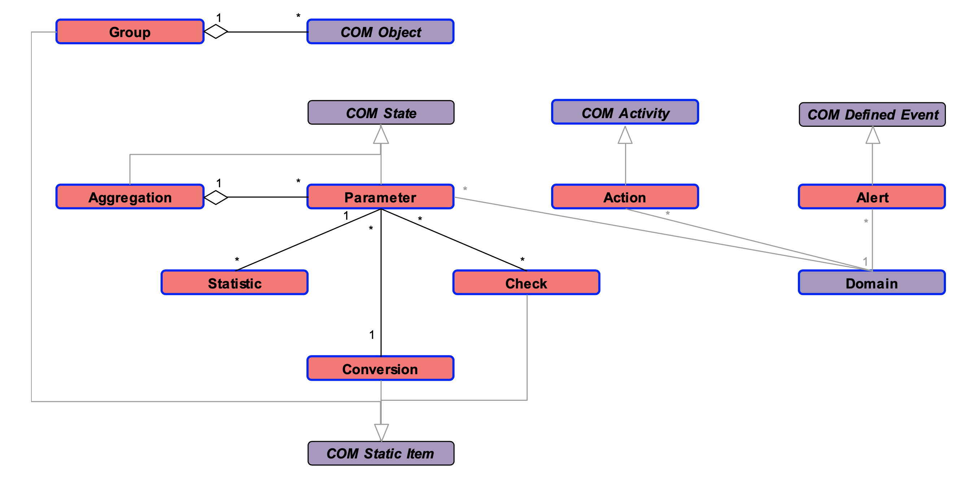
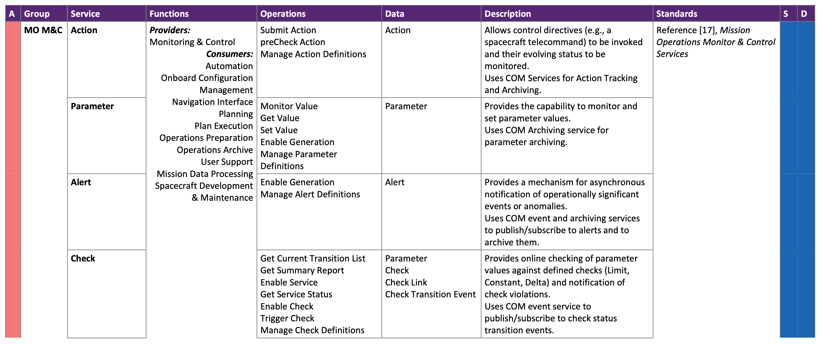
ASL-style Services Viewpoint Example: Mission Control
Service Table and correspondences
Information
View:
Information Object
Description
Monitoring and Control
M&C
Services Viewpoint Table
Function, Operation, Data
Service View:
Service
Description
Node A
Communications
view:
Layered Service
Interface
Protocol Bindings
Function A
(Provider)
Service Layer
Message Abstraction
Technology Binding
Transport Protocol
Network Protocol
Link Layer
Fig 11-5

Slide 105
Relationship of Services to Message Bus, Web or Cloud, or Message Protocols
A service has four properties according to one of many definitions of SOA (Definitions taken from https://en.wikipedia.org/wiki/Service-oriented_architecture):
  It logically represents a business activity with a specified outcome.
  It is self-contained (not well defined).
  It may be a black box for its consumers, meaning the consumer does not have to be aware of the service's inner workings.
  It may consist of other underlying services.
The CCSDS use of “Service” is consistent with these definitions
From a protocol / interface binding perspective services may be deployed in many different ways, built upon different underlying protocol stacks: message bus, web services, “cloud”, or other messaging protocols.
  Message Bus: Typically a bespoke protocol implementation, possibly in an on-board context, or using something like JMS. Often uses an API to hide implementation details which may not employ an interoperability spec, but may be layered on underlying transport/network layer like TCP/IP or a link layer.
  Web or Cloud: Typically use HTTP(S)/REST or related protocols on top of a network/transport layer. Server may be on local hardware, or at a data center, or a “cloud” deployment. Actual End-to-End protocol stack may involve intermediate caching systems for performance.
  Message protocols: May use an interoperable message protocol spec like AMS and layer upon TCP/IP or DTN network layer.
Services come in many different deployment “flavors”, including: thick client, thin client, browser “app”, virtualized, SaaS, PaaS, IaaS, … All use one flavor or another of application and underlying comm protocol stacks with different deployment models.

Slide 106
Operations Viewpoint - New
The Operations Viewpoint …
Stakeholder Concerns:
  The operations enabled by using the system;
  The activities carried out by using the system;
  The requirements on operations and activities (from Enterprise);
  Responding to constraints (e.g. cost, performance, policies) on operations and activities (from Enterprise) and Murphy…;(
  Describing how these support enterprise capabilities (from Enterprise);
  How these utilize systems capabilities (from Connectivity/Deployment); .
Operations Objects:
  Types: Capabilities (), Tasks, Processes (), Activities (), Scenarios (), Resources (systems, Persons, data, etc) having Operations roles;
  Attributes: names, types, flows, relationships, interaction modes, states (nominal, off-nominal), constraints;
Domains: boundaries of responsibility or ownership, related to org/team;
Relationships (implemented by, executed by, satisfies, provides);
Information (defined instances of requirements, plans, processes, resources, objectives, goals, scenarios, where formal specifications of the data to be exchanged are found in the Information Viewpoint).
Correspondences to Enterprise (requirements, objectives, Persons, policies), Systems (Connectivity view), Information (defined instances of documents, agreements, contracts, policies, requirements, objectives, goals, scenarios)
Operations viewpoint defines the objects and relations and rules for constructing views
Operations views are used to address specific concerns and represent activities, processes, and behaviors.

Slide 107
Operations Viewpoint
(Abstract Operations Object Representation)
Management Interfaces:
How operations are configured,
controlled, and reported upon
Operations Object
Service Interfaces:
How operations tasks are requested by other Organization or Operations Objects
External Interfaces:
How Products are supplied to and requests are made of other Operations Objects
Attributes
Type (task, activity, process)
Properties
Products
Performance constraints
Fig 12-1

Slide 108
Formalized Relationships among Terms
(Operations Viewpoint ontology)
Product
Operations
Requirements
Work
Specify
Produces
Performs
Operations Process
Performed
by
Persons
Member
of
Department
Uses …
Describes / Uses …
Perform …
Operations
Procedure
Accesses
Implemented by 1..
Data
Artifacts
System Element
Standard
Operations
Procedure
Defines
Normative
Specification
Fig 12-2

Slide 109
RASDS Operations View Representation
Swimlane (System A)
Swimlane (System B)
Operations Objects are Tasks, treated like functions, abstract representations of behavior. For this purpose they are shown within some system context (swimlanes).
Operations Objects may themselves be decomposed into lower level Operations. Different uses of the same Operations Object may be expressed in other views and referenced by correspondence.
Operations views are intended to describe temporal flows among different systems elements.
Operations views may explicitly show timing and/or duration, and are suitable for representing instances, durative events, and sequences of events.
They may explicitly identify the information objects that are exchanged (tied by correspondence to the Information View where they are defined).
Logical Link:
flow between tasks
Subsequent Task
(start time or event, optional)
Task A
Task B
DATA
Sub-Function B1
Information Object
(optional)
Source Task
(start/stop or duration, optional)
Specific and Generic Data Types and Containment:
DATA
Denotes a specific Data Type subject to standardisation by CCSDS / SC14
Italics denotes an Abstract or Generic Data Type
Faded Colour: Data contained within another Data item (to which it is attached)
DATA
DATA
Standardisation Status:
DATA
Unspecified Status (typically used for aggregated or grouped data/services)
Published CCSDS / SC14 Standard (Blue or Magenta Book)
[Future]: CCSDS / SC14 Standard Under Development
[Prospective]: Proposed CCSDS / SC14 Standard (Green Book – future road map)
No CCSDS / SC14 Standard Identified
DATA
DATA
DATA
DATA
Fig 12-3
Notes:
ASL Fig 3-4, trim headers & footers

Slide 110
Operational Viewpoint (temporal aspect)
has
Plan
uses
provides_ordering_for
Schedule
Process
has_inter_connected
part_of
Procedure
change
trigger
has_ordered_set
Event
Activity
describes
sets_parameters
has_cohesive_set
generates
Task
performs
Action
invokes
System
Element
Product
creates
Fig 12-4

Slide 111
Formalized Relationships among Terms
(Operations Process ontology)
Operations Process
Produces
(Std Ops)
Procedure
Has 1 .. Inter-related
Ordered set of 1 ..
Activity
Task
Performs …
Has cohesive set of 1 ..
Is …
Occurs within …
Action
Hardware
Product
Composed of 1..
Work
Software
System
Element
Data
Artifacts
Missing temporal aspects (Event) from recent Costin work
Person

Slide 112
Operations Viewpoint
(Abstract Operations Object Representation)
Notes
  An enterprise capability denotes the “What” an enterprise can do, whereas an Operations process outlines “how” a particular activity gets done.
Operations Process: An Operations process is defined as a set of activities and tasks that, once completed, will produce a product or perform work
* A System Element includes “Application”, which is a set of functions deployed (somehow) on a server as part of a system
Viewpoint Concerns:
Issues
Resources requirements
Constraints

Slide 113
Simple–Operations Activity
Example
Command
Delivery
Activity
Uplink Generation
Activity
Command Generation
Activity
Mission Planning & Sequencing
Activity
Fig 12-5
Notes:
ASL Figure 4-4, trim top & bottom
M&C: Monitoring & Control
AUT: Automation
OSM: On-board Software Management
OPM: On-board Procedure Management

Slide 114
Functional Viewpoint – Telemetry & Mission Operations Functions & Service Interfaces
TT&C
Processing
Navigation & Timing
TDM
CLTU
Uplink Generation
ODM
Frames
Maneuver Design
Cmds
Command Generation
Process Telemetry
Chan
TCM
TLM
AppSeq
L0Data
S/C & Trend Analysis
Telem
Planning & Sequencing
CorrAct
Science
Processing
ProcSci
Science Planning
SciPlan
Telem
L1Data
Telem
Manage Mission Data
L1Data
Data Storage and Archiving
Telem
Meta
Fig 12-6
Notes:
ASL Figure 4-4, trim top & bottom
M&C: Monitoring & Control
AUT: Automation
OSM: On-board Software Management
OPM: On-board Procedure Management

Slide 115
Temporal Aspects of Operational Viewpoint (UPDATED)
The Operational Viewpoint may describe any of the following:
  Activity, Procedure and Task all may have stated temporal aspects
    May have start time, stop time, or duration specified
    May be used to represent both planning views and actual “as executed” views
  Action:
    An Action may be instantaneous or have some finite duration
    An Action may have both planning estimates and actual “as executed” observations
  Event:
    “Any observable system or natural occurrence.” NIST (modified)
    “The fundamental entity of observed physical reality represented by a point designated by three coordinates of place and one of time in the space-time continuum postulated by the theory of relativity”, Merriam Webster
  Sequence of Events (SOE):
    “a number of events or activities that come one after another in a particular order”
    “the predicted order of events during spacecraft operations”, also
    “the observed order of events during spacecraft operations”
Temporal aspects extend core ops model
Plan = Captures the (acceptable) balance of risk vs. result in generating an operational product. E.g. Nominal or Off-nominal plans.
Schedule = Captures temporal context for Plan. (e.g. keeps track of SoE <anomaly vs. “as predicted/expected”>)
Process = What needs to happen in the plan to generate an operational product.

Slide 116
Operations Viewpoint Selected Definitions of Terms
For the Operations Viewpoint we need a self-consistent set of terms and associated definitions.
  Process:
    “set of interrelated or interacting activities which transforms inputs into outputs” NIST
  Activity:
    “Set of cohesive tasks of a process.” NIST
  Procedure:
    “An ordered set of tasks for performing some action.” Wikipedia
    Std Operations Procedure - A set of instructions used to describe a process or procedure that performs an explicit task or explicit reaction to a given event.” NIST
  Task:
    “A Task is a specific defined piece of work that, combined with other identified Tasks, composes the work in a specific specialty area or work role.” NIST
  Action:
    “An action is something that happens within an object, either with or without participation of another object. An interaction is an action performed by an object with participation of another object or with its environment. “ RASDS
  Product:
    “Result of a process. Note: A system as a “product” is what is delivered by systems engineering.” NIST
  Scenario
    A sequential, narrative account of a hypothetical incident that provides the catalyst for the exercise and is intended to introduce situations that will inspire responses and thus allow demonstration of the exercise objectives. NIST
    a postulated sequence or development of events. Oxford
    a description of how things might happen in the future. Oxford
See temporal aspects slide

Slide 117
Operations Viewpoint – Mission Control Process Diagram (tasks & data flows)
Mission Control
Science Data Sys.
Navigation
Planning & Seq.
Sci. Planning
TT&C Services
Navigation
& Timing
Channelized data
S/C and Trend Analysis
Downlink Data
Tracking data
Orbit
Data
Process Telemetry
Corrective Action
Maneuver
Design
L0 data
Science Activity Plan
Science Processing
Planning & Sequencing
TCM and/or Pointing Solution
Science Data
Science planning
Manage Mission Data
Approved Sequence
L1 Data &
Metadata
Archive service
Uplink Generation
Command Generation
Science Data
Uplink data
Commands
    NOTE: All of these may have start time, stop time, or duration specified
Fig 12-7

Slide 118
Relationships between Functional and Operations views
Functional View
  Shows Functions (and associated Functional Group using color coding)
  May show Provided Interfaces
  Shows Data that is exchanged (defined in Information Views)
  Does not show any temporal aspects or recursion
Operations View
  Describes how to perform a process to accomplish Tasks
  Shows tasks executed within System Elements (vertical or horizontal swimlanes)
  Shows temporal ordering of flows (starting upper left in this case) between Activities (or Tasks), may show recursion
  May show timing and duration of activities (or tasks)
  Names the Data objects that are exchanged
  May show timing (start/stop or duration) or events
  May represent predicted or observed sequence of events

Slide 119
RASDS++ in wider social context
Business
model
Enterprise
Services
Services
Wider
Spatial Scope
Function
Functional model
RASDS++
Interoperability Viewpoints
Information
Data model
Space
Globe
Protocol
Optical
Region
Communication
Scope
City
RF
Venue
Operations
Ops Process
System
Component
Lifecycle
Environment
Disposal
Operations
Requirement
Verification
Architecture
Production
Design & Engineering
Service/Operation
Source: Koki Asari, Japan Space Systems
ISO TC 20/SC 14/WG8
Mission assurance
Fig 13-1

Slide 120
RASDS Object Hierarchies
In many systems architecture contexts explicitly identify different kinds of objects, and different hierarchies or aggregates of objects, that are needed in the domain:
  Enterprise: mission phases, org structures, requirements decomposition “levels”
  Functions: high level “functional groups”, “complex functions”, “atomic functions”
  System Elements: systems, subsystems, elements, devices, components …
  Aggregation: of objects with similar purposes, data types, uses, …
Because of the wide range of possible domains RASDS cannot create any definitive hierarchies, but it can provide examples and descriptions of how to do this.
RASDS recommends that such hierarchies are defined, documented, and used consistently.

Slide 121
UML System Decomposition Profile
The following is just one possible example of how to do this:
  Created using SysML
  Defines the <<stereotype>> for the top level system elements
  Defines names for successive levels of decomposition of system elements, down to Subsystem
  Splits below that level into a hardware hierarchy (HW) and a software hierarchy (SW)
  Other hierarchies of terms and levels may be selected and defined, as driven by project needs. Just use them consistently.
  Use the same basic process to create other decomposition hierarchies, like SE or RQ Levels.
This example also defines a non-normative color palette for different groupings of function types, i.e. kinds of functions, or different ownership.

Slide 122
RASDS++ System Architecture Model
Objectives
RASDS++ provides an Architecture Description Framework and methodology, a specific Space System Reference Architecture model …
  Provides clear & unambiguous viewpoints for describing space systems architectures
  Shows relationship of design to requirements and driving scenarios
  Separates abstract design from implementation concerns in the model to maintain a degree of freedom to do trades
  Details the model & views to the level appropriate for further systems engineering and supports evolution of the detailed design
  Enables concurrent design of spacecraft, ground systems, communications & control systems, components, and their mission or science operations
Notes:
122

Slide 123
A reminder from DoDAF:
DoDAF Viewpoints and Models - intro
To assist decision-makers, DoDAF provides the means of abstracting essential information from the underlying complexity and presenting it in a way that maintains coherence and consistency. One of the principal objectives is to present this information in a way that is understandable to the many stakeholder communities involved in developing, delivering, and sustaining capabilities in support of the stakeholder's mission. It does so by dividing the problem space into manageable pieces, according to the stakeholder's viewpoint, further defined as DoDAF-described Models.
Each viewpoint has a particular purpose, and usually presents one or combinations of the following:
  Broad summary information about the whole enterprise (e.g., high-level operational concepts).
  Narrowly focused information for a specialist purpose (e.g., system interface definitions).
  Information about how aspects of the enterprise are connected (e.g., how business or operational activities are supported by a system, or how program management brings together the different aspects of network enabled capability).
However, it should be emphasized that DoDAF is fundamentally about creating a coherent model of the enterprise to enable effective decision-making. The presentational aspects should not overemphasize the pictorial presentation at the expense of the underlying data.
RASDS defines specific objects and representations for different viewpoints and a methodology that may be used to define and aid understanding of different systems technical architectures, information & communications aspects, and deployment approaches.

Slide 124
Mapping RASDS Into SysML
Introduce general approach of mapping RASDS PPT presentation style to SysML / MBSE
  Create Profile
  List diagram type to Viewpoint mapping approaches
Use the following set of “PPT hacked” example diagrams?
Or use example diagrams from Shames, Sarrel, Friedenthal paper?
Consider SysML V2???

Slide 125
Mapping RASDS into SysML
No simple one for one mapping from RASDS to SysML, their intent and scope are different
RASDS uses Viewpoints to expose different concerns of a single system
SysML uses specific diagrams to capture system structure, behavior, parameters and requirements
More than one SysML diagram, focused on different RASDS object classes, may be usefully applied to different Viewpoints
Extended SysML Views may be used to define the relationships between Viewpoints and Diagrams
SysML can provide useful tooling and offer support for more accurate fine grained modeling of structure, relationships and behavior than was expected of RASDS

Slide 126
Mapping RASDS into SysML
Enterprise
  Organizational component & collaboration diagrams
  Use case, interaction overview diagrams
  Requirements & constraints for rules, policies & agreements
Connectivity
  Physical component, composition, collaboration & class diagrams
  Parametric diagram for physical link characterization
Functional
  Logical component, collaboration & class diagrams
  Activity, state chart, parametric, & timing diagrams
Informational
  Information class & parametric diagrams
Communication
  Protocol component & collaboration diagrams
  State machine, sequence, activity & timing diagrams
Operations
  Activity / swimlane diagrams, tasks and flows

Slide 127
SysML Example of System Decomposition
Fig C-1

Slide 128
Note to CTE
See separate VG package for Fig C-1 thru C-5…
  SCaN Trade Space Architecture Model SO12-1275283 14May12

Slide 129
SysML Version (INCOSE-IS-2016)
RASDS Physical / Connectivity - E2E
Copyright INCOSE IS 2016 by Peter Shames, Sandy Freidenthal, Marc Sarrel
Used with permission
Fig C-6

Slide 130
SysML Version (INCOSE-IS-2016)
RASDS Connectivity - Components
Copyright INCOSE IS 2016 by Peter Shames, Sandy Freidenthal, Marc Sarrel
Used with permission
Fig C-7

Slide 131
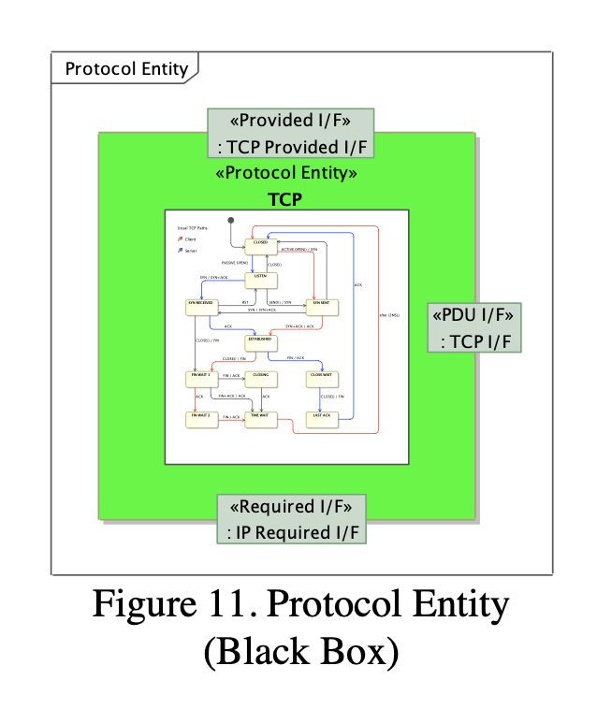
SysML Version (INCOSE-IS-2016)
RASDS Communications - Protocol entity
Copyright INCOSE IS 2016 by Peter Shames, Sandy Freidenthal, Marc Sarrel
Used with permission
Fig C-8

Slide 132
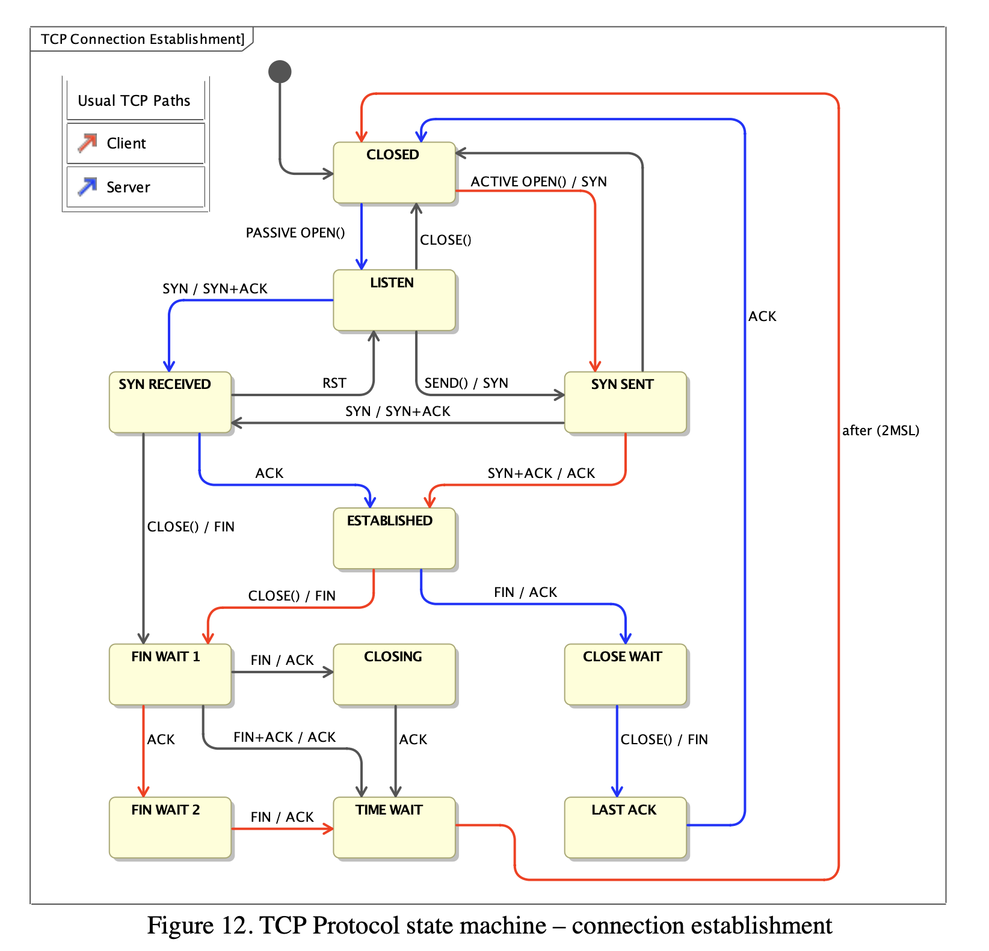
SysML Version (INCOSE-IS-2016)
RASDS Communications - Protocol State Chart
Copyright INCOSE IS 2016 by Peter Shames, Sandy Freidenthal, Marc Sarrel
Used with permission
Fig C-9

Slide 133
SysML Version (INCOSE-IS-2016)
RASDS Information
Copyright INCOSE IS 2016 by Peter Shames, Sandy Freidenthal, Marc Sarrel
Used with permission
Fig C-10

Slide 134
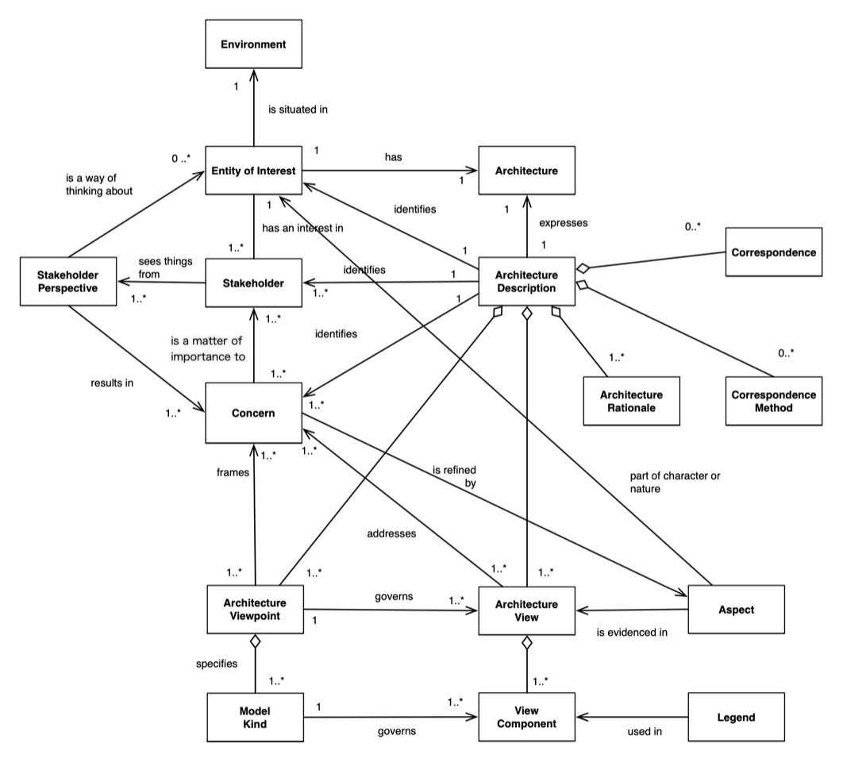
RASDS Revision – ISO 42010-2022 conceptual framework (ontology)… from http://www.iso-architecture.org/42010/cm/
We adopt and build upon this system architecture meta-meta-model framework, creating meta-models for viewpoints aligned with it that are suitable for space system architecture description
Copyright 1998-2023 by Rich Hilliard
Used with permission
Fig D-1

Slide 135
Meta-models: relationships between UML, ISO 42010, RASDS meta-models, and user models
conformsTo
RASDS meta-model defines specific Viewpoints, Objects, and Representations, and conforms to ISO 42010
conformsTo
A RASDS conformant Architecture Description Model adopts specific Views & Model attributes, users may extend
representedBy
Users adopt / adapt RASDS to describe their specific systems architecture
Copyright 1998-2016 by Rich Hilliard :: http://www.iso-architecture.org/42010
Used with permission
Reference: Jean Bezivin, “On the unification power of models”, 2005
Fig D-2

Slide 136
ISO 42010-2022 Architecture Definitions
Architecture Viewpoint
  Set of conventions for the creation, interpretation, and use of an architecture view to frame one or more concerns
  Note: a viewpoint is a frame of reference for the concerns determined by the architect as relevant to the purpose of the architecture description.
  Note: The conventions of an architecture viewpoint are included in a specification of this viewpoint. In some communities and architecture frameworks, “view specification” is used to mean the same thing.
Architecture View
  An Information item, governed by an architecture viewpoint, comprising a portion of an architecture description
  Note: An architecture view could include contextual schema, conceptual, logical and physical data models, data dictionary and documents as view components, and entities, relations and attributes as AD elements.
Concern
  Matter of relevance or importance to a stakeholder regarding an entity of interest, or some matter related to that entity.
  Note: Stated concerns are useful when relevant to the purpose of the architecting effort and refer to specific rather than categorical difficulties, problems, or requirements.
Correspondence
  Identified or named relationship between two or more architecture description elements
  Note: A function such that for elements in one viewpoint there is a related element in another viewpoint; the condition of being in conformity from elements in one viewpoint to elements in another.
  Note: Correspondences are used to express a wide range of relationships, such as equivalence, composition, refinement, consistency, traceability, dependency, constraint, satisfaction, and obligation.

Slide 137
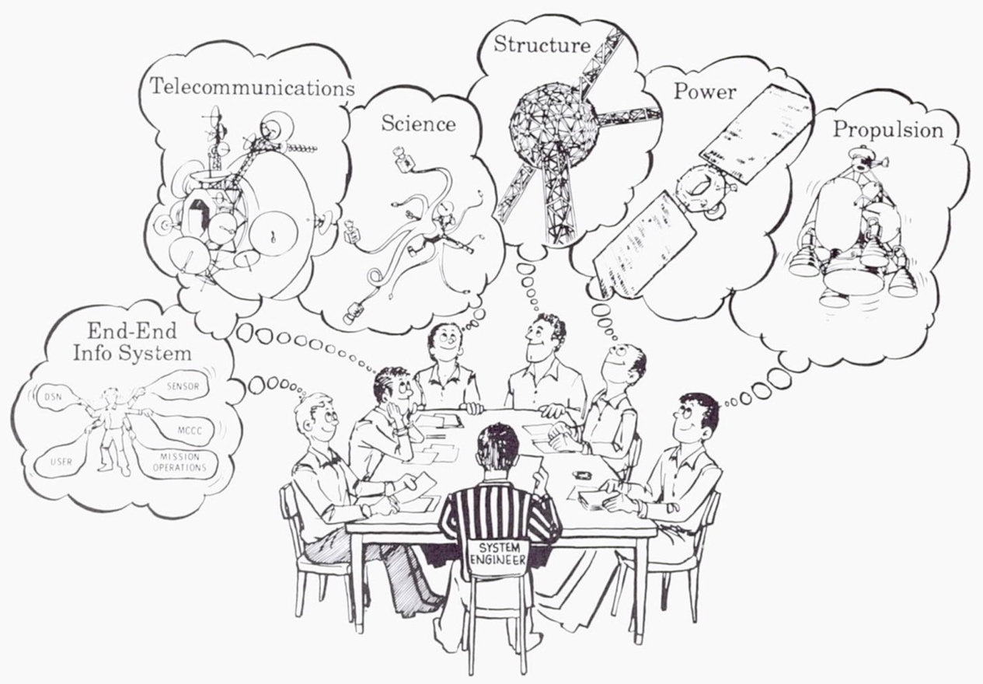
Earlier Arch Viewpoints
From JPL Pub 89-24, “The Voyager Neptune Travel Guide”, Charles Kohlhase editor, June 1, 1989 (artist Phil Gwinn)
Fig D-3

Slide 138
Enterprise View Using SysML
Use Case Diagram
<<usage>>
Enterprise: Use Case
Mars Exploration
Program Federation
Preliminary
Agency ABC
<<includes>>
<<includes>>
Agency QRS
<<extends>>
Cross Support
Agreement
<<extends>>
Science
Team
<<primary>>
<<includes>>
<<includes>>
Mission A
<<includes>>
Mission Q
Science
Team
<<primary>>
<<extends>>
GTN B
<<includes>>
Relay
Service A
Mission
Operations
Team
<<Primary>>
<<extends>>
Instr C
TT&C
Service B
Instrument
Team
<<Secondary>>
Operations
Contract
Service Operations
Team
<<Secondary>>
Instrument
Integration

Slide 139
Connectivity View (Nodes & Links)
Using SysML Components (Spacecraft)
Spacecraft
CDH : CmdDataHandlingSystem
sciInstr : scienceInstrument
dm :
s :
Sensor
ap: Mechanical
Preliminary
DataManager
SensorData
CmndIn
Port
DataDonePort
ecu : Execution
Control Unit
ap : Aperture
InstrCmnd
Port
ObsFin
Port
oc :
ic :
ObsControl
TakeObs
InstrControl
TelemPort
dl : DownLink
TeleCmndPort
ul : UpLink
Derived from: SysML Partners
RFAntenna

Slide 140
Connectivity View (Nodes & Links)
Using SysML Components (MOS & TT&C Systems)
MOS : MissionOpsSystem
TT&C : TrackTelemCommand
Telem
Port
DL
Port
dm :
TM :
Telemetry
DataManager
dl : DownLink
TelemData
Tele
Cmnd
Port
Re
Trans
Port
RF
Ant
UL
Port
ObsReq
Port
TelemDonePort
MOP : Mission
TC :
ul : UpLink
OpsPlanning
Telecommand
CmndData
Cmnd Port
SC :
SendCmnd
Pt : Pointing
PointingData
Ant: Mechanical

Slide 141
Connectivity View (Composition)
Using SysML Components
Spacecraft
CDH : CmdDataHandlingSystem
sciInstr : scienceInstrument
S :
Sensor
AP:
Mechanical
dm :
DataManager
SensorData
Cmndin
Port
DataDone
Port
ecu : Execution
Control Unit
Ap :
Aperture
Preliminary
InstrCmnd
Port
ObsFin
Port
oc :
IC :
MOS : MissionOpsSystem
TT&C : TrackTelemCommand
ObsControl
Take
Obs
InstrControl
Telem
Port
DL
Port
TelemPort
dl : DownLink
dm :
TM :
Telemetry
dl : DownLink
TeleCmndPort
ul : UpLink
RFAnt
DataManager
TelemData
Tele
Cmnd
Port
Re
Trans
Port
RF
Ant
RF: link [KaBand]
TelemDone
Port
UL
Port
ObsReq
Port
TC :
MOP : Mission
Telecommand
ul : UpLink
RF: link [X-band]
OpsPlanning
CmndData
Cmnd Port
Global structure inherited by each kind of Spacecraft …
SC :
Pt :
Pointing
SendCmnd
Ant:
Mechanical
Pointing
Data
… and constrained for each kind

Slide 142
Operations View Using SysML
Activity Diagram
Showing component allocations (optional)
retransReq
obsComplete
Mission Ops
Plan
Prepare
Accept
Finish
ObsSeq
Cmnd
Data
ObsSeq
Preliminary
Ground System
plannedObs
readyCmnd
TT&C Network
Xmit
Recv
Cmnd
Data
Recv
Execute
retransDataReq
S/C Control
Cmnd
Cmnd
Transmit
Store
Data
Spacecraft
Data
Instr
Cmnd
Instrument
Take Obs

Slide 143
Informational View Using SysML
Class Diagram
Reusable, refinable information structure:
<<info obj>>
InstrCmndFile
Preliminary
<<data obj>>
InstrCmndList
describes
<<metadata obj>>
InstrCmndMetaData
1..*
1
<<data obj>>
InstrCmnd
1..*
<<metadata obj>>
InstrCmndSemantics
<<metadata obj>>
InstrCmndStructure
Global representation inherited by each kind of Information Object
Derived from: SysML Partners

Slide 144
Communication View (Protocol Objects)
Using SysML Component Diagram
MOS : MissionOpsSystem
SC : SpaceCraft
Cmnd
Port
CmndIn
Port
SC :
SendCmnd
<<controls>>
MOP : Mission
ECU : Execution
TC :
TeleCmnd
OpsPlanning
Control Unit
Preliminary
<<protocol>>
TP: TransportLayer
<<protocol>>
TP: TransportLayer
<<protocol>>
IP: InternetLayer
<<protocol>>
IP: InternetLayer
<<protocol>>
LL: LinkLayer
<<protocol>>
LL: LinkLayer
<<protocol>>
PL: PhysLayer
<<protocol>>
PL: PhysLayer
RF: link [Xband]
CmndData:RF
Derived from: SysML Partners

Slide 145
Communication View Using SysML
State Machine Diagram
<<protocol>>
TP: TransportLayer
Sending
evSend /
transmitCount=0
Preliminary
Idle
evDoneSend /
++transmitCount
tm(Wait Time)
[transmitCount<LIMIT]
evACK[isValid]
Waiting
tm(Wait Time)
Throw(“Unable to Send”)
Protocol specifications inherited by each instance of Protocol Objects
Derived from: SysML Partners

Slide 146
CCSDS / SC14 - RASDS update project
Proposed RASDS update tasks
  Update RASDS, add new viewpoints
    Integrate ASL & SCCS ADD approaches to refine framework
    Work in collaboration with TC20/SC14 SE team to extend framework
    Incorporate published diagrams from ASL and SCCS where appropriate
    Update security view sections, as needed
    => Is a new Engineering / Process Viewpoint needed to deal with SC14 V&V and process considerations? No, leave for ISO 15288 and agency stds.
  Add annex with MBSE / SysML representations
    May use SysML representations or just adopt a uniform set of OWL / ontology diagrams documenting the concepts for each viewpoint
    The methodology is the same for either approach, but the representation differs
    Incorporate representation & figures from published MBSE papers
  With TC20/SC14 refine and extend existing CCSDS Glossary
    Leverage SANA on-line repository for human and machine access
    Add SC14 specific terms where required
    ECSS interests may also be considered

Slide 147
BACKUP

Slide 148
“Singing and Dancing” Views
Shows the relationship between related Functional and Task flows shown using a UML Activity diagram.
UML Activity diagram is better for showing temporal flows
Functional diagram is better at showing relationships, interfaces, and data source / sink behavior
Each step in the flow is marked to show the active functions

Slide 149
Functional & Operations Diagram
Tracking #1
TT&C
TDM
Navigation & Timing
CLTU
Uplink Generation
ODM
Frames
Cmds
Maneuver Design
Process Telemetry
Command Generation
Chan
AppSeq
TCM
L0Data
TLM
S/C & Trend Analysis
Telem
CorrAct
Planning & Sequencing
Science
Processing
ProcSci
Science Planning
SciPlan
Telem
L1Data
Telem
Manage Mission Data
L1Data
Data Storage and Archiving
Telem
Meta
Mission Control
Science Data Sys.
Navigation
Planning & Seq.
Sci. Planning
TT&C Services
Channelized data
Navigation
& Timing
Downlink Data
Tracking data
S/C and Trend Analysis
Process Telemetry
Orbit
Data
Corrective Action
Maneuver
Design
L0 data
Science Processing
Planning & Sequencing
Science Activity Plan
TCM and/or Pointing Solution
Science Data
Science planning
Manage Mission Data
Approved Sequence
L1 Data &
Metadata
Archive
Uplink Generation
Command Generation
Uplink data
Commands
Notes:
ASL Figure 4-4, trim top & bottom
M&C: Monitoring & Control
AUT: Automation
OSM: On-board Software Management
OPM: On-board Procedure Management

Slide 150
Functional & Operations Diagram
Tracking #2
TT&C
TDM
Navigation & Timing
CLTU
Uplink Generation
ODM
Frames
Cmds
Maneuver Design
Process Telemetry
Command Generation
Chan
AppSeq
TCM
L0Data
TLM
S/C & Trend Analysis
Telem
CorrAct
Planning & Sequencing
Science
Processing
ProcSci
Science Planning
SciPlan
Telem
L1Data
Telem
Manage Mission Data
L1Data
Data Storage and Archiving
Telem
Meta
Mission Control
Science Data Sys.
Navigation
Planning & Seq.
Sci. Planning
TT&C Services
Channelized data
Navigation
& Timing
Downlink Data
Tracking data
S/C and Trend Analysis
Process Telemetry
Orbit
Data
Corrective Action
Maneuver
Design
L0 data
Science Processing
Planning & Sequencing
Science Activity Plan
TCM and/or Pointing Solution
Science Data
Science planning
Manage Mission Data
Approved Sequence
L1 Data &
Metadata
Archive
Uplink Generation
Command Generation
Uplink data
Commands
Notes:
ASL Figure 4-4, trim top & bottom
M&C: Monitoring & Control
AUT: Automation
OSM: On-board Software Management
OPM: On-board Procedure Management

Slide 151
Functional & Operations Diagram
Tracking #3
TT&C
TDM
Navigation & Timing
CLTU
Uplink Generation
ODM
Frames
Cmds
Maneuver Design
Process Telemetry
Command Generation
Chan
AppSeq
TCM
L0Data
TLM
S/C & Trend Analysis
Telem
CorrAct
Planning & Sequencing
Science
Processing
ProcSci
Science Planning
SciPlan
Telem
L1Data
Telem
Manage Mission Data
L1Data
Data Storage and Archiving
Telem
Meta
Mission Control
Science Data Sys.
Navigation
Planning & Seq.
Sci. Planning
TT&C Services
Channelized data
Navigation
& Timing
Downlink Data
Tracking data
S/C and Trend Analysis
Process Telemetry
Orbit
Data
Corrective Action
Maneuver
Design
L0 data
Science Processing
Planning & Sequencing
Science Activity Plan
TCM and/or Pointing Solution
Science Data
Science planning
Manage Mission Data
Approved Sequence
L1 Data &
Metadata
Archive
Uplink Generation
Command Generation
Uplink data
Commands
Notes:
ASL Figure 4-4, trim top & bottom
M&C: Monitoring & Control
AUT: Automation
OSM: On-board Software Management
OPM: On-board Procedure Management

Slide 152
Functional & Operations Diagram
Tracking #4
TT&C
TDM
Navigation & Timing
CLTU
Uplink Generation
ODM
Frames
Cmds
Maneuver Design
Process Telemetry
Command Generation
Chan
AppSeq
TCM
L0Data
TLM
S/C & Trend Analysis
Telem
CorrAct
Planning & Sequencing
Science
Processing
ProcSci
Science Planning
SciPlan
Telem
L1Data
Telem
Manage Mission Data
L1Data
Data Storage and Archiving
Telem
Meta
Mission Control
Science Data Sys.
Navigation
Planning & Seq.
Sci. Planning
TT&C Services
Channelized data
Navigation
& Timing
Downlink Data
Tracking data
S/C and Trend Analysis
Process Telemetry
Orbit
Data
Corrective Action
Maneuver
Design
L0 data
Science Processing
Planning & Sequencing
Science Activity Plan
TCM and/or Pointing Solution
Science Data
Science planning
Manage Mission Data
Approved Sequence
L1 Data &
Metadata
Archive
Uplink Generation
Command Generation
Uplink data
Commands
Notes:
ASL Figure 4-4, trim top & bottom
M&C: Monitoring & Control
AUT: Automation
OSM: On-board Software Management
OPM: On-board Procedure Management

Slide 153
Original RASDS
Top Level Object Ontology
Composed Of
Organization
Meta-model
(each Viewpoint)
Mission
Defines Objects
Requirements
Defines Relations
FulfilledBy
Objectives
Defines Rules
Goals
Exposes Concerns
ComposedOf
Scenarios
Owns/Operates
Fulfills
Calls
Function
Produces
Information
Logical structure
Consumes
Data
Behavior
Metadata
Interfaces
IsAllocatedTo
ComposedOf
Rules
Constraints
ContainsInstances
Component
ProvidesService
Environment
Uses
Type
Affects
ImplementedOn
Attributes
ConnectVia
Physical Environs
Communication
Ports
Attributes
Location
ConnectToPort
Protocol stack
Connector
Standards
AssociatedWith
Type
Attributes

Slide 154
Organizations value and manage Assets (NIST 800-207 terms)
Organization
Creates Catalog
System
Is an
Values
Catalog
Is composed of …
Is Inventory of
Assets
Person
Procedures
Assets have attributes: Asset Type {Data, Database, virtual artifacts}; Deployment Type {Physical, virtual, cloud}; Asset state {Sensitivity, Integrity, Security posture}; Environmental attributes {…}; Other {…}
Resource
Resource = All hardware, software, programs, information, data, and other devices that are in use within or connected to a given system
Device
Software
IT Circuit
Network
Data
Hardware
Virtual Platform

Slide 155
Research: Operations Viewpoint Identified Definitions of Terms
For the Operations Viewpoint we need a hierarchy of terms and associated definitions. We did some research and found these (not necessarily self-consistent):
  Action:
    “An action is something that happens within an object, either with or without participation of another object. An interaction is an action performed by an object with participation of another object or with its environment. “ RASDS
  Activity:
    “Work, not specific to a single organization, Operations system or individual that transforms inputs (Resources) into outputs (Resources) or changes their state.” DoDAF – modified
    “An activity is a specification of behavior described as a sequence of actions” RASDS
    “Set of cohesive tasks of a process.” NIST
    “An Activity is a generic term for work that company performs. An Activity can be atomic or non- atomic (compound). The types of Activities are: Task and Sub-Process.” BPMN
  Procedure:
    “An ordered set of tasks for performing some action.” Wikipedia
  Process:
    “A Process is an activity authorized by a Work Package in support of delivering a Component or producing a Product. “ IMCE
    “Business Process Model is a network of graphical objects, which are activities (i.e., work) and the flow controls that define their order of performance. “ BPMN
    “A logical, systematic sequence of activities, triggered by an event, producing a meaningful output.” DoDAF
    “set of interrelated or interacting activities which transforms inputs into outputs” NIST
  Product:
    “A Product is a concrete output of the design process. It may be a Component or a Document. A Product is any Element that an Authority properly supplies or produces. “ IMCE
    “Result of a process. Note: A system as a “product” is what is delivered by systems engineering.” NIST
  Task:
    “An action, activity or undertaking enabling missions, activities or functions to be performed or accomplished.” DoDAF
    “A Task is a specific defined piece of work that, combined with other identified Tasks, composes the work in a specific specialty area or work role.” NIST

Slide 156
DRAFT Operations Meta-model (OWL)
Replace / Update
Process
Has 1 .. Inter-related
Procedure
If these are the definitions of terms and relationships, does this ontology accurately reflect them?
Produces
Activity
Ordered set of 1 ..
Has cohesive set of 1 ..
Task
Performs …
Product
Is …
Action
Occurs within …
Work
Systems
Object

Slide 157
Formalized Relationships between Enterprise & Technical Architecture
(Enterprise Viewpoint & System Architecture Viewpoint objects)
  The Enterprise Architecture addresses processes, services, and applications, all of which are implemented by the Technical Architecture, but without directly addressing the relationships among functions, HW, SW, and Persons that are addressed in the Technical Architecture.
Business
Possess set of 1..
Capability
Uses
“Logical” Enterprise System Boundary **
The “Enterprise Architecture”, in actuality, is implemented by the Technical Architecture
(Business) Process
Performed
by
Actor
Member
of
Department
Supports the Enterprise
Process is an ordered set of Functions
Uses …
Uses …
The “Technical Architecture” implements the systems, services, and processes.
Service
Application
Business
Information
Services …
Hardware
Composed of 1..
Accesses
Software
Data Artifact
Application*
Implemented by 1..
Implement 1..
System **
Persons
* An “Application” is Software, a set of functions deployed (somehow) on a server as part of a system, with defined interfaces
Function
Function offers 0.. Service Interfaces
Affects
Procedures
“Actors” are Persons who have assigned identities and roles in a real system.
Process
Action
Task
Environment

Slide 158
Connectivity View
Nodes & Links
SPACECRAFT
Mission Planning
Computer
Spacecraft
Transceiver
Command &
Data Handling
Computer
Internet
Space Link
S/C Bus
Ground
Tracking
Station
Science
Instrument
Spacecraft
Control
Computer
ACS
Computer
Connectivity Concerns:
  Distribution
  Communication
  Physical Environment
  Behaviors
  Constraints
  Configuration

Slide 159
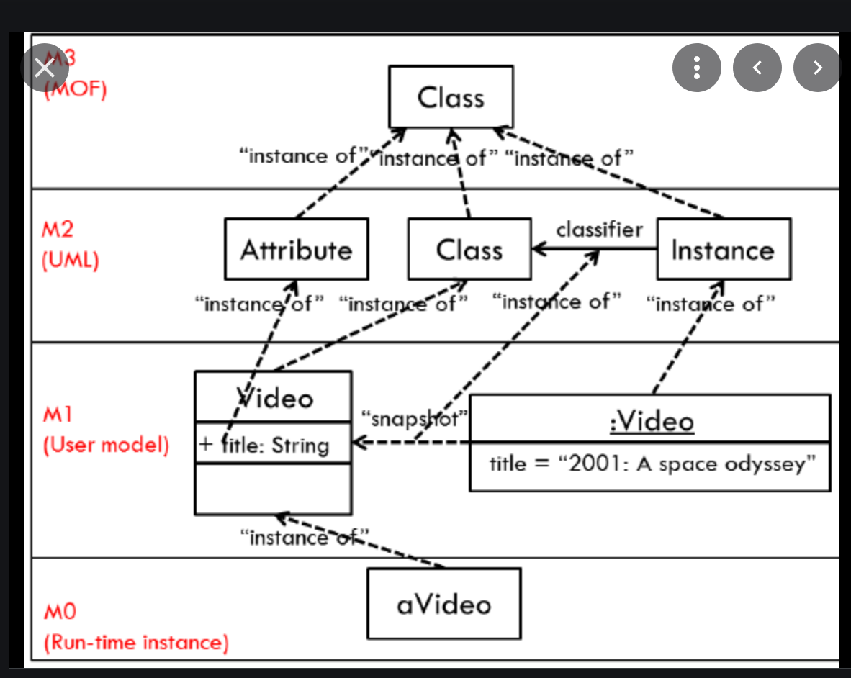
Meta-models: UML relationships among meta-models, user models, and instances

Slide 160

ASL Connectivity Example: Physical Model (SSI)
With representative Functional Deployment
Spacecraft
Relay Spacecraft
Lander/Rover
or Habitat
MCS
MPS
MCS
MPS
DSA
NAVT
DSA
NAVT
MCS
MPS
DSA
NAVT
ESLT
TT&C
NSC
MOC
DPC
DAC
NAVT
DSA
MCS
MPS
OPS
MPS
Mission Data
Processing
DSA
NAVT
DSA
NAVT
SCM
POC
PI/User
Spacecraft
Development &
Maintenance
OPS
MCS
MPS
OPS
User Support
DSA
NAVT
Notes:
ASL Fig 8-4, trim headers & footers

Slide 161
ASL Example: Mission Control functional decomposition
User Support
Operations
Preparation
Planning & Scheduling
Mission Data
Processing
SDB
AUT
OBSM
M&C
Spacecraft Development & Maintenance
APD
OBPM
OBSW
M&C
APD
Automation
Monitoring and Control
TT&C
M&C
MD-CSTS
SC-CSTS
OBSM
M&C
OBPM
M&C
M&C
TCM
AUT
On-board Configuration Management
Navigation Interface
ODM
Navigation & Timing
ADM
NEM
PRM
OBSM
AUT
M&C
OBPM
Data Storage and Archiving
Notes:
ASL Figure 4-4, trim top & bottom
M&C: Monitoring & Control
AUT: Automation
OSM: On-board Software Management
OPM: On-board Procedure Management

Slide 162
Alternate Functional & Protocol Diagram
(for a Single Process)
put
get
application
Protocol SAP
database
Outbound App PDU
put
application
protocol
get
Inbound App PDU
MIB
Outbound Link PDU
encryption
service
Inbound Link PDU
link protocol

Slide 163
Proposed Utilization of RASDS/RASDS++
3D-view of views: Viewpoints, adding Lifecycle, Scope dimensions
Try to align the colors of VP & objects w/ RASDS canonical choices
Business
model
Enterprise
Connectivity
(Structure)
Wider
Spatial Scope
Function
RASDS/RASDS++
Interoperability viewpoints
Data model
Space
Information
Globe
Protocol
RF
Region
Communication
Scope
City
Venue
Operations
System
Component
Lifecycle
Environment
Disposal
Operations
Requirement
Verification
Architecture
Production
Design & Engineering
Service/Operation
Source: Koki Asari, Japan Space Systems
ISO TC 20/SC 14/WG8
Mission assurance

Slide 164
DoDAF Operations Viewpoint
(for consideration …)
DoDAF-described Models in the Operations Viewpoint describe the tasks and activities, Operations elements, and resource flow exchanges required to conduct operations. A pure Operations model is materiel independent. However, operations and their relationships may be influenced by new technologies, such as collaboration technology, where process improvements are in practice before policy can reflect the new procedures.
Use of Operations Viewpoint DoDAF-described Models should improve the quality of requirements definitions by:
  Explicitly tying user requirements to strategic-level capability needs, enabling early agreement to be reached on the capability boundary.
  Providing a validated reference model of the business/operations against which the completeness of a requirements definition can be assessed (visualization aids validation).
  Explicitly linking functional requirements to a validated model of the business or operations activities.
  Capturing information-related requirements (not just Information Exchange Requirements [IERs]) in a coherent manner and in a way that really reflects the user collaboration needs.
  Providing a basis for test scenarios linked to user requirements.
  Capturing the activities for Process Engineering or Process Re-engineering.

Slide 165
DoDAF Operational Viewpoint, contd
Possible Model Views
Operations Model Descriptions
Model | Description
OV-1: High-Level Operational Concept Graphic | The high-level graphical/textual description of the operational concept.
OV-2: Operational Resource Flow Description | A description of the Resource Flows exchanged between operational activities.
OV-3: Operational Resource Flow Matrix | A description of the resources exchanged and the relevant attributes of the exchanges.
OV-4: Organizational Relationships Chart | The organizational context, role or other relationships among organizations.
OV-5a: Operational Activity Decomposition Tree | The capabilities and activities (operational activities) organized in a hierarchal structure.
OV-5b: Operational Activity Model | The context of capabilities and activities (operational activities) and their relationships among activities, inputs, and outputs; Additional data can show cost, performers or other pertinent information.
OV-6a: Operational Rules Model | One of three models used to describe activity (operational activity). It identifies business rules that constrain operations.
OV-6b: State Transition Description | One of three models used to describe operational activity (activity). It identifies business process (activity) responses to events (usually, very short activities).
OV-6c: Event-Trace Description | One of three models used to describe activity (operational activity). It traces actions in a scenario or sequence of events.

Slide 166
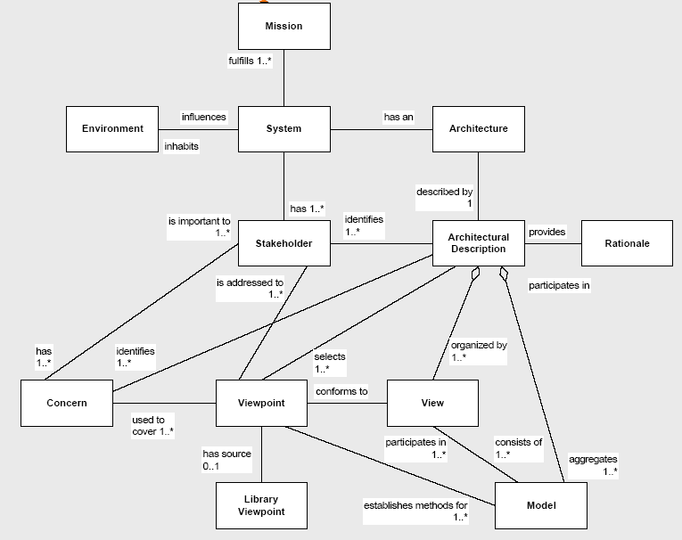
RASDS background – from the
IEEE-1471-2000
conceptual framework…
We formalize and adapt this generic conceptual
framework into one for
suitable for space data system design
Notes:
166

Slide 167
SAWG Observations on Terminology
Some of the terms used in CCSDS documents are not even in the CCSDS Glossary
We only have accurate information models and schema for a small sub-set of the terms in use
Some terminology is defined in multiple different standards, and this is where issues arise
Lack of consistent terminology makes automation and cross use of terms much more difficult
Some terminology is in isolated domains and not an issue
Multiple inconsistencies in use of terminology
  Collisions of usage (same word, two different meanings)
  Specializations (same word, on analysis one derived from another)
  Multiple terms used for the same things
  Internal inconsistencies in usage or definitions
  Inconsistent use of representations (lack of class diagrams)
  Inconsistent references to external standards (ISO BRM and other)
Some differences appear to be easy to resolve (reference the document/namespace), others will require more work

Slide 168
DoDAF Services Viewpoint
The DoDAF-described Models within the Services Viewpoint describes services and their interconnections providing or supporting, DoD functions. DoD functions include both mission and business functions. The Service Models associate service resources to the operational and capability requirements. These resources support the operational activities and facilitate the exchange of information.
The relationship between architectural data elements across the Services Viewpoint to the Operational Viewpoint and Capability Viewpoint can be exemplified as services are procured and fielded to support the operations and capabilities of organizations. The structural and behavioral models in the OVs and SvcVs allow architects and stakeholders to quickly ascertain which functions are carried out by humans and which by Services for each alternative specification and so carry out trade analysis based on risk, cost, reliability, etc.
Services are not limited to internal system functions and can include Human Computer Interface (HCI) and Graphical User Interface (GUI) functions or functions that consume or produce service data to or from service functions. The external service data providers and consumers can be used to represent the human that interacts with the service.

Slide 169
DoDAF Services Viewpoint, cont
Possible Model Views
Model | Description
SvcV-1 Services Context Description | The identification of services, service items, and their interconnections.
SvcV-2 Services Resource Flow Description | A description of Resource Flows exchanged between services.
SvcV-3a Systems-Services Matrix | The relationships among or between systems and services in a given Architectural Description.
SvcV-3b Services-Services Matrix | The relationships among services in a given Architectural Description. It can be designed to show relationships of interest, (e.g., service-type interfaces, planned vs. existing interfaces).
SvcV-4 Services Functionality Description | The functions performed by services and the service data flows among service functions (activities). (Note: service de-composition into functions)
SvcV-5 Operational Activity to Services Traceability Matrix | A mapping of services (activities) back to operational activities (activities).
SvcV-6 Services Resource Flow Matrix | It provides details of service Resource Flow elements being exchanged between services and the attributes of that exchange. (Note: Explicitly includes security attributes)
SvcV-7 Services Measures Matrix | The measures (metrics) of Services Model elements for the appropriate timeframe(s).
SvcV-8 Services Evolution Description | The planned incremental steps toward migrating a suite of services to a more efficient suite or toward evolving current services to a future implementation.
SvcV-9 Services Technology & Skills Forecast | The emerging technologies, software/hardware products, and skills that are expected to be available in a given set of time frames and that will affect future service development.
SvcV-10a Services Rules Model | One of three models used to describe service functionality. It identifies constraints that are imposed on systems functionality due to some aspect of system design or implementation. (Note: includes components, interfaces, links, I/O, and state)
SvcV-10b Services State Transition Description | One of three models used to describe service functionality. It identifies responses of services to events.
SvcV-10c Services Event-Trace Description | One of three models used to describe service functionality. It identifies service-specific refinements of critical sequences of events described in the Operational Viewpoint.
Service Model Descriptions

