Slide 1
SEA: Analysis of
Mission Operations
Message Abstraction Layer (MAL) Blue Book
CCSDS 521.0-P-2.0
Peter Shames
SEA Area Director
13 July 2022
Notes:
1
1
1

Slide 2
CCSDS Organization and Processes CCSDS A02.1-Y-4
CCSDS defines a standard set of processes for all of our Working Groups.
These include consensus definitions, WG requirements, and document type requirements.
The following pages contain text quoted verbatim from this set of requirements as they have been presented, for the last several years, in the CCSDS “Boot Camp”.

Slide 3
Why you should care about “colors”?
CCSDS has defined different book categories for a reason …
Different technical contents
Different purposes
Different styles (and templates…)
Different approval procedures & criteria
Because of these real distinctions it is usually not possible to just “paint a book a different color”
Not OK to “upgrade” a book because you want it to be Blue / Normative
Also not OK to “downgrade” a book because of personal or agency preferences about what is an acceptable standard
It is up to the agencies to determine whether they will adopt a CCSDS recommendation as an agency standard, but that is a separate issue from the content of the book
Producing books with incorrect or inappropriate content or format just makes more work for everyone, WG, tech editor, CESG, and agencies

Slide 4
Book Type Definitions (1 of 5)
From the revised “Organization and Processes for the Consultative Committee for Space Data Systems”. CCSDS A02.1-Y-4, Yellow Book. Issue 4. Jan 2016.
RECOMMENDED STANDARDS (BLUE BOOK)
CCSDS Recommended Standards (Blue Books) define specific interfaces, technical capabilities, or protocols, or provide prescriptive and/or normative definitions of interfaces, protocols, or other controlling standards such as encoding approaches.
Recommended Standards must be complete, unambiguous and at a sufficient level of technical detail that they can be directly implemented and used for space-mission interoperability and cross support.
Recommended Standards must say very clearly, “These are the technical properties of what the implementer must build and how it must behave if it is to be compliant and interoperable.”
Blue Books may be of three different types:
1) CCSDS Recommended Standard (a document that internally contains a native specification developed by CCSDS);
2) CCSDS Recommended Standard: Adaptation Profile (a document that adopts/adapts a native specification developed somewhere else, such as by another standards organization);
3) CCSDS Recommended Standard: Utilization Profile (a document that specifies how to use one or more existing CCSDS Blue Books or other normative standards to perform a particular function).
Blue Books defining communications protocols must include a Protocol Implementation Conformance Statement (PICS) proforma as a normative annex.

Slide 5
Book Type Definitions (2 of 5)
RECOMMENDED PRACTICES (MAGENTA BOOK)
CCSDS Recommended Practices (Magenta Books) are the consensus results of CCSDS community deliberations and provide a way to capture “best” or “state-of- the-art” approaches for applying or using standards or for documenting reference architectures and other formal specifications.
Magenta Books may document guidelines for standardized processes or procedures for accomplishing tasks. They may document reference models or reference architectures to assist in the design, use, description, or selection of one or more standards.
Practices say, “Here is how the community recommends that one should carry out or describe this particular kind of operation at present, or how the community recommends that it should be carried out in the future.”
While these guidelines are generally different in scope and style from protocol standards, their establishment needs a similar process [to that used for Blue Books] for consensus building.

Slide 6
Book Type Definitions (3 of 5)
RECOMMENDED PRACTICES, contd
Recommended Practices are normative and have prescriptive content but are typically not directly implementable for interoperability or cross support. They may be of several types:
a) specifications that are “foundational” for other specifications, but within themselves do not define content in a way that allows independent development and testing of separate but interoperable systems;
b) system descriptions that are more general in nature and capture “best” or “state-of- the-art” recommendations for applying standards or defining standardized processes;
c) reference architectures and other formal but not directly implementable specifications;
d) operational practices that are associated with other CCSDS specifications.
e) Application Programming Interfaces (API), which are useful for portability but do not in themselves provide interoperability.

Slide 7
Analysis of MO MAL draft, CCSDS 521.0-P-2.0
This analysis was done in conformance with CCSDS Org & Proc and Publications document guidelines.
The analysis relied upon 20+ years of CESG experience as applied across the entire range of CCSDS Areas, WGs, and documents.
Analysis was done on the document itself, on the external references (even where they were not present), and on comparisons to similar documents as produced by other CCSDS Areas.
The MO MAL document has undergone extensive editing as part of revising it to meet the needs of the MOIMS MPS WG.
These changes are throughout the document so it was characterized as a “Pink Book” and the entire document was therefore subject to review.
The document itself is named and intentionally defined to be “abstract” in nature, with very little that is truly “concrete”.
The concrete parts are stated to belong to “technology bindings” which are specified elsewhere.
This is a “feature”, but it is also problematic for interoperability and cross support.
During review a large number of missing/required features, undefined terms & references, vague statements, and disconnects were identified.
Examples of these issues and comparisons to similar CCSDS documents are provided below.

Slide 8
Message Abstraction Layer (MAL)
The document is intentionally abstract, attempting to separate the message interaction patterns, protocol data structures, and protocol behaviors from the details of data representation and data transport.
The stated motivation is to allow the development of many different (at least 12) combinations of “bindings” of data representations (XML, binary, split binary) to many different transport protocols (TCP/IP, Space Packets, HTTP, ZeroMQ (ZMTP)).
As a result of this abstract approach, coupled with separate bindings, there is little in this document that is “concrete”, all is stated as abstractions.
This is seen as a strength, and it does offer much deployment variety.
But it does it at the expense of any clear definitions of the protocol, PDUs, or even, in many cases, the fundamental terms and data objects.
Also, and not directly a part of this document, it appears that not all of these “bindings” are naturally idempotent and therefore require out of band interchanges, limiting true interoperability.

Slide 9
Removed / Missing Features
Given the abstract nature of the MAL one of the most important features is how this becomes a “concrete” spec capable of providing interoperability.
That is largely accomplished by “technology bindings” to transport protocols and data representations.
This issue of the document removes the entire section (Sec 3.7) on the Transport interface.
Features are still delegated to the Transport layer, but it is now more vague than it previously was.
These MAL bindings are a series of separate documents, leaving this entirely abstract in nature, and more vague than it had been.
Security features and descriptions are nearly totally lacking and vague.
The one stated feature “Access Control” (sec 3.7) says it uses a “Check Pattern” with a MAL message sent to Access Control.
A MAL message may include an Authentication ID, which is never defined except as a “Blob”. There is no other formal definition of expected contents or intent for Authentication ID, not even in the abstract.
That Authentication ID appears to be required in the body of many MAL messages, but in sec 3.4.1.6 it is listed as an “Extra” and optional, which is it?
The mandatory Security Annex is singularly uninformative, and offers no real guidance to the implementers of this spec. Responsibility is uniformly relegated to “the systems and networks on which this Recommended Standard is implemented.”

Slide 10
Undefined Terms
The document is very casual about defining terms before they are used or defining them with sufficient clarity and precision.
Terms like Area, Service, Zone, Domain, Session, Auth id, Priority are used without being clearly defined. These appear, from usage, to have significance, but since they are undefined what that might be is unclear.
Terms that appear to be defined in other documents are casually introduced, but they are not defined, nor are references provided: IEEE 754, UTF, URI, XML, Unicode, SANA, etc are just casually tossed into the text without proper references.
The document itself is rather poorly structured in that many terms cannot be understood correctly without doing a lot of “forward references”. For example, the fundamental data element, object definitions, and structures upon which all the earlier text depends are not clearly described until Sec 4, 179 pages into the document.
Many of the fundamental data objects can (eventually) be mapped to nominal abstract data types & field sizes, but some are left entirely vague and unbound until some separate “representation binding” step.

Slide 11
Undefined References
The document identifies only two “normative references”:
The MO Mission Operations Reference Model (MORM)
An IANA “Media Types” list
Many other CCSDS (or ISO, IETF) terms and concepts are either ‘borrowed” without attribution or just used without reference.
As such these “dangling references” render the document vague since terms like “URI” or “Unicode” cannot be traced to formal definitions, in other cases they are missing or out of line with common CCSDS use.
Some included “definitions”, like:
Duration / Time "It represents a length of time in seconds. It may contain a fractional component"
Boolean "Possible values are ‘True’ or ‘False’."
Are vague, imprecise, and subject to misinterpretation. For Time a standard CCSDS reference could have been cited, similarly for “packet”
A SANA registry for “Areas” is mentioned without ever being formally defined.

Slide 12
Vague Definitions, 1
Example: Sec 3.4.1 MAL Msg Header
This is the primary message header, all fields are abstract
Some field names are undefined in meaning or intent: Authentication ID (same as Auth ID?), Service Area
Some types are vaguely defined: Time, Boolean

Slide 13
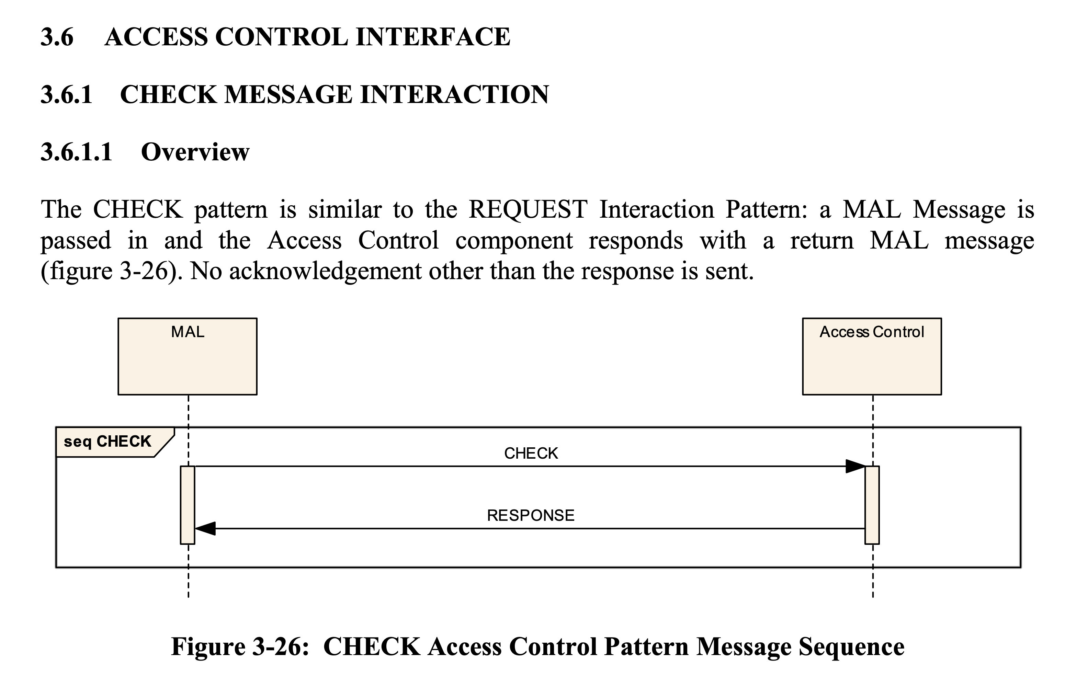
Vague Definitions, 2
Example: Sec 3.6 Access Control
A MAL “check” message is passed in, a MAL “response” message is returned
The MAL Message may (or may not) contain an Authentication ID
Sec 3.6.1.8.1.3 “b) It is implementation and deployment specific what checks an implementation of the Access Control component shall perform upon reception of a CHECK Request.”
Much of this is entire feature is vague and not likely to ever be interoperable

Slide 14
Internal Disconnects
Real definitions of MO Object, Object, Composite, and Attribute appear late in the document (sec 3.7, sec 4.1.4) and there appear to be internal inconsistencies
Sec 1.7 Definitions: “MO Object: The concept that allows complex data models to be defined within MO services. It enables objects to be created in MO and it allows references from other Composites to be created.”
Sec 3.7: "An MO Object is an extension of a Composite data type with the first field being its identity”
From this it appears that “MO Object” is either a “concept” or a specialized composite data type (composed of elements). One of these definitions is flawed. No mention of “Object” here (see below).
Sec 4.1.4: “Attributes are the simplest MAL type; they cannot be decomposed into any smaller elements and are used to build more complex structures. “
“Attribute”, in most normal English or computer usage, is defined as “a quality or feature regarded as a characteristic or inherent part of someone or something”, or as “a piece of information which determines the properties of a field or tag”
Attributes, are usually descriptions of something, and not the “thing” itself
Sec 4.2.3 Object extends Composite, Composite extends Element, and Attribute also extends Element.
It appears that “Element” is the most basic MAL “thing”, but that it is not a “type” nor an “object”.
Sec 4.2.4 “Object is the base structure for composite structures that contain a set of elements for MO Objects.”
These MO Object definitions are unclear, inconsistent, scattered in the document, and in more or less reverse order.
Since Object is already a Composite what is the need for an MO Object that is derived from an Object?
Why isn’t an MO Object just a special case of Composite?

Slide 15
Clarity Comparison - 1 MO MAL Message (CCSDS 521.0-P-2.0) compared to CSS CSTS Framework PDU (CCSDS 921.1-B-2)
MO MAL Message
The spec is entirely abstract in nature.
Many field types are never clearly defined (Auth ID, Timestamp, Area) and PDUs remain abstract.
The MAL Message Header, table 3-1, provides more specific info, but is still abstract and not complete.
This spec can only create a fully specified, interoperable, message structure after a separate data representation binding is specified.
Mandatory and optional fields are not clearly nor consistently articulated.
Security topics are weakly addressed.
A very abbreviated and incomplete PICS Pro Forma is provided.
Key SANA registry is unspecified.

Slide 16
Clarity Comparison - 2 MO MAL Message (CCSDS 521.0-P-2.0) compared to CSS CSTS Framework PDU (CCSDS 921.1-B-2)
CSTS Framework PDU
CSTS PDUs are formally defined using Abstract Syntax Notation 1 (ASN.1).
All field types are clearly defined
The CSTS “messages”, the PDUs, are all completely specified in an Annex that can be extracted and complied into code
Similar to the MAL, this can only become a fully interoperable deployment after transport binding is specified.
A standard transport binding to TCP/IP is defined in a separate spec
The service spec itself (PDUs, fields, behaviors) is fully defined as it stands, no ambiguities exist
State charts define high level behaviors
State tables carefully define each low level behaviors
All PDUs and primitives are defined in ASN.1
All mandatory and optional fields are carefully defined throughout the document
SANA registries are fully specified

Slide 17
Clarity Comparison - 3 MO MAL Message (CCSDS 521.0-P-2.0) compared to SIS AMS message standard (CCSDS 735.1-B-1)
AMS Message Standard PDU
AMS PDUs are explicitly defined using a tabular field / length / value approach
All field types and sizes are clearly defined
The AMS “messages”, the PDUs, are all completely specified in the document
Unlike the MAL & CSTS, this is a fully interoperable spec, but it does need an underlying transport
Standard transport bindings to space data links, SOIS Subnet Service, and DTN are defined in the spec
The service spec itself (PDUs, fields, behaviors) is fully defined as it stands, no ambiguities exist
State charts define high level behaviors
State tables carefully define each low level behaviors
All PDUs and primitives are defined
All mandatory and optional fields are carefully defined throughout the document
Conformance classes and capability sets are clearly articulated
SANA registries are fully specified
Security topics, encryption keys, and separate / merged domains are explicitly addressed
A full PICS Pro Forma is provided

Slide 18
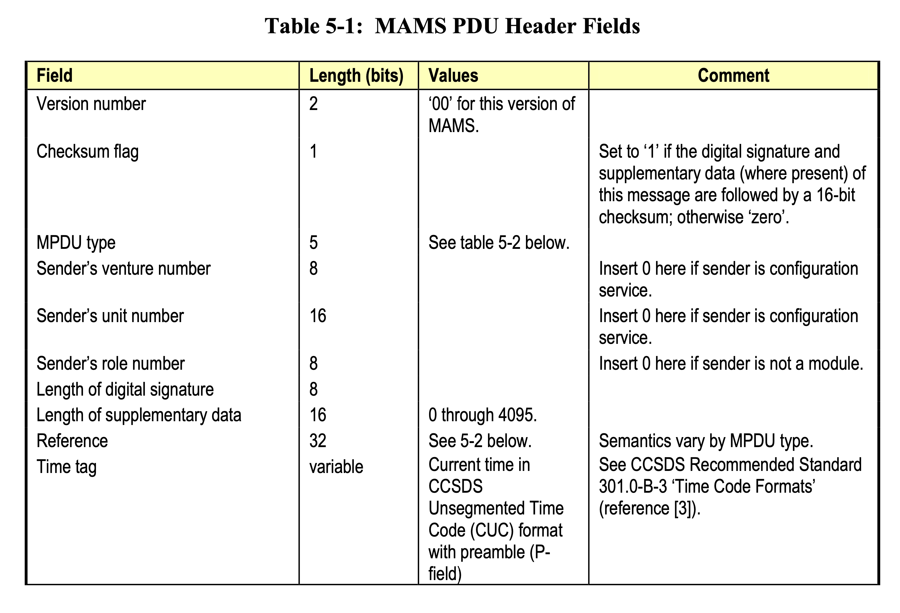
Clarity Comparison – 3, cont MO MAL Message (CCSDS 521.0-P-2.0) compared to SIS AMS message standard (CCSDS 735.1-B-1)
AMS Message PDU header
One of several explicit AMS PDU header and data structure tables
No ambiguities for fields or sizes
Directly implementable based on this spec

Slide 19
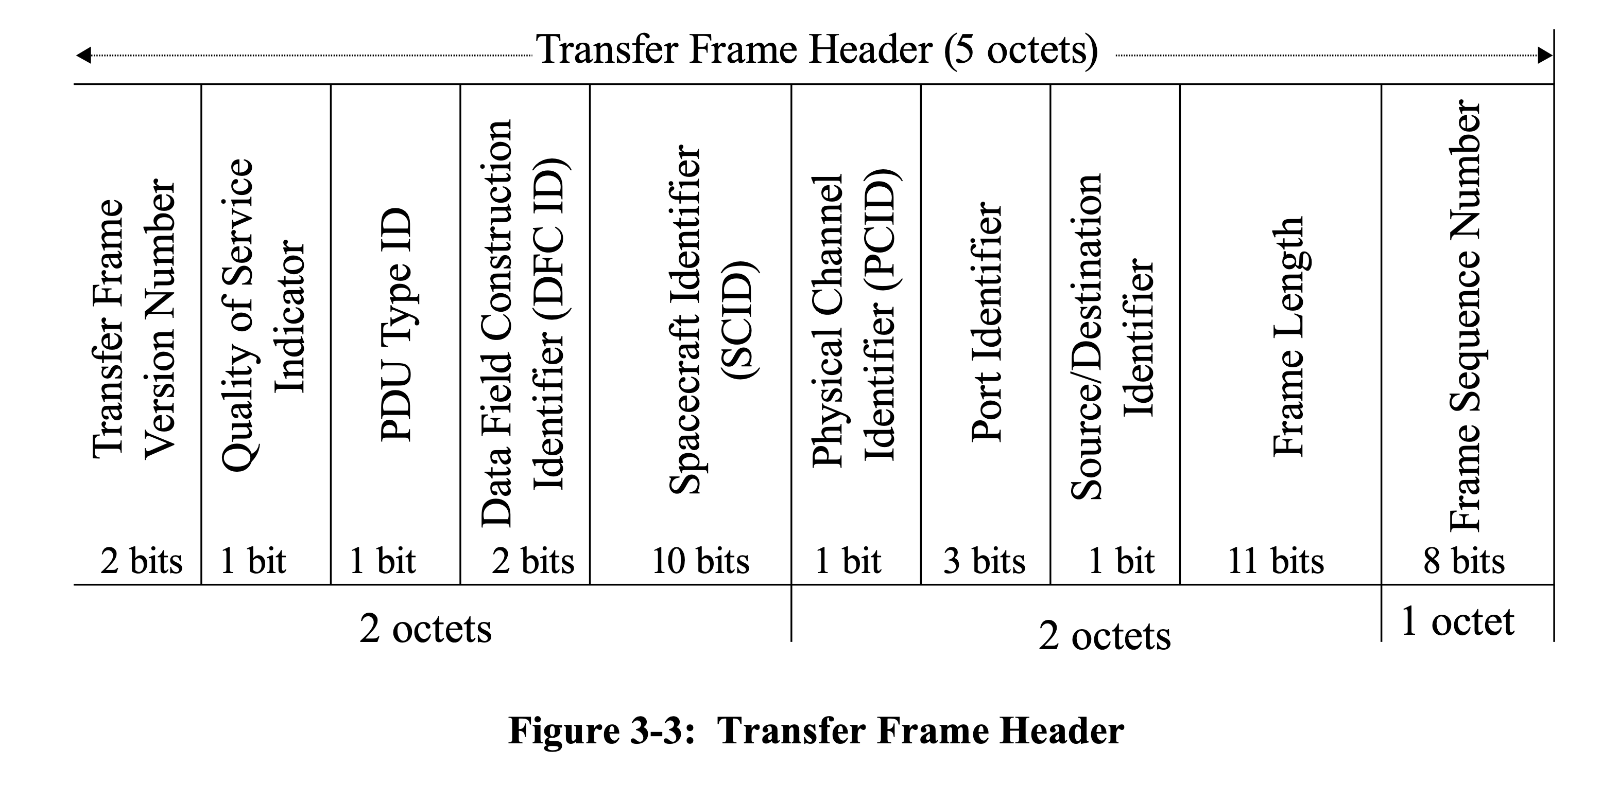
Clarity Comparison – 4 MO MAL Message (CCSDS 521.0-P-2.0) compared to SLS Prox-1 link layer standard (CCSDS 211.0-B-6)
Prox-1 PDU header
The key Prox-1 PDU transfer frame header definition
No ambiguities for fields or sizes
All terms (and behaviors) are defined in the text
Directly implementable based on this spec
The spec also includes other, similarly explicit, data link frame, field, and state table protocol descriptions

Slide 20
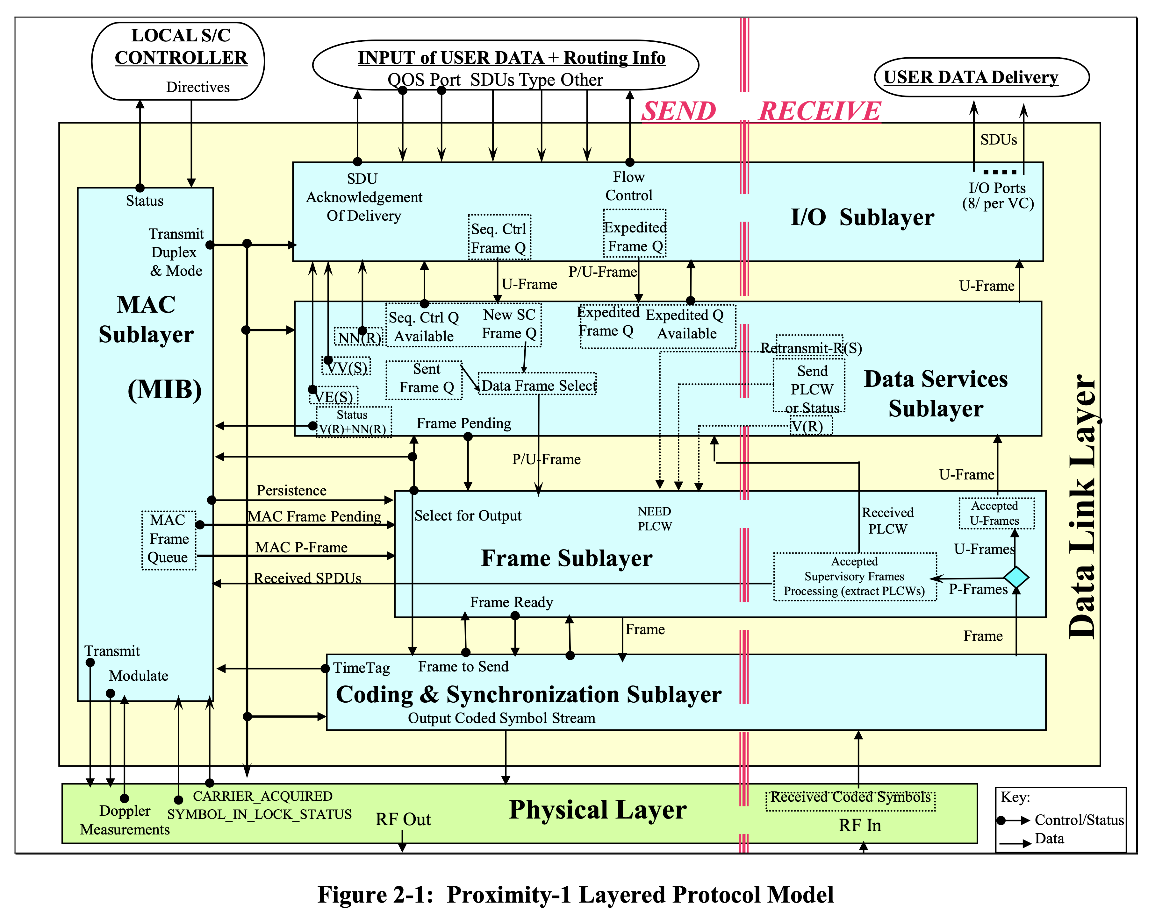
Clarity Comparison – 4, cont MO MAL Message (CCSDS 521.0-P-2.0) compared to SLS Prox-1 link layer standard (CCSDS 211.0-B-6)
Prox-1 Protocol Layering
The key Prox-1 protocol layer behavior diagram
Several complex sublayers are described
Data transport, signaling, and management protocol / MIB elements are all clearly described
There is no comparable layering diagram in MO MAL, but a much simpler one does appear in the MORM and ASL.
The MO MAL does have a series of separate, much smaller, activity and sequence diagrams.

Slide 21
Summary of Analysis of MO MAL draft, CCSDS 521.0-P-2.0
During review a large number of missing/removed elements, undefined terms, vague statements, and disconnects were identified
In comparison to other, similarly classified, CCSDS documents it is clear that this document, in its current form, is mischaracterized as a Blue Book
During analysis it became clear that the document, while styled and formatted as a Blue Book, did not, in fact, meet the test of:
“complete, unambiguous and at a sufficient level of technical detail that they can be directly implemented and used for space-mission interoperability and cross support”
Accordingly the SEA recommendation is that it either:
Be reformatted as a Magenta Book to align with its current inherent nature as a “foundational” reference spec for the separate, interoperable, MO bindings, or
Be extensively re-written to comply with actual CCSDS Blue Book standards
In addition, the document must be scrubbed, end to end, and all of the identified lapses and issues, and all related issues that appear elsewhere in the document, must be remedied.

Slide 22
BACKUP

