Slide 1

Spring 2022 Virtual CCSDS Technical and CESG Meetings
11 May 2022
14:00UTC

Slide 2
Time (UTC) | Duration | Topic | Presenter
14:00 | 5 minutes | Welcome | Sami Asmar – CCSDS General Secretary
14:05 | 10 minutes | Introduction | Klaus-Juergen Schulz – CESG Chair
14:15 | 10 minutes | Role of the CESG | Peter Shames – SEA Area Director
14:25 | 10 minutes | MOIMS Workplan | Mario Merri – MOIMS Area Director
14:35 | 10 minutes | SIS Workplan | Tomaso de Cola – SIS Area Director
14:45 | 10 minutes | SLS Workplan | Ignacio Aguilar – SLS Area Director
14:55 | 10 minutes | SOIS Workplan | Jonathan Wilmot – SOIS Area Director
15:05 | 10 minutes | CSS Workplan | Erik Barkley – CSS Area Director
15:15 | 10 minutes | SEA Workplan | Peter Shames – SEA Area Director
15:25 | 5 minutes | Fall 2022 Meetings | Michael Blackwood - Secretariat
15:30 |  | Additional Topics
16:00 |  | Adjournment | Klaus-Juergen Schulz – CESG Chair

Slide 3





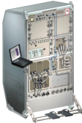

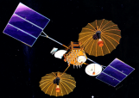



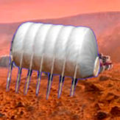

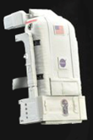






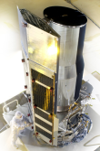
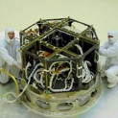



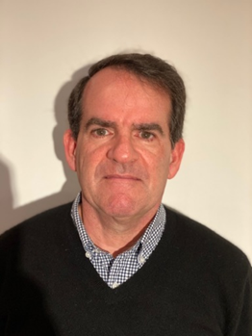






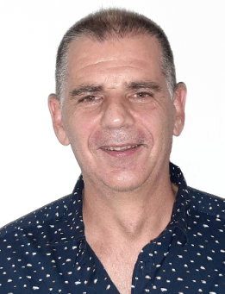
Members of the CESG
CESG Chairs
CESG Chair K.-J. Schulz
Deputy Timothy Pham
SE Area Director Peter Shames
Deputy Hiroshi Takeuchi
MOIMS Area Director Mario Merri
Deputy Marc Duhaze
CSS Area Director Erik Barkley
Deputy Colin Haddow
SLS Area Director Ignacio Aguilar Sanchez
Deputy Gilles Moury
SIS Area Director Tomaso de Cola
Deputy Rodney Grubbs
SOIS Area Director J. Wilmot
Deputy X. He
6 Areas
23 WGs
Systems Engineering
Security
Delta-DOR
System Architecture
MISSION CONTROL
CENTER
End Users
Applications/Archives
MISSION CONTROL
CENTER
End Users
Spacecraft Onboard
Interface Services
Space Link
Services
Cross Support
Services
Space Internetworking
Services
Mission Ops &
Info Mgt Services
Onboard Wireless WG
Application Supt Services
Subnetwork Services
RF & Modulation
Coding & Sync.
Multi/Hyper Data Comp.
Space Link Protocols
Space Data Link Security
Optical Communications
CS Service Management
CS Transfer Services
Motion Imagery & Apps
Delay Tolerant Networking
Voice
CFDP Revisions
Data Archive Ingestion
Navigation
Spacecraft Monitor & Control
Telerobotics
Planning & Scheduling

Slide 4
CCSDS Publications since CMC Mtg Spring 2021
Blue Books – Recommended Standards
CCSDS 231.0-B-4, TC Synchronization and Channel Coding, July 2021
CCSDS 509.0-B-1 Cor. 1, Technical Corrigendum 1 to CCSDS 509.0-B-1, Issued February 2018
CCSDS 505.0-B-2, XML Specification for Navigation Data Messages, May 2021
Magenta Books – Recommended Practices
None
Orange Books
CCSDS 131.31-O-1, CCSDS Space Link Protocols over ETSI DVB-S2X Standard, September 2021
CCSDS 131.21-O-1, Serially Concatenated Convolutional Codes—Extension (SCCC-X), May 2021
Green Books – Informational Reports
CCSDS 660.1-G-2, XML Telemetric and Command Exchange (XTCE)-Element Description, August 2021
CCSDS 720.1-G-4, CCSDS File Delivery Protocol (CFDP)—Part 1: Introduction and Overview, May 2021
CCSDS 720.2-G-4, CCSDS File Delivery Protocol (CFDP)—Part 2: Implementers Guide, May 2021

Slide 5
CMC Poll Statistics since CMC Mtg Spring 2021
Authorisation to publish
CCSDS 732.1-B-2, Unified Space Data Link Protocol (Blue Book, Issue 2)
CCSDS 732.0-B-4, AOS Space Data Link Protocol (Blue Book, Issue 4)
CCSDS 232.0-B-4, TC Space Data Link Protocol (Blue Book, Issue 4)
CCSDS 230.1-G-3, TC Synchronization and Channel Coding—Summary of Concept and Rationale (Green Book, Issue 3)
CCSDS 132.0-B-3, TM Space Data Link Protocol (Blue Book, Issue 3)
Agency Reviews
CCSDS 876.0-P-1.1, Spacecraft Onboard Interface Services-XML Specification for Electronic Data Sheets
CCSDS 131.0-P-3.1, TM Synchronization and Channel Coding
CCSDS 131.2-P-1.1, Flexible Advanced Coding and Modulation Scheme for High Rate Telemetry Applications
CCSDS 414.1-P-2.1, Pseudo-Noise (PN) Ranging Systems
CCSDS 653.0-R-1, Information Preparation to Enable Long Term Use
CCSDS 355.0-P-1.1, Space Data Link Security Protocol
CCSDS 502.0-P-2.1, Orbit Data Messages (Pink Book, Issue 2.1)

Slide 6
CMC Poll Statistics since CMC Mtg Spring 2021
Approval of new Projects
New Projects of the SEA Area
Secure Software Engineering for Space Missions - Magenta Book
New Projects of the SLS Area
Robust Compression of Fixed-Length Housekeeping Data Packets - Summary of concept and rationale - Green Book
Space Data Link Security Protocol--Summary of Concept and Rationale - Issue 2 - Green Book
Pseudo-Noise (PN) Ranging Systems - Issue 3 - Blue Book
Simultaneous Transmission of GMSK Telemetry and PN Ranging - Issue 2 - Green Book
New Projects of the MOIMS Area
Navigation Data Messages Overview Green Book (V.3) - Green Book

Slide 7
CMC Poll Statistics since CMC Mtg Spring 2021
New Appointments
Appointment of new SLS Area Director: Ignacio Aguilar Sanchez (ESA)
Appointment of new SIS Area Director: Tomaso de Cola (DLR)
Appointment of new Deputy SIS Area Director: Rodney Grubbs (NASA)
(CESG Poll) Appointment of new SIS CFDP Working Group Chair: Felix Flentge (ESA)

Slide 8
CCSDS Resources

Slide 9
Area Directors / Area Directors Overview

Slide 10
WG Chair / Deputy Chair Overview

Slide 11
Fall 2021 Virtual CCSDS Meetings
Role of the CESG

Slide 12
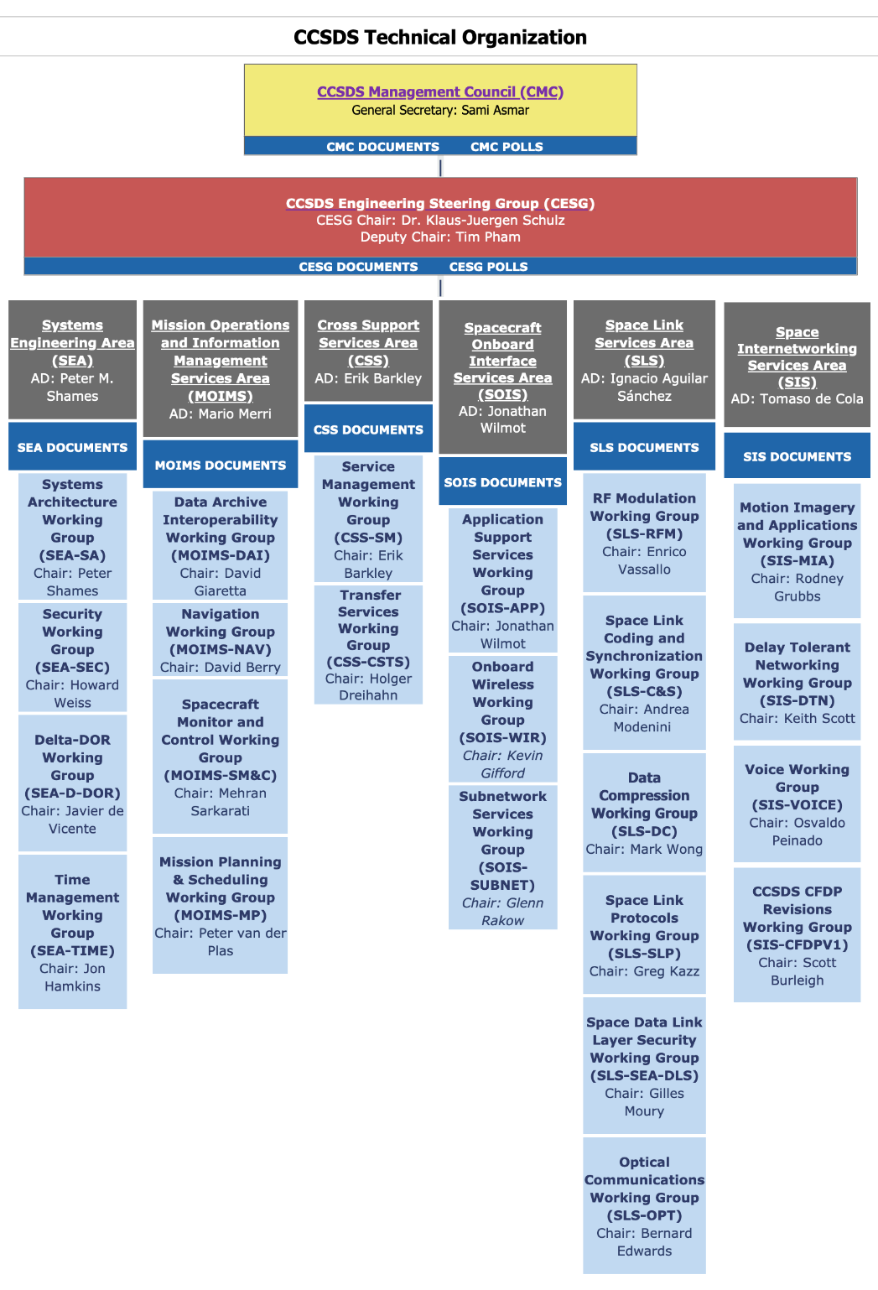
CCSDS Technical Organization
CCSDS Engineering Steering Group
CESG Chair and Deputy
6 Area Directors & Deputies
Review and approve documents for technical content (and other criteria)
CCSDS Working Organization
6 areas of work
Total of 22 Working Groups (Fall 2021)
Create projects & produce documents
But … just what does the CESG do?

Slide 13
Role of the CESG
Defined in CCSDS Organization and Processes – A02.1-Y-4
“The CCSDS Engineering Steering Group (CESG) is responsible for technical management across CCSDS domains and for the top-level coordination of the overall international standardization process.”
  “A candidate for selection as CESG chair, Area Director, or their deputies must have demonstrated the ability to function independently of his/her own agency’s agenda and to be able to fairly lead the development of international consensus. “
“Providing the CCSDS-wide forum where the work programs of the Areas may be coordinated and synchronized in the context of an overall architecture for space- mission cross support and the needs of individual customers”

Slide 14
Role of the CESG
Defined in CCSDS Organization and Processes – A02.1-Y-4
“Ensuring that all CCSDS work follows the set of architectural principles agreed to by the CESG and is properly synchronized with work in other areas and with the smooth evolution of the large installed base of CCSDS-compatible mission-support infrastructure”
Identifying “red flag” items where technical work in a proposed CCSDS document is not of the required quality or nature … or where significant issues exist
Final technical approval before release for agency review or publication

Slide 15
MOIMS inputs to CCSDS Opening Plenary
CCSDS Meeting Fall 2021
Mario Merri (ESA), Marc Duhaze (CNES)
21/10/2021

Slide 16
CCSDS/MOIMS Document Status (Apr21-Oct21)-1
Data Archive Interoperability WG (DAI)
  MB: 650.0 Open Archival Information System (OAIS): 5y revision Completed AR, disposing RIDs
  MB: 652.0 Audit and Certification of Trustworthy Digital Repositories: 5y revision Under CMC poll for AR
  MB: 652.1 Requirements for Bodies Providing Audit and Certification of
  Trustworthy Digital Repository: 5y revision Under CMC poll for AR
  MB: 653.0 Information Preparation to Enable Long Term Use (IPELTU) Under AR, RIDs due 22Nov
  MB: 671.0 Open Archive Information Systems Interoperability
  Framework (OAIS-IF) Architecture Description On-going
Navigation WG (NAV)
  GB: 500.2 Navigation Data Messages Overview: refresh New project approved
  BB: 502.0 Orbit Data Message (ODM - NASA, ESA): 5y revision Under AR, RIDs due 14Dec
  BB: 503.0 Tracking Data Message (TDM - NASA, ESA): 5y revision Lower priority because of workload
  BB: 504.0 Attitude Data Message (ADM - CNES, ESA): 5y revision Almost ready for polls for AR
  BB: 505.0 Navigation Data Message XML Specs (NDM - no prototype): 5y revision Published. New project for corrigenda
  approved
  BB: 507.0 Navigation Events Message (NEM – CNES, ESA) Lower priority because of workload
  BB: 508.0 Conjunction Data Message (CDM): 5y revision Disposing comments from internal review
  BB: 509.0 Pointing Request Message (PRM) Corrigenda published

Slide 17
CCSDS/MOIMS Document Status (Apr21-Oct21)-2
Spacecraft Monitor & Control WG (SM&C)
  GB: 520.0 MO Services Concept (ESA): 5y revision Slowed down to reflect MO 2.0
  MB: 520.1 Mission Operations Reference Model (DLR): 5y revision Disposing CESB poll conditions for AR with
  the support of the Security WG
  BB: 522.2 Mission Product Data Distribution Services (ESA, CNES) Slowed down to reflect MO 2.0
  BB: 522.x File Management Services (ESA, ?) Slowed down to reflect MO 2.0
  GB: 660.1 XTCE Element Description (NASA): 5y revision Published
Mission Planning & Scheduling WG (MP&S)
  BB: Mission Planning and Scheduling (ESA, DLR) Progressing nominally

Slide 18
SIS Meeting Objectives (1 of 2)
Motion Imagery and Applications WG
  November 4th-5th
    Specifications for Real-time Protocol as transport for audio & video over DTN
      Review Interoperability Testing status
      Update Yellow Book documentation of testing if no further testing is needed
      Prepare for publication of Blue Book
    Review research conducted by DLR on Video Quality Assessment as potential future work for the group
CFDP Revisions WG
  Not meeting
VOICE WG
  Not meeting
Notes:
18
18

Slide 19
SIS Meeting Objectives (2 of 2)
Delay Tolerant Networking WG
  October 25th
    LTPv2 Review
    Orange Block Discussions
    Protocol Naming
    LTP Sec Comments Review
  October 29th
    ESA Compressed Status Reports
    BP Custody Discussion
  November 2nd
    BPv7 Update
      Current Status Review
    Formal Naming of Protocol Elements
      IETF / IANA URI scheme
      → Joint meeting w/ CSS on FRM second week of November
  November 3rd
    BPsec:
      Joint Meeting w/ SEA-SEC
      Operational Concerns / Work-Arounds
Notes:
19
19

Slide 20

RF & Modulation WG (E. Vassallo & D. Lee)
  401.1-B RF & Modulation:
  22 GHz Earth-to-space
  26 GHz channel model
  26 GHz space-to-space
  Applicability of 131.2-O (SCCC-X) and 131.1-O (DVB-S2X)
  211.1-B Proximity-1 Physical Layer:
  Frequency plan
  414.1-B PN Ranging
  Wide-band PN DDOR recommendation
  RFM Charter and projects
  401.1-B RF & Modulation:
  Discussion of draft recommendation
  Discussion
  Agree on recommendation
  Discussion (with C&S WG)
  211.1-B Proximity-1 Physical Layer:
  Discussion on changes (in cooperation with SFCG)
  Disposition of Agency Review RIDs
  Discussion of new draft recommendation (with SEA-DDOR WG)
  Review in light of new requirements (lunar missions, RA protection, Proximity-1 PL changes)
Space Link Code/Sync WG (A. Modenini & K. Andrews)
  121.0-B TM Coding:
  randomizer
  CADU and CSM terms unification
  Agency Review RIDs
  Variable Length Frames
  431.1-B VCM Protocol:
  Technical corrigendum on header and randomizer
  131.2-B Flexible ACM Scheme for HR TM
  Agency Review RIDs
  732.0-B AOS SDL Protocol
Space Link Code/Sync WG
  121.0-B TM Coding:
  Discussion
  Discussion of proposal
  Disposition
  Discussion on new project
  431.1-B VCM Protocol:
  Discussion
  131.2-B Flexible ACM Scheme for HR TM
  Disposition
  otDiscussion of technical corrigendum on FHEC
Space Link Protocols WG (G. Kazz & M. Cosby)
  121.0-B TM Coding:
  Variable Length Frames
  130.0-G Overview of Space Communication Protocols
  732.0-B AOS SDL Protocol
  FHEC
  Common Terms within SLS Area
  Encapsulation Packet and Space Packet GBs
  CCSDS 232.1-B COP-1
Space Link Protocols WG
  121.0-B TM Coding:
  Discussion on path forward
  Discussion about its future
  732.0-B AOS SDL Protocol
  Discussion about its removal
  SLS Glossary Magenta Book update
  Review progress
  5-year review
Notes:
Welcome, tribute to Gian Paolo
The RFM WG has already met on Monday, Tuesday and Wednesday of this week.
The C&S WG has already met on Monday of this week.
The SLP WG will meet next week.

Slide 21
Space Data Link Security (SDLS) WG (G. Moury & H. Weiss)
  355.0-B SDLS pink sheets
  350.11-G SDLS Extended Procedures
  350.5-G SDLS Core Protocol
  911.5-B SLE ROCF and 912.1-B SLE F-CLTU
  Agency Review RIDs disposition
  Review contributions and produce final draft
  Update document to include new standards (USLP, SDLS-EP, …)
  Discussion of SDLS impact
Multispectral & Hyperspectral Data Compression (MHDC) WG (M. Wong)
  120.2-G Near-Lossless Extension of CCSDS-123.0-B
  124.0-G Robust Compression of FL HK Data
  125.0-B Raw SAR Compression
  ACHIEVEMENTS: 124.0-B Robust Compression of FL HK Data Blue Book: (submitted for Agency review);
Space Link Code/Sync WG
  Review final draft and agree on request for Agency reviewing:
  Review draft and make writing assignments
  Review draft and make writing assignments
Optical Communications WG (B. Edwards & C. Heese)
  Optical Communications C&S for Optical On/Off Keying (O3K)
  CCSDS 141.1-M Atmospheric Characterization and Forecasting for Optical Link Operations
  NASA’s Optical Communications Terminal on Orion and the ISS
  NASA’s Terabyte Infrared Delivery (TBIRD) project
  Japanese Data Relay Satellite
Space Link Protocols WG
  Finalize recommendations
  Agency review RIDs disposition
  Receive an update
  Receive an update
  Receive an update
I. Aguilar & G. Moury
Notes:
SDLS WG will meet on the 8 and 9 November.
DC WG will meet on the 3 November.
Optical WG will meet on the 4 and 23 November.
SLS Plenary will take place on the 10 November.

Slide 22
Spacecraft Onboard Interface Services (SOIS)
Opening Plenary
Jonathan Wilmot (Area Director)
Xiongwen He (Deputy Area Director)
Fall 2021 Meetings
Notes:
22
22
22

Slide 23
SOIS-App Fall Meeting
Activities - Last Six months
  Participated in a series of technical reviews of Artemis/Gateway XTCE and SEDS requirements documents
    Review limited to NASA, US industry, and Artemis partners: ESA, JAXA, CSA
    Feedback incorporated as part of recent Pink sheet review
  SEDS pink sheet agency review complete
  Submitted SOIS/MOIMS orange book for publication
  Created SEDS DTN operational interfaces and MIB data sheet
  Coordinated with Cross Support Services (CSS) area on Functional Resource Model/SEDS
Upcoming Meeting goals
  Finalize 870.1, 876.1, 870.0 with inputs from Pink sheet review and Artemis feedback
    Discuss SEDS application to configuration data (Tables, files, memory loads,…)
    Discuss SEDS tooling needs (Use cases)
      Artemis Mission Control Center (MCC) looking for editing and display tools
  Develop green book material on relationship of component SEDS and deployment SEDS
  Present DTN SEDS to SIS-DTN WG during fall meeting, work DTN Network Management group
    DTN BP encoding in SEDS has highlighted issues in the IETF DTN standard
  Coordinate with Cross Support Services (CSS) area and SEA on Functional Resource Model/SEDS mapping of operational interfaces and MIBs
  Access resources and discuss WG future plans

Slide 24
SOIS-Subnet Fall Meeting
  Activities - Last Six months
  Minimal
  Staff supporting higher priority flight projects
  5-year reviews are late
Upcoming Meeting goals
  Develop plan to address staffing issues
  Discuss book priorities
  Analysis of upcoming mission needs highlight a disconnect between useability/applicability of some existing books and future mission requirements
  Significant mission use case for updating Synchronization Service book (in 5-year review).
    Coordinate with SEA-Time

Slide 25
SOIS-Wireless Area Fall Meeting
  Activities - Last Six months
  Processed Agency RIDs for CCSDS 883.0-R-1,
  Processed CESG poll conditions for CCSDS 883.0-R-1 publication
  Began on 3GPP band survey for lunar surface spectrum trade study (via NASA 3GPP WG)
  Conducted bi-weekly WG tagups
    Document editing
    Interoperability testing progress review
    Stakeholder coordination (e.g., Nokia lunar LTE demonstration team, NASA spectrum)
  Meeting Objectives
  Finalize resolution of CESG poll conditions for 883.0-R-1
    Primarily DTN adaptation profile diagram details
  Begin composition of follow-on pink sheets to add roaming scenarios
  Plan post-pink sheet SOIS-WIR activities with international partners (primarily CSA)
  Continue 3GPP band survey for lunar surface spectrum trade study

Slide 26
CSS Virtual Fall 2021 Meeting Objectives
Cross Support Transfer Services WG
  Monitored Data Service (BB-2) Convince the AD to submit for AR polling
  Tracking Data Service (BB-2) Convince the AD to submit for AR polling
  All SLE Books Revise and re-submit for AR polling
  Functional Resource Model (MB) Assess readiness for agency review; plan for book captain succession
  Functional Resource Model (SANA+) Review Tier 2 resource definitions
  SANA Functional Resource Registry (Tier 1) Approve publication of registry
Cross Support Service Management WG
  Service Management Concept (GB) Survey for refresh
  Communications Planning Information Format (BB) Review prototype report; release for publication polling
  Terrestrial Generic File Transfer (BB) CESG publication poll condition resolution
  Service Management Utilization Request Format (BB) Convince the AD to submit for agency review
  Service Package Data Format (BB) Convince the AD to submit for agency review
  Event Sequence Review examples from consistent with current draft outline/direction
  Configuration Profile, Service Agreement Review auto schema (from FRM) generation progress; discuss service agreement content
CSS (Area Level)
  CSTS & CSSM Discuss, coordinate: re
  o FRM classification metadata
  o FRM & use of Eclipse modeling framework (EMOF)
  o CSS Area standards & cloud computing
  o Use of GitHub
  CSS + SIS DTN WG Overview of FRM and discussion – this is a follow up to
  discussion with SOIS Area earlier this year
Notes:
26

Slide 27
Fall 2021 Virtual CCSDS Meetings
SEA Plenary – Workplan

Slide 28
SEA Meeting Objectives: 1/1
Security WG (Chair: Howie Weiss)
  Key Management (GB, MB) MB sent to CESG for approval to publish, application being worked in SDLS, GB in work
  Threat GB GB sent to CESG for approval to publish
  Algorithm GB Updates In work
  Intergovernmental Certificate Authority MB In development
  Bundle Protocol Security (BPSec) Joint with DTN WG, agree to base on IETF
  Standard security section Mandatory
Delta-DOR WG (Chair: Javier de Vicente)
  Delta-DOR Architectural Guidelines (MB) MB in process
  Delta-DOR Raw Data Exchange update (BB) BB in progress
  Delta-DOR Operations update (MB) MB in progress
System Architecture WG (Chair: Peter Shames)
  RASDS MB Extensions Updates in development, joint with TC20 / SC 14
  SCCS Architecture Reqmts MB Updates for new standards, in development
  CCSDS Ontology Glossary issues noted, TC20/SC14 meetings held
Time Exchange / Sync Standards WG (Chair: Jon Hamkins)
  Time Management GB GB in progress, expected soon
  Time Management BB & MB In planning, waiting on GB completion
SANA Steering Group (SSG) (Chair: Peter Shames)
  SANA Steering Group (SSG) Active, meeting this month
  CCSDS Registry interfaces Working on improving access & controls for SANA Registries
  Standard SANA section Mandatory

Slide 29
CCSDS Fall 2022 Meeting

Slide 30
Future Meetings (to be updated)
Date | WG/CMC | Host | Location | Date | Comments
Spring 2022 | WG/CESG | NASA | Huntsville, Alabama, USA | 9-16 May 2022
 | CMC/SC13 | JAXA | Tokyo, Japan | TBD
Fall 2022 | WG/CESG | CNES | Toulouse, France | TBD Date
 | CMC/SC13 | CNES | Toulouse, France | TBD Date
Spring 2023 | WG/CESG | NASA | TBD | TBD Date
 | CMC/SC13 | INPE | Sao Jose dos Campos, Brazil | TBD Date
Fall 2023 | WG/CESG | ESA | TBD, hosted by ESTEC | TBD Date
 | CMC/SC13 | ESA | TBD | TBD Date
Spring 2024 | WG/CESG | NASA | USA | TBD Date
 | CMC/SC13 | ROSCOSMOS | TBD | TBD Date
Fall 2024 | WG/CESG | UKSA | TBD | TBD Date
 | CMC/SC13 | UKSA | TBD | TBD Date
5-Day
5-Day

Slide 31
Acknowledgements

Slide 32
Working Group Agendas and Additional Resources
All information about the CCSDS Spring 2022 Meetings can be found on the CCSDS Public Website page:
Individual Working Group Agendas may be found on the CCSDS Public Website at:
A schedule of individual meeting sessions is available on the public website in two versions. As a List (add link) or a Table (add link).
To find contact information for each Area Director and Working Group Chair and request a meeting invitation visit the CWE at: https://cwe.ccsds.org/default.aspx.
If you have any questions about the meetings or require any other assistance, please let us know at secretariat@mailman.ccsds.org.

