Slide 1
Systems Engineering Area (SEA)
Space Assigned Numbers Authority (SANA) Report
Spring 2021 Meetings
Peter Shames (Area Director)
Marc Blanchet (Viagenie)
June 2021 – CMC Meeting (abridged version)
Notes:
1
1
1

Slide 2
SANA Steering Group Executive Summary
Achievements for this meeting cycle:
Review SANA Operations report and authorization framework implementation status
New authorization framework and multiple organization / user are deployed, will be slowly rolled out to ESA and NASA ARs
New standards projects that will have an effect on the SANA were discussed (CSS Functional Resource Model (FRM), ISO use of Glossary, operational use of registries)
Working Group Status:
New QSCID registries are in use, some agencies are still reporting anxiety about dual (multiple) SCID allocations and possibility of assigning more than one SCID per spacecraft. This must be confronted now.
A number of issues affecting registry updates and extensions were discussed. Including: Object Identifier (OID) issues, Service Site & Aperture (SS&A) and FRM registries, missing frequency band information, abbreviation issues
Interaction with other WGs
Reviewed Terms and Abbreviations registry with ISO TC20/SC14 as part of liaison agreement. Approach for handling recommended definitions in different domains were discussed and agreed in principle. Copyright issues with ISO were resolved and a SANA Beta prototype is being planned.
We need to initiate the Terminology Expert Group (TEG), defined in the RMP, Sec 3.4.4. Members are sought from relevant WGs.
Notes:
JAXA is interested, resources being identified. Possible issues getting resources allocated / schedule.

Slide 3
FORWARD WORK
Problems and Issues:
The Service Site and Aperture (SSA) registry is only open to those with CCSDS login, and SANA now has list of users with CWE credentials.
The SANA has developed a new authorization structure to allow secure, remote access, provided update interfaces for nominated Agency Representatives (AR) to take responsibility for their own Agency’s data. Agency Heads of Delegation (HoD) have been asked to assign these ARs.
CCSDS Glossary – update of documents and terms in the Glossary, which involves waiting on document publication, is slow. A method for each domain (WG or Area) to mark their ”Preferred” terms is proposed.
“Abbreviations” in SANA registries are sometimes missing, sometimes longer than the name. There is no consistent approach. D-DOR, Service Management (SM), Navigation, and other WG would like for there to be shorter abbreviations. We need some consistent rules. Establishing a cross WG effort to create some new rules.
Concerns
CCSDS Area and Agency attention to / alignment with the SANA policies is still growing. Some WG are on top of it, others still need to be reminded.
Lessons Learned
The SANA guys are very hard-working, and they tend to take a sound approach to engineering updates instead of applying “band-aids”. This can cause schedule stretch, but the outcome has always had good long term consequences.

Slide 4
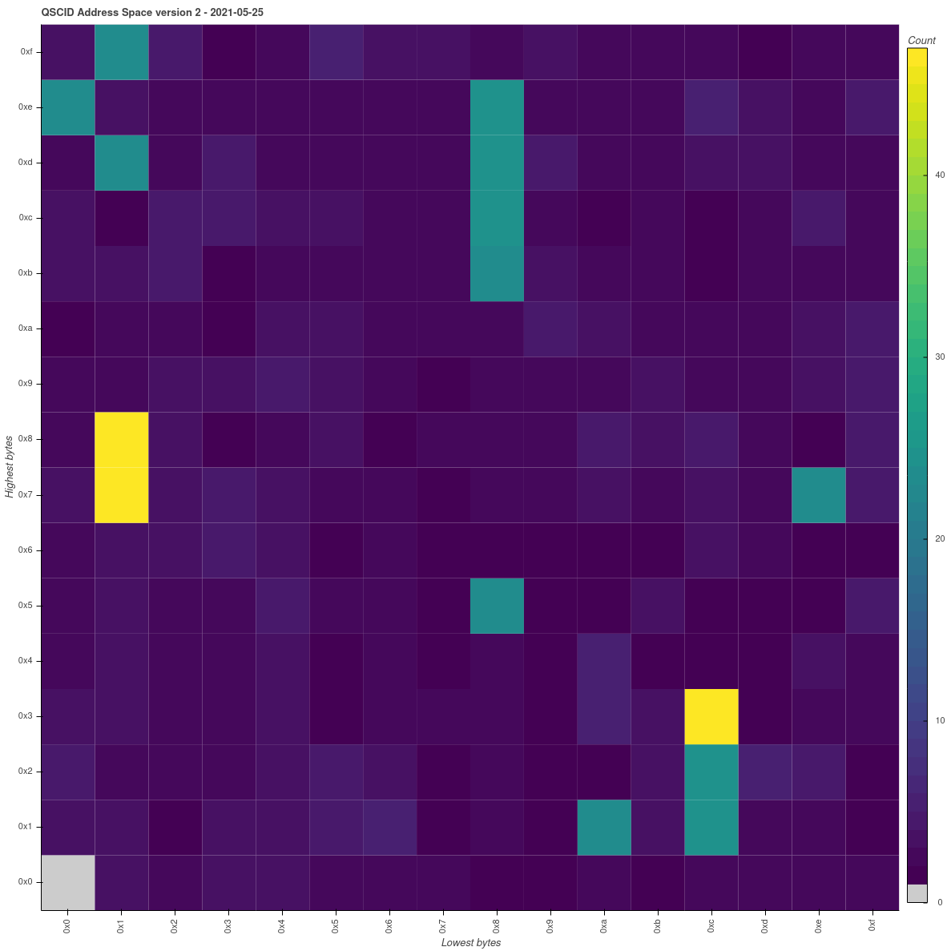
SANA Spacecraftid Assignments
QSCID Version 2 (AOS, 8 bits)
All frequencies (if it is not Grey it has been assigned in at least one frequency bin
Number of allocated QSCIDs
Grey is unallocated
Yellow is completely allocated

Slide 5
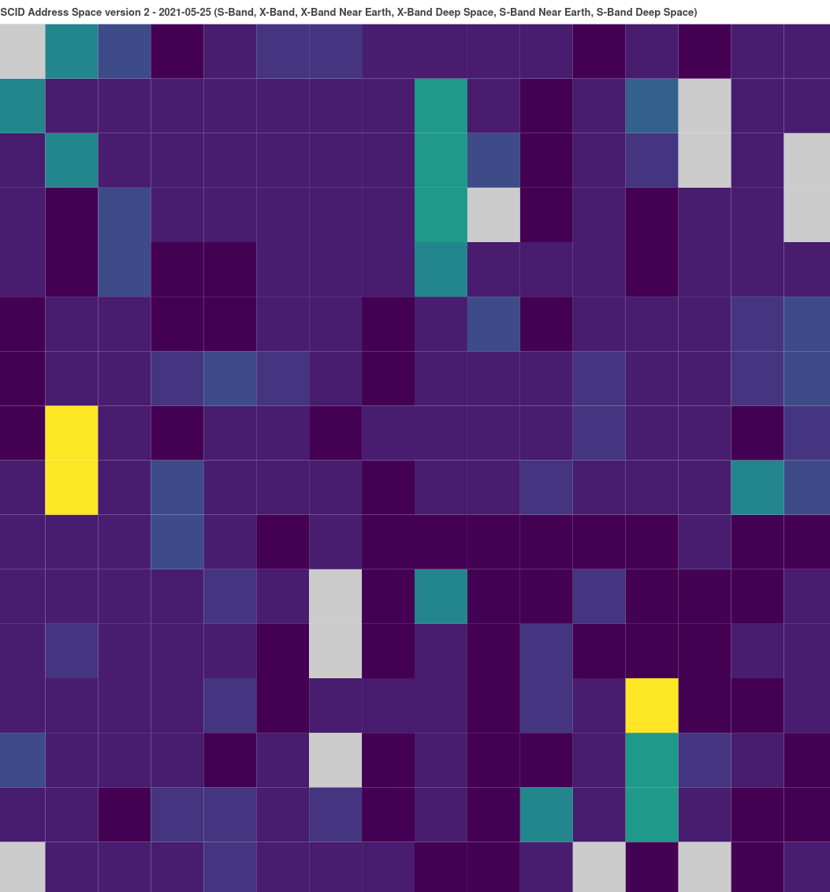
SANA Spacecraftid Assignments
QSCID Version 2 (AOS, 8 bits)
S & X-band (if it is not Grey it has been assigned in at least one of these two frequency bins
Number of allocated QSCIDs
Grey is unallocated
Yellow is completely allocated

Slide 6
SANA Steering Group (SSG) Meeting Agenda 28 May 2021
Opening remarks / agenda hacking
SANA Operator report
New SANA Registry topic discussion
Adaptations for TC 20 / SC14 shared use of Terminology registry & harmonization approaches
Organizations registry (and others) and appropriate abbreviations
Functional Resource Model (FRM) and related CM concerns
SSA Registry, access for updates, contents, & DDOR issues
XML registry CM topics
“Operational use” of the SANA registries, use by agencies
OID issue repairs
Doc ID management / update
OID use for ISO doc ID purposes
SANA / CCSDS website integration issues
Wrap-up

Slide 7
SSG Special Topic
Organizations and SS&A registries and appropriate abbreviations
Nav WG wants complete Org abbreviation set
D-DOR WG wants short set of 4-char “ground station” abbreviations in SS&A registry
CSSM wants a set of service site and aperture abbreviations, and a set of S/C abbreviations
Proposal: Ask the Nav WG, D-DOR WG, and CSSM WG to participate in the SSG and develop a simple policy for creating unique abbreviations.
Announce the selected approach
Apply these to the registry entries
Ask Agencies to comment / correct as they wish

