Slide 1
Systems Engineering Area (SEA)
Area Report
SANA and SANA Steering Group (SSG)
Peter Shames (Area Director)
Hiroshi Takeuchi (Deputy Area Director)
October 2019 – CMC Meeting
Notes:
1
1
1

Slide 2
SEA SANA Steering Group Executive Summary
Achievements for this meeting cycle:
Review SANA Operations report, QSCID implementation status, user acceptance
Review CCSDS website integration into SANA, discuss remaining issues
Discuss work flow issues re registry updates from SANA and WG perspectives
Working Group Status:
New QSCID registries are in use, making allocations within frequency bands. Web interface refinement has been done. See new registries @ https://sanaregistry.org/
CCSDS website “member” Contacts and Organizations have been imported into SANA, which is now the authoritative source for display. CCSDS Website pages that access the SANA are deployed and performance is very good.
The CCSDS CWE contacts (“users”) are exported to the SANA for use in access control.
Interaction with other WGs
MOIMS Nav WG: Nav data providers merged into SANA Organizations registry
SSG: discuss issues with process description, workflow, and SANA registries
Problems and Issues:
Agency Representatives have been slow to carry out their responsibilities for verifying / updating agency data, we still have very limited AOS (v2) SCIDs for assignment in key frequency bands (S&X)
The Service Site and Aperture (SSA) registry is only to be open to those with CCSDS login, and SANA now has list of users with CWE credentials (see above), but we do not yet have access
CCSDS Glossary – all WG are now starting to review their documents and verify terms, these references are now all marked “Provisional” and not “Approved”, and this causes confusion, recommend changing it now
Recommend SANA provide web pages to allow each Agency Representative (AR) to directly manage updates of information under their control, this is in planning
Notes:
JAXA is interested, resources being identified. Possible issues getting resources allocated / schedule.

Slide 3
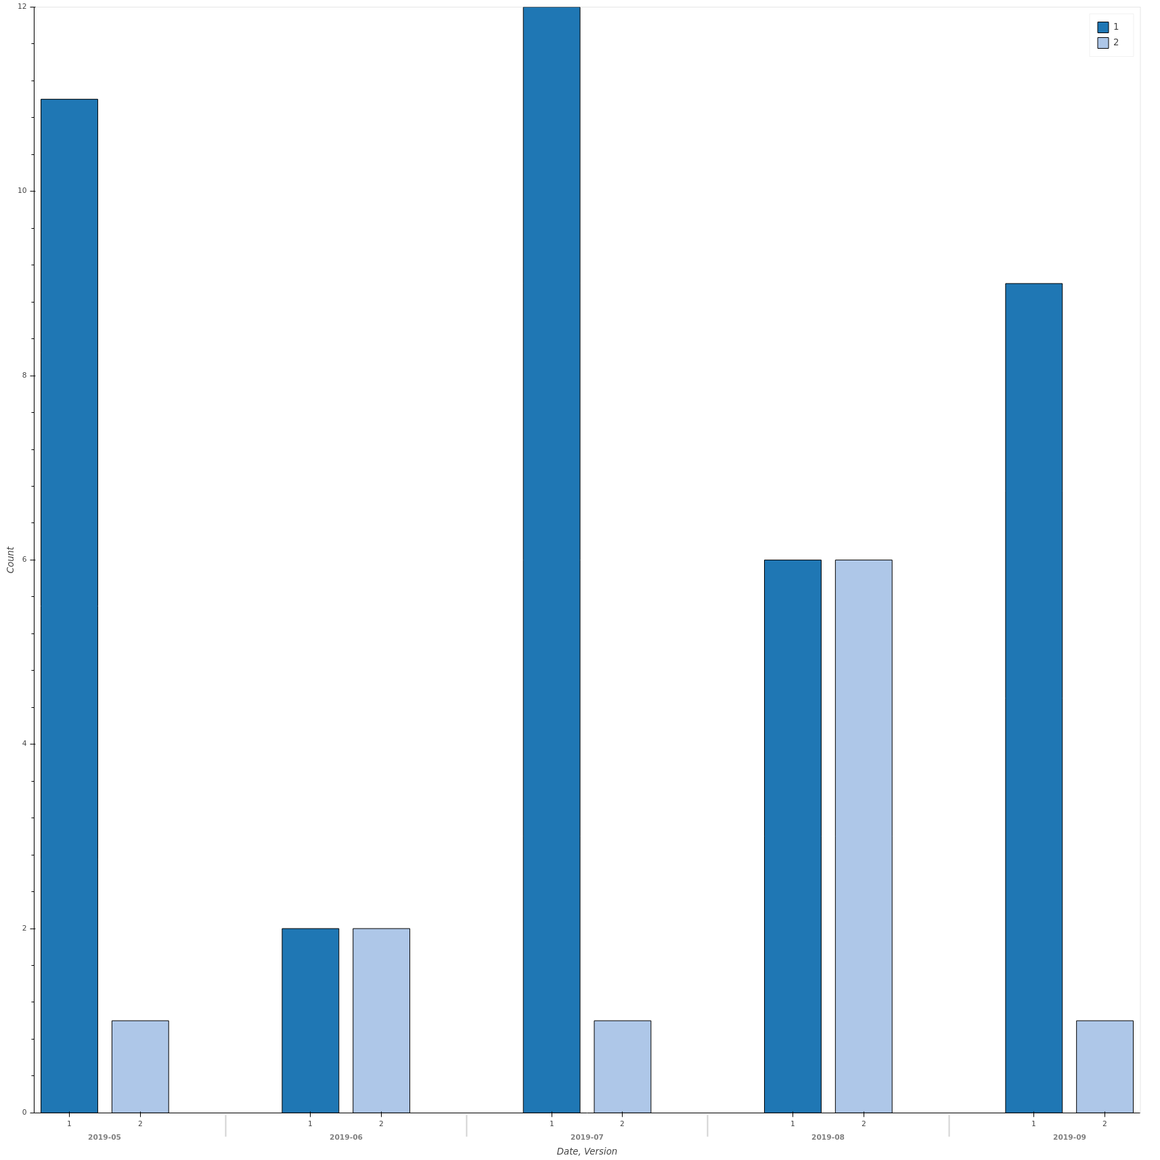
Spacecraftid Assignments
20 new spacecrafts
51 assigned QSCID since last CCSDS: 40V1, 11V2
JAXA: V1: 8, V2: 8
CNSA: V1: 2, V2: 2
CNES: V1: 2
ISTRAC: V1: 7
DLR: V1: 8
ESA: V1: 10, V2: 1
NSPO: V1: 3

Slide 4
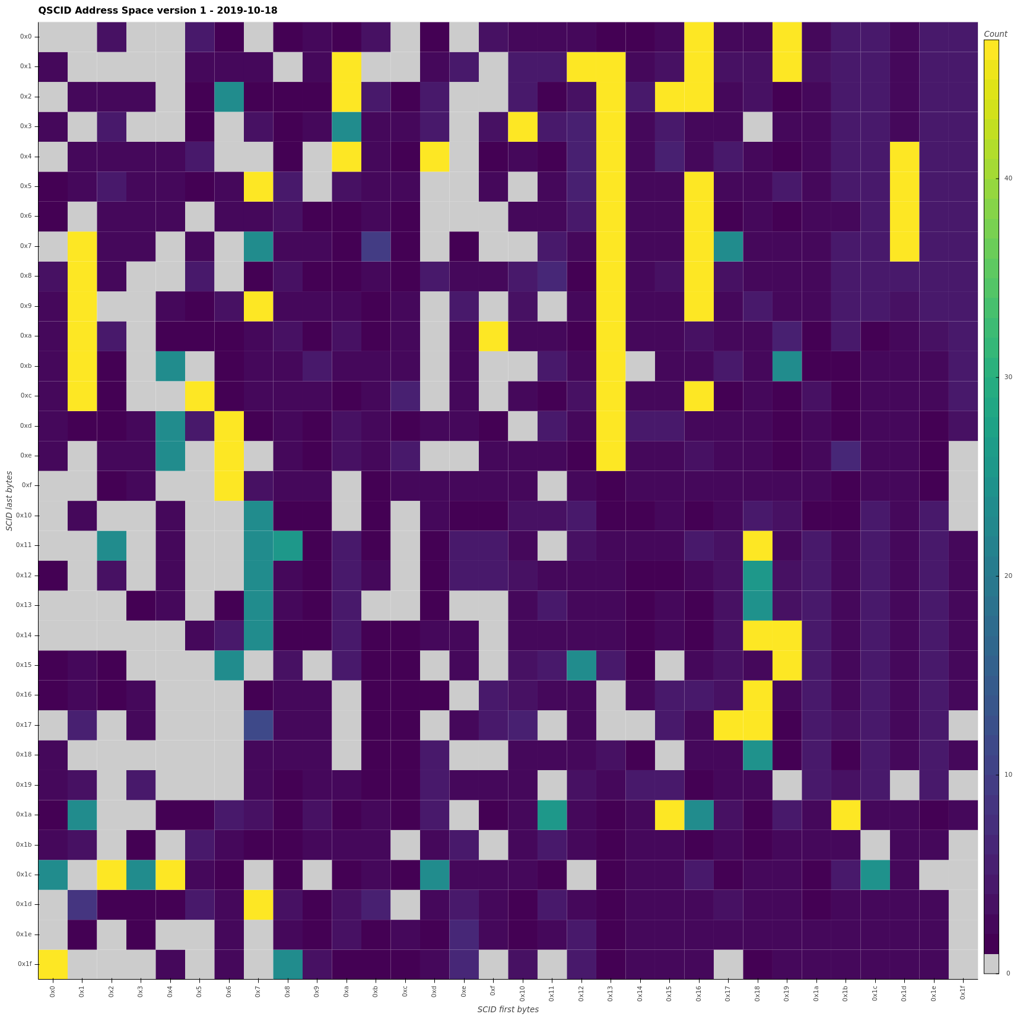
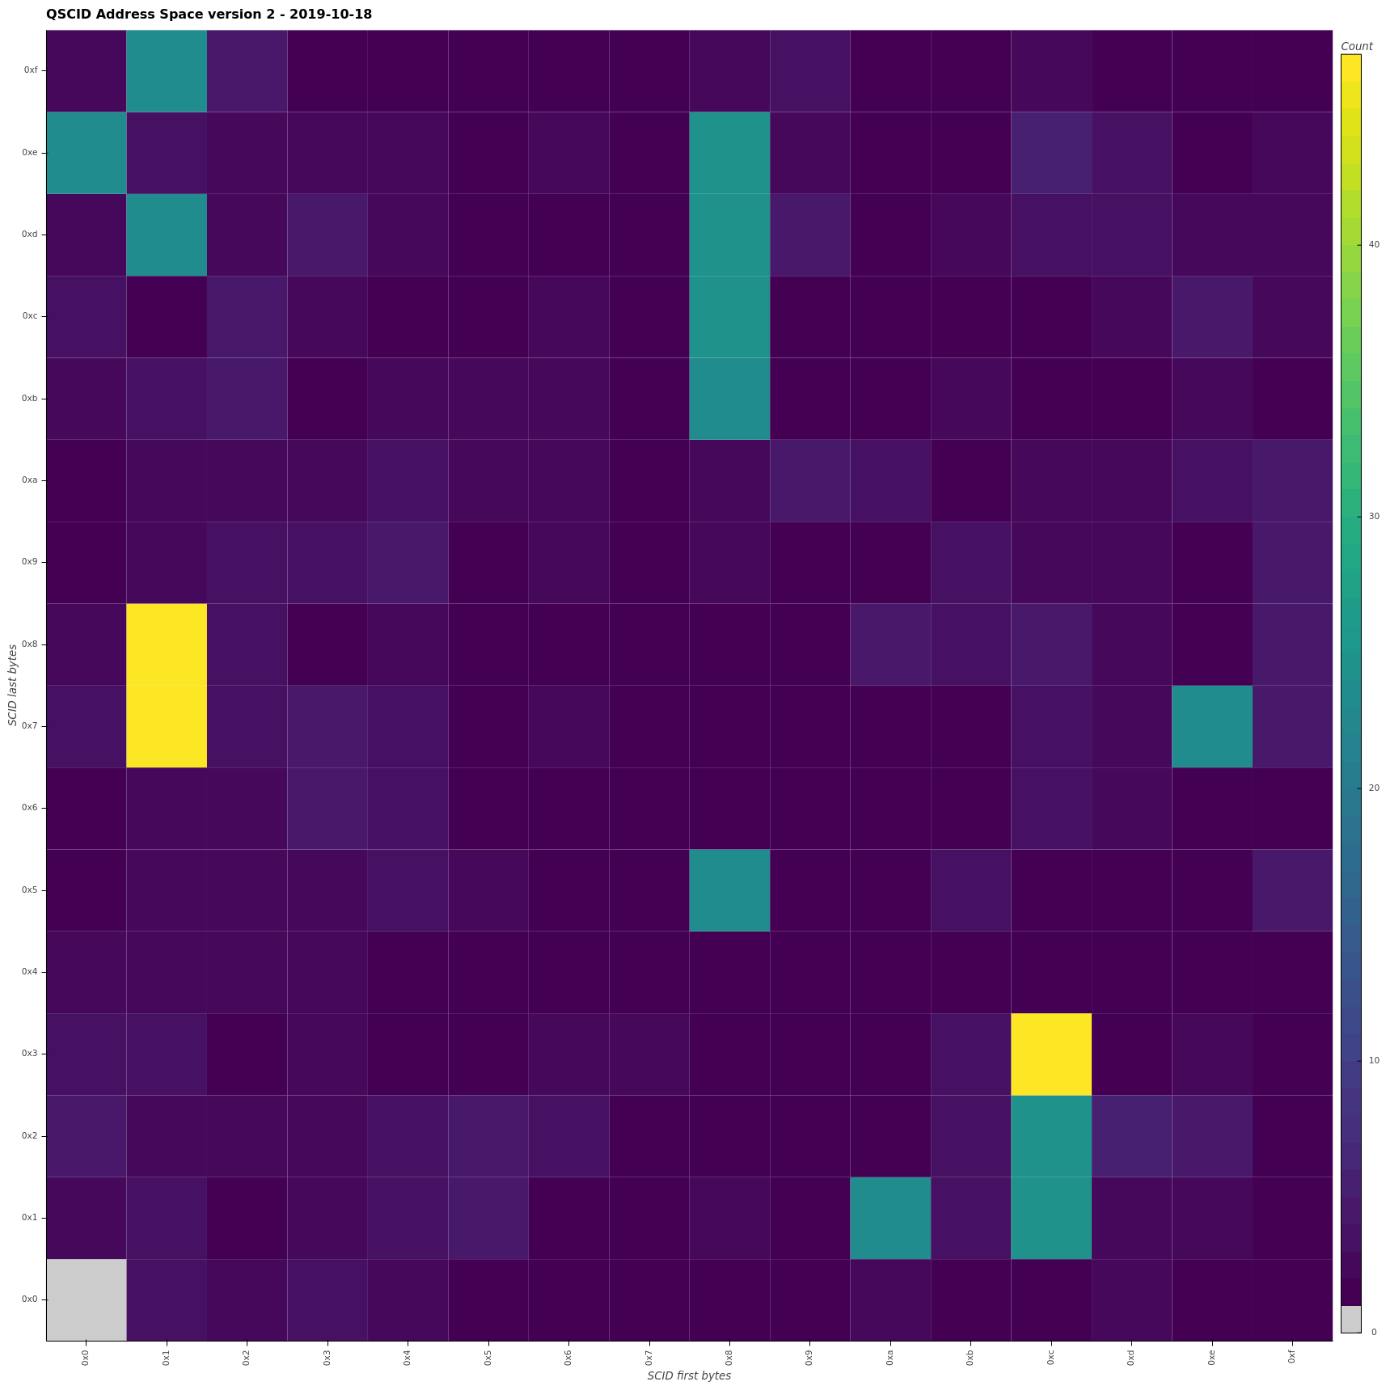
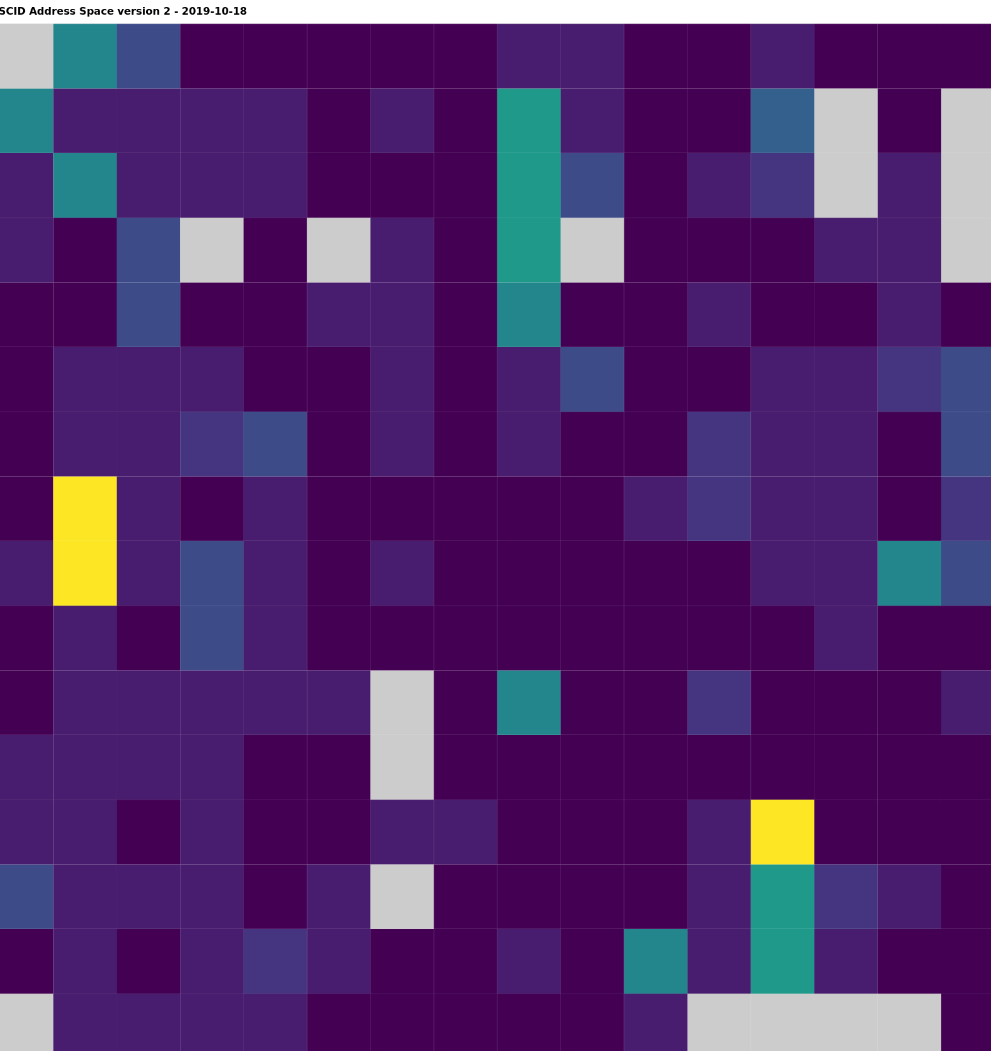
SANA QSCID Assignment view
V1
V2
V2 (S & X only)
Legend
Grey – unassigned
Yellow – all assigned (usually due to unknown frequency bands for a S/C)
Teal green – U/L or D/L assigned (due to uplink or downlink unknown)
Shades of dark blue (assigned in one or more frequency bands, darkest = only 1 band assigned)

Slide 5
Synchronization with CCSDS Secretariat
SANA Databases are now the official reference databases for:
Organizations
Contacts
Missions
CCSDS Secretariat directly updates data in SANA using their login and new interface.
CCSDS Web site fetches data in real time from these SANA registries.
CWE contacts synchronized from Website to SANA for use in access control

Slide 6
Registry Management
Discrepancy with SCID frequency bins
Revision of CCSDS 320.0-M-7 to align frequency bins with ITU and not IEEE
SCID form updated to use new frequency bins
Data migration performed, need AR feedback to update SCIDs (create, approve, delete)
Missing some AR info/wrong AR info
=> need feedback from CCSDS Secretariat
Initial email to ARs was apparently not clear enough, clarification sent
Deadline for feedback from ARs (September 30th) is passed
Status:
25 emails sent
2 did not reach their destination (bad email addresses)
7 clear answers received
2 asking for more time
Need to proceed with answers and send a message to the other agencies telling them we are going to update their data regardless

Slide 7
SANA Upcoming Work
Assist CCSDS working groups to create/modify/enhance registries
Develop mechanisms to allow WG to elect which columns to display, in which order, for their registries
On-line interface / process to allow authorized users (Agency AR) to create/update their registry entries:
SSA
Contacts
Organizations
Interfaces for SCID updates by ARs
Release a SCID
Deny a SCID request
Develop XML schema versioning mechanism
Fix SCIDs/Spacecraft registries data once AR’s reply

Slide 8
SANA Process and Workflow Issues
SANA Process Issues
Recent CESG reviews have revealed confusion in several WG about SANA registry documentation and registration processes
Analyses of SANA Yellow Books, four separate documents including the CCSDS Organization & Processes, Space Assigned Numbers Authority (SANA)—Role, Responsibilities, Policies, and Procedures, and the two newer SANA registry books, revealed some ambiguities, sources of confusion, and lack of one coherent doc where WG needs were covered
Proposal to clarify all of this and update the Procedures for SANA Registry Specification, CCSDS 313.2-Y-1 to provide a single, compact, straightforward, guide for the WGs to follow
SANA Workflow Issues
From the SANA Operator point of view the process we follow does not give them adequate guidance as to when registries change state, from Beta, to Provisional, to Approved.
From the WG and Secretariat point of view, we need to make the timing of registry creation and promotion clearer so that the whole process flows more smoothly

Slide 9
Proposed SANA YB Editorial Changes
CCSDS Organization & Processes, CCSDS A02.1-Y-4
Add a reference to the Procedures for SANA Registry Specification, CCSDS 313.2-Y-1 to the SANA section in this doc
Augment the WG section to make clearer the SANA registry requirements
Augment the CESG review section to document the expectation that checking the SANA Registry status is a part of their review
Augment the publication process section to briefly document SANA registry approval flow
Augment the Agency review section to document the expectation that this is a part of their review
Procedures for SANA Registry Specification, CCSDS 313.2-Y-1
Edit to include all of the relevant guidance that a Working Group needs (specific requirements, process flow, SANA section outline, and new examples)
Keep it as short and succinct as possible
Space Assigned Numbers Authority (SANA)—Role, Responsibilities, Policies, and Procedures, CCSDS 313.0-Y-1
Clean up the process flow from the SANA Operator point of view
Move the details of the required SANA section to the SANA Registry Spec for WG
Point at the SANA Registry Spec for WG as the source of WG guidance and workflow

Slide 10
Proposed Registry Creation / Approval Process
Define registry in White Book before first Agency review
WG: Create registry spec and work details with SANA operator
SANA: Create Beta registry before first RB review
CESG : Verify that Beta registry exists before approving doc for initial review
Update registry as needed prior to final RB review / approval
WG: Work with SANA to make any needed changes to registry
WG: Prior to request for final review / approval to publish notify SANA
SANA: transition registry from Beta to Provisional
CESG : Verify that Provisional registry exists before approving doc for final review
Mark registry as Approved when document is published
Secretariat: Notify SANA to mark registry as Approved once doc is published
SANA: Mark registry and cleared contents as Approved
NOTE: some contents may remain as Provisional until state change is requested by WG

