Slide 1
Operational Interfaces for On-Board Service Management, Protocol Management Information Base (MIB)
Jonathan Wilmot
NASA/GSFC
cFS Software Architect
CCSDS SOIS Area Director
September 05, 2019

Slide 2
Onboard Protocol Operational Interfaces
Conceptual DTN operational interfaces available to onboard applications, crew, and ground operators
Commands: (currently CCSDS Space Packets)
Start/stop BP flow(s) for science, spacecraft engineering, …
Set BP flow size and bandwidth (flow control)
Set BP flow QOS (priority, reliability,…)
Set BP flow time-to-live
Telemetry: (currently CCSDS Space Packets)
Flow state reports (scheduled reports on transmission, storage counters,…)
Command acceptance/rejection counters
Event messages (asynchronous messages for low latency operational data)
PACE mission has created these based on CCSDS SPP formats
CCSDS DTN MIB (next chart)
No Commands defined (example how to change priority at relay node?)
No data types defined
No names defined(?) Put in a BP DOT?
DTN WG members working in IETF seem to be using JSON to define Data Model
DTN WG members working in IETF seem to be defining management protocol (Asynchronous Management Protocol draft-birrane-dtn-amp-05)

Slide 3
Potential Use On Lunar Gateway Program
Gateway is discussing putting DTN applications on both the Power & Power Element (PPE) and Habitat to communicate with landers, rovers, and ground operations
Systems engineering wants a common/standard operational interface to both to be commandable and configurable from onboard and ground operations
A common vehicle management application that can change location (element/module) will control both DTN applications locally or over TTE subnets using SPP as the format for commands and telemetry
It is expected that this same operational interface be used for relay satellites as well

Slide 4
CCSDS BUNDLE PROTOCOL (734.2-B-1) MIB

Slide 5
DTN IPN Service Number SEDS Example
</IntegerDataType>
<IntegerDataType name="IpnServiceNumberInt" interpretation="name" foreignKeyTo="SanaCcsdsCbheServiceNumberRegistry">
<IntegerDataEncoding encoding="unsigned" sizeInBits="64"/>
<Range>
<!--todo: what is the range that IANA has delegated to SANA?-->
<MinMaxRange rangeType="inclusiveMinInclusiveMax" min="0" max="18446744073709551615"/>
</Range>
</IntegerDataType>
<ContainerDataType name="IpnEndpointId">
<EntryList>
<Entry name="nodeNumber" type="IpnNodeNumberInt"/>
<Entry name="serviceNumber" type="IpnServiceNumberInt"/>
</EntryList>
Full example on SOIS Github site
https://github.com/nasa/SOIS-CCSDS-XML
Log in required

Slide 6
Develop one example of mapping/interfacing of one MO service to one board service. JW to propose one on board SOIS service ( e.g one instrument on a subnet, described by EDS’s) , MOIMS and SOIS to develop the relevant mapping example.
SOIS/MOIMS CESG Spring 2019 Action Item

Slide 7
SOIS/MOIMS AI Timeline (1)
From Mario on June 26 - in order to progress with our action from the last CESG meeting, I propose we organise a webex next week. In my opinion, the goal should be to identify concrete examples to be developed off-line where we could better understand: 1. Implications of MO Service on board 2. Relationship between EDS and MO Services (how can we make them compatible and coherent) The webex could take place at 17:00 for about 1h either the 2nd or 3rd or 4th of July
From Jonathan June 27 - Due to the holiday next week, July 2nd is the only available date. What time zone is the suggested 17:00?
The CESG meeting notes state:
Develop one example of mapping/interfacing of one MO service to one board service. JW to propose one on board SOIS service ( e.g one instrument on a subnet, described by EDS’s) , MOIMS and SOIS to develop the relevant mapping example.
After talking with Dan, we thought it would make sense to work through a few different examples to demonstrate mappings
1) MO parameter service mapping to an existing EDS described NASA and/or ESA flight interface
2) MO file service mapping to an existing EDS described NASA and/or ESA flight interface
3) MO service to an existing EDS described instrument or device
The idea would be to show how a MOIMS standard/common operator interface would be mapped to deployed real-time flight software and devices as described by EDSes. Mapping to a deployed system would demonstrate a quick path to allow common operator views across heterogeneous systems.
From Mario, June 30 - we need to cancel the video conference foreseen for Tuesday 2nd July. I guess we will have to postpone it after the summer holidays.

Slide 8
SOIS/MOIMS AI Timeline (2)
From Ramon on July 3 - Hi Mario, Jonathan has assigned work on the following action item from CESG to Richard Melvin and I:
“Develop one example of mapping/interfacing of one MO service to one board service. JW to propose one on board SOIS service ( e.g one instrument on a subnet, described by EDS's) , MOIMS and SOIS to develop the relevant mapping example.)" The work item should include commanding as well as an interface to the MOIMS parameter service.
Richard and I are thinking that the OPSSAT project is a likely place for this work. Richard already is funded to work on OPSSAT.
Can you identify a person in MOIMS who can work with us on this project?
From Mario on July 9 - Dear Ramon, thanks for your email. It is school holiday time here. Meharn will contact you as soon as possible
From Ramon August 6 ⁻Hi Mario and Mehran, I hope the your holidays are pleasant. We just concluded a teleconference for SOIS in which OPSSAT was one of the topics. Richard has written an EDS description of the interface for the iADCS instrument on OPSSAT. We are ready to coordinate the interface with MO services for commanding and parameters.
As of Sept 5 no further response from Mario or Meharn
SOIS Area still proposes
MO parameter service mapping to an existing EDS described NASA and/or ESA flight interface
MO file service mapping to an existing EDS described NASA and/or ESA flight interface
MO service to an existing EDS described instrument or device

Slide 9
Space Packet Protocol Secondary Header Registration in SANA

Slide 10
SPP Secondary Header Extension
SSP secondary header extension first proposed to SLS Area at CCSDS spring meeting 2015 for inclusion in SPP Blue book
Discussions held with SLS Area at subsequent meeting
SOIS Area proposed secondary header is in use for Lunar Gateway program and other NASA missions
Spring 2018 SLS Area conclusion stated by SLS AD – Secondary headers are mission/architecture specific and should not be in SPP Blue Book
SOIS AD response – We now have two widely used secondary headers that are not CCSDS and cannot be machine parsed without a priori knowledge of the source (spacecraft). Applications do not see the AOS frame and do not know the source system
SEA AD proposed registering secondary headers in SANA and having SPP Blue Book reference SANA
Concurrence from SOIS and SLS areas
SOIS Area in process of creating SANA registry
There is still no standard way on Lunar Gateway type missions to determine which secondary header in is use for SPP packets (cFS ≠ PUS)

Slide 11
What Problem am I trying to Solve? In a standard way
ACS sensor data created on habitat
ACS sensor data
read on Orion
Orion applications need to know the data format and what system the data came from:
Habitat.GNC.sensorData
Both cFS and PUS secondary headers solve this but in architecture specific ways

Slide 12
PUS-C Secondary Headers
Telecommand
Version = 2
Telemetry
Version = 2

Slide 13
Proposed Updates to CCSDS SPP

Slide 14
Onboard Services Operational Interfaces

Slide 15
Onboard Operational Interfaces
Most (all) on-board applications and protocol implementations have a operational interface allowing configuration, control and management of that application or protocol
These interfaces allow ground operators and/or on-board procedures to:
Turn functions on/off, set modes, …
Change a Attitude and Orbit Control System (AOCS) scale factor, monitor limit or response action
Load or modify flight software, configure the telemetry downlink,…
Configure protocols such as CCSDS CFDP, DTN, USLP,…
The interface applications run in the context of a real-time system and must:
Limit the real-time resource use in major/minor frames of the schedule
Avoid impacting hard real-time software functions
Minimize and limit memory use
Have constraints such that the operator cannot damage the system
Be scheduled and access protected to ensure atomic change to any request as needed

Slide 16
Mission Need for Common Operational Interfaces
Missions with heterogeneous systems provided by international partners require common operational interfaces for common services outside of CCSDS defined protocols and MIBs. (examples ISS, Lunar Gateway)
NASA, ESA, and other agencies have existing standards
SOIS Area is working to develop EDSs specifying these interfaces for Lunar Gateway
If Lunar Gateway retains/enforces Program Level 2 requirement for NASA cFS framework these interfaces will be cFS and described in a SEDS
Common interest for SOIS and MOIMS Areas
Is there a mapping of MOIMS services to cFS services as defined in a SEDS?
Is there a mapping of MOIMS services to ECSS PUS services as defines in a SEDS?

Slide 17
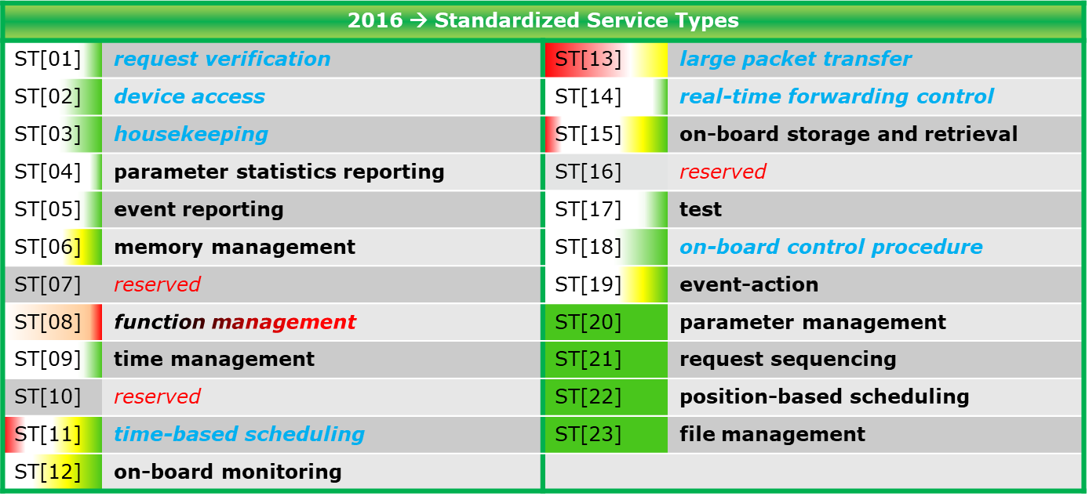
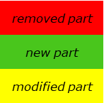
Onboard Services PUS-C

Slide 18
Onboard Services - NASA cFS
Executive – Application startup, load/unload, restart, processor affinity, priority, stack sizes, MIB reporting
Table – Application configuration, scale factors, load/dump, storage
Message Exchange – MIB reporting and setting
Time – Setting, source selection, diagnostics, reporting
Event Handler – Asynchronous message filtering, logging, and forwarding
Health and Safety – Application and performance monitoring
Housekeeping – Telemetry parameter repacking
Data storage/recorder - Packet store
TC/TM storage/playback – Time based recorder for scenario replay
File Manager – delete, copy, rename, create directory …
File transfer manager (local and remote) CFDP, TFTP, front end for queuing, prioritization …

Slide 19
Typical NASA On-Board Managed Services
Memory Dwell – generate periodic TM for any set of memory or I/O
Memory manager – Load/dump, peek, poke any memory or I/O location
Stored command sequencer – Absolute and relative TC executive
Telemetry monitor – Monitors telemetry parameters and initiates actions
Data integrity – checks integrity of selected memory locations and data structures
Telemetry output – Gathers, filters, queues, prioritizes, … TM packets
Command uplink – Validates and forwards commands to applications
Memory scrubbing – Radiation effects mitigating for memories
Performance reporting – Processor and resource utilization reporting
NOOP/Ping application request verification pattern (pseudo service)
Device Access (pseudo service) implemented via device apps

Slide 20
Detailed Example: cFE Event Handler Service
Management interfaces
Ping event service (a no-op command that responds, verifying function execution, command/response path. supported by all cFS applications)
Enable/disable reporting of individual message classes (Critical, debug, informational, error)
Enable/disable reporting format(short for low bandwidth utilization or normal)
Enable/disable an individual application’s event reporting (all or by class)
Reset an application’s message counter(s) (all or an individual counter)
Set an applications message filter
Enable/disable reporting “ports” ( ports are mission defined paths to send messages to serial, spacewire, software message bus…
Add/remove an application’s filter
Write local event log to a file (file name) File will then be transferred CFDP/TFTP
Clear the local log
These interfaces all have missions operations counterparts that are mature Class B/A with years of multi-mission heritage

Slide 21
Event Service (cFE)
Onboard application interfaces
Register an applications (filter table, number of filters, filter algorithm type)
Unregister that application (void)
Clean Up App called on app exit (if app dies, cFE fault management will call this)
Send event message (event ID, type, string specification)
cFE inserts who called service, and time
There are variations of this to insert a different application identifier and/or time,…
Reset caller’s filter counter (event ID)
Reset all caller’s counters
The management application calls some of these software architecture specific APIs

Slide 22
CCSDS Service Interface Specification
NASA cFS software framework has defined many cFS operational interfaces in SOIS EDSs
Defining formats, protocols and interaction patterns
ECSS PUS has defined formats, protocols and interaction patterns in paper documents
Level 2 requirement for Lunar Gateway and Lander programs call out machine readable interface definitions using SOIS EDS
Proposal to have working groups define CCSDS MIBs with operational commands, telemetry and configuration data structures using SOIS SEDS and DOT
SEDs and DOTs would be registered in SANA

Slide 23
Acronyms

