Slide 1
DAI Architecture Analysis
SEA System Architecture WG
Peter Shames NASA / JPL
Roger Thompson ESA

Slide 2
Motivation
Analysis of DAI White Paper requested by CESG Chair
Assumption is that this is an initial, very abstract, architecture concept and not yet focused on implementation details
Analyze the proposed architecture and work plan
Identify any issues and provide feedback
Intent is to improve the White Paper and to assist the WG in refining their vision

Slide 3
Contents of this Presentation
Analysis of “Standardized Archive System Architecture”
Considerations / rationale that drive observations and suggested alternative approaches
Identified issues / questions
Alternative representation that deals with these issues
Analysis of “More Detailed Draft Concept”
Identified issues / questions
Alternative representations that deal with these issues (architecture separated from information model)
Discussion of deployment / implementation considerations
Three abstract deployment options
Two proposed abstract protocol stacks
Discussion of existing, relevant, CCSDS approaches
MO and RASIM

Slide 4
Considerations / Rationale for Alternative approach
Different user communities (astronomy, planetary, library, etc) have very different models of interaction with their data
Astronomy wants RA/DEC, and catalogs of different kinds of objects like pulsars, galaxies, etc
Planetary wants catalogs of bodies, atmospheres, rings, asteroids, etc
Libraries want books, collections, digital images, sounds, etc
Most of these communities have well established (distributed) archive services that are already tuned for their communities
Different user communities have very different kinds of data objects and new missions / uses within those communities will evolve / expand those data types
See above. Both the objects, and the kinds of queries differ.
It’s not clear that integrating across these communities will be seen to have broad value.
The fundamental data services interfaces (put, get, verify, manipulate, filter) and common support functions (registry, repository, data store, data producer) should be able to be defined in common, if their interfaces can be adapted using customized, community and data specific information models
Information models can be used to formulate (and adapt) user front end experience
Web site / query interfaces may need to be further customized for the community
Different levels of secure access can / should be available at service interfaces

Slide 5
Considerations / Rationale for Alternative approach, cont
Adoption of a modularized set of service objects with well designed interfaces should allow these to be customized, configured, and distributed as need be
Registry, repository, data store, data producer may all be distributed
Some may be at user nodes, some at domain nodes, some even at central / community nodes
Isolation of the specific archive service adapter within the nodes offering access to local archives removes the N**2 problem
Allocating the responsibility for dealing with local archive interface issues down to the archive itself simplifies the overall design
Using common services and protocols across the domains simplifies the overall design
Use of a common data representation, potentially XML (or JSON, or whatever, pick one) and a common protocol for messages, such as HTTP(S)/REST and TCP/IP, adopts familiar and well supported paradigms and simplifies the protocol stack
Use of a single protocol stack and common service messages simplifies the overall design and avoids complicated protocol matching / mapping strategies
Adaptation of the message content, driven by the info models, allows customization for domains and data sets
Use of common, well supported, Internet protocols simplifies the overall deployment model, supports distribution and integration, and it can also be used to apply another layer of security (HTTPS) or even message authentication and/or encryption

Slide 6
Standardized Archive System Architecture
PAIS – Producer Archive Interface Specification
PAIP – Producer Archive Interface Protocol
CAIS – Consumer Archive Interface Spec
CAIP – Consumer Archive Interface Protocol
AAL – Archive Abstraction Layer
ADD – Archive Description Document
Producer Archive
Application
Consumer Archive
Application
PAIS
PAIP
CAIS
CAIP
Producer Archive I/F
Consumer Archive I/F
AAL
Doesn’t bind to message
/comm systems, rather
Archive application layer
functions
Archive Abstraction Layer
ADD
Science
Data
Binding
Enterprise Data
Binding
Mission
Housekeeping
Binding
Doc/PDF
Binding
Multiple Future
Bindings/plugins
For many various
Archive types.
Including vendor-
unique archives
or datastores.
Science Data
Archive I/F
Enterprise Data
Archive I/F
Mission
Housekeeping
Archive I/F
Doc/PDF
Archive I/F
ARCHIVE -- Long-term Data Preservation Archive (w/ Archive Information Packages, etc.)

Slide 7
Questions about “Standardized Archive System Architecture” diagram
From top down:
The relationship of existing DAI data artifacts, AIP, SIP, DIP to this model is unclear.
The approach does not appear to make allowance for different community / domain info models, query models, or interaction models., either at the top (query interfaces) or at the bottom (archive interfaces).
The nature of the interfaces between these “layers” are not clear: are they API calls or protocols, are they formalized or internal to applications?
The operations (functions), data objects, and the transformations associated with each of these layers is unclear.
The nature of the bottom layer “archive bindings” is unclear. Are these local to the use, or to some server, or distributed at the archives? These could be simple (archive already is compliant with OAIS / PAIS) or very complex (archive has its own well developed and really different distributed system architecture).
The identified archive types and architectures are not distinct. What makes an “Enterprise” archive different from a Doc/PDF archive? Suggest using distinct science domains to make this clearer.

Slide 8
Notes on Alternative “Archive System Architecture” diagram
Edited a version of the initial “Archive System Architecture” diagram to make some of the identified issues clearer.
Added domain specific archives and showed how their interfaces could appear at the top and the bottom.
Added notations about the role of AIP, SIP, DIP.
Added annotations about the operations associated with each layer.
Separate diagrams later in this package show the implications of alternative deployment / implementation choices.

Slide 9
Alternative Standardized Archive System Architecture
PAIS – Producer Archive Interface Specification
PAIP – Producer Archive Interface Protocol
CAIS – Consumer Archive Interface Spec
CAIP – Consumer Archive Interface Protocol
AAL – Archive Abstraction Layer
ADD – Archive Description Document
Producer Archive
Application
Consumer Archive
Application
Show roles of AIP, SIP, DIP
Show domain specific query interfaces
SIP
DIP
PAIS
PAIP
CAIS
CAIP
Producer Archive I/F
Consumer Archive I/F
Access, submit, response I/F
Access, query, response I/F
AAL
Doesn’t bind to message
/comm systems, rather
Archive application layer
functions
SIP, DIP & AIP
Archive Abstraction Layer
Query and AIP. SIP, DIP validation, transformation, processing
AIP => PSData
AIP => ESData
AIP => AData
ADD
Planetary Science
Data
Binding
Earth Science Data
Binding
Mission
Housekeeping
Binding
Astronomy
Data
Binding
AAL interface & function translations to domain specific interfaces & functions
Multiple Future
Bindings/plugins
For many various
Archive types.
Including domain
unique archives
or datastores.
Planetary Science Data
Archive I/F
Earth Science Data
Archive I/F
Mission
Housekeeping
Archive I/F
Astronomy Data
Archive I/F
PSD Archive
ESD Archive
MHK Archive
AD Archive
ARCHIVE(s) -- Long-term Data Preservation Archives (w/ Archive Information Packages, etc.)

Slide 10
More Detailed Draft Concept - Standardized Archive System Architecture
Protocol view
Archive Consumer Application
Archive Producer Application
Archive Consumer
Application
Archive Producer I/F
Archive Consumer I/F
User Systems
Archive Abstraction Layer
Archive Abstraction Layer
Archive
Common Calls
Doc/PDF
Binding
Web/HTML
Binding
Enterprise Data
Binding
Science Data
Binding
Other TBD
Bindings
Archive
Common Calls
Doc/PDF
Binding
Web/HTML
Binding
Enterprise Data
Binding
Science Data
Binding
Other TBD
Bindings
Communications Layers
Communications Layers
Archive
Common Calls
Doc/PDF
Web/HTML
Enterprise
Science
Other
Archive
Common Calls
Doc/PDF
Web/HTML
Enterprise
Science
Other
Archive
Common Calls
Doc/PDF
Web/HTML
Enterprise
Science
Other
Archive
Common Calls
Doc/PDF
Web/HTML
Enterprise
Science
Other
Representation Information
Data
Representation Information
Data
Object layer
Preservation
Description Info
Preservation
Description Info
Context Info
Reference Info
Fixity Info
Access Rights Info
Archive Systems
Object layer
Context Info
Reference Info
Fixity Info
Access Rights Info
Semantic layer
Provenance Info
Provenance Info
Semantic layer
Structure layer
Structure layer
Bit layer
Bit layer
Archive Information Package Interface Layer
Archive
Preservation activities/processes

Slide 11
Notes on “Detailed Draft Concept” diagram
What are the functions of the Archive Producer / Consumer I/Fs? How are these adapted to different domains and user community expectations?
What are the functions of the Archive Abstraction Layer? How does it integrate all of these parts and support heterogeneous archives?
Why are “doc”, “web”, “enterprise data”, “science data” all part of the Archive Abstraction Layer? Aren’t “docs” and “science data” just different kinds of content? Isn’t “web” really a protocol binding? Why is “enterprise” a special case, can’t libraries and science archives use enterprise technologies? What makes these different?
What is in the Communications Layers? What services does it (they) provide? Why is it plural?
Why are Representation Information, Data, and Preservation Description Info shown as a layer under the Communications Layers? Aren’t these just the descriptions of primary data objects (AIP, SIP, DIP) that exist at the Archive Layer, or even in the the Producer & Consumer?
What is the Archive Information Package Interface Layer and why is it on top of the Archive Layer and under the Communications Layers? Isn’t this just the definitions of the AIP, DIP, and SIP? If so, these are information specs, i.e. content, and not a protocol layer. Aren’t they most likely produced within the Archive Producer / Consumer I/Fs?

Slide 12
Alternative Detailed Draft Concept - Standardized Archive System Architecture
Protocol view
User Systems
Archive Consumer Application
Archive Producer Application
Archive Consumer
Application
Configured to use:
AIP, SIP, DIP Specifications
Science and other Archive Domain
Interface Specifications
Data Specification
Query specifications
Product specification
Archive Producer I/F
Archive Consumer I/F
Archive Abstraction Layer
Archive Abstraction Layer
Archive
Common Calls
Astronomy
Binding
Planetary
Binding
Earth Science
Binding
HousekeepingData
Binding
Other TBD
Bindings
Archive
Common Calls
Doc/PDF
Binding
Web/HTML
Binding
Enterprise Data
Binding
Science Data
Binding
Other TBD
Bindings
Communications Layers
Communications Layers
Archive
Common Calls
Doc/PDF
Web/HTML
Enterprise
Science
Other
Archive Interface
Archive
Preservation activities/processes

Slide 13
Alternative Detailed Draft Concept - Standardized Archive System Architecture
Information view
Archive Information Specs
Archive
Common Calls
Doc/PDF
Web/HTML
Enterprise
Science
Other
Archive
Common Calls
Doc/PDF
Web/HTML
Enterprise
Science
Other
Archive
Common Calls
Doc/PDF
Web/HTML
Enterprise
Science
Other
Archive
Common Calls
Doc/PDF
Web/HTML
Enterprise
Science
Other
Representation Information
Data
Representation Information
Data
Object layer
Preservation
Description Info
Preservation
Description Info
Context Info
Reference Info
Fixity Info
Access Rights Info
AIP, SIP, DIP
Specifications
Object layer
Context Info
Reference Info
Fixity Info
Access Rights Info
Semantic layer
Provenance Info
Provenance Info
Semantic layer
Structure layer
Structure layer
Bit layer
Bit layer
Info Specs for Science and other Archive Domains
Interface Specifications (for each archive)
Data Specifications (for data types)
Query specifications (for domains)
Product specifications (for archive processing)

Slide 14
Implementation Architecture / Deployment Options
There are many possible implementation architectures. In order to see the impacts of certain choices this will explore just three:
Option 1: “Fat Client” where the query interface, producer / consumer interface, Archive Abstraction Layer, and each domain archive binding is implemented in each client. Access to the archives uses archive specific “bespoke” interfaces.
Option 2: Distributed archive with common protocol, where the client implements the query interface, producer / consumer interface, and the interface to the Archive Abstraction Layer, and each archive implements the Archive Abstraction Layer and creates a local binding to their bespoke archive interfaces.
Option 3: (shown separately) A distributed archive with common protocol (variant on option 2) where the query interface, producer / consumer interface, the interface to the Archive Abstraction Layer are implemented as distributed, or centralized, services. The client is just a web interface to these services. Local bespoke archive bindings are as in Option 2, local to the archives.
The following diagram overlays Options 1 (LH) & 2 (RH) on the Alternative Standardized Archive System Architecture diagram. Option 3 reduces the User client on the diagram to just the “Consumer and Producer Archive Application“ implemented as web pages.

Slide 15
Alternative Standardized Archive System Architecture Deployment Options (1 And 2)
PAIS – Producer Archive Interface Specification
PAIP – Producer Archive Interface Protocol
CAIS – Consumer Archive Interface Spec
CAIP – Consumer Archive Interface Protocol
AAL – Archive Abstraction Layer
ADD – Archive Description Document
LHS is Option 1
RHS is Option 2
Producer Archive
Application
Consumer Archive
Application
SIP
DIP
PAIS
PAIP
CAIS
CAIP
Producer Archive I/F
Consumer Archive I/F
Access, submit, response I/F
Access, query, response I/F
AAL
Doesn’t bind to message
/comm systems, rather
Archive application layer
functions
SIP, DIP & AIP
Archive Abstraction Layer
Query and AIP. SIP, DIP validation, transformation, processing
AIP => PSData
AIP => ESData
AIP => AData
ADD
Planetary Science
Data
Binding
Earth Science Data
Binding
Mission
Housekeeping
Binding
Astronomy
Data
Binding
AAL interface & function translations to domain specific interfaces & functions
Multiple Future
Bindings/plugins
For many various
Archive types.
Including domain
unique archives
or datastores.
Planetary Science Data
Archive I/F
Earth Science Data
Archive I/F
Mission
Housekeeping
Archive I/F
Astronomy Data
Archive I/F
PSD Archive
ESD Archive
MHK Archive
AD Archive
ARCHIVE(s) -- Long-term Data Preservation Archives (w/ Archive Information Packages, etc.)

Slide 16
Alternative Standardized Archive System Architecture Deployment Option (3)
PAIS – Producer Archive Interface Specification
PAIP – Producer Archive Interface Protocol
CAIS – Consumer Archive Interface Spec
CAIP – Consumer Archive Interface Protocol
AAL – Archive Abstraction Layer
ADD – Archive Description Document
Option 3 is web HTTP interfaces &
Distributed services
Producer Archive
“Application” (web browser)
Consumer Archive
“Application” (web browser)
SIP
DIP
PAIS
PAIP
CAIS
CAIP
Producer Archive I/F
Consumer Archive I/F
Access, submit, response I/F
Access, query, response I/F
AAL
Doesn’t bind to message
/comm systems, rather
Archive application layer
functions
SIP, DIP & AIP
Archive Abstraction Layer
Query and AIP. SIP, DIP validation, transformation, processing
AIP => PSData
AIP => ESData
AIP => AData
ADD
Planetary Science
Data
Binding
Earth Science Data
Binding
Mission
Housekeeping
Binding
Astronomy
Data
Binding
AAL interface & function translations to domain specific interfaces & functions
Multiple Future
Bindings/plugins
For many various
Archive types.
Including domain
unique archives
or datastores.
Planetary Science Data
Archive I/F
Earth Science Data
Archive I/F
Mission
Housekeeping
Archive I/F
Astronomy Data
Archive I/F
PSD Archive
ESD Archive
MHK Archive
AD Archive
ARCHIVE(s) -- Long-term Data Preservation Archives (w/ Archive Information Packages, etc.)

Slide 17
Options for Binding to a Distributed Archive
The following diagrams have been produced in the context of the System Architecture WG’s current reference architecture activity covering MOIMS and SOIS. They attempt to represent different approaches for constructing the Archive Abstraction Layer (AAL) and bindings to existing Archive Systems:
Option 1: Binding is via an API to an existing Archive Interface built into the Producer or Consumer Application housed in each “fat” client. There is no separate distributed communications protocol at the AAL aside from whatever each Archive defines.
Option 2: Binding between AAL and Archive Interface is performed at each Archive. The AAL includes a communications protocol to enable distributed access from Producer and Consumer (and possibly other) nodes using “thinner” clients.
Option 3: uses the Option 2 style bindings, but takes advantage of protocol interfaces to permit distribution of servers and flexible / hierarchical assignment of relationships among them.
The Options correspond to those on the previous slides.
DAI should clarify which of these Options (or others) are intended to be within the scope of the proposed activities.

Slide 18
MOIMS Data Archive Protocol Stack
DAI Compliant Services
MOIMS
Archive Producer
MOIMS
Archive Consumer
PAIS
CAIS
AAL
Archive Binding
Archive Interface
ARCHIVE
AAL: Archive Abstraction Layer
PAIS: Producer Archive Interface Service
CAIS: Consumer Archive Interface Service
ARCHIVE: may be a Science Data Archive, Enterprise Data Archive, Mission Operations Data Archive, Document Archive
Archive Interface: any legacy or proprietary interface to a Data Archive

Slide 19
Data Archive Deployment (Option 1)
Producer Node
Data Archive
Consumer Node
MOIMS
Archive Producer
MOIMS
Archive Consumer
PAIS
CAIS
AAL
AAL
Archive Binding
Archive Binding
Archive Interface
Archive Interface
Archive Interface
ARCHIVE
[Science, Enterprise, Operations or Document]
Archive Producer, Data Archive and Archive Consumer may be distributed over separate nodes
Binding is to existing legacy or proprietary Archive Interfaces at the user side
Communications layers are encapsulated within the bespoke Archive Interface and may be available within the Producer and Consumer Nodes (no commonality at that point)

Slide 20
Data Archive Deployment (Option 2)
Producer Node
Data Archive
Consumer Node
MOIMS
Archive Producer
MOIMS
Archive Consumer
PAIS
CAIS
AAL
AAL
AAL
Archive Binding
Archive Interface
ARCHIVE
[Science, Enterprise, Operations or Document]
Archive Producer, Data Archive and Archive Consumer may be distributed over separate nodes
Binding is to existing legacy or proprietary Archive Interface, at the Data Archive Nodes
Distributed Communications are managed within the Archive Abstraction Layer using a standardised communications protocol (technology and protocol stack TBD).

Slide 21
Existing Relevant CCSDS Standards
MO COM Archive Service: This may be applicable in the context of Mission Operations History (Operations Archives). If a long-term Data Archive including Preservation Data is to include “Mission Housekeeping (HK)” data this should be considered.
Uses MO Common Object Model
Defines simple archive service interface suitable for HK data
Reference Architecture for Space Information Management (RASIM): Developed jointly by the SEA IA WG and the MOIMS IPR WG.
Defines relevant functional objects for archives: query service object, registry service object, repository service object, product service object, archive service object
Defines information and data objects
Defines patterns of use for these objects and their interconnections
Services may be distributed and connected as needed

Slide 22
RASIM Functions in Context

Slide 23
Alternative Standardized Archive System Architecture RASIM Service Object Overlay
PAIS – Producer Archive Interface Specification
PAIP – Producer Archive Interface Protocol
CAIS – Consumer Archive Interface Spec
CAIP – Consumer Archive Interface Protocol
AAL – Archive Abstraction Layer
ADD – Archive Description Document
Producer Archive
Application
Consumer Archive
Application
SIP
DIP
PAIS
PAIP
CAIS
CAIP
RASIM Query Service
RASIM Query Service
Producer Archive I/F
Consumer Archive I/F
Access, submit, response I/F
Access, query, response I/F
AAL
Doesn’t bind to message
/comm systems, rather
Archive application layer
functions
RASIM Registry Service
SIP, DIP & AIP
RASIM Repository Service
RASIM Product Service
Archive Abstraction Layer
Query and AIP. SIP, DIP validation, transformation, processing
AIP => PSData
AIP => ESData
AIP => AData
ADD
Planetary Science
Data
Binding
Earth Science Data
Binding
Mission
Housekeeping
Binding
Astronomy
Data
Binding
RASIM Archive Service
AAL interface & function translations to domain specific interfaces & functions
Multiple Future
Bindings/plugins
For many various
Archive types.
Including domain
unique archives
or datastores.
Planetary Science Data
Archive I/F
Earth Science Data
Archive I/F
Mission
Housekeeping
Archive I/F
Astronomy Data
Archive I/F
PSD Archive
ESD Archive
MHK Archive
AD Archive
ARCHIVE(s) -- Long-term Data Preservation Archives (w/ Archive Information Packages, etc.)

Slide 24
Summary of SEA SAWG Analysis
The DAI has identified an ambitious plan to develop a broadly applicable archive framework.
The architecture is expected support the needs of a much larger community than just the CCSDS space agencies.
With resources provided by the much larger community.
But insuring a framework and space-specific capabilities that are tuned to the requirements of the CCSDS space agencies.
“Core” portions of the architecture will support all disciplines.
The concept intends to leverage one or more abstraction layers for modularity and interoperability with plugins for specific communities and data types, but what these might be and how they might work is unclear.
It is not clear if this is intended to be one integrated architecture framework for all identified disciplines or a re-usable framework that can be adapted to different disciplines. These are very different in scope, and would affect the overall architecture.
This overall concept is an interesting one and it may well have value to CCSDS and space data users, but it needs considerable work, even at the conceptual / abstract architecture level before it should be initiated.
Even at this conceptual architecture level due consideration should be given to analysis of the implications of deployment choices and their feasibility and functionality.
In the interest of scoping this effort at an achievable level with available resources, due consideration should be given to leveraging existing approaches and simplifying the architecture as much as is possible.
There are many open questions raised in this analysis, all of which should be addressed in a White Paper accompanying the usual request for a WG charter change.

Slide 25
BACKUP

Slide 26
RASIM Service / Information Object relationships

Slide 27
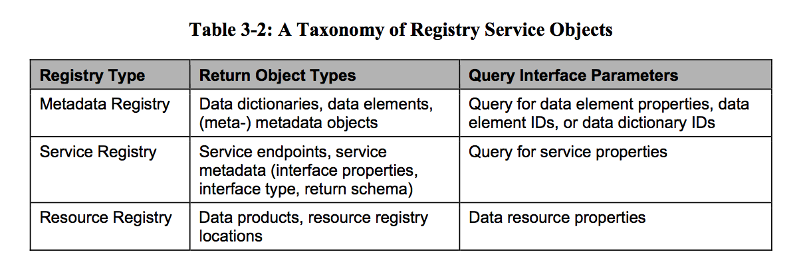
RASIM Registry Service Object

Slide 28
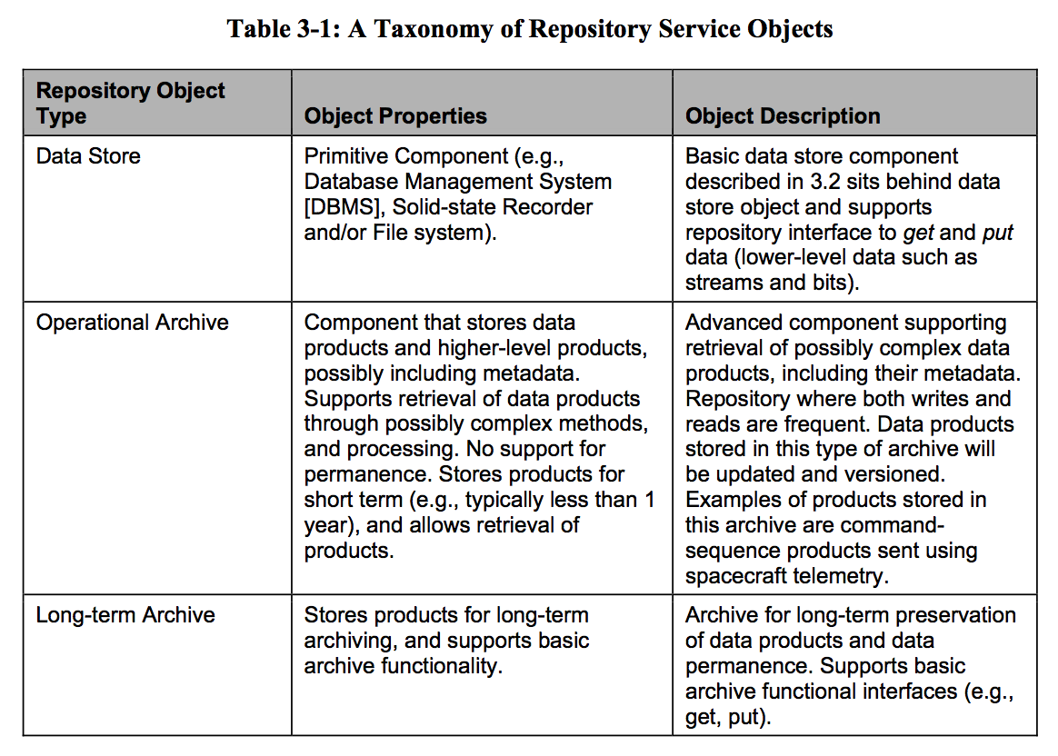
RASIM Repository Service Object

Slide 29
PDS4 Service Deployment (example of RASIM style archive services)

