Slide 1

CCSDS Engineering Steering Group (CESG):
report to the
CCSDS Management Council (CMC)
concerning the Spring 2016 Technical Plenary
Joint CMC-CESG Meeting
INPE Sao Jose dos Campos, Brasil
Hosted by INPE
26 April 2016

Slide 2
CESG Spring 2016:
CCSDS Overview

Slide 3
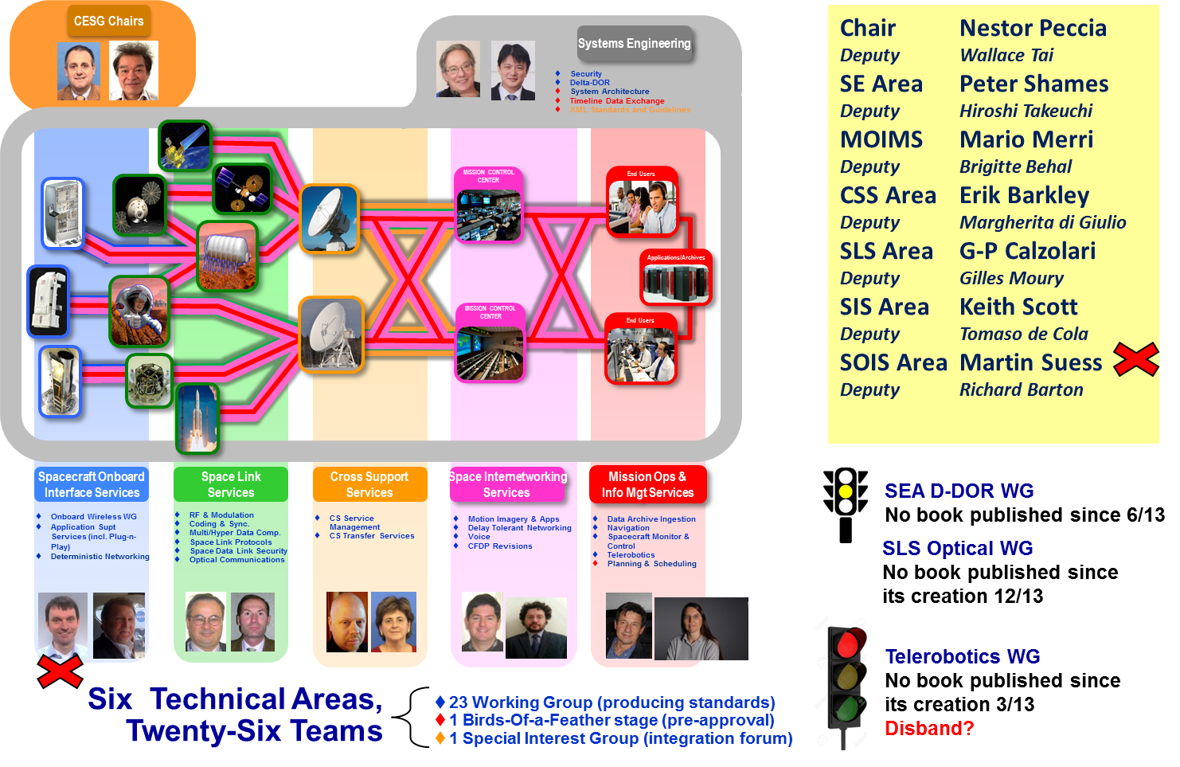
CESG Organization + E2E Overview
Notes:
3

Slide 4
CCSDS Overview
Active Publications
Currently Active Publications: 150 Normative (Blue & Magenta): 92
Informative (Green): 58
Downloadable for free from www.ccsds.org
All major pubs since 1982: ~336
(Some were historical mission needs
or superseded technology)
782 space missions have adopted and used various CCSDS standards

Slide 5
CMC / CESG Poll Statistics
CMC Polls
  Publication
    MOIMS NAV Data Messages Overview
    SEA SEC Threats against Space Missions
    SLS MHDC Lossless Multispectral and Hyperspectral Image Compression
    CCSDS Procedures & Organization (Corrigendum)
  Agency Review
    MOIMS NAV Pointing Request Message
    SIS MIA Digital Motion Imagery
    SLS RFM Systems Part 1 Earth Stations and Spacecraft
  Approval of SEA SEC, CSS SM, SOIS WIR, SIS MIA and SIS Voice new Projects
  Approval of CSS SM WG Trajectory Prediction Project termination
  Approval of SANA action to recover SCID assigned to Simulators
  Authorisation to liaise between CCSDS (MOIMS DAI WG) and CASCO (Committee on Conformity Assessment)
  SEA System Architecture WGs
  12 on-going polls
CMC Poll on Project Approval
Resources for Editor, Prototype 1 and 2 are a must

Slide 6
CMC / CESG Poll Statistics
CESG Polls, not through CMC Poll yet
  Publication
    SANA Registry Management Policy
    Procedures for SANA Registry Specification
    SANA – Role, Responsibilities, Policies and Procedures
  Retirement
    Encryption Algorithm Trade Survey
    Authentication / Integrity Algorithm Issues Survey
  Re-Confirmation
    SLS COP-1
    SCPS-TP
    SEA RASDS
  Creation of SOIS Sub-network Working Group
  Nomination of new
    SLS C&S WG Deputy Chair (K. Andrews NASA/JPL),
    SEA SA WG Chair (P. Shames NASA/JPL)
    SEA SEC WG Deputy Chair (D. Fischer ESA)
    MOIMS P&S WG Chair (M. Sarkarati ESA) and Deputy Chair (S. Chien NASA/ JPL)
    SOIS Subnet WG Chair (G. Rakow – NASA) and Deputy Chair (M. Rovatti – ESA)

Slide 7
CESG Spring 2016:
Area Reports

Slide 8
MISSION OPERATIONS
AND INFORMATION MANAGEMENT SERVICES
(MOIMS) AREA
Report to CESG
Mario Merri (AD)
Brigitte Behal (DAD)
Cleveland 11Apr16
Notes:
8

Slide 9
MOIMS Area Report Meeting Demographics
 | Plenary | Navigation | SM&C | Mission Planning
ASI
CNES | 4 | 2 | 3 | 1
CNSA | 1 | 1 |  | 1
CSA
DLR | 1 |  | 1 | 1
ESA | 9 | 4 | 10 | 4
INPE
JAXA | 1 | 1 | 1
NASA | 9 | 6 | 8 | 3
RFSA |  | 1
UKSA | 2 |  | 2 | 1
Other | 1* | 1 |  | 1*
TOTAL | 28 | 16 | 25 | 12
 | *S. Korea |  |  | *S. Korea
Meeting Duration | 1 | 4 | 4.5 | 2
Agency Diversity | 8 | 7 | 6 | 7

Slide 10
  MOIMS AREA REPORT: DAI WG
GOAL: data acquisition, ingestion and preservation in archives
STATUS OF BOOKS
GB: Producer Archive Interface Specification (PAIS)
  Awaiting publication by mid16 (CESG resolution submitted)
  MG: Information Lifecycle and Long Term Usage MB
    Title will be changed to “Information Preparation to Enable Long-Term Use”
    Good progresses and several drafts. Awaiting publication by end16
  OB: Data Entity Dictionary Specification Language (DEDSL) XML Schema
    Completed internal WG review and ready for implementation testing
    Currently there is no 2nd prototype: investigating resurrecting a previous UK implementation to be confirmed by mid16
  MG: Reference Model for an Open Archival Information System (OAIS)
    Plan on starting new projects for 5-year review
  MG: Audit and Certification of Trustworthy Digital Repository
    Plan on starting new projects for 5-year review

Slide 11
  MOIMS AREA REPORT: DAI WG
STATUS OF WORKING GROUP
David Giarretta (UKSA) nominated new chair
WG active and making progress
Exceptionally meeting in College Park, MD, USA
  Only CNES had funding for travel to Cleveland
  7 on-site participants from NASA/GSFC and SEDAC, CNES, NARA, other US participants
  4 Offsite participants from NASA/JPL , UK, other USA participation
  Also met with Vint Cerf, Google VP, JPL associate, a father of the internet
Liaisons with ISO CASCO and ISO TC 46/SC 4 and 11
ISSUES
Need additional agency support for WG

Slide 12
  MOIMS AREA REPORT: DAI WG
RESOLUTIONS
Thank NARA for hosting (alternate site) and NASA/GSFC for hosting the meeting with Vint Cerf
Publish PAIS tutorial Green Book
Approve draft OAIS 5-year review and update project
Approve draft RAC metrics 5-year update project
WORKING GROUP STATUS: Active
status: | OK | CAUTION | PROBLEM
comment: |  | Limited momentum

Slide 13
  MOIMS AREA REPORT: NAV WG
GOAL: development of technical flight dynamics standards (orbit/trajectory, attitude, tracking, maneuver, pointing, orbital events, conjunction assessment…).
STATUS OF BOOKS:
GB: Navigation Data - Definitions and Conventions
  On going. Dale Force (Nasa/Glen) is new Lead Editor
BB: Navigation Data Message / XML Specification (NASA, ESA?)
  Resolution for revision will be raised
BB: Pointing Request Message (PRM) (ESA, ?)
  RIDs from AR successfully dispositioned. Missing Proto2
BB: Attitude Data Message (ADM): 5-year review (CNES, ?)
  On going. Missing Proto2
BB: Tracking Data Message (TDM): 5-year review (NASA, ESA)
  Discussion of further changes based on results of internal review
BB: Orbit Data Message (ODM): 5-year review (NASA, ESA)
  Review of WG comments completed
BB: Events Message (EVM)
  On hold. Harmonisation with CSS/SM and SM&C COM needed. Potential use of SANA for event catalog

Slide 14
  MOIMS AREA REPORT: NAV WG
STATUS OF BOOKS (continue):
  BB: Navigation Hardware Message (NHM) (NASA, ?)
  No discussion as there is no Lead Editor
  BB: Spacecraft Maneuver Message (SMM) (NASA, ?)
  Discussion of potential overlaps between SMM and ODM/OCM
STATUS OF WORKING GROUP
Attendance: CNES, ESA/GMV, ETRI, JAXA, NASA, NSSC/CAS, ISO TC20/SC14 participated in the meetings; from 9 to 11 participants each day
Satisfactory progress catching up on items delayed by intensive work on CDM (ADM, ODM, PRM). Little progress on TDM, Green Book, EVM. No progress on NHM, SMM
Discussed future topics: Fragmentation Data Message (FDM), Re-Entry Data Message (RDM), Launch Data Message (LDM)
Joint meeting with CSS/SM WG and MOIMS on Event Message. Harmonisation need agreed
Joint meeting with CSS/CSTS on the “Validated Radiometric Service”
Supported XSG SIG, SAWG, and SANA SG meetings

Slide 15
  MOIMS AREA REPORT: NAV WG
ISSUES
Many books in progress, difficult to get detailed commentary on new drafts
4 books (ADM, PRM, SMM, NHM) still missing 2nd prototype
Several new ideas, but slow progress on existing items
New Lead Editor unable to attend Boot Camp due to its cancellation

Slide 16
  MOIMS AREA REPORT: NAV WG
RESOLUTIONS
Resolution 1: The Navigation WG requests approval to add a project to update the Navigation Data Messages XML Specification (5-year revisions)
Resolution 2: The Navigation WG proposes that the “boilerplate text” Security section of Blue/Magenta books be added to the Blue/Magenta Book templates (see example next page)
Resolution 3: The Navigation WG proposes that a “Concept Paper Template” be added to the document templates on the CESG CWE site
Resolution 4: The Navigation WG expresses appreciation to NASA and the staff of the Westin Cleveland for their excellent support of these meetings
WORKING GROUP STATUS: Active
status: | OK | CAUTION | PROBLEM
comment: | X

Slide 17
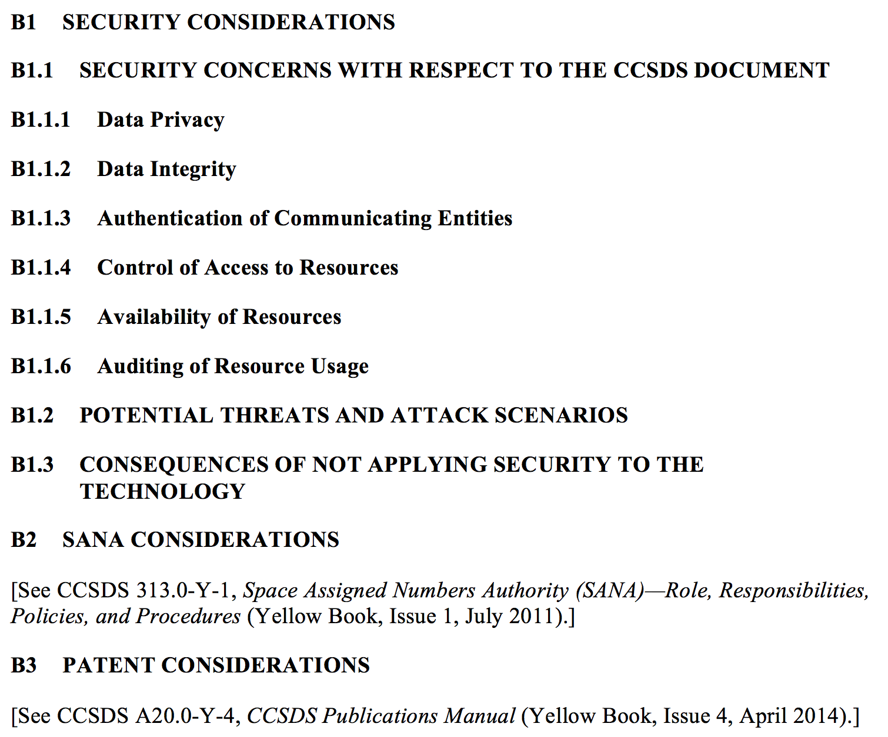
  MOIMS AREA REPORT: NAV WG
Resolution 2: Current Blue Book Annex for Security, SANA, Patent

Slide 18
  MOIMS AREA REPORT: SM&C WG
GOAL: definition of an extensible set of services to support mission operations
STATUS OF BOOKS:
  BB: Monitor & Control Services (ESA + DLR)
  Successful RID discussion, awaiting publication by end 2016
BB: Common Services (ESA + CNES)
  Awaiting publication by end 2017
BB: Mission Product Data Distribution Services (ESA + ?)
  2nd internal review: NASA will provide mapping to their needs by Jun16
BB: TCP/IP Transport Binding and Split Binary Encoding (ESA + CNES)
  Successful RID discussion. Proto2 by CNES. Publication by end 2016
BB: HTTP Transport Binding and XML Encoding (ESA + JPL TBC)
  Awaiting publication by beginning 2017
BB: ZeroMQ Transport Binding and CNES Binary Encoding (CNES + ESA)
  Proto2 by ESA. Awaiting publication by April 2017
MB: C++ MAL API (NASA)
  NASA approved for release! - Awaiting publication by end 2016
BB: XML Telemetric & Command Exchange (XTCE)
  Awaiting OMG approval. Publication end 2016. No prototype assumed

Slide 19
  MOIMS AREA REPORT: SM&C WG
STATUS OF WORKING GROUP
WG active and making progress
Sam Cooper (ESA) nominated deputy chair
Meeting attendance: 20 people on average from different agencies/organisations
Discussed format-based (preferred by NASA) versus services-based specifications. Tool provided to NASA that generates the underlying formats exchanged via MO messages
Discussed preliminary IOAG MOSSG report: the 8 findings are valid and already being worked within the WG. No show-stopper identified
Discussed events. Events are needed by NAV and CSS/SM. The SM&C COM BB (published) already defines events. Harmonisation need agreed
Supported Reference Architecture WG. Agreed stronger interaction with SOIS, in particular on the relation between EDS and MO Services
Supported SANA “training”
Creation of CCSDSMO project on GItHub
ISSUES
None

Slide 20
  MOIMS AREA REPORT: SM&C WG
RESOLUTIONS
AD to raise CMC resolution to add the resources for Proto2 to
  BB: TCP/IP Transport Binding and Split Binary Encoding (ESA + CNES)
  BB: ZeroMQ Transport Binding and CNES Binary Encoding (CNES + ESA)
SM&C WG thanks NASA Glenn Research Center for the excellent organization of the workshop at the Westin Hotel. It was very convenient to have the meeting rooms right in the hotel
WORKING GROUP STATUS: Active
status: | OK | CAUTION | PROBLEM
comment: | X

Slide 21
  MOIMS Area Report: TEL WG Report
GOAL: definition of telerobotics services
STATUS OF BOOKS:
  GB: Telerobotics Standard Roadmap
  Almost final. There is general commitment (NASA, ESA, DLR) to pragmatically publish the GB
  BB: Telerobotic Standard
  Not started yet
STATUS OF WORKING GROUP
WG not active. Current chair (David Mittman, NASA/JPL) needs to step down because of other commitments. New chair sought
As last step, the chair will distribute the current GB for publication and the list of suggested changes to be implemented in next issue by 15Apr16. DLR offered to implement the outstanding changes
WORKING GROUP STATUS: Non Active
status: | OK | CAUTION | PROBLEM
comment: |  |  | X

Slide 22
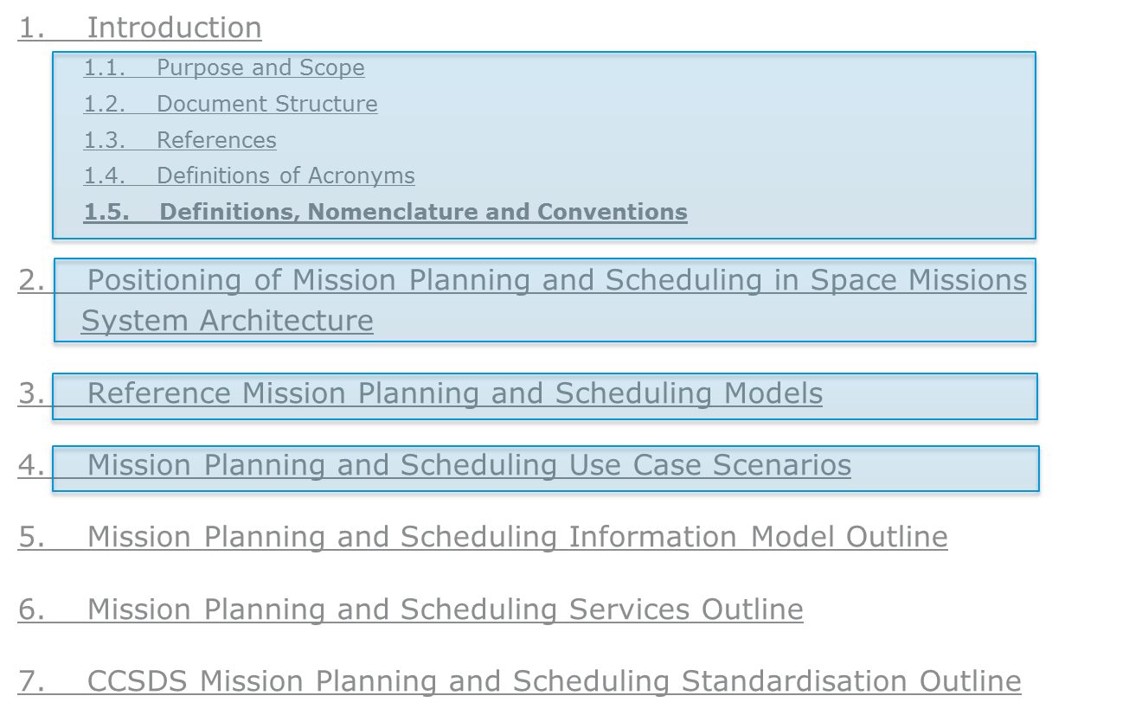
  MOIMS AREA REPORT: MP&S WG
STATUS OF BOOKS
GB: Mission Planning & Scheduling
  Discussion on first 4 chapters

Slide 23
  MOIMS AREA REPORT: MP&S WG
WORKING GROUP STATUS
    WG met two days (Thursday and Friday)
    Good participation from: ESA 3 (+1), CNES 1, CNSA 1, DLR 1, KARI 1, NASA 3, UKSA 1
    Target: Have the complete draft of the GB by Rome meeting
    In order to fulfill the conditions put by the CMC and avoid a gap in the work of the WG:
      We plan to submit the version of the GB, reviewed and agreed by the WG to the CMC and request the approval of the BB project
      ESA, UKSA, DLR and NASA representatives of the WG took action to check and confirm by July availability of resources for BB prototyping.
    Submit the GB in Nov to Area Director with request for publication
    ISSUES: None
    WORKING GROUP STATUS: Active
status: | OK | CAUTION | PROBLEM
comment: | X

Slide 24



  MOIMS Area: Executive Summary
DAI: Data Archive Ingestion WG
GB: Producer Archive Interface Specification (PAIS)
  Awaiting publication by mid16 (CESG resolution submitted)
  MG: Information Lifecycle and Long Term Usage
    Good progresses and several drafts. Awaiting publication by end16
NAV: Navigation WG
GB: Navigation Data - Definitions and Conventions
  On going. Dale Force (Nasa/Glen) is new Lead Editor
BB: Navigation Data Message / XML Specification (NASA, ESA?)
  Resolution for revision will be raised
BB: Pointing Request Message (PRM) (ESA, ?)
  RIDs from AR successfully dispositioned. Missing Proto2
BB: Attitude Data Message (ADM): 5-year review (CNES, ?)
  On going. Missing Proto2
BB: Tracking Data Message (TDM): 5-year review (NASA, ESA)
  Discussion of further changes based on results of internal review
BB: Orbit Data Message (ODM): 5-year review (NASA, ESA)
  Review of WG comments completed
BB: Events Message (EVM)
  On hold. Harmonisation with CSS/SM and SM&C COM needed. Potential use of SANA for event catalog
  BB: Navigation Hardware Message (NHM) (NASA, ?)
  No discussion as there is no Lead Editor
  BB: Spacecraft Maneuver Message (SMM) (NASA, ?)
  Discussion of potential overlaps between SMM and ODM/OCM
SM&C: Spacecraft Monitor & Control WG
BB: Monitor & Control Services (ESA + DLR)
  Successful RID discussion, awaiting publication by end 2016
BB: Common Services (ESA + CNES)
  Awaiting publication by end 2017
BB: Mission Product Data Distribution Services (ESA + ?)
  2nd internal review
BB: TCP/IP Transport Binding and Split Binary Encoding (ESA + CNES)
  Successful RID discussion. Proto2 by CNES. Publication by end 2016
BB: HTTP Transport Binding and XML Encoding (ESA + JPL TBC)
  Awaiting publication by beginning 2017
BB: ZeroMQ Transport Binding and CNES Binary Encoding (CNES + ESA)
  Proto2 by ESA. Awaiting publication by April 2017
MB: C++ MAL API (NASA)
  NASA approved for release! - Awaiting publication by end 2016
BB: XML Telemetric & Command Exchange (XTCE)
  Awaiting OMG approval. Publication by end 2016. No prototype assumed
MP&S: Mission Planning & Scheduling WG
GB: Mission Planning & Scheduling
  Discussion on first 4 chapters
  TEL: Telerobotic WG
  GB: Telerobotics Standard Roadmap
  Almost final. There is general commitment (NASA, ESA, DLR) to pragmatically publish the GB
  BB: Telerobotic Standard
  Not started yet

Slide 25
SPACE
INTERNETWORKING SERVICES
(SIS) AREA REPORT
Keith Scott (AD)
Tomaso De Cola (DAD)
Notes:
25
25
25

Slide 26
SIS Area Report
B. Meeting Demographics
 | Plenary | CFDP Refresh | DTN | MIA | DTN-Interop Test | Voice
ASI
CNES
CNSA | 2 | 2 | 2 | 1 | 2 | 1
CSA
DLR | 2 |  | 3 | 2 | 2 | 3
ESA |  |  | 1 | 1 |  | 1
INPE
JAXA | 3 | 4 | 4 | 4 | 4
NASA | 2 | 1 | 9 | 6 | 6 | 6
RFSA
UKSA
Other |  | 3* | 3* |  | 2*
TOTAL | 9 | 10 | 22 | 14 | 16 | 11
 |  | *S. Korea | *S. Korea |  | *S. Korea
Meeting Duration | .5 | .5 | 1 | 1 | .5 | 1
Agency Diversity | 5 | 4 | 6 | 5 | 5 | 4

Slide 27
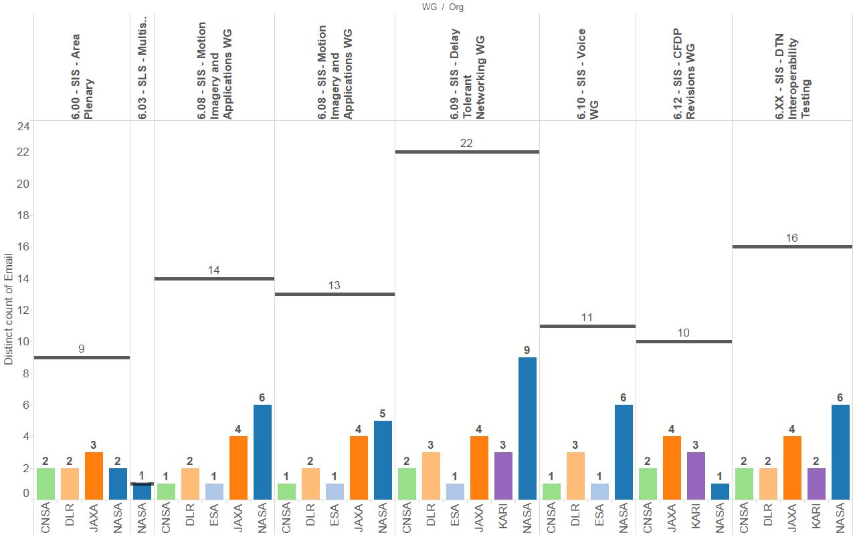
SIS Demographics Alternate View

Slide 28
  SIS Area Report
CFDPv1 WG
Goals:
  Resolve interoperability testing impasse.
Working Group Status:
  Green Book revisions completed, Pink Sheets completed and out of agency review.
  Interoperability testing is not yet possible: ESA implementation suspended.
Remarks
  JAXA is interested in participating in the interop testing, exercising the ION implementation.
  China is interested in observing the interoperability testing.
Plans
    Several options identified. In order of descending preference:
      KARI implementation of CFDP is extended with the Revisions and used for interop testing.
      CMC allocates additional resources for completion of ESA implementation.
      GSFC implementation of the Revisions is completed and used for interop testing.
      Publish the Pink Sheets as an Orange Book.
  Working Group Summary Situation:
status: | OK | CAUTION | PROBLEM
 |  | No firm date for interop testing.
Notes:
JAXA is interested, resources being identified. Possible issues getting resources allocated / schedule.

Slide 29
  SIS Area Report
Motion Imagery & Applications WG
Goals:
  Review and address RIDS to Blue Book Pink Sheets
  Develop outline and add content to Green Book, “Streaming Services over Bundle Protocol Requirements”
Working Group Status:
  Developing ”Streaming Services” Green Book with participation from DTN WG members
Remarks
  No RIDS to the Blue Book Pink Sheet additions were received
  Considerable progress to the Green Book First Draft with substantial content provided by NASA/JPL and DLR
Plans
    First Draft of the Green Book will be distributed to WG by end of April 2016
    Edit content and add content over Summer 2016 leading to review of 2nd Draft by Fall meetings in Rome
  Working Group Summary Situation:
status: | OK | CAUTION | PROBLEM
 | Substantial content added to First Draft of Green Book

Slide 30
  SIS Area Report
Voice and Audio Communications WG
Goals:
  Discuss CCSDS Technical Editor’s processing of Voice Red book
  Start updating the Voice Green Book (5 years review)
Working Group Status:
  Review, agreement and update of the Green Book
Remarks
  Voice protocol Red book still being processed by technical editor; hasn’t gone out for CESG review yet
  Considerable progress to the Green Book First Draft with substantial content provided by NASA/Marshall and DLR
Plans
    First Draft of the Green Book update will be distributed to WG by end of April 2016
    Edit content and add content over Summer 2016 leading to review of 2nd Draft by Fall meetings in Rome
  Working Group Summary Situation:
status: | OK | CAUTION | PROBLEM
 | Substantial update agreed of the Green Book

Slide 31
  SIS Area Report
Delay Tolerant Networking WG
Goals:
  Review draft Security and Schedule-Aware Bundle Routing (was CGR) books
  Review various agencies’ experiences with DTN testing and experimentation
Working Group Status:
  First draft of Security and Schedule-Aware Bundle Routing books reviewed by WG
    Comments will be provided over email after meetings
    Resources for 2nd security protocol prototype tentatively identified
  For both books, see if we can go to agency review (Red-1 Books) before Fall meetings, but might slip to just after the fall meetings
Remarks
  Network Management and other work not yet approved for start (will require CMC approval at a later date)
Plans
    Try to get Red-1 books in Security, and Routing by the Fall meetings
    Track ongoing work in Network Management experimentation by NASA, DLR, and others.
    Discuss schedule for introducing future work (including current set of draft projects)
    Track proposed improvements to LTP for inclusion in revised LTP specification
  Working Group Summary Situation:
status: | OK | CAUTION | PROBLEM
 | Good Progress on Security and Routing

Slide 32
SIS-DTN Resources Discussion
Work Item | Current Status | Target Date | Resources Needed (total, across all agencies) | Notes
Bundle Security (Blue) | WORKING | End of CY2018 | 12 WM | Tentatively identified resources for 2nd prototype (not finalized yet)
Contact Graph Routing (Blue) | WORKING | End of CY2018 | 18 WM | JAXA can produce a prototype

Slide 33
  SIS Area Report: Document Summary
Books Forthcoming | Resolution to Publish
CFDPv1 GB: Overview | Waiting on interoperability testing; see options on CFDPv1 slide
CFDPv1 GB: Implementers’ Guide
CFDPv1 GB: Test Plan
CFDPv1 BB: CFDPv1
Motion Imagery and Applications BB | Agency Review of Pink Sheets completed; target 8/1/2016 for CESG poll for publication
Motion Imagery and Applications Streaming Services Requirements GB | 5/1//2017
Voice and Audio communications Red-1 review | In review by CCSDS Technical Editor
SIS-DTN Security | CESG Poll to release for agency review -- 8/1/2016 (may slip)
SIS-DTN Schedule-Aware Bundle Routing | CESG Poll to release for agency review -- 8/1/2016 (may slip)
Resolution to reconfirm SCPS-TP | 5/11/2016
Notes:
33
33
33

Slide 34
  SIS Area Report: Upcoming New Work Items
New Work Items
Update DTN Rationale and Requirements Green Book | This can be taken up by the existing DTN WG. Estimated resource requirement: total resource estimate: 1 WM. Take up at low level of effort in parallel with other efforts. Add scenarios that could be used to evaluate implementations? Ensure synchronization with SSI Architecture and CSS Architecture Requirements Documents
Notes:
34
34
34

Slide 35
SIS Area Report : SUMMARY
CFDPv1
  Blue Book awaiting second prototype; options:
    KARI implementation of CFDP is extended with the Revisions and used for interoperability testing.
      Will have update on feasibility for CESG / CMC meeting.
    CESG allocates additional resources for completion of ESA implementation.
    GSFC implementation of the Revisions is completed and used for interoperability testing.
    Publish the updated CFDP protocol as an Orange Book.
  SIS suggests delaying publication of Green Book updates until the Blue Book update is ready
Motion Imagery
  No RIDs received from agency review of pink sheets to MIA protocols
  Started work on Green Book on requirements / experiences with Bundle Streaming
Voice
  Waiting for technical editor review and formatting of Red Book for CESG poll to release for agency review
  Started Green Book update.
DTN
  Reconfirmed SCPS-TP book
  Completed first WG review of Security and Routing Books
  Collecting proposed updates to LTP specification
  Coordinating with IETF on IETF version of Bundle Protocol

Slide 36
SPACE LINK SERVICES
(SLS) AREA
Gian Paolo Calzolari (AD)
Gilles Moury (DAD)
Spring 2016 Meeting Westin Cleveland, Ohio, USA
Notes:
36
36

Slide 37
  SLS AREA REPORT
CURRENTLY ACTIVE WGs, BOFs & SIGs WITHIN AREA
RFM WG Radio Frequency & Modulation
C&S WG Coding & Synchronization
SLP WG Space Link Protocols
MHDC WG Multi/Hyperspectral Data Compression
SDLS WG Space Data Link Security (Joint with SEA)
OPT WG Optical Communications

Slide 38
SLS Area Report
B. Meeting Demographics
 | Plenary | C/S | SLP | RFM | Optical | SDLS | MHDC
ASI
CNES | 1 | 1 | 1 | 2 | 1 | 1 | 2
CNSA |  | 3 | 3 | 3 | 1
CSA
DLR | 1 | 2 | 3 | 2 | 3 | 2
ESA | 5 | 4 | 4 | 4 | 6 | 4 | 4
INPE
JAXA | 3 |  |  |  | 7
NASA | 6 | 9 | 10 | 7 | 14 | 6 | 7
RFSA |  | 2 | 3 | 3 |  | 2
UKSA | 1 | 1 | 1 | 1 |  | 1
Other |  |  | 2* |  | 2*
TOTAL | 17 | 22 | 27 | 22 | 34 | 16 | 13
 |  |  | *S. Korea |  | *S. Korea
Meeting Duration | .5 | 1 | 2 | 1 | 3.5 | 2 | 2.5
Agency Diversity | 6 | 7 | 8 | 7 | 7 | 6 | 3

Slide 39
  SLS AREA REPORT
Radio Frequency and Modulation (RFM) WG – Progress Summary
  1. Recommendations for Simultaneous High Rate Telemetry and Ranging
  A restructured Draft GREEN Book on GMSK+PN ranging was presented to the WG.
  Resolution: WG request publication of this (new) Green Book.
2. Proposed Ranging Recommendation for 401.0-B
  A telemetry-based ranging technique that is suitable for simultaneous high rate telemetry and ranging and time correlation was presented again to the WG.
  WG propose that a new Project be created. A concept paper will be provided and resources will be identified for eventual WG Resolution.
  3. Update of Recommendation 401 (2.4.18) on 8 GHz modulation for EESS
  Work on revision of Rec 401 (2.4.18) to include higher order modulations for 8 GHz EESS has completed. Revision to be kept in WG until SFCG deliberation in June 2016.
  4. VCM Magenta Book (“Joint” with C&S although there was no formal joint meeting)
  VCM magenta book reviewed (with C&S WG), no significant change.
  5. DDOR (with SEA-DDOR WG)
  Lower frequency tone to be added to section on DDOR tones via Pink Sheets to 401.0-B (modifications to Charter and/or Projects to be done).
  6. Prox-1 Green Book
  The 512 Kbps data rate (present in the blue book) is erroneously omitted in the Green Book and it will be added by CCSDS editor (via editorial corrigendum).
  7. Throughput Analysis under RFI - revisited
  The Aerospace paper has been presented and discussed. Need for comparison with existing CCSDS recommendations on CDMA identified.

Slide 40
  SLS AREA REPORT
RFM WG Summary
status: | OK | CAUTION | PROBLEM
comment: | Good progress
Problems and Issues:
    None
Planning:
    Green Book on GMSK+PN Ranging ready for publication
    Review of Efficient Modulation Green Book (413.0-G-2) planned to start after Spring 2016 (New Project to undergo approval)
    Revision to Rec 401 (2.4.18) will continue until Fall 2016 Meeting pending SFCG comments.
    Aerospace suggests we consider spread spectrum for interference mitigation
    Resolution:
    Publication of Green Book 413.1 on GMSK+PN Ranging

Slide 41
  SLS AREA REPORT
C&S: Coding & Synchronization WG - Working Group Summary progress (1 of 2)
Uplink codes (LDPC added to existing BCH Code in 231.0 TC Coding Blue Book)
  Pink sheets complete and agreed upon at WG level. WG Resolution for starting Agency Review
  Input provided to AD to issue Area Resolution to start related polls
  Yellow book (documenting interoperability between ESA and NASA) drafted
Sliced data transfer in 131.0 TM Coding Blue Book
  Pink sheets completed. WG Resolution for starting Agency Review
  Input provided to AD to issue Area Resolution to start related polls
VCM Magenta Book (Joint with RFM WG)
  Draft Red Book completed and agreed upon by the WG. WG Resolution for starting Agency Review
  Input provided to AD to issue Area Resolution to start related polls
Notes:
41

Slide 42
  SLS AREA REPORT
C&S: Coding & Synchronization WG - Working Group Summary progress (2 of 2)
SCCC
  Revised draft of GB presented. Additional measurement results presented.
  A new version will be submitted for WG review at the next meeting.
Proximity-1 Coding Book
  Evaluation of NASA Concept Paper identifying the need for updating this Blue Book in order to support the forthcoming Version 4 Transfer Frame being defined by SLP WG for the Unified Space Link Protocol (USLP). Resources identified. Resolution to request CMC to approve new CWE Project.
SLS-C&S General Status
status: | OK | CAUTION | PROBLEM
comment: | Good progress
Notes:
42

Slide 43
  SLS AREA REPORT
SLS Space Link Protocols (SLP) WG
Goals:
Review the Unified Space Data Link Protocol (USLP) White book with a focus on coming to consensus on the contents and test planning to a sufficient maturity to generate the RED book before the Fall 2016 meeting.
Reconfirm the COP-1 protocol due to 5 year review, CCSDS 232.1-B-2.
*Along with the SDLS WG, investigate the need for the transmission of the Extended SDLS Procedures PDUs over the space link as well as the need to further specify the non-security protection of Only Idle Data (OID) Transfer Frames .
*Verify how USLP (Version 4) Frame can be transferred over Proximity-1 links (see C&S WG report for results of proposed Prox-1 C&S document revision project).
* These were joint meetings.
status: | OK | CAUTION | PROBLEM
comment: | Good progress
Notes:
43

Slide 44
  SLS AREA REPORT
  SLP WG Summary Progress:
  USLP White Book
  Use Encapsulation Service to support the transport of DTN (BP and LTP) across the link. Agreed with SIS Area Director.
  Remove MAP_UPDU service since CCSDS recognized protocols that carry a defined length field can already be transferred using CCSDS IP-over-CCSDS (IPoC) and/or Encapsulation Service.
  Keep the COPs Management Service as a reference to the COPs directives sent by the protocol. SDLS Extended Procedures Management will also be added.
  Remove On-demand Insert Zone since there is no consensus for it. The belief is the functionality can be accomplished using packets. (Insert Zone as in AOS still available.)
  Additional details provided in the report to SLP WG members at Cleveland meeting.
  Preliminary test plan with supporting agencies (NASA, DLR) identified.
Notes:
44

Slide 45
  SLS AREA REPORT
  SLP WG Summary Progress:
  USLP Green Book
  Reviewed two key areas within the Green book in detail
    How USLP frames are generated and received
    Details of the Transfer Frame Data Field (TFDF) Construction Rules: their motivation, completeness, and association with the USLP Protocol IDs
  COP-1
  All agencies were polled at the meeting and there were no negative reaction to the reconfirmation of the COP-1, CCSDS 232.1-B-2.
  SLP WG request SLS Area to issue relevant resolution.
WG Resolutions:
  Reconfirmation of COP-1, CCSDS 232.1-B-2
Notes:
45

Slide 46
  SLS AREA REPORT
SLS-SLP WG (cnt’d)
Planning:
  Before Fall 2016 meeting (via telecons & email) :
      Update USLP White Book to include Cleveland Meeting changes by April 19
      Distribute this updated White book to SLP WG and poll membership if this document is of sufficient maturity to go to RED-1.
      Consensus by Mid-May may allow sufficient time for secretariat processing and Agency Review to complete before Fall 2016 Meeting.
      In case this is not possible, RED Book will be issued after Fall 2016 meeting.
      Analyse USLP Utilization Profiles to be presented at Fall 2016 Meeting
Notes:
46

Slide 47
  SLS AREA REPORT
Multispectral & Hyperspectral Data Compression (MHDC) WG
  Revision of 122.0-B-1: RESOLUTION requesting promotion to Pink Book towards Issue 2.
  New 122.1-B: Spectral pre-processing transform stage to extend 122.0-B to support multispectral & hyperspectral images
    Cross-verification complete, Yellow Book nearly complete
    Established timeline for final edits/review of White Book to be complete April 29, at which time we will request promotion to Red Book
    Ready to begin work for associated Green Book; reviewed an outline of GB contents. RESOLUTION requesting related Draft CWE Projects be converted to Active Project.
  123.1-B: extension of existing 123.0-B to provide near-lossless low-complexity multi- & hyper-spectral compression
    Reviewed proposals and compared performance results for 3 candidate proposals
    Established plans to produce information to compare alternative proposals for entropy coding stage and make a selection by Fall Meeting
  Working Group Status: Active X Idle ____
status: | OK | CAUTION | PROBLEM
comment: | Good progress
Notes:
47

Slide 48
  SLS AREA REPORT
MHDC WG (con’t)
Problems and Issues:
    None
Planning:
    122.1-B: Spectral pre-processing transform stage to extend 122.0-B …….
      Review/edits of current White Book & revisions to be incorporated/addressed & final approval (or objections) by end of April.
      Resolution for Red Book expected beginning of May;
      Drafting of text for associated Green Book planned to begin beginning of May
    123.1-B: extension of existing 123.0-B …….
      A “skeleton” White Book to be produced till May (incorporating non-controversial elements and keeping a placeholder for to-be-decided entropy coding stage); further inputs on entropy coding options to be provided July, with selection planned for September; White Book at fall meeting.
Resolutions:
122.0-B-1 Pink Book towards Issue 2
Activation of Project for Green Book supporting 122.1-B
Notes:
48

Slide 49
  SLS AREA REPORT
Space Data Link Security (SDLS) WG
  Working Group Status: Active - Progress report:
  SDLS core protocol
    Blue Book (355.0) published – September 2015 : already several missions have selected SDLS for TC/TM/AOS links security
    Joint session with SLP WG
      Discussion on Only Idle Data (OID) frames and SDLS (potential missing specification to avoid encryption of OID frames)
      Discussion on interaction of SDLS with USLP
    Green Book (350.5) :
      Review of the complete document. Discussion on last inputs to the document. Document now quasi-complete.
      Target: final editing and review by the WG June 2016. Transfer to the CCSDS editor for publication resolution before September 2016.
Notes:
49

Slide 50
  SLS AREA REPORT
Space Data Link Security (SDLS) WG
  Working Group Status: Active - Progress report:
  SDLS extended procedures
    Finalization of Monitoring & Control, SA management and Key management services/procedures/PDU
    Discussion and decision on the communication service to be used for EP PDU transmission over the space link (joint session with SLP WG)
    Final decision on definition and parameters for baseline mode
    Discussion on validation and interoperability testing :
      Agreement on tests objectives, coverage & configurations
      2 prototypes currently being developed : ESA, NASA (3rd to be developed by CNES)
        Cloud based implementation. Interconnection of prototypes tested successfully.
    White book 90% complete. Target : final WB agreed by the WG at mid-May telecon. Resolution for Red Book to be issued before next meeting.
Notes:
50

Slide 51
  SLS AREA REPORT
Space Data Link Security (SDLS) protocol (cont’d)
Problems and Issues:
None
status: | OK | CAUTION | PROBLEM
comment: | Good progress
Planning:
SDLS core protocol:
  Green Book completion : June 2016
  Resolution for Publication : July 2016
SDLS extended procedures :
  White book – final : May 2016
  Resolution for Agency Review of Red book (including baseline mode): September 2016
  Green book to be started at next meeting
Notes:
51

Slide 52
  SLS AREA REPORT
SLS-OPT: Optical Communications Working Group (1 of 3)
  Summary of Progress:
  Deep Space Scenario: Additional High Photon Efficiency (HPE) Physical Layer and Coding & Synchronization inputs were presented by NASA. ESA made a presentation on their SC-PPM channel simulator.
  Near Earth Scenario for Low Complexity (LC) Systems: Agency inputs for Low Complexity were discussed and agreements listed.
  Green Book on Atmospheric Characterization for Optical Communication Systems: The latest version was reviewed. The Working Group members agreed to a resolution to send the Green Book to the SLS Area Director for future processing and eventual publication.
  Magenta Book on Optical Link Operations based on Atmospheric Characterization and Forecasting: The Working Group developed a Concept Paper and agreed to a resolution to start a Magenta Book project about Optical Link Operations based on Atmospheric Characterization and Forecasting.
  Working Group also held presentations on current and planned optical demonstrations (JAXA: JDRS; NICT: SOTA; NICT: Scintillation model of laser beam propagation; ESA: EDRS; CNES: CCSDS Proposals Interesting to CNES and their view on High Data Rate)
Notes:
52

Slide 53
  SLS AREA REPORT
SLS-OPT: Optical Communications Working Group (2 of 3)
  Issues:
  Near Earth Scenario for High Data Rate (HDR): There is no consensus on how to proceed.
    NASA would like to release an Orange Book based on its input with further comments from CNES. NASA proposes that ESA also releases an Orange Book based on its input.
    ESA & DLR would like to continue based on the current SLS-OPT charter aiming at blue books also for High Data Rate with 2 options, acknowledging that for the physical layer there are different wavelength dependent solutions, spectral shaping methods and modulation schemes related to mature but different technology. A building block based approach should be considered.
    At the request of ESA and DLR, the Working Group members agreed to postpone the discussion on the possible path forward.
Notes:
53

Slide 54
  SLS AREA REPORT
SLS-OPT: Optical Communications Working Group (3 of 3)
  Problem and Issues:
status: | OK | CAUTION | PROBLEM
comment: | Green Book for Atmospheric Characterization ready for SLS Area Director review; White Book material for High Photon Efficiency and Low Complexity are progressing well |  | Blue Books Issue: The Working Group does not have consensus on how to move forward with the High Data Rate recommendation
  Planning:
  The schedule for the Blue Books is TBD given the High Data Rate issue
  The Optical Communications Working Group holds monthly teleconferences;
  Planning for Fall 2016 Face-to-Face Meeting:
  Work on the Magenta Book on Atmospheric Characterization for Optical Communication Systems
  White Book chapters input for Physical Layer BB on High Photon Efficiency and Low Complexity
  White Book chapters input for Coding & Synchronization Layer BB on High Photon Efficiency
Notes:
54

Slide 55
  SLS AREA REPORT – SUMMARY (1 of 3)
RFM WG Radio Frequency & Modulation
GMSK+PN Ranging Green Book ready for publication
Recommendation 401 (2.4.23) on 26 GHz modulations for EESS at agency review.
Support to C&S WG given for VCM Magenta Book.
C&S WG Coding & Synchronization
Agency review for uplink LDPC expected shortly (Telecommand Coding Blue Book Pink Sheets).
Agency review for sliced LDPC expected shortly (Telemetry Coding Blue Book Pink Sheets).
Agency review for Draft Red Book for VCM Magenta book expected shortly
SCCC green book under preparation
Resolution to start new project for Proximity-1 Coding Book update
SLP WG Space Link Protocols
Unified Space Data Link Protocol (USLP)
  White Book reviewed and progress made toward RED Book.
  Green Book reviewed and progress made.
Consensus achieved on the Reconfirmation of CCSDS 232.1-B-2 COP-1 Blue Book.

Slide 56
  SLS AREA REPORT – SUMMARY (2 of 3)
MHDC WG Multispectral & Hyperspectral Data Compression
New 122.1-B: Spectral pre-processing transform stage to extend 122.0-B to support multispectral & hyperspectral images:
  On schedule to request promotion to Red Book at start of May.
  Developed outline of content for associated Green Book.
New CCSDS-123.1-B: Near-Lossless extension of CCSDS-123.0-B “Lossless Multispectral & Hyperspectral Image Compression”: Reviewed submitted proposals, agreed on several elements to be included, and established plans to provide more information to select between two alternative entropy coding modules.
OPT WG Optical Communications
Deep Space Scenario: Additional material for the High Photon Efficiency (HPE) Physical Layer and Coding & Synchronization White Books were presented and reviewed
Near Earth Scenario for Low Complexity (LC) Systems: Agency inputs for Low Complexity were discussed and agreements listed.
Green Book on Real-Time Weather and Atmospheric Data: Working Group approved a resolution to submit the GB to the SLS Area Director for approval for publication.
Magenta Book on Atmospheric Characterization: Working Group approved a Concept Paper to submit to the SLS Area Director for approval to start this new project.
Near Earth Scenario for High Data Rate (HDR): There is no consensus on how to proceed and it was not discussed at this meeting.
  This threatens the schedule for the publication of any Blue Books.

Slide 57
  SLS AREA REPORT – SUMMARY (3 of 3)
SDLS WG Space Data Link Security
  SDLS core protocol
    Green Book (350.5) : Review of the complete document. Target: finalization June 2016.
  SDLS extended procedures
    Finalization of Monitoring & Control, Security Association (SA) management and Key management services/procedures/PDU
    Finalization of definition and parameters for baseline mode
    Discussion/decisions on interoperability testing :
      Tests objectives, coverage & configurations
      2 prototypes under development : ESA, NASA
      Interconnection of prototypes done using Virtual Machines over cloud service
    White book 90% complete. Target : Resolution for Red Book review expected September 2016.
SLS Area want to thank NASA/GRC for the excellent accommodation and facilities.

Slide 58
SPACECRAFT ONBOARD INTERFACES SERVICES
(SOIS) AREA
Spring 2016
Richard Barton (DAD)
Notes:
58
58
58
58

Slide 59
SOIS Area Report
Meeting Demographics
 | Plenary | Det Ntwrk BoF | Wireless | App Suppt Svcs
ASI
CNES
CNSA | 2 | 2 | 1 | 1
CSA | 1 |  | 1
DLR | 1 |  | 1
ESA | 4 | 4 | 1 | 3
INPE
JAXA | 1 |  | 1
NASA | 9 | 7 | 4 | 3
RFSA |  |  | 1
UKSA | 1 | 1 |  | 1
Other |  |  | 1*
TOTAL | 19 | 14 | 11 | 10
 |  |  | *South Korea
Meeting Duration | 1 | .25 (*met with SOIS APP Friday) | 2.5 | 3.75 (met with SUBNET Friday)
Agency Diversity | 7 | 4 | 8 | 4

Slide 60
SOIS Area Report
Onboard Wireless WG (WIR)
  Goals:
    Finalize RFID Tag Encoding Blue Book Test Plan and update schedule for book publication
    Finalize organization and schedule for HDR-WLAN Blue Book
  Working Group Status:
    RFID Tag-Encoding Interoperability Testing Plan (Yellow Book) development completed. Execution of the interoperability test plan contingent upon FSA providing funding by July-2016.
    Reached consensus that the HDR-WLAN Blue Book should be split into two different recommended standards as follows:
      HDR-WLAN #1 is ISS-focused with NASA-leadership, FSA and CSA participation
      HDR-WLAN #2 is launcher- and AIT-focused with JAXA, DLR, FSA leadership and ESA participation
  Remarks:
    NASA and FSA funding for development of HDR-WLAN #1 already committed but will confirm commitment with new book organization
  Planning:
    NASA WG members to confer with ISS EWC upgrade team to secure commitment to help with development and prototyping effort for ISS-centric WLAN Blue Book (HDR-WLAN #1)
    JAXA, DLR, FSA, and ESA WG members to confer with Agency representatives to secure resource commitments for development and prototyping effort for Launcher- and AIS-centric WLAN Blue Book (WLAN #2)

Slide 61
SOIS Area Report
WIR WG (continued)
  Current Project Plan
Activity | Milestone | Planned End Date
Approved Projects
WWG RFID Encoding Blue Book | Prototype testing complete; Submit to CMC for publication | Fall 2016
WWG Wireless Local Area Network Blue Book #1 (ISS centric) | Final draft complete; Submit for CESG review | Spring 2017
Draft Projects
WWG Wireless Local Area Network Blue Book #2 (Launcher and AIT centric) | Final draft complete; Submit for CESG review | Spring 2018 (project not yet submitted for approval)
881x0m1: RFID-Based Inventory Management Systems Magenta Book – updates to include new security standards | Publication of Issue 2 | Not yet submitted for approval
RFID Sensing Blue Book | Publication of new book | Not yet submitted for approval
880x0g3: WWG Green Book – updates for Wi-Fi and LTE-based technology evolution? | Publication of Issue 4 | Not yet submitted for approval
881x1r1: RFID Tag-Encoding Specification Blue Book – updates to introduce ISO/EPC compliance | Publication of Issue 2 | Not yet submitted for approval

Slide 62
SOIS Area Report
Application Support Services Working Group (APP)
  Goals:
    Review and disposition all RIDs for Electronic Data Sheets (EDS) and Common Dictionary of Terms (DoT) Red Books and prepare for 2nd Agency review
    Continue joint meetings with SOIS SUBNET to evolve structure of overall SOIS architecture to support distributed, partitioned, and multi-processor architectures
    Continue meetings with with SEA and MOIMS on design and documentation of SOIS interfaces and points of interoperability within CCSDS reference architecture
  Working Group Status:
    Completed preparations to submit EDS and DoT Red Books for 2nd Agency review
    Presented EDS interoperability concepts to SEA and MOIMs and demonstrated operation of NASA and ESA EDS tools (very positive response)
    Agreed on the need to re-evaluate the SOIS APP services together with their respective magenta books to clarify how services fit in the overall CCSDS architecture and in development tools and to provide more SEDS examples in the RBs and GB

Slide 63
SOIS Area Report
APP WG (continued)
  Planning:
    Submit EDS and DoT Red Books to CESG/CMC for 2nd Agency review
    Identify necessary resources and request CESG/CMS approval to begin work on current draft projects to create Orange Books for
      NASA core Flight System (cFS) as a CCSDS onboard reference architecture
      SAVOIR as a CCSDS onboard reference architecture
      CAST Flight Software as a CCSDS onboard reference architecture
    Begin planning for 5-year review of all SOIS APP books
      Review and update SOIS EDS Overview and Rationale Green Book to reflect updated EDS and DoT Red Books
      Possible extension of EDS Overview and Rationale Green Book to include further documentation of EDS as point of interoperability within SOIS architecture and replace planned SOIS User’s Guide Green Book (current draft project)
      Consider combining existing magenta books into a single magenta book to make them more readable and consistent and deprecate existing books if not considered useful (silver books)
    Investigate options for proof of concept prototype for interoperability between MOIMS and SOIS via EDS

Slide 64
SOIS Area Report
APP WG (continued)
  Current Project Plan
Activity | Milestone | Planned End Date
Approved Projects
XML Specification for Electronic Data Sheets for Onboard Devices Blue Book | 2nd Agency review |  | Fall 2016
Common Dictionary of Terms for Onboard Devices Magenta Book | 2nd Agency review |  | Fall 2016
EDS and DoT Interoperability Test Yellow Book | Test plan completed and Data set created |  | Spring 2017
EDS Blue Book and DoT Magenta Book | Book publication |  | Spring 2018
Draft Projects
SOIS User’s Guide Green Book | Probably deleted in favor of current green gook updates |  | Not yet submitted for approval
NASA cFS mapping to SOIS Orange Book | Book publication |  | Not yet submitted for approval
ESA SAVOIR mapping to SOIS Orange Book | Book publication |  | Not yet submitted for approval
CNSA CAST mapping to SOIS Orange Book | Book publication |  | Not yet submitted for approval

Slide 65
SOIS Area Report
Subnetwork Working Group (SUBNET)
  Goals:
    Continue joint meetings with SOIS APP to evolve structure of overall SOIS architecture to support distributed, partitioned, and multi-processor architectures
    Continue meetings with with SEA and MOIMS on design and documentation of SOIS interfaces and points of interoperability within CCSDS reference architecture
    Review SUBNET charter goals, deliverables, schedule and proposed work plan
  Working Group Status:
    Bulk of meeting was joint with SOIS APP and focus was on finalization of EDS & DoT Red Books, which influence work of both WGs; Refer to APP WG slides for details
    Reviewed SUBNET charter, deliverables, schedules, and work plan and initiated re-planning effort
    Proposed initial group of subnets to be mapped to SUBNET services and documented in orange books
    Initial review of packet service indicates that it may be adequate to support deterministic networks and Deterministic Services Magenta Book in current plan may not be necessary

Slide 66
SOIS Area Report
SUBNET Working Group (continued)
  Planning:
    Finalize SUBNET work plan and update deliverables
    Review remaining services (other than packet service) for adequacy to support deterministic services
    Decide whether to delete Deterministic Services Magenta Book from plan and include support for determinism in updated service magenta books currently under 5-year review
    Identify resources for developing initial set of orange books on mapping SUBNET services into selected subnets
  Remarks:
    Re-planning effort will be completed before Fall 2016 Technical Meetings

Slide 67
SOIS Area Report
SUBNET WG (continued)
  Current Project Plan
Activity | Milestone | Planned End Date
Approved Projects
5-Year review of existing SOIS SUBNET Magenta Books | Finalize plan on how to update books |  | Fall 2016
Deterministic Services Magenta Book | Probably delete book |  | Fall 2016
Draft Projects
SOIS SUBNET Utilization Profiles Blue Book | Probably deleted in favor of multiple orange books |  | Not yet submitted for approval

Slide 68
SOIS Area Report
SOIS Area Summary
The SOIS area is still undergoing personnel changes. New AD and DAD need to be identified by Fall 2016 meetings in Rome
New SOIS Subnetwork WG (SUBNET) has been approved by CMC and work has begun
SOIS APP and SUBNET are cooperating closely with SEA SAWG on inclusion of SOIS On-Board Architecture in CCSDS Reference Architecture
Multiple agencies (CNSA, NASA, ESA) are implementing SOIS services using different software development environments (CAST, cFS, SAVOIR)

Slide 69
SOIS Area Report
SOIS Area Summary (continued)
Book Development:
  Onboard Wireless Working Group (WIR)
    Green Book revision to Issue 3 submitted to Secretariat for editorial review and subsequent publication processing
    RFID Tag Encoding Red Book Agency review completed, Interoperability Test Plan Yellow Book completed, interoperability testing to be completed by Fall 2016, publication expected in Spring 2017
    HDR-WLAN #1 (ISS-centric) draft completion expected by Spring 2017
    HDR-WLAN #2 (Launcher- and AIT-centric) draft completion expected by Spring 2018
  Application Support Services (APP)
    EDS and DoT Red Books expected to be released for second agency review in Fall 2016, Interoperability Test Plan Yellow Book expected to be completed in Spring 2017, EDS Blue Book and DoT Magenta Book expected to be published in Spring 2018
    3 orange books on implementation of services in different development environments expected to be approved for active status by Fall 2016
    Proposed User’s Guide Green Book expected to be deleted

Slide 70
SOIS Area Report
SOIS Area Summary (continued)
Book Development (continued):
  Subnetwork Support Services (SUBNET)
    Book development plan still in flux, to be completed by Fall 2016

Slide 71
SYSTEMS ENGINEERING
(SE) AREA
Peter Shames (AD)
Hiroshi Takeuchi (DAD)
Notes:
71

Slide 72
SYSTEMS ENGINEERING
(SE) AREA
Peter Shames (AD)
Hiroshi Takeuchi (DAD)
Notes:
72

Slide 73
System Engineering Area (SEA)
Objective
  Guide overall CCSDS architecture for space mission communications, operations, and cross-support
  Support the CESG in evaluating consistency of all area programs of work with the defined architecture
  Create cross-cutting working groups and BOFs as required to progress the work of CCSDS
Focus
  Define reference architectures for describing space mission communications, operations, and cross-support standardization
  Coordinate and collaborate with other areas about architectural choices and options
  Define standards for cross cutting topics such as security and discrete architecture frameworks, and for those that cross cut multiple layers of protocols
  Support other working groups and BoFs that are addressing cross cutting issues
SEA Working Groups
  Security Working Group
  Delta-DOR Working Group
  System Architecture Working Group
  Space Assigned Numbers Authority (SANA) Steering Group (operational)
  XML Standards and Guidelines (XSG) Special Interest Group (published RFC)
  Timeline Data Exchange Birds of a Feather (request to close submitted)
Notes:
73

Slide 74
SE Area Report
B. Meeting Demographics
 | Plenary | SAWG | SANA SG | Security | D-DOR | XML Standards + Guidelines | SAWG [MOIMS + SOIS]
ASI
CNES | 1 |  |  | 1 |  |  | 2
CNSA | 1 | 1 |  |  |  |  | 1
CSA |  |  | 2
DLR | 1 | 1 | 1 | 1 |  | 1 | 1
ESA | 2 | 2 | 1 | 2 | 1 | 2 | 4
INPE
JAXA | 1 |  |  |  | 1 |  | 1
NASA | 10 | 4 | 4 | 5 | 1 | 3 | 8
RFSA
UKSA | 1 | 1 |  | 1 |  |  | 2
Other
TOTAL | 17 | 9 | 8 | 10 | 3 | 6 | 19
Meeting Duration | 1 | 2 | .5 | 1.5 | 1.5 | .5 | .5
Agency Diversity | 7 | 5 | 4 | 5 | 3 | 3 | 7

Slide 75
SEA Planned Resolution Summary
Sec WG
    Resolution: Network Layer Security to go for CESG and Agency review.
    Will recommend adopting cloud based environment for testing where needed, guideline to be produced
D-DOR WG
  Resolution: Quasar Catalog MB in editor queue for agency review, the X-band Quasar Catalog on the SANA is updated.
  Resolution: D-DOR Operation MB, version 2, in editor queue for agency review
SAWG WG
    Resolution: CCSDS RASDS reconfirmation agreed by CESG, submit for CMC review
SANA
    Resolution: Publish Registry Management Policy and companion docs,CMC review.
    Resolution: Request CMC, AR, and Spectrum managers to provide S/C frequency data.
XSG SIG
    Resolution: Finalize XML Policy document and then close.
    Future work on XML guidelines and validation tools to be done in restarted SAWG.
TDE BoF
    Resolution: Request made to close BoF and archive materials.

Slide 76
  SEA Area WG REPORT
SUMMARY TECHNICAL STATUS
Delta-DOR WG
  Goal: Standardising cross-support for Delta-DOR measurements
  Working Status: Active
  Summary progress / Major accomplishments:
  Magenta Book on Quasar catalogue: Waiting in document editing queue at Secretariat.
  Magenta Book on DDOR operations v2: Waiting in document editing queue at Secretariat.
  Green Book: TOC finalized; work distributed to complete first draft.
  Revision of RDEF Blue Book: revisions to header parameters discussed
  Planning to introduce a higher accuracy DOR tone spec in the future
  Progress since last meeting: Green Book and Blue Book revisions discussed
Status: | OK | CAUTION | PROBLEM
 | X

Slide 77
D-DOR Interactions with other WG
CSSM Joint Meeting:
  CSSM is committed to supporting DDOR. Example DDOR Service Requests as now in use by DDOR WG were discussed.
    CSSM is quite confidant they can map DDOR SR parameters for single spacecraft measurements into CSSM framework
    It may be possible to handle this scenario with pass-through parameters
    Second spacecraft may be considered as just another radio source
  It was agreed that a further joint session will be held in Fall 2016 to monitor the progress of the activity
RF&Mod joint meeting:
  DDOR WG proposed a revision to DOR tone specification in BB 2.5.6B
    Ambiguity resolution for missions with limited downlink capability is more robust if the lower frequency tone has a lower frequency, especially
    RF&Mod WG was receptive to idea and asked DDOR WG to draft a proposed revision to BB 2.5.6B
    Pink Sheets could be distributed before Fall Meeting

Slide 78
  SEA Area WG REPORT
SUMMARY TECHNICAL STATUS
Security WG
  Goal:
  Working Status: Active _X_ Idle ____
  Summary progress: documents actively being produced: Key Management MB, Network Layer BB, Cloud Testing. All docs green.
  Progress since last meeting: network layer security testing, KM MB progress, DTN Security (using Cryptographic Message Syntax (CMS)), Secure Protocol revision.
  Problems and Issues: None
status: | OK | CAUTION | PROBLEM
Comment: Working Group is advancing and producing good products. | Docs OK.

Slide 79
SecWG Executive Summary
Close out the cloud computing action and to document it (e.g., produce a CCSDS Cloud Testing Procedure Yellow book)
Reviewed use of the SANA registries and plan to create a CCSDS registry for standard security algorithms.
For “CCSDS credentials” agreed to create a standard based on ISO 9594-8 with a “strong” option based on X.509 certificates and a “less strong” option based on “protected simple authentication” as used by SLE.
Planning revision of 350.0 (CCSDS Protocols to Secure Systems) which will be edited and distribute to the WG.
Network Layer Security adaption profile testing is completed as is the Yellow Book with the test results. The BB will be revised as needed and forwarded to the AD and Secretariat for polling.
Live demo between NASA and ESA using the “cloud” for CCSDS testing was completed and reviewed.
Considering “trusted hardware” in concert with or as an adjunct to the previously discussed trusted/secure software initiatives.
Reviewed security adoption and “Considerations Section” compliance in other working groups (see spreadsheet)
Discussed the changes/restructuring of the Key Management Magenta Book.

Slide 80
  SEA Area WG Report
SUMMARY TECHNICAL STATUS
System Architecture WG
  Goal: Develop “CCSDS Reference Architecture” and other related standards
  Working Status: Active _X_ Idle ____
  Summary progress: WG restarted. Active participation by CNSA, ESA, and NASA. MOIMS & SOIS reps participated in Reference Architecture task. Re-confirm RASDS in current form.
  Progress since last meeting: Three telecons and CCSDS Application and Support Architecture working meetings. Reviewed initial concepts with MOIMS & SOIS. Approved RASDS re-confirmation.
  Problems and Issues: There is only a near-term commitment of resources to do the Application and Support Architecture PPT.
status: | OK | CAUTION | PROBLEM
Comment: Resource constraints |  | Resources to do work not always consistent.

Slide 81
CCSDS Architecture WG Meeting Notes
Agree to use RASDS for diagrams, for consistency with existing SCCS-ADD materials
Agree to initially model SM&C/MOIMS on the ground and SOIS in space
  Use of MOIMS in R/T space environment will be evaluated
Not all MOIMS or SOIS functions are fully specified, even as groups.
  Agree to show these with only high level functions and interfaces, and mark as [FUTURE]
  Agree to handle Nav WG as document exchanges, not services
MOIMS & SOIS have each identified a person to work with SEA to develop initial diagram set
  Agree to a set of viewpoints and views to be applied uniformly
  Initial draft set of materials produced that shows the rough shape and content of the final product
Feedback from MOIMS and SOIS, in separate and joint meetings, is very positive

Slide 82
Application and Support Architecture Approach
Create first phase (viewgraph) and second phase (document) materials for the Application and Support Architecture document
Develop viewgraph level materials first for MOIMS, SOIS, and joint deployments
  include the use of services and interfaces identified in the SCCS-ADD/ARD (CSS, SLS, SIS & most of SEA), include security services as needed
Use a consistent set of viewpoints and views based on RASDS method and representations
Develop base materials adhering to the SOIS and MOIMS services and functions as they are defined
Propose extensions to the documented base as and where this seems advisable
Review base materials and proposed extensions with the relevant MOIMS & SOIS groups

Slide 83
Reference Architecture Views
Service view, including service types:
  Table with group name, functions, operations, stds reference
Functional views:
  Top level black box (overview) and white box (at least 1 level, possibly 2)
  Functions (with operations lists) & relationships
Protocol views, including service interface bindings:
  Building blocks & end-to-end,
  Space transport & terrestrial transport,
  Reference SCCS underpinnings
Information views:
  Identify all major data objects from functional views,
  At abstract (key component) level, not at detail level
Deployment view examples (single link & space internetworking:
  Show relationship of the app layer functions to SCCS and below,
  Show MOIMS and SOIS separately and also integrated,
  Ground, flight, and also flight & ground

Slide 84
MOIMS Data and Services Functional Groups
CSS-M&C
User Support
Planning & Scheduling
TT&C
MPS
CSS-SM
NAVT
MPS
NAVT
AUT
MPS
NAVT
M&C
Automation
Navigation & Timing
M&C
NAVT
MPS
NAVT
MDP
NAVT
M&C
M&C
M&C
SWM
Monitoring & Control
Software
Management
M&C
M&C
AUT
MPS
NAVT
SWM
SWM
File Handling
M&C
Satellite
Dev. & Maint.
AUT
NAVT
SWM
MDP
M&C
AUT
Functions and Data Colour Coded: Data in Rectangles; Services indicated at Provider End by Circle
MDP = Mission Data Product
Notes:
The 6 MOIMS Areas are colour coded.
Each application level interaction is annotated with the Data exchanged. At this level all Data generated by each Function is grouped as a single type (the abbreviation reflects the function name).
Potential service interfaces identified by MO are indicated by a colour-coded circle representing the Service Provider
Data formats may be separately defined [NAV, MPS] or specified in the context of the service [MO M&C, MPS].
File Handling is a bit different – there are special services for File Management and File Transfer [the latter delegated to a lower level protocol, such as CFDP or FTP], but the file content my be associated with any of the other Functional Areas. It essentially provides the transport layer for bulk transfer of service messages or data formats. Mission Data Products may also be transferred as files.
Note Planning/Scheduling interactions with the GSTS are greyed out as they are outside the scope of MOIMS standardisation [CSS boundary agreement].

Slide 85
SOIS Functional Groups
SOIS services are categorized in five functional groups.
Data Distribution applies various technologies to deliver the latest data to applications and distribution of data among processing nodes
Device & Access Services provide services used by applications to do device access, memory, and packet services.
Vehicle Manifest provides a description of onboard devices and their interfaces
Device Content Services is a set of spacecraft-oriented file system and time services.
Communication Protocols provide access and a common interface for the underlying physical communication subnets.
Applications
Data Distribution
Vehicle Manifest
Device & Access Services
Device Content Services
Communication
Protocols

Slide 86
  SEA Area Area Working Group Report
SUMMARY TECHNICAL STATUS
SANA Steering Group (SSG)
  Goal: Re-Engineer the SANA Registries to fix major issues
  Working Status: Active _X_ Idle ____
  Summary progress: Documents re-engineering the SANA registries approved by the CESG. New Registry Management Policy (RMP), SANA WG “CookBook” and revised SANA YB.
  Progress since last meeting: Revised documents are finalized. SANA operator & Secretariat planning for updates (plan end of April). CSS area lined up as first customer. SM&C and CSTS WG did detailed review & provided only minor requests for edits.
  Problems and Issues: Expect CMC review request within the month
status: | OK | CAUTION | PROBLEM
Comment: SSG and other WG concur | Docs approved by CESG, queued for CMC

Slide 87
CCSDS SCID Registry Discussion
The RMP extends the existing SCID registry
Uses the same pattern of requiring:
  A designated AR from a Member or observer agency, or from an affiliate, to request SCID assignment or relinquishment
Adds:
  Unique OIDs for all Spacecraft that are registered, in addition to the SCID
  Adds spacecraft name, abbreviation, and alias attributes
  Permits assignment of an OID without a SCID and makes OIDs permanent tags for the spacecraft
  Requires tagging all data, uniformly, with the date of any changes and the ID of the persons requesting and performing the change
  Will need to add allocated frequencies if frequency bin proposal is adopted
  Could include list of protocols that are used
The SCID registry is managed by the SANA Operator

Slide 88
Spacecraft (SCID) Registry Structure
Add
Allocated frequencies
Adopted protocols
Items in red are new or modified fields

Slide 89
CMC Issues SEA Poll - CMC-P-2016-01-002
SEA Analysis
By definition any simulator or “flight-less bird” is never communicated to using free space RF radiation.
The whole purpose of SCID assignment is to provide a unique CCSDS identifier so that there is no mistake when sending data to S/C using RF radiation.
Unless these rules are violated there is no possibility of ambiguity if the SCIDs for simulators or “flight-less birds” are recovered and re-assigned.
In practical terms, the agencies may continue using the current SCIDs, or any other SCIDs that they wish to select, for simulators or “flight-less birds”, as long as they do not radiate them.
Managing these “SIM SCIDs” is then purely an agency matter.
Agencies have been notoriously slow (or un-responsive) in responding to requests for feedback or returning OIDS
  By count that are seven (7) identified Type 2 “SIM” allocations
There is no technical reason to delay this further, especially since there are only two (2) unassigned Type 2 SCIDs remaining.

Slide 90
SEA Issues for CESG
Sec WG
    Cloud based environment for testing, procedure as YB or GB
D-DOR WG
  None
SAWG WG
    Level of support for the requested “CCSDS Reference Architecture” is uneven
    Allocated resources only adequate to do Powerpoint version
SANA
    Inclusion of frequency bins in SCID registry
    Request coordination among CMC, Agency Reps, and Spectrum Managers to provide essential frequency data and avoid issues
XSG SIG
    No resources identified to produce XML Policy document, but several WG producing and updating XML specs

Slide 91
Cross Support Services
(CSS) AREA
Erik Barkley, NASA/JPL (AD)
Margherita diGiulio ESA/ESOC (DAD)
Notes:
91

Slide 92
CSS Area Report
Active WGs
Cross Support Transfer Services
  Framework and application thereof for terrestrial data transfer services between TT&C Networks and Mission Operations for cross supported missions
Cross Support Service Management
  Planning, requesting and configuration of and accounting for cross support services of TT&C Networks for cross supported missions

Slide 93
CSS Area Report
B. Meeting Demographics
 | Plenary | Service Management | X Suppt Trans Svcs
ASI
CNES
CNSA |  | 1
CSA
DLR | 2 | 2 | 1
ESA | 8 | 6 | 4
INPE
JAXA | 1 | 1
NASA | 13 | 12 | 5
RFSA
UKSA | 1 | 1
Other
TOTAL | 25 | 23 | 10
Meeting Duration | 1 | 5 | 2.5
Agency Diversity | 5 | 6 | 3

Slide 94
  CSS REPORT
Cross Support Transfer Services (CSTS) WG
CSTS Framework (Nearly) Ready for Publication
Just need SANA Registry URL to put in book
Prototyping completed
  Yellow book (test report) completed
MD-CSTS Ready for Publication
Read for publication but need prototyping to complete
  Inter-operations testing
    Takes more effort than anticipated to enable communications CNES ← → ESA (security)
    Inter-operation testing should be completed by end of May/early June

Slide 95
  CSS REPORT
Cross Support Transfer Services (CSTS) WG
TD-CSTS Book
Book has been updated; anticipated to be sent to AD by early May as RED-1, for Agency Review
Prototype efforts in place
  Resources DLR (provider), NASA (user)
    But NASA changed prototype resources
    Timeline for interaction to be determined by Rome Meeting
Concept Book
No progress – lack of resources
CSTS Guidelines Book
Projected candidate Magenta-1 to AD by July 2016
SLE Blue Books
Area submitted candidate blue resolution in December 2015
CESG/CMC release polls pending secretariat clearing work backlog

Slide 96
  CSS REPORT
Cross Support Transfer Services (CSTS) WG
Functional Resources + SANA Registry
Agreed on registry for OIDs
  In conformance with new registry management policy (RMP)
Tool for OID editing to produce registry has been developed
  Something to consider – do we have CCSDS software to be made available?
In general CSS Area requests other areas of CCSDS and member agencies to review the registered set of functional resources and provide feedback
  E.g., this is seen as leading to “standard” TT+C monitor data

Slide 97
  CSS REPORT
Cross Support Transfer Services (CSTS) WG
New Services (1/2)
Forward Frame (FF-CSTS) General Scoping
  Production machine further refined with respect to the functional resource model
    Informs what are the managed parameters for CSSM WG
  Outline of recommendation produced/reviewed
  Draft project definition done mid-December 2015
    Resources:
      Book captain: NASA/JPL
      Prototype 1: TBD but NASA/JPL has indicated likely to support
      Prototype 2: still needed
  Estimate first draft White book by Spring 2017 meetings

Slide 98
  CSS REPORT
Cross Support Transfer Services (CSTS) WG
New Services (2/2)
Service Control (SC-CSTS)
  No resources spent on this – no progress
Off-line (Validated) Radiometric Data Transfer Service
  Joint meeting with NAVWG held
    NAVWG prefers to keep current TDM definition
    Implies that CSS Area will have to produce some ancillary recommendation or otherwise account for validated radiometric considerations in service management
      Push-only approach re TGFT not accepted by NAVWG

Slide 99
  CSS REPORT
Cross Support Transfer Services (CSTS) WG
Prototyping
CSTS SFW/API
  Completed
MD-CSTS
  In inter-operation phase
TD-CSTS
  Advanced development planning

Slide 100
  CSS REPORT
Cross Support Transfer Services (CSTS) WG
Summary
CSTS FW in Blue State – pending Registry creation
MD CSTS in Blue State – pending interop-ability testing completion and registry creation
TD-CSTS in Red state – ready for Agency review
Good steps towards defining next set of cross support data transfer services
OIDS/Registry -- inputs for SANA registry progressing (activity more demanding than anticipated)
status:
status:
OK
OK
CAUTION
CAUTION
PROBLEM
PROBLEM
comment:
comment:
X

Slide 101
  CSS REPORT
Cross Support Service Management (CSSM) WG
Simple Schedule of Services
CESG Blue book poll pending registry creation
  ESA/ESTRACK and NASA/DSN are already working on implementations
Planning Information Format
Internal WG review completed; some minor updates in progress
  Further coordinated with MOIMS NAVWG and SMC re event definition
    Updated version sent out for review – allow identification of different timescales
Celestial body naming “source” – a question for CESG/SEA – should JPL NAIF be used as is currently done in MOIMS NAV recommendations?
  CSS Area does not particularly care what is indicated as the source
    Mostly interested in ensuring common, well coordinated references for CCSDS customers
Candidate R1 by June 2016
Draft prototype test plan has been produced

Slide 102
  CSS REPORT
Cross Support Service Management (CSSM) WG
Service Management Utilization Request Format
Preliminary draft review completed
  UML Class diagrams adjusted at the spring workshop
Candidate R1 by October 2016 (Rome meetings)
5 major test cases identified re prototyping
Terrestrial Generic File Transfer
Lacking in progress
  Study re use of XFDU did not really occur – really only item needed to complete white book
Some Prototype planning with CSNA
  CNES representative unable to attend Cleveland meeting
Draft White book by August 2016

Slide 103
  CSS REPORT
Cross Support Service Management (CSSM) WG
Service Package Data Format
Design work (preliminary class digarams) conducted since last workshop reviewed
Some concept leveling work required
  Needs to be better separated from definition of configuration profile
    Too tightly bound – impact to agency adoption, tending to significantly require implementation of configuration profile
  Focused telecon scheduled for early June
Configuration Profile & Service Agreement Data Format
Outline produced and reviewed
Agreed to simplify approach by removing temporal constraints from profile definition
  To be dealt with exclusively by event sequencing information entity

Slide 104
  CSS REPORT
Cross Support Service Management (CSSM) WG
Event Sequences
No resources applied since Darmstadt meeting due to higher priorities
Presentation from NASA/DSN on expressing event sequencing relative to logical events rather than absolute time reviewed
Exercise pending to show capturing/addressing temporal constraints in configuration profile
  If successful will “unify” near-earth and deep space temporal expressions from a data systems standardization viewpoint
Service Catalog
Reviewed preliminary draft exercise putting NASA SCaN service catalog into CCSDS magenta book format
Conclusion is to pursue magenta book for expression of service catalogs from member agencies
  Templates for service expression that will facilitate overviews of services offered
  Detailed parameters to be found in Sites and Apertures registry
Accountability Data Format
No resources applied since Darmstadt meetings due to higher priorities

Slide 105
  CSS REPORT
Cross Support Service Management (CSSM) WG Summary
Current Projects – all okay
  Schedule of Services – Ready for publication (pending registries)
  Planning Data Format – Ready for agency review
  Service Management Utilization Request Format – on track to be reviewed in
  Terrestrial Generic File Transfer – needs attention re XFDU as last item for Whitebook
Planned projects – all okay
  Most attention needed on conceptual details for service package – splinter session(s) to be work the issue
status:
status:
OK
OK
CAUTION
CAUTION
PROBLEM
PROBLEM
comment:
comment:
X

Slide 106
  CSS REPORT
Area Summary
The area has made good progress, advancing several recommendations
  Nearly to be published
    CSTS FW
    MD-CSTS
    Schedule of Services
  Nearly ready for agency review
    TD-CSTS
    Planning Information
Area level considerations
  Functional Resource Model has become “bedrock” for the area
  It makes sense to advance this from a technical note to a Magenta Book
    At the moment, AD does not want to request resources for this
    CSS Area requests that other areas take a look; SLS in particular
      → Action on CESG; suggested due date of October 1, 2016
  CSS Area recommends CESG determine overall CCSDS approach as to proper authoritative source to reference in referring to celestial bodies

Slide 107
CESG Spring 2016
MEETING STATISTICS

Slide 108
CCSDS Spring 2016 statistics
171 registrants
ASI (Italy) 0
CNES (France) 10
CNSA (China) 7
CSA (Canada) 0
DLR (Germany) 15
ESA (various Centres) 33
ETRI (South Korea) 3
KARI (South Korea) 1
FSA (Russia) 4
JAXA (Japan) 15
NASA (various Centres) 77
UKSA (UK) 6

Slide 109
  Spring 2016 Total Attendance
Notes:
109

Slide 110
Spring 2016 Attendance By Sponsoring Agency

Slide 111
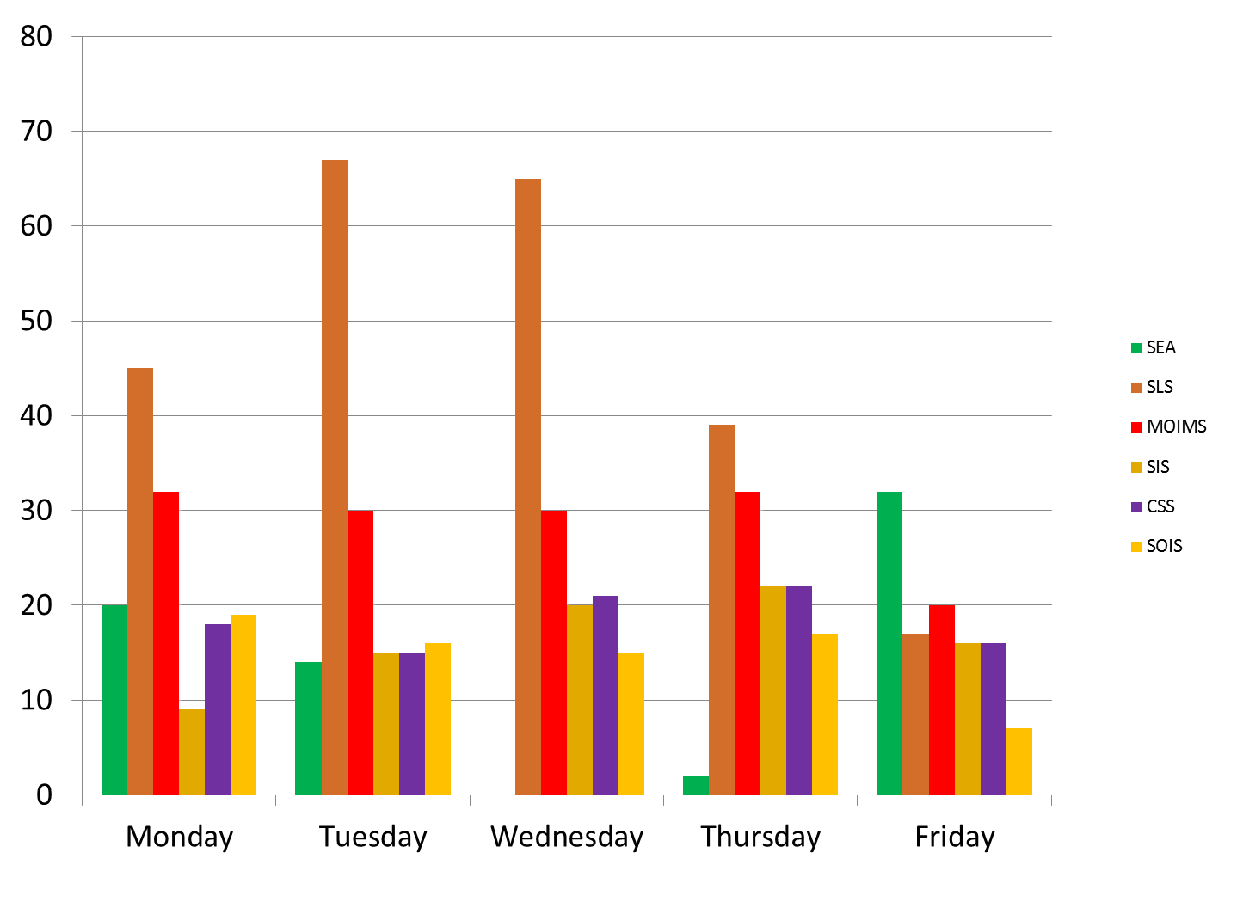
Spring 2016 Daily Attendance By Area

Slide 112
Spring 2016 Daily Room Utilization

Slide 113
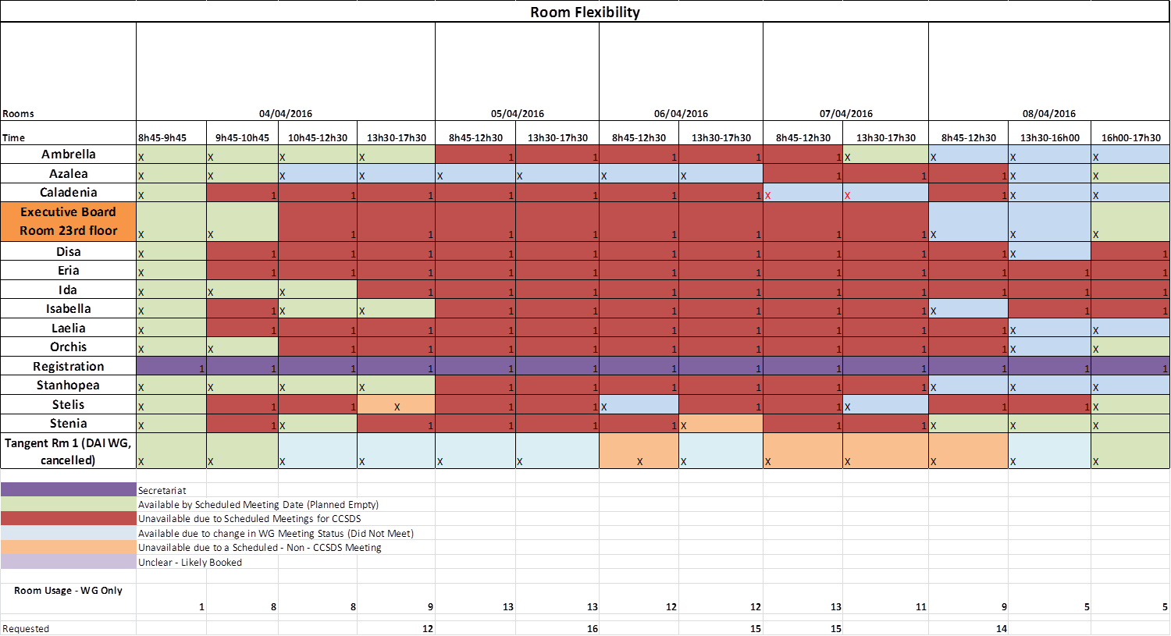
Spring 2016 Daily Room Utilization

Slide 114
Spring 2016 Daily Room Utilization

Slide 115
CCSDS Spring 2016 Meetings – Some issues
There was not an optimal use of the requested meeting rooms at the Westin Hotel. Many rooms remained free on Thursday and Friday.
CESG has discussed this issue at length.
CESG has no clear consensual position, but the following is noted:
  There are different opinions within CESG about the meeting duration ( 4 or 5 days)
  It is recognised that the host is the one deciding the meeting duration (4 or 5 days)
  An optimization can be done based on maximum number of rooms per day (e.g. 12 meeting rooms per day). CESG needs more data tracking the room utilisation.
  It is difficult to plan in advanced (1 month prior meeting start) all the required meeting rooms.

Slide 116
CESG Spring 2016:
items brought to attention
of the CMC

Slide 117
CESG – IT Support meeting
There will be only one mail address for all traffic between CESG/WGs and IT / Technical Support / Tom Gannet, i.e. secretariat@mailman.ccsds.org
Mail archive shall be kept (start date 2003) when migrating to new OS (Ubuntu) and mailman last version. Security issues in mailman will still persist.
RID system: BO will distribute the RID requirements before coding.
Polling System: BO will distribute the existing requirements.
The fact that CWE Projects can be edited only in parts is not very visible.
Editing of CWE Projects Dates it is sometimes difficult and is unstable.
Some members of mailing lists experienced problems because their e-mails to the list were marked as SPAM.
Chrome sometimes does not allow to sign in to the CWE.

Slide 118
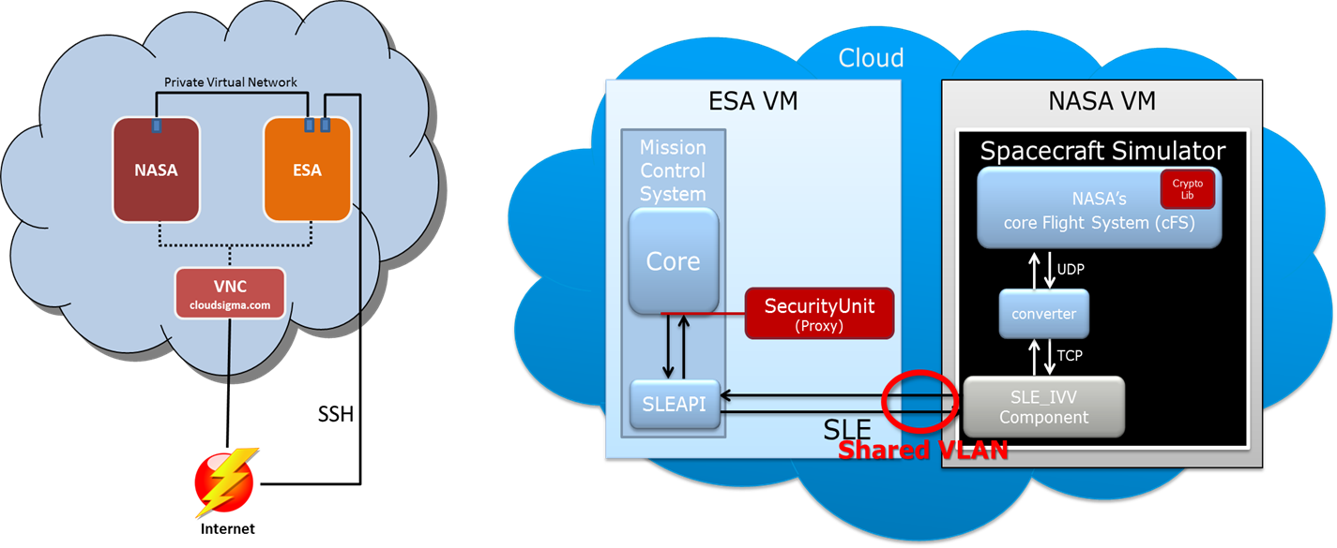
  Cloud Testing Pilot – Report from SDLS WG
Space Data Link Security (SDLS) WG chosed by CESG to be a pilot study for interoperability testing in the cloud (between ESA and NASA)
  ESA and NASA (by using modified process to host information systems externalk to NASA) used CloudSigma, by depositing money in their accounts which will get billed as the virtual machines are used.
  Last 30 days costed approximately $34 USD per Agency
  it took ca 10 hrs between meetings with NASA, ESA, CloudSigma, ESA management, NASA HQ management. This would not be the case in the future as the ground work has already been completed
  Each agency successfully imported their custom VM into CloudSigma and were able to connect over SLE and send/receive commands

Slide 119

  Cloud Testing Pilot – Report from SDSLS WG
The cloud can be used for future interoperability testing for CCSDS WGs
The cloud setup will be used to perform the SDLS Extended Procedure interoperability testing.
This pilot proved that testing in the cloud is a low cost, efficient option for CCSDS working groups to interface their implementations.
This approach will decrease the time needed to perform interoperability testing as agencies will not have to wait until the physsical technical meetings or get bogged down with IT security and firewall modification requests.
It is recommended that agencies use the same cloud provider using a shared VLAN vice connecting over public IP space
CESG recommends that all WGs adopt this approach for all future interoperability tests.
A recommended procedure shall be produced (YB) describing how to configure and perform the interoperability testing (e.g. a cookbook).

Slide 120

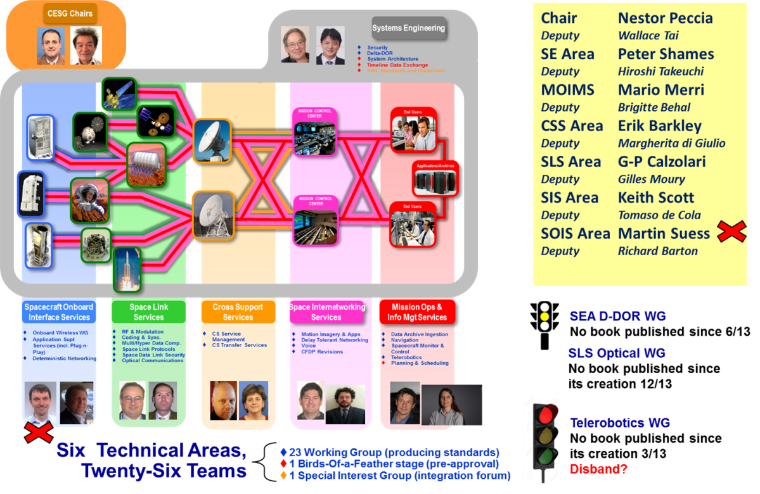

We’re done!
Many thanks to NASA / Glenn Research Center (GRC) for meeting hosting during the CCSDS Spring 2016 meetings!

