Slide 1
Cloud Testing Pilot Response to CESG
Daniel Fischer, Brandon Bailey, David Koisser, John Lucas
Spring 2016 Technical Meetings, Cleveland Ohio
08 April 2016

Slide 2
Background
In the Spring 2015 CCSDS meetings in Pasadena, CA it was disclosed at the opening plenary that the Space Data Link Security (SDLS) Working Group was chosen by the CESG to be a pilot study for interoperability testing in the cloud.
A whitepaper was generated and presented in Darmstadt, Germany that discussed the different approaches for using “the cloud” to perform interoperability testing.
Based on the research performed, a pilot was conducted between ESA and NASA

Slide 3
Coordination
Several meetings were held within ESA and NASA to determine the possibility of hosting virtual machines in the cloud with the following results
ESA can use CloudSigma
NASA can follow recently modified process (ITS-HBK 2810. 02-05 - February 2016) to host “information systems” external to NASA
Lesson Learned:
NASA and ESA have their own separate virtual machines that were procured by the agency separately. From ESA’s perspective if NASA paid for the virtual machine then that brought in legal challenges where intellectual property transfers and licensing would need to be submitted.
Each agency deposited money in their CloudSigma account which will get billed as the virtual machines are used.

Slide 4
Cost for Pilot
Below depicts the cost burn down over the first month for NASA. This graphic is to demonstrate the low cost for performing the pilot of two separate agency communicating “in the cloud”. As you can see, the last 30 days costed approximately $34 USD. ESA’s cost would be similar.
In order to conduct the pilot, it is estimated that it took 10 hours between meetings with NASA, ESA, CloudSigma, ESA management, NASA HQ management. This would not be the case in the future as the ground work has already been completed

Slide 5
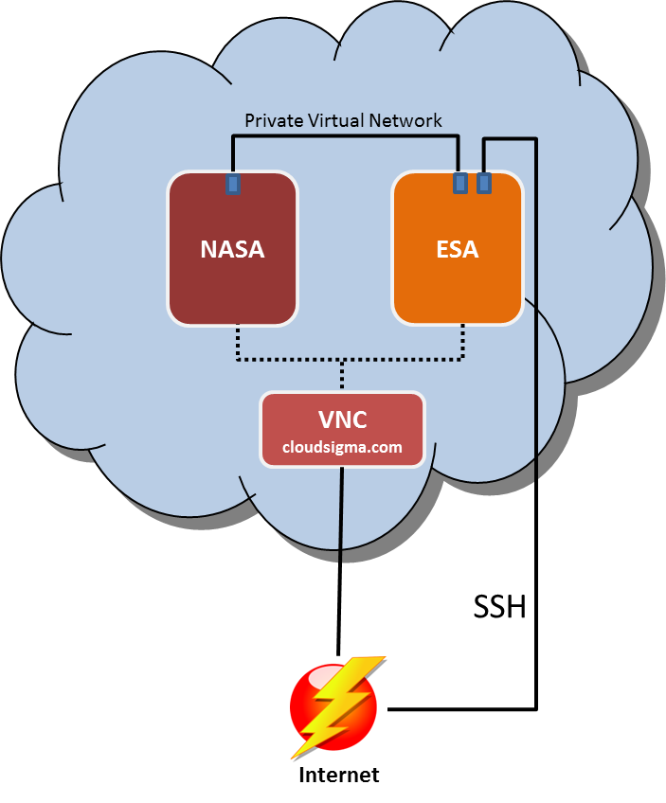
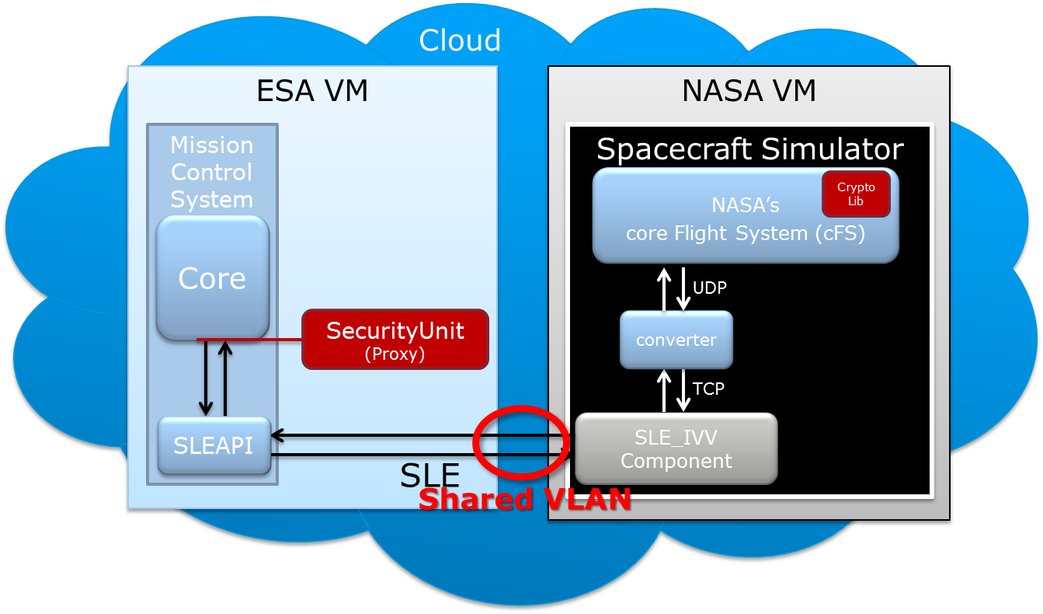
Cloud Setup

Slide 6
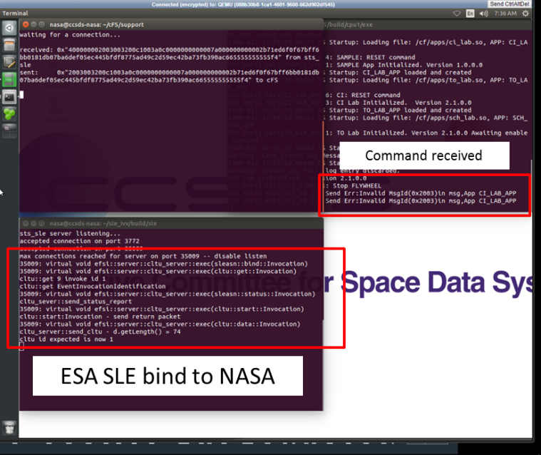
Tests Performed “in the cloud”
There were three test cases performed which resulted in a successful pilot
Test Case #1: Import Custom VM
Test Case #2: Basic Ping Test
Test Case #3: Connect via SLE
Details of each test case are in the document titled Update to CCSDS Cloud Testing
In summary, each agency successfully imported their custom VM into CloudSigma and were able to connect over SLE and send/receive commands

Slide 7
Summary/Recommendation
The cloud pilot was deemed successful and can be used as proof of concept for future interoperability testing for CCSDS working groups.
The cloud setup described herein will be used to perform the SDLS Extended Procedure interoperability testing.
This pilot proved that testing in the cloud is a low cost, efficient option for CCSDS working groups to interface their implementations.
This approach could possibly decrease the amount of time to perform interoperability testing as agencies will not have to wait until the technical meetings every six months or get bogged down with IT security and firewall modification requests.
It is recommended that agencies use the same cloud provider using a shared VLAN vice connecting over public IP space

