Slide 1


CCSDS Opening Plenary Darmstadtium |  | 9 November 2015 Darmstadt, Germany
08:45 | Opening remarks | Nestor Peccia, CESG Chair
08:50 | Welcome by Darmstadt Major | Jochen Partsch
09:05 | Introduction by ESA/ESOC host | Juan Miro
09:15 | CCSDS meeting overview: Administrative, Boot Camp, Meetings | Nick Tongson, Tom Gannett
09:25 | CESG Open Issues & More | Nestor Peccia, CESG Chair
09:30 | Systems Engineering Area objectives | Peter Shames, SEA Area Director
09:37 | Mission Ops and Information Mgt Services Area objectives | Mario Merri, MOIMS Area Director
09:45 | Cross Support Services Area objectives | Erik Barkley, CSS Area Director
09:52 | Space Link Services Area objectives | Gian-Paolo Calzolari, SLS Area Director
09:59 | Space Internet Services Area objectives | Keith Scott, SIS Area Director
10:06 | Spacecraft Onboard Interface Services Area objectives | Martin Suess, SOIS Area Director
10:15 | Closing remarks; Adjourn

Slide 2
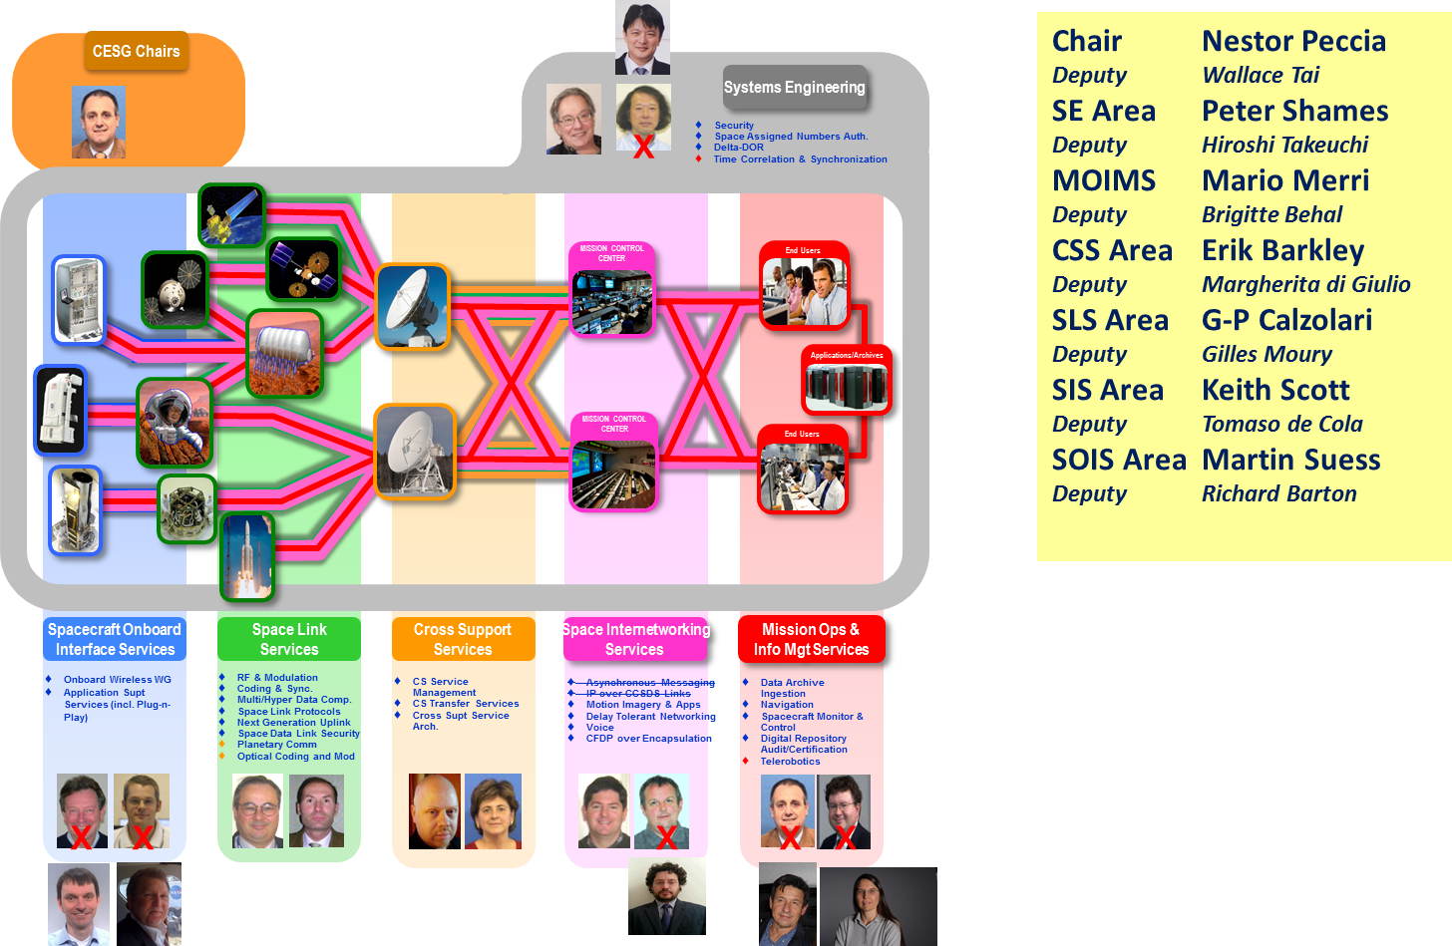
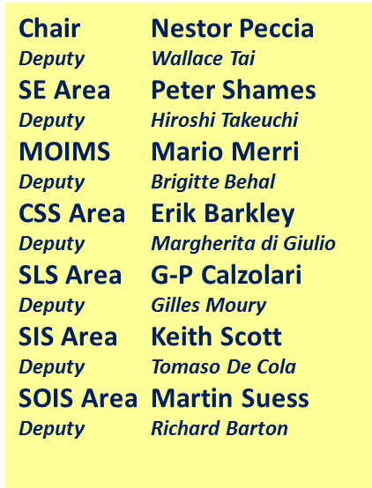


A new CESG Organization
Nestor to update
Notes:
2

Slide 3
Administrative Overview
Registration / Secretariat will remain at Beckman Institute all week.
Meeting and break schedules:
    Start time 08:45
    Coffee break 10:30-10:45
    Lunch Break 12:30-13:30 (staggered lunch breaks)
    Coffee Break 15:30-15:45
    End time 17:30
Coffee, tea, snacks will be served at Beckman Institute, Dabney, and Moore.
No host lunch available in the restaurant/cafeteria (cash only).
Please let the Secretariat know as soon as possible if you will not be using your meeting room or if you will meet beyond the schedule time.
Wireless internet is available in all the meeting rooms and around campus:
  SSID: Caltech Conference Network
  Username: CCSDS
  Password: Workshop2015
Nick to update
Notes:
3

Slide 4



CCSDS Technical Editors:
“Boot Camp”
Tom Gannett - CCSDS Chief Technical Editor
Peter Shames – CCSDS SEA Area Director
Tom / Peter to update
The purpose of the technical editor “boot camp” is to improve overall quality and enable faster processing of documents submitted to the Secretariat by familiarizing working group technical editors with CCSDS requirements for technical content, publication style and procedures for document submission.
IT IS MANDATORY THAT ANY PERSON WHO IS ASSIGNED TO BE THE EDITOR OF A CCSDS DOCUMENT MUST ATTEND A BOOT CAMP.
This week, Boot Camp sessions are scheduled as follows:
Session
Room
Monday, 13:30 - 17:30
Friday, 13:30 - 17:30
Dabney 110
Keck 142

Slide 5
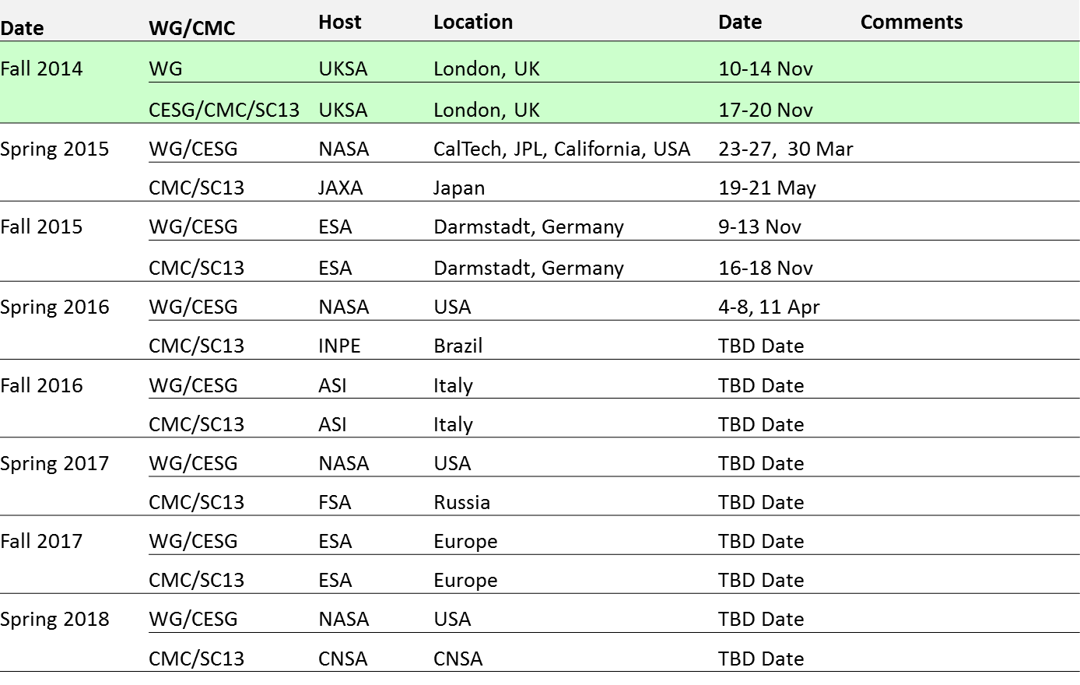
Upcoming Meetings
Nick to update
5-Day
4-Day
5-Day
Visa letters: now being provided for the next meeting. Available 6 months in advance – get yours NOW for Fall 2015 from Nick Tongson (CCSDS Secretariat) at the registration desk

Slide 6
CCSDS Overview
Active Publications
Currently Active Publications: 141 Normative (Blue & Magenta): 86
Informative (Green): 55
Downloadable for free from www.ccsds.org
All major pubs since 1982: ~285
(Some were historical mission needs
or superseded technology)
Nestor to update
751 space missions have adopted and used various CCSDS standards

Slide 7

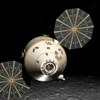
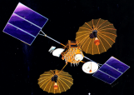
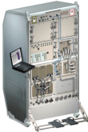



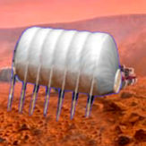

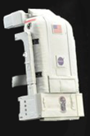






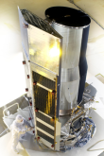
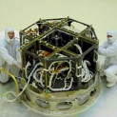

CCSDS Overview
End-to-End Architecture
Six Technical Areas,
Twenty-Six Teams
Systems Engineering
20 Working Group (producing standards)
4 Birds-Of-a-Feather stage (pre-approval)
1 Special Interest Group (integration forum)
Security
Delta-DOR
System Architecture
Timeline Data Exchange
XML Standards and Guidelines
MISSION CONTROL
CENTER
End Users
Applications/Archives
MISSION CONTROL
CENTER
End Users
Spacecraft Onboard
Interface Services
Space Link
Services
Cross Support
Services
Space Internetworking
Services
Mission Ops &
Info Mgt Services
Onboard Wireless WG
Application Supt Services (incl. Plug-n-Play)
Deterministic Networking
RF & Modulation
Space Link Coding & Sync.
Multi/Hyper Data Compress.
Space Link Protocols
Space Data Link Security
Optical Coding and Mod
CS Service Management
CS Transfer Services
Motion Imagery & Apps
Delay Tolerant Networking
Voice
CFDP Revisions
Data Archive Ingestion
Navigation
SM&C
Telerobotics
Planning & Scheduling

Slide 8
CESG Open Issues & more
CESG main topics addressed since Nov 2014
  Overlaps (3 solved, 4 open)
  Cloud based Interoperability testbed
    SDLS Extended Procedures selected as pilot Project
  Consistent Resource Unit agreed : wm = Workmonths
  Definition of Expert Groups
Project resources in the FW CWE 109 Projects currently in CWE FW
  72 Approved Projects with10 behind schedule ➔ Check
  32 pending Projects ➔ Check need for CMC approval
  3 Pending Projects, with an approved CMC poll to change status
  2 Grandfathered Projects, whose status has to be changed
CESG meeting on Monday 30th March – Main topics
  Strategic Plan in CWE – Updates done by Areas CCSDS Project resources / schedule status – issues Future (Draft) Projects
  ICPA (IOAG CCSDS Product Agreement) New field added in Project View
  Multiple Registries
  Wiki Forum Approach ➔ Check at WG / Area level
  CCSDS Terminology
Nestor to update

Slide 9
CESG Open Issues & more
2014 Publication Statistics
  9 BBs, 4 MBs, 8 GBs, 1 OB, 1 YB
  Total = 23 books or ca. 2 Books / month
193 Registrants
  ASI 1
  CNES 20
  CNSA 3
  CSA 1
  DLR 18
  ESA 40
  FSA 8
  INPE 1
  JAXA 12
  ETRI 2
  KARI 1
  NASA 80
  UKSA 6
Missing WG Co-Chairs: Discussion at Area Plenary and WG meetings
  To be discussed in next CESG meeting
CONGRATULATIONS
Nestor to update

Slide 10
RESOURCES
To be reviewed
CESG Chair will visit each WG
Nestor to update

Slide 11
CESG / CMC Poll Statistics
CMC Polls since London meeting (Nov 2014)
  Publication
    SLS RFM Part 1 Earth Station and Spacecraft
    SEA Cryptographics Algorithm
    SLS Image Data Compression
    CCSDS Procedures and Organization Yellow Book
  Agency Review
    CSS CSA – Space Communication Cross Support Architecture Requirements Document
    CSS CSTS – SLE Internet Protocol for Transfer Services
  Nomination of James Afarin (NASA) as new CMC Chair and General Secretary
  Nomination of new ADs / DADs
  Approval of CSS CSTS, SIS DTN and MOIMS DAI new Projects
  Approval of online Strategic Plan
  Completion of MOIMS Digital Repository Audit and Certification WG
  Approval of the Electronics and Telecommunications Research Institute (ETRI) of South Korea as a CCSDS Observer Agency
CESG Polls since London meeting, not through CMC Poll yet
  Publication
    SIS Digital Motion Imagery
    SIS Motion Imagery and Applications
    SLS Short Block length LDPC codes for TC sync and channel coding
    MOIMS MAL Spacde Packet Binding
    SIS Licklider Transmission Protocol
    SOIS Wireless Network communication Overview for Space Mission Operations
  Nomination of new SM&C Chair (Dan Smith – NASA/GSFC) and Deputy Chair (M. Sarkarati – ESA)
  Nomination of NAV WG Deputy Chair (Frank Dreger – ESA) and SOIS App WG chair (J. Wilmot – NASA/GSFC)
Nestor to update

Slide 12
SEA Meeting Objectives
Security WG
  Link Layer Security (BB) Joint with SLS, RID processing
  Key Management (GB, MB) MB draft in work, application worked in SDLS
  Network Layer Security Testing IP, evaluating DTN & cloud based testing
  Application & Physical Layer Security Starting evaluation of approaches
  Standard security section Mandatory
Delta-DOR WG
  Overview document (GB) GB, planning v2 revision
  Delta-DOR implementation architecture (MB) BB, published Jun 2013
  Quasar catalog MB and SANA X-band Catalog, in development
  Delta-DOR Operations (MB) MB, planning v2 revision
System Architecture (SAWG) BoF BoF active
  CCSDS Reference Architecture & related architecture projects Study & evaluate
  RASDS refresh Active, meeting this week
  CCSDS Ontology Study & prototype
SANA Steering Group (SSG)
  SANA Steering Group (SSG) Active, meeting this week
  CCSDS Registry Re-Engineering Create SANA registry policy & “WG cookbook”
XML Standards & Guidelines (XSG SIG) SIG active
  CCSDS RFC & XML guidelines Active, meeting this week
Timeline Data Exchange (TDE) BoF BoF on hold …
  TDE Charter & White Paper Inactive, not meeting this week

Slide 13
SANA Registry Re-Engineering
A number of issues with the current CCSDS SANA registries have been identified
The CCSDS registries, counting both the SANA and the CCSDS Web Site, now include the following:
  Ten separate "organization" type registries (member, observer, affiliate, operator, originator);
  Four different "contacts" registries (contacts, PoC, HoD) with different levels of completeness and accuracy;
  Two different antenna and station registries (plus future optical assets and a new, weakly specified, station registry)
A study has been performed to develop an approach to remove issues and to clarify the common / core Enterprise & Global registries for re-use
SSG proposes requiring WGs to re-use existing well specified registries instead of inventing new, weakly specified, ones:
  Define policies for using defined registries and extending as needed
  Add new organizations and contacts as needed to re-engineered registries
  Add new roles and other attributes as needed

Slide 14
Re-engineered CCSDS SANA Databases

Slide 15
MOIMS Meeting Objectives
DAI WGs
  PAIS (Producer Archive Interface Specification) GB example results Discussion
  Information Long Curation Process (ILPC): FW, terminology, WB Discussion
  DEDSL (Data Entity Dictionary Specification Language) XML Schema - WB Discussion
NAV WG
  Navigation Green Book V.4 Review
  TDM (Tracking Data Message) 5-year Review (Version 2) Discussion
  ODM (Orbit Data Message) 5-year review Pink Book / sheets Discussion
  ADM (Attitude Data Messages) 5 Year Review (Version 2) Discussion
  Navigation Hardware Messages (NHM) White Book Review
  Spacecraft Maneuver Message (SMM) Requirements / White Book Review
  PRM (Pointing Request Message) Review
SM&C WG
  MO Services Big Picture Discussion
  M&C Service Finalisation Discussion
  Common Services Discussion
  XTCE Discussion
  Use of MO Services: OPS-SAT, Savoir and Data Distribution Discussion
  New Technology mappings for ground-based MO services Discussion
  C++ Language API Discussion
Telerobotics WG
  Not meeting physically this time
Mission Planning BOF
  Charter draft, Concept WB draft, Resources Discussion
All WGs: Review of Charters, 5 Year Roadmap, Long Term Strategy, Project Schedule
Mario to update

Slide 16
CSS Meeting Objectives
Cross Support Architecture WG
  Architecture Book (MB) Done; Terminate WG
Cross Support Transfer Services WG
  Cross Support Transfer Service Framework (BB) Agency Review Completed; Finalize/release
  Monitored Data Service (BB) Agency Review Completed; Finalize/release
  Tracking Data Service (BB) Review, determine agency review, prototype plan
  Framework and Monitoring Service Prototypes Discuss, Plan
  Concept + Guidelines (GBs) Discuss, Plan
  Forward Frame Discuss, Plan; Charter
  Service Control Discuss, Plan; Charter
  SLE Blue Books Update, release for review
Cross Support Service Management WG
  Schedule of Services Publication Format (BB) Agency Review Completed; Finalize/release
  Planning Information Data Formats (BB) Review, determine agency review, prototype plan
  Configuration Profile/Service Agreement (BB) Review, discuss, development plan
  Event Sequence (BB) Review, discuss, development plan
  Service Request/Service Package (BB) Review, discuss, development plan
  Generic File Transfer Review, discuss, development plan
CSS (Area Level)
  Service Control – CSTS & CSSM Discuss, coordinate
  Offline Radiometric data transfer Discuss, coordinate
  SE DDOR + CSS CSSM Discuss, coordinate
  XML Schema management Discuss, participate
Erik to update
Notes:
16

Slide 17
SLS Meeting Objectives: 1/2
RF & Modulation WG
  401.0-B RF & Modulation:
  Modulation for high rate TM & PN ranging: Drafting of Green Book (413.1-G)
  Review of relevant inputs
  Modulation for 26 GHz Earth Exploration-Satellite Service (ESSS) downlinks:
  Review of technical input contribution
  413.0-G-2 Bandwidth-Efficient Modulations Review of technical input contribution
  ACHIEVEMENTS: 401.0-B Radio Frequency and Modulation Systems--Part 1: Earth Stations and Spacecraft, Issue 25 (new recommendations 2.4.22A and 2.4.22B updated recommendation 4.1.5): Published;
Space Link Code/Sync WG
  Uplink (update 231.0-B) Code selected, New CLTU acquisition and termination
  LDPC Slicing (update 131.0-B) Consolidate (draft) Pink Sheets
  Best Practice for VCM/ACM Update draft VCM Magenta Book (with RFM)
  Erasure Coding Concept Paper status and way forward
  DVB-S2 Green Book Discuss comments and progress
  ACHIEVEMENTS: 231.1-O-1, Short Block Length LDPC Codes for TC Synchronization and Channel Coding (Orange Book): [under Poll to be] Published
Space Link Protocols WG
  Unified Space Data Link Protocol Review USLP Green Book Draft#2
  Review USLP White Book (BB precursor)
  TM, TC, AOS Blue Books (SDLS Protocol and 5-year) Publish with SDLS BB issue 1 (pending)
  Update 130.2-G-2 Space Data Link Protocols GB WG review of updates (SDLS driven)
  CMC Action CMC-A-2014-11-19 Check assigning same SCID to multiple Spacecraft
  CCSDS 133.1-B-2 Encapsulation Service Reconfirmation (5-year) review
Gippo to update

Slide 18
SLS Meeting Objectives: 2/2
Multispectral & Hyperspectral Data Compression (MHDC) WG
  Lossy Compression
    Review CCSDS 122.1-B (Transform Stage Extension of 122.0-B):
      results of new experiments intended to determine parameter settings to be standardized
      progress of cross-verification efforts
    Discuss proposed new work for lossy extension of CCSDS-123.0-B (Lossless MH Image Compression).
  CCSDS 120.2-G (Lossless Multispectral & Hyperspectral Image Compression) Review several new contributions to the book & Identify any remaining areas in need of revision. ➔ Resolve for publication.
  ACHIEVEMENTS: 120.1-G Image Data Compression Green Book, Issue 2: Published;
Space Data Link Security WG
  SDLS Core Protocol
    Interoperability Interoperability Testing results & Finalization of Test Report (Yellow Book)
    Blue Book Prepare resolution for publication
    Green Book Discuss missing sections & Finalize draft
  SDLS Extended Protocol Review of inputs & Finalization of White Book v1
Optical Communications WG
  Optical Communications “Physical Layer” and “Coding & Synchronization” Blue Books :
    Deep Space Scenario: Review NASA’s High Photon Efficiency proposal
    Near Earth Scenario: Review competing NASA & ESA/DLR proposals for High Data Rate communications. Discuss a dual wavelength implementation option that may allow interoperability.
    Near Earth Scenario for Low Complexity Systems: Review draft DLR / IKN / CNES / NICT documents & further develop the definition and proposal for standardization.
  Real Time Weather and Atmospheric Characterization Data Green Book: Review draft#2 and discuss comments and issues from draft#1.
Gippo to update

Slide 19
SIS Meeting Objectives: 1/2
CFDP Revisions WG – Monday / Tuesday
Review proposed resolutions to RIDs from Agency Review, reach consensus.
Review plan for interoperability testing.
Review current status of Green Book revisions.
Voice WG –Wed AM/PM
  Review updates to voice specification (in particular, chapter 3)
  Review of the proposed PICS
  Discussion about yellow book for testing and creation of a blue book
Keith to update
Notes:
19
19

Slide 20
SIS Meeting Objectives: 2/2
Delay Tolerant Networking WG – Thu AM/PM, Fri AM
  Discuss Bundle Streaming Service (BSS)
  NASA DTN Project status
  Review CESG RIDs against LTP-for-CCSDS
  Review BP-for-CCSDS interoperability test results
  Begin working Network Management, Routing, and Security documents
DTN Interoperability Testing, Fri PM
  Review on-going experimentation and operations
  Status of ESA METERON and DTN
  Discuss interoperability and/or testing opportunities on ISS
SIS Plenary – Fri PM
  Review WG progress
  Identify issues/topics for CESG/CMC action
Keith to update
Notes:
20
20

Slide 21
SOIS Meeting Objectives
Achievements since our last meeting
  3 Red Books + Wireless Green book submitted to Tom for Agency Review/ publication
Application Support Services WG
  Presentations on tool sets and progress since last meeting
  Define interoperability requirements
  Establish additional EDS targets
  Progress Green Book
Wireless WG
  Progress the WLAN Blue book for proximity operations
  Progress BOF on Deterministic Onboard Communication
Subnetwork WG
  Initiate 5 year review
AOB
  Plenary all day today to review overall SOIS activities, introduce new incumbents and establish forward work plan
  After 30 years, say a fond farewell to all my CCSDS colleagues
Martin to update

Slide 22
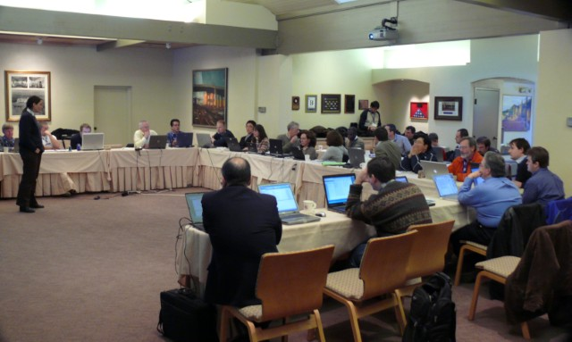



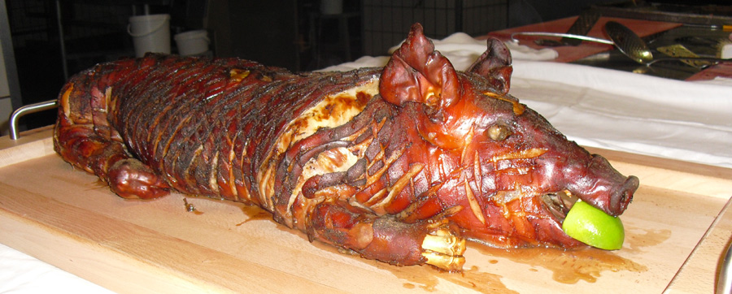




Have a great meeting week!
08:45
17:30
?

