Slide 1
SIS Area Report
Delay Tolerant Networking WG
Goals:
Begin work on Security and Contact Graph Routing Blue Books
Joint meeting with SEA-SEC to talk about bundle security.
Identify additional resources to support Network Management Book
Decide whether we need a NM Green Book or if we should go straight to Blue
Review various agencies’ experiences with DTN testing and experimentation
Working Group Status:
LTP RIDs from final CESG review cleared – book is done (need resolution to publish to secretariat).
BP interoperability testing complete – submit book for final CESG polling and CMC polling.
Reviewed pending Bundle Security Protocol with SEA Security WG
Remarks
Resources for follow-on work in security and routing identified (rollover from BP and LTP work)
Network Management and other work will start later (will require CMC approval at that time)
Plans
Complete BP and LTP; move forward with Security, and Routing; track ongoing work in Network Management experimentation by NASA, DLR, and others.
Working Group Summary Situation:
status: | OK | CAUTION | PROBLEM
 | LTP and BP Completed

Slide 2
SIS-DTN Resources Discussion
Work Item | Current Status | Target Date | Resources Needed (total, across all agencies) | Notes
Bundle Security | APPROVED | End of CY2018 | 12 WM
Contact Graph Routing | APPROVED | End of CY2018 | 18 WM | JAXA can produce a prototype
Network Management Green Book | PENDING (will require CMC approval) | End of CY2019 | 12 WM | WG to consider need for separate Green Book; may proceed directly to Blue but schedule will have to wait for resource availability
Network Management Blue Book | PENDING (will require CMC approval) | End of CY2020 | 24 WM

Slide 3
SIS Area Report B. Meeting Demographics
 | Plenary | CFDP Refresh | DTN | DTN-Interop Test | Voice
ASI |  |  | 1 | 1
CNES
CNSA
CSA
DLR | 1 |  | 4 | 3 | 2
ESA |  | 1 | 2
INPE
JAXA |  | 1 | 2 | 3
NASA | 2 | 3 | 8 | 8 | 3
RFSA |  | 2 | 2 | 1 | 2
UKSA
Other* |  | 1 | 1 | 1
TOTAL | 3 | 8 | 20 | 17 | 7
 |  | *South Korea | *South Korea | *South Korea
Meeting Duration | 0.5 | 1.5 | 1.5 | 0.5 | 1
Agency Diversity | 2 | 4 | 7 | 6 | 3

Slide 4
SIS Area Report: Summary
Books Forthcoming | Resolution to Publish
CFDPv1 GB: Overview | 6/15/2016
CFDPv1 GB: Implementers’ Guide | 6/15/2016
CFDPv1 GB: Test Plan | 6/15/2015
CFDPv1 BB: CFDPv1 | 6/15/2016
Motion Imagery and Applications BB | 4/15/2015 (for Red-2 review)
Motion Imagery and Applications GB | 9/30/2015
Voice and Audio communications BB | 11/15/2015 (will be delayed)
Licklider Transmission Protocol BB | 3/31/2015
Bundle Protocol BB | 4/15/2015 (for CESG polling)
Notes:
4
4
4

Slide 5
SIS Area Report: New Work Items
New Work Items
SCPS-TP Refresh Working Group | New WG to refresh or retire SCPS-TP specification. Estimate total time commitment: total ~40 hours work.
Update DTN Rationale and Requirements Green Book | This can be taken up by the existing DTN WG to be completed by Fall 2015 CCSDS meetings. Estimated resource requirement: total resource estimate: 1 WM.
Voice Green Book Update | This can be taken up by the existing Voice WG, to be completed by the Fall 2015 CCSDS Meeting. Total Resource Estimate: 4 WM.
Motion Imagery Update for Motion JPEG2000 | This can be done by the existing MIA WG as a pink sheet to the forthcoming book. Total resource estimate: 2 WM. Within current WG charter –waiting on industry standardization for this pink sheet. H.265 Pink Sheet will be considered for sometime thereafter.
Notes:
5
5
5

Slide 6
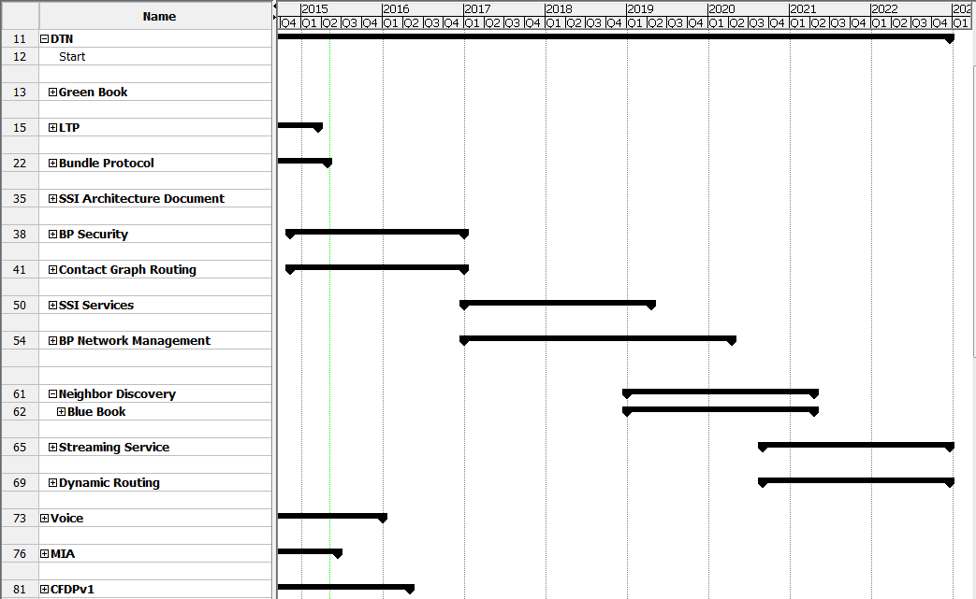
SIS Schedule and Resources
CMC Approval Will be Required to For Additional Work Items (in Yellow)

