Slide 1

Exploring CCSDS Terminology Differences
Peter Shames, SEA AD
Matthew Bennett, NASA JPL
31 Mar 2015

Slide 2
Contents
A review of some key CCSDS terms currently defined in all six CCSDS areas
Terms selected for relevance and also because there were multiple definitions
Terms are shown along with their definitions and the documents that were used as sources for the Glossary
In some cases other sources were sought for well formed definitions
SAWG Observations are provided like this
A proposed approach is offered at the end

Slide 3
Example Terminology Sources
Term | Standards
Entity | RASDS 311.0-M-1; SLERM 910.4-B-2
Object | RASDS 311.0-M-1; SLERM 910.4-B-2
Service | RASDS 311.0-M-1; SLERM 910.4-B-2; SM&C MORM 520.1-M-1; TM SCC 131.0-B-2; TM SDLP 132.0-B-1; TC SCC 231.0-B-2; TC SDLP 232.0-B-2
Action | RASDS 311.0-M-1; SM&C 520.0‑G‑3
Application | SLE, IPTS 913.1‑B‑1; AMS 735.1‑B‑1; SOIS-TAS 872.0‑M‑1
Information Model | RASDS 311.0-M-1; RASIM 312.0-G-1
Data Model | RASDS 311.0-M-1; RASIM 312.0-G-1
Information Object | RASDS 311.0-M-1; RASIM 312.0-G-1
Data Object | SDSO SFDU: SIA 610.0‑G‑5; SFDU: SCR 620.0‑B‑2; SFDU: T 621.0‑G‑1; RMOAIS 650.0‑M‑2; XFDU SCR 661.0‑B‑1; PAIMAS 651.0‑M‑1; RASDS 311.0-M-1; RASIM 312.0-G-1
Binding | MORM 520.1‑M‑1; SCCS-ADD 901.0-G-1;
Domain | MOSC 520.0‑G‑3; RASDS 311.0-M-1
Channel | DELTA-DOR OPS 506.0‑M‑1; DELTA-DOR RDEF 506.1‑B‑1; SOIS 850.0-G-2; SOIS-SPS 851.0‑M‑1; SOIS-SMAS 852.0‑M‑1; SOIS-SSS 853.0‑M‑1; SOIS-SDDS 854.0‑M‑1; SOIS-TAS 855.0‑M‑1
Protocol Data Unit | SOIS 850.0‑G‑2; RASDS 311.0‑M‑1; MOSC 520.0‑G‑3

Slide 4
Examples of Terminology Differences
  service (RASDS 311.0-M-1)
  A service is a provision of an interface of an object to support actions of another object.
  service user/provider (SLE Ref Model 910.4-B-2)
  An entity that offers a service to another by means of one or more of its ports is called a service provider (provider). The other entity is called a service user (user). An entity may be a provider of some services and a user of others.
  service (SM&C MORM 520.1-M-1)
  A set of capabilities that a component provides to another component via an interface. A Service is defined in terms of the set of operations that can be invoked and performed through the Service Interface. Service specifications define the capabilities, behaviour and external interfaces, but do not define the implementation.
  service (TM SCC 131.0-B-2; TM SDLP 132.0-B-1; TC SCC 231.0-B-2; TC SDLP 232.0-B-2)
  A capability provided to an entity (defined by reference to ISO 7498-1).
  Observation: RASDS & SLE definitions are very similar, but SLE is about a user / provider of such services. SM&C addresses capabilities at the interface (more about behavior), but then starts telling a story that is really three separate definitions in one. TM/TC also addresses the capability provided (at a SAP).

Slide 5
A Sketch of “Service” ontology
RASDS: A service is a provision of an interface of an object to support actions of another object.
SLE: An entity that offers a service to another by means of one or more of its ports is called a service provider (provider). The other entity is called a service user (user). An entity may be a provider of some services and a user of others.
Discussion: The SLE service is a specialization of RASDS service. The SLE entity looks like a specialization of RASDS object, but the SLE entity appears to be an enterprise viewpoint object related to organization rather than a system object.

Slide 6
Examples of Terminology Differences, contd
  action (RASDS 311.0-M-1)
  An action is something that happens within an object, either with or without participation of another object. An interaction is an action performed by an object with participation of another object or with its environment.
  action (SM&C 520.0‑G‑3)
  An atomic (non-interruptible) control directive of mission operations (equivalent to a telecommand or ground-segment directive) that can be initiated by manual or automatic control sources, via the M&C service. An action may have arguments and its evolving status can be observed. An action can typically apply pre- and post-execution checks.
  Observation: RASDS is about behavior inside an object. It also adds in the definition of “inter-action”. SM&C qualifies this as “non-interruptible” but then constrains it to “control directive” or “command”. It then adds in other aspects “manual/ automatic”, “arguments”, “status”, and “pre-/post- execution checks”. These are separate topics.

Slide 7
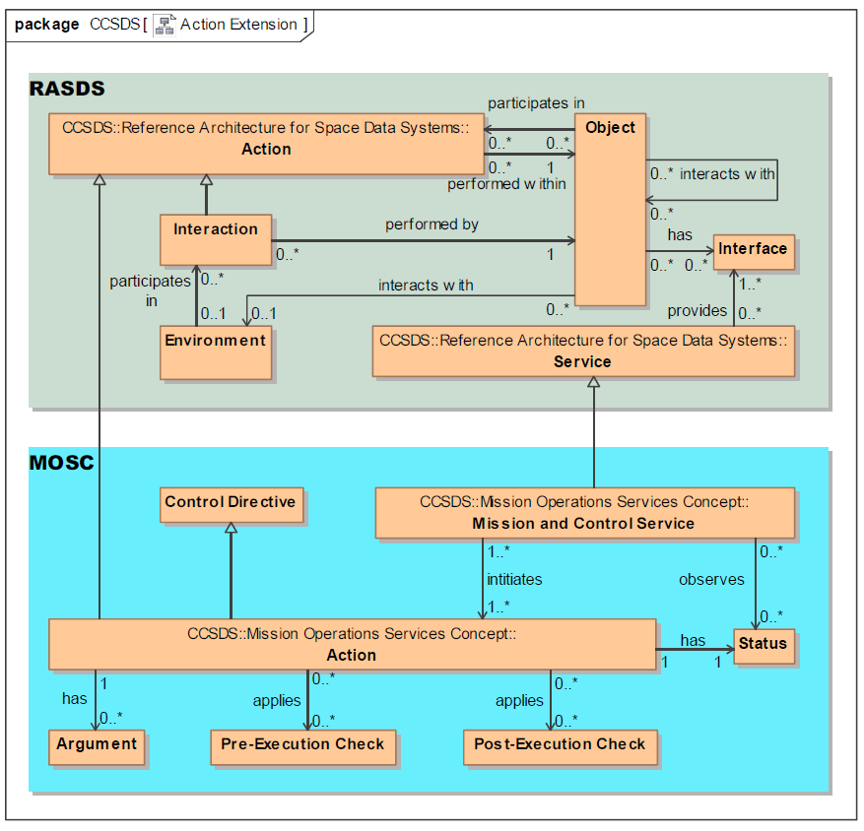
A Sketch of “Action” ontology
RASDS: An action is something that happens within an object, either with or without participation of another object. An interaction is an action performed by an object.
  MOSC: An atomic (non-interruptible) control directive of mission operations (equivalent to a telecommand or ground-segment directive) that can be initiated … via the M&C service. An action may have arguments …. An action can typically apply pre- and post-execution checks.
Discussion: The MOSC MCS appears to be a specialization of RASDS service. The action looks like a specialization of RASDS action, but “action” in MOSC appears to be more like a generalized directive that can be specialized. MOSC does define service interface but that does not appear in this “action” definition.
NOTE: The MOSC part of this diagram should show “Control Directive” instead of “Action”. We think Action is a specialization of Control Directive.

Slide 8
Examples of Terminology Differences, contd
  application (RASDS 311.0-M-1)
  Applications (software Engineering Objects) use Communications protocols to transfer Information among themselves. These protocols are defined by Standards.
  application (SLE, IP for Transfer Services, 913.1‑B‑1)
  A software entity in an SLE user system or an SLE provider system that makes use of the ISP1 protocol, as distinguished from the software implementing the protocol layers defined in this Recommended Standard. The application is considered to implement the ‘higher layers’ defined in the architectural model in section 2.
  application (AMS protocol, 735.1‑B‑1)
  A data system implementation, typically taking the form of a set of source code text files, that relies on AMS procedures to accomplish its purposes. Each application is identified by an application name.
  application (SOIS Time Access Service, 872.0‑M‑1)
  Component of the onboard software that makes use of the Time Access Service.
  Observation: RASDS is about software and protocols, and their relationship to standards. SLE is also about software, with a specific specialization, and it is also tied to protocols. AMS addresses the source of the software (text files), includes a tie to AMS procedures (protocol), and adds a separate aspect, that of naming. SOIS is similar to the others and specialized.

Slide 9
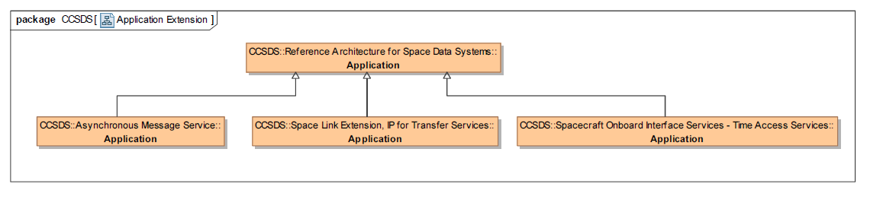
A Sketch of “Application” ontology
  Applications in AMS, SLE IP for Transfer Services, and SOIS – TAS are specializations of the general RASDS application concept.

Slide 10
Examples of Terminology Differences, contd
  information model (RASDS 311.0-M-1)
  Schema—An information model defined in a document or a database.
  information model (RASIM 312.0-G-1)
  Each of the mission-oriented application functions can be instantiated with a common set of information services coupled with information models for their local deployment. These models dictate the structure, organization, and content of the information objects that flow between the application functions.
  data model (RASDS 311.0-M-1)
  A data model is the schema and structure definitions of information in a system.
  data model (RASIM 312.0-G-1)
  The process of comparing data elements is made much easier if a single data model (or metamodel) is used to capture the domain data models. It provides a standard notation, syntax, and semantics so that data elements from two different domains can be contrasted and compared.
  Examples of data modeling theory include the Entity-Relationship (E-R) Model, the UML, and ontologies based on the Web Ontology Language (OWL).
  Observation: RASDS says “info model = schema”. RASIM says “info model = ‘structure, organization, and content of the information objects’”. These are similar, but RASIM is more specific. RASDS say “data model = schema & structure definitions”, which sounds a lot like the RASDS info model. RASIM says “data model = standard notation, syntax, and semantics”, which sounds a lot like the RASIM info model in slightly different words.

Slide 11
Examples of Terminology Differences, contd
  information object (RASDS 311.0-M-1)
  Information object—Data, along with the necessary structure and syntax to allow interpretation and use of that data; may also have associated metadata, including the relationships among Data Objects, rules for their use and transformation, and policies on access.
  information object (RASIM 312.0-G-1)
  An application information object is an independent, flexible model of the data and corresponding metadata in an information system, and is meant to be reusable across many information system domains. The information object is composed of a data object—a sequence of bits responsible for physically representing data, and a metadata object
  data object (RASDS 311.0-M-1)
  Data objects are the basic information objects, either physical or digital.
  data object (RASIM 312.0-G-1)
  Data objects are either physical objects or digital objects.
  Observation: RASDS says “info object = data, plus structure & syntax”, and then folds in other aspects such as metadata, relationships, rules. RASIM says “info object = ‘independent flexible model of data and metadata’”. These are similar, but RASIM is more specific. RASDS say “data object = info objects”, which is circular. RASIM says “data objects = physical or digital objects”.

Slide 12
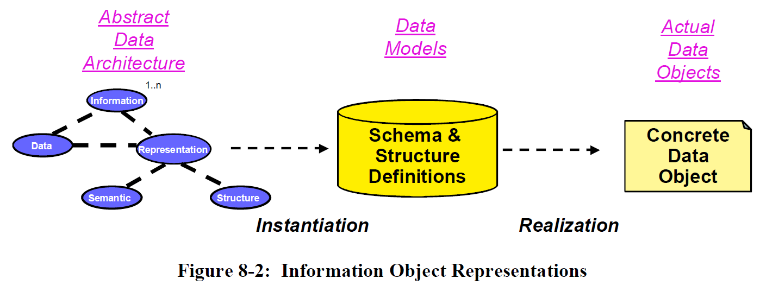
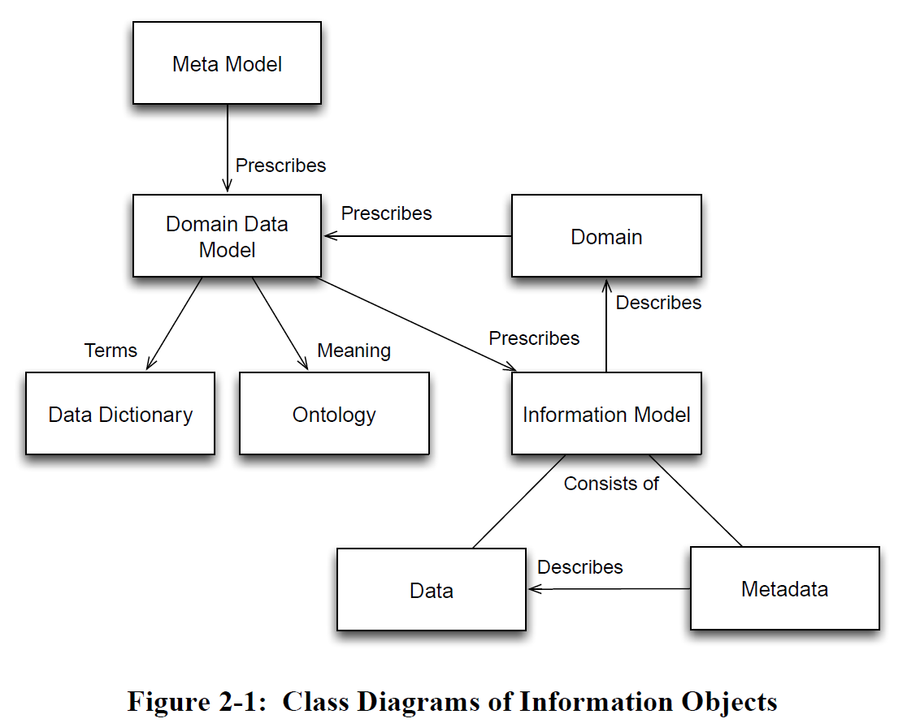
Examples of Terminology Differences, contd
Discussion:
This RASDS diagram states that Information Models and the Information Objects that comprise them and the relationships between the Information Objects comprise a higher level of abstraction than Data Models and Data Object.
This RASIM diagram states that an Information Model is an instance of a Data Model. This is the opposite of what RASDS states.
RASDS
RASIM

Slide 13
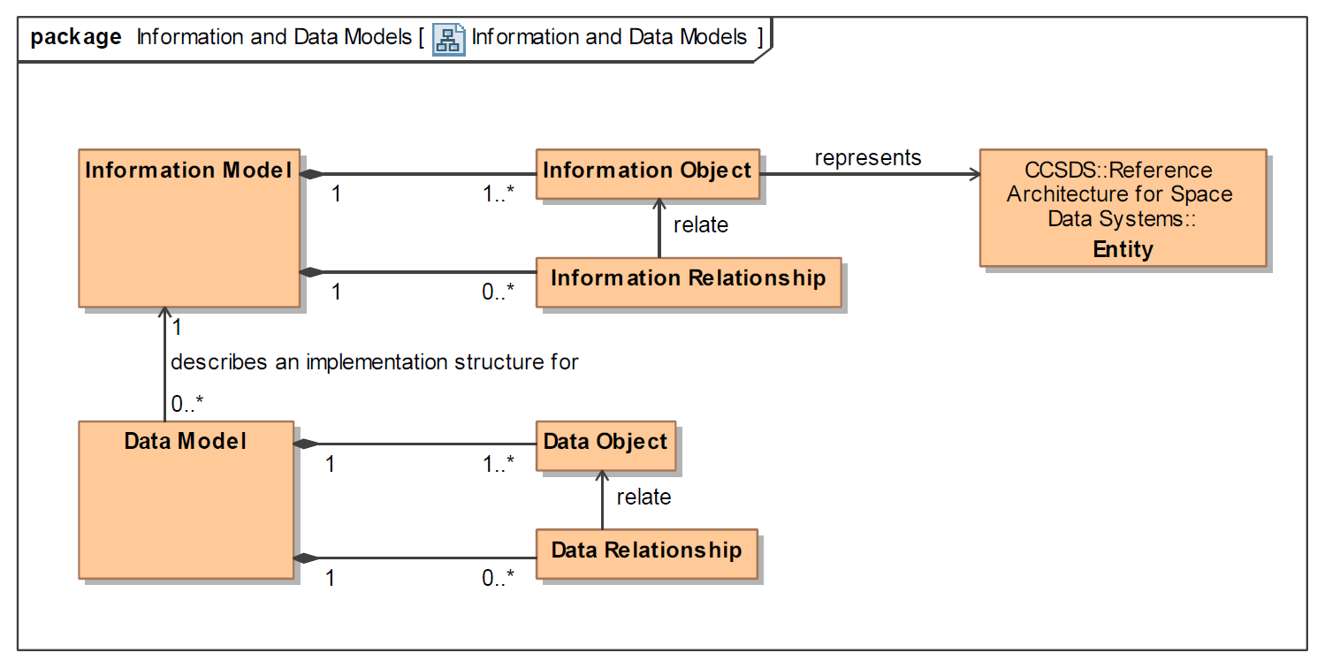
A Sketch of “Information and Data” ontology
In accordance with the Internet Research Task Force (IRTF) https://tools.ietf.org/html/rfc3444
“The main purpose of an IM is to model managed objects at a conceptual level, independent of any specific implementations.
DMs, conversely, are defined at a lower level of abstraction and include many details. They are intended for implementors and include protocol-specific constructs.”
Note that “object” on this diagram corresponds to the concept of “class” in object-oriented modeling.
Observation: This definition is very close to the RASDS diagram, but the RASDS definitions are not as crisp. It is different from the RASIM definitions which reverse the ordering.

Slide 14
Examples of Terminology Differences, contd
  data object (SDSO SFDU: SIA 610.0‑G‑5; SFDU: SCR 620.0‑B‑2; SFDU: T 621.0‑G‑1)
  A collection of data elements that are aggregated for or by a specific application.
  data object (RASDS 311.0-M-1)
  Data objects are the basic information objects, either physical or digital.
  data object (RASIM 312.0-G-1; RMOAIS 650.0‑M‑2; PAIMAS 651.0‑M‑1)
  Data objects are either physical objects or digital objects.
  data object (XFDU SCR 661.0‑B‑1)
  Object that contains some file content and any data required to allow the information consumer to reverse any transformations that have been performed on the object and restore it to the byte stream intended for the original designated community and described by the Representation metadata pointed to by the repID attribute of the data object.
  Observation: The SFDU definition is really for a “complex/aggregate data object” rather than for a “primitive data object”. The RASDS and RASIM are similar, but the RASIM/OAIS/PAIMAS is more precise. The XFDU says “data object = file content” and then starts to tell a story about transformations, communities, representations and metadata.
  If XFDU started with “data” and “complex/aggregate data” definitions, it could then just specialize that for file data. The other topics belong in separate definitions.

Slide 15
Examples of Terminology Differences, contd
  binding (CSRM SLES 910.4‑B‑2)
  The act of establishing an association between two ports of the same type such that a service can be provided.
  binding (MORM 520.1‑M‑1)
  The access mechanism for a Service. Bindings are used to locate and access Service Interfaces. Services use bindings to describe the access mechanisms that consumers have to use to call the Service. The binding specifies unambiguously the protocol stack required to access a Service Interface. Bindings may be defined statically at compile time or they may use a variety of dynamic run-time mechanisms (DNS, ports, discovery).
  interface binding (SCCS-ADD 901.0-G-1)
  The technical means by which a user of the service locates, accesses, configures, and utilizes the service itself. This binding includes not just the address of the platform that hosts the service element and the address of the port for the service, it also includes a description of the stack of protocols that the service expects to respond to.
  Observation: SLE defines “binding” as the act, but it does reference ports and service. The MORM says “binding = access mechanism”, but then goes on to reference location (discovery), descriptions of access mechanisms (interface signature), protocols stacks, and run-time mechanisms. The SCCS-ADD says “interface binding = means by which a user locates, accesses, configures, and utilizes the service”. This is similar to the MORM, in that is includes discovery and interface signature, and it also convolves several different topics including protocol stacks.
  These are all separate topics needing definition, and the SLE “action” verb form is likely needed along with a normalized MORM / SCCS-ADD noun form.

Slide 16
Examples of Terminology Differences, contd
  domain (MOSC 520.0‑G‑3)
  A namespace that partitions separately addressable entities (e.g., actions, parameters, alerts) in the space system. The space system is decomposed into a hierarchy of domains within which entity identifiers are unique.
  domain (RASDS 311.0-M-1)
  A Domain (e.g., NASA Code Y) is a type of Community that is under single organizational, administrative, or technical control. A domain may have resources, policies, access control, and possibly constraints on quality of service. A Domain may be subdivided into Subdomains. Multiple independent Domains may be organized into a Federation.
  domain (AMS 735.1‑B‑1)
  The set of modules to which a service request pertains. It comprises all of the modules that are members of the venture in which the operative module is itself a member, with some defined exceptions.
  Observation: The MOSC defines a namespace for addressable entities (presumably software entities), but it then says “entities = actions, parameters, alerts”. A more usual definition might say that “entities have actions, parameters, alerts”. The RASDS defines “domain = a type of community”, i.e. an organization or enterprise object. The AMS refers to a group of communicating software modules, rather like a “community of software modules”.
  These are entirely different concepts and probably, after fixing issues, need to be retained as separate definitions.

Slide 17
Examples of Terminology Differences, contd
  channel (DELTA-DOR OPS 506.0‑M‑1; DELTA-DOR RDEF 506.1‑B‑1)
  A slice of the frequency spectrum containing a spacecraft or quasar signal.
  channel (SOIS 850.0-G-2; SOIS-SPS 851.0‑M‑1; SOIS-SMAS 852.0‑M‑1; SOIS-SSS 853.0‑M‑1; SOIS-SDDS 854.0‑M‑1; SOIS-TAS 855.0‑M‑1)
  Identifier for subnetwork resources associated with a resource reservation.
  channel (SLS RF & Modulation Systems 401.0-B-23)
  Uses the terms “channel” and “spacelink” without ever defining them or referencing them from some other document.
  physical channel (SLS TM 132.0-B-1, TC 232.0-B-2, TM Synch & Channel Coding 131.0-B-2)
  A stream of bits transferred over a space link in a single direction.
  physical channel (SLS Prox-1 211.1-B-4)
  physical channel: The RF channel upon which the stream of channel symbols is transferred over a space link in a single direction.
  virtual channel (SLS TM 132.0-B-1, TC 232.0-B-2)
  The Virtual Channel facility allows one Physical Channel to be shared among multiple higher-layer data streams, each of which may have different service requirements. A single Physical Channel may therefore be divided into several separate logical data channels, each known as a ”Virtual Channel”. Each Transfer Frame transferred over a Physical Channel belongs to one of the Virtual Channels of the Physical Channel.
  Observation: Although these are stated in quite different words several of the terms can be easily related; a space “communications channel = a slice of the frequency spectrum”. This could be RF or optical and the reference to quasar is a D-DOR specialization. Except for SOIS these ambiguities could be resolved through specialization, use of namespaces, or by adding a modifier to the names. The SLS TM virtual channel definitions is more of a “story”.
  RF&M makes use of many such terms without ever defining any of them.
  SOIS, on the other hand, is in a different domain entirely, that of spacecraft on-board subnets, and will either require use of namespaces or re-definition in the subnet context.

Slide 18
Examples of Terminology Differences, contd
  protocol data unit (SOIS 850.0‑G‑2)
  A unit of data specified in a protocol and consisting of protocol-control-information and possibly user data.
  protocol data unit (RASDS 311.0‑M‑1)
  A unit of data specified in an (N-layer)-protocol, consisting of (N-layer)-protocol-control-information and possibly (N-layer)-user-data; the actual data objects that are exchanged between peer protocol entities.
  protocol data unit (MOSC 520.0‑G‑3)
  Elemental data message for exchange between peer service layers of two applications using a particular implementation protocol.
  Observation: The RASDS re-uses the ISO BRM definition. The SOIS definition is very similar and well aligned. The MOSC definition starts to sound aligned, but then veers into “peer service layers” (one layer on top of another?) and “applications using a … protocol”. These are (possibly) related topics, but are not part of a normal PDU definitions.
  The separate concepts and relationships among “PDU”, “protocol”, “layer”, “peer protocol entities”, and applications using a protocol stack to communicate need to be crisply defined and properly re-used.

Slide 19
SAWG Observations
Some of the terms used in CCSDS documents are not even in the CCSDS Glossary
We only have accurate information models and schema for a small sub-set of the terms in use
Some terms are (re-)defined in multiple different standards, and this is where issues arise
Lack of consistent terminology makes automation and cross use of terms much more difficult
Some terminology is in isolated domains and not an issue
Multiple inconsistencies in use of terminology
  Collisions of usage (same word, two different meanings)
  Specializations (same word, but on analysis one derived from another)
  Multiple terms used for the same things
  Internal inconsistencies in usage or definitions
  Inconsistent use of representations (lack of class diagrams)
  Inconsistent references to external standards (ISO BRM and other)
Some differences appear to be easy to resolve, others will require more work

Slide 20
SAWG Recommended Approach
Understand and quantify the severity of the problem
Review issues and proposed solutions with WGs and Areas
Use a formal terminology approach (ontology) to identify terms, relationships, concepts, and specializations
Support multiple definitions where they are really required
Provide English clarifications (reed, read, red, read)
Create consistent definitions and re-use them
Use clear representations (class diagrams)
Use consistent references to external standards (ISO BRM and other)
Create as consistent a set of terms as possible, use namespace to disambiguate where possible
Propose clarified definitions where necessary
Update the ontology then bring standards in-line when they are “refreshed”

