Slide 1

Example CCSDS Terminology Differences
Peter Shames, SEA AD
Matthew Bennett, NASA JPL
12 Mar 2015

Slide 2
Example Terminology Differences
Term | Standards
Entity | RASDS 311.0-M-1; SLERM 910.4-B-2
Object | RASDS 311.0-M-1; SLERM 910.4-B-2
Service | RASDS 311.0-M-1; SLERM 910.4-B-2; SM&C MORM 520.1-M-1; TM SCC 131.0-B-2; TM SDLP 132.0-B-1; TC SCC 231.0-B-2; TC SDLP 232.0-B-2
Action | RASDS 311.0-M-1; SM&C 520.0‑G‑3
Application | SLE, IPTS 913.1‑B‑1; AMS 735.1‑B‑1; SOIS-TAS 872.0‑M‑1
Information Model | RASDS 311.0-M-1; RASIM 312.0-G-1
Data Model | RASDS 311.0-M-1; RASIM 312.0-G-1
Information Object | RASDS 311.0-M-1; RASIM 312.0-G-1
Data Object | SDSO SFDU: SIA 610.0‑G‑5; SFDU: SCR 620.0‑B‑2; SFDU: T 621.0‑G‑1; RMOAIS 650.0‑M‑2; XFDU SCR 661.0‑B‑1; PAIMAS 651.0‑M‑1; RASDS 311.0-M-1; RASIM 312.0-G-1
Binding | MORM 520.1‑M‑1; SCCS-ADD 901.0-G-1;
Domain | MOSC 520.0‑G‑3; RASDS 311.0-M-1
Channel | DELTA-DOR OPS 506.0‑M‑1; DELTA-DOR RDEF 506.1‑B‑1; SOIS 850.0-G-2; SOIS-SPS 851.0‑M‑1; SOIS-SMAS 852.0‑M‑1; SOIS-SSS 853.0‑M‑1; SOIS-SDDS 854.0‑M‑1; SOIS-TAS 855.0‑M‑1
Protocol Data Unit | SOIS 850.0‑G‑2; RASDS 311.0‑M‑1; MOSC 520.0‑G‑3

Slide 3
Examples of Terminology Differences
  service (RASDS 311.0-M-1)
  A service is a provision of an interface of an object to support actions of another object.
  service user/provider (SLE Ref Model 910.4-B-2)
  An entity that offers a service to another by means of one or more of its ports is called a service provider (provider). The other entity is called a service user (user). An entity may be a provider of some services and a user of others.
  service (SM&C MORM 520.1-M-1)
  A set of capabilities that a component provides to another component via an interface. A Service is defined in terms of the set of operations that can be invoked and performed through the Service Interface. Service specifications define the capabilities, behaviour and external interfaces, but do not define the implementation.
  service (TM SCC 131.0-B-2; TM SDLP 132.0-B-1; TC SCC 231.0-B-2; TC SDLP 232.0-B-2)
  A capability provided to an entity (defined by reference to ISO 7498-1).

Slide 4
A Sketch of “Service” ontology
RASDS: A service is a provision of an interface of an object to support actions of another object.
SLE: An entity that offers a service to another by means of one or more of its ports is called a service provider (provider). The other entity is called a service user (user). An entity may be a provider of some services and a user of others.
Discussion: The SLE service is a specialization of RASDS service. The SLE entity looks like a specialization of RASDS object, but the SLE entity appears to be an enterprise viewpoint object related to organization rather than a system object.

Slide 5
Examples of Terminology Differences, contd
  action (RASDS 311.0-M-1)
  An action is something that happens within an object, either with or without participation of another object. An interaction is an action performed by an object with participation of another object or with its environment.
  action (SM&C 520.0‑G‑3)
  An atomic (non-interruptible) control directive of mission operations (equivalent to a telecommand or ground-segment directive) that can be initiated by manual or automatic control sources, via the M&C service. An action may have arguments and its evolving status can be observed. An action can typically apply pre- and post-execution checks.

Slide 6
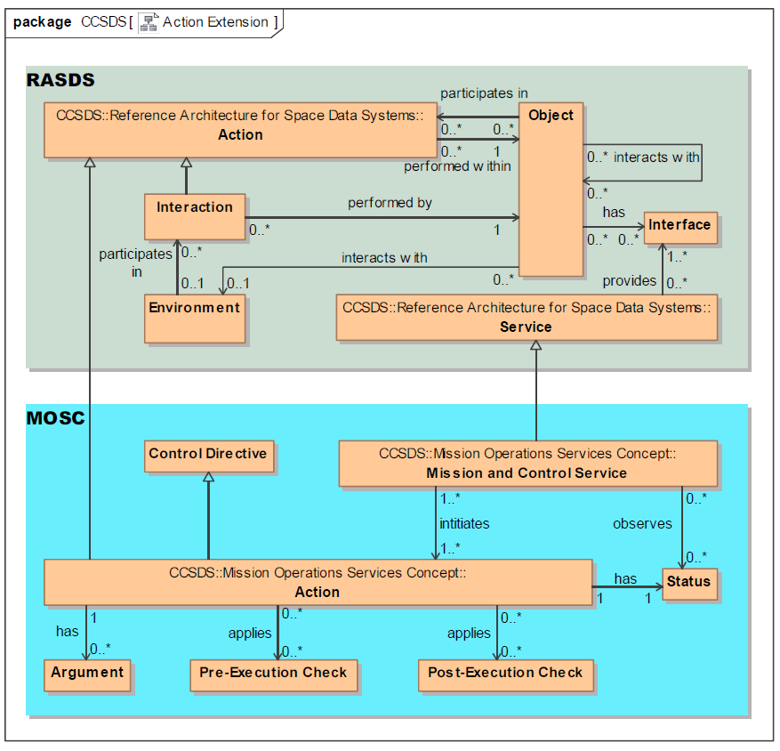
A Sketch of “Action” ontology
RASDS: An action is something that happens within an object, either with or without participation of another object. An interaction is an action performed by an object.
  MOSC: An atomic (non-interruptible) control directive of mission operations (equivalent to a telecommand or ground-segment directive) that can be initiated … via the M&C service. An action may have arguments …. An action can typically apply pre- and post-execution checks.
Discussion: The MOSC MCS appears to be a specialization of RASDS service. The action looks like a specialization of RASDS action, but “action” in MOSC appears to be more like a generalized directive that can be specialized. MOSC does define service interface but that does not appear in this “action” definition.
NOTE: The MOSC part of this diagram should show “Control Directive” instead of “Action”. We think Action is a specialization of Control Directive.

Slide 7
Examples of Terminology Differences, contd
  application (RASDS 311.0-M-1)
  Applications (software Engineering Objects) use Communications protocols to transfer Information among themselves. These protocols are defined by Standards.
  application (SLE, IP for Transfer Services, 913.1‑B‑1)
  A software entity in an SLE user system or an SLE provider system that makes use of the ISP1 protocol, as distinguished from the software implementing the protocol layers defined in this Recommended Standard. The application is considered to implement the ‘higher layers’ defined in the architectural model in section 2.
  application (AMS protocol, 735.1‑B‑1)
  A data system implementation, typically taking the form of a set of source code text files, that relies on AMS procedures to accomplish its purposes. Each application is identified by an application name.
  application (SOIS Time Access Service, 872.0‑M‑1)
  Component of the onboard software that makes use of the Time Access Service.

Slide 8
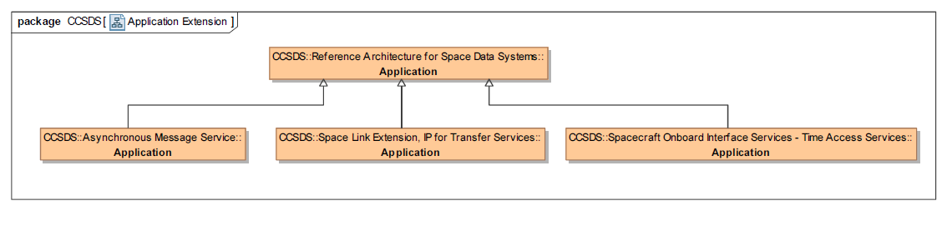
A Sketch of “Application” ontology
  Applications in AMS, SLE IP for Transfer Services, and SOIS – TAS are specializations of the general RASDS application concept.

Slide 9
Examples of Terminology Differences, contd
  information model (RASDS 311.0-M-1)
  Schema—An information model defined in a document or a database.
  information model (RASIM 312.0-G-1)
  Each of the mission-oriented application functions can be instantiated with a common set of information services coupled with information models for their local deployment. These models dictate the structure, organization, and content of the information objects that flow between the application functions.
  data model (RASDS 311.0-M-1)
  A data model is the schema and structure definitions of information in a system.
  data model (RASIM 312.0-G-1)
  The process of comparing data elements is made much easier if a single data model (or metamodel) is used to capture the domain data models. It provides a standard notation, syntax, and semantics so that data elements from two different domains can be contrasted and compared.
  Examples of data modeling theory include the Entity-Relationship (E-R) Model, the UML, and ontologies based on the Web Ontology Language (OWL).

Slide 10
Examples of Terminology Differences, contd
  information object (RASDS 311.0-M-1)
  Information object—Data, along with the necessary structure and syntax to allow interpretation and use of that data; may also have associated metadata, including the relationships among Data Objects, rules for their use and transformation, and policies on access.
  information object (RASIM 312.0-G-1)
  An application information object is an independent, flexible model of the data and corresponding metadata in an information system, and is meant to be reusable across many information system domains. The information object is composed of a data object—a sequence of bits responsible for physically representing data, and a metadata object
  data object (RASDS 311.0-M-1)
  Data objects are the basic information objects, either physical or digital.
  data object (RASIM 312.0-G-1)
  Data objects are either physical objects or digital objects.

Slide 11
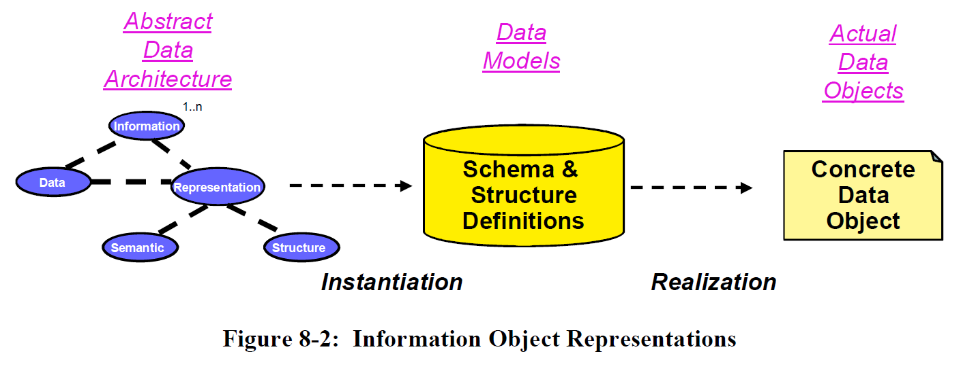
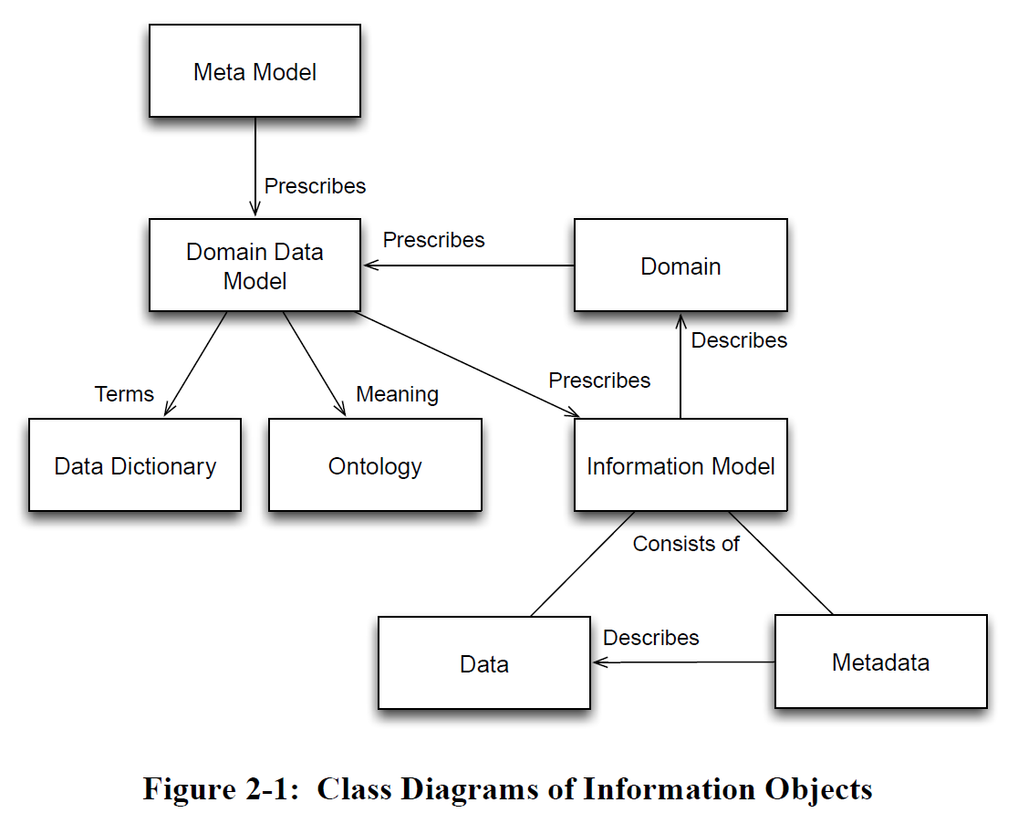
Examples of Terminology Differences, contd
Discussion:
RASDS implies that Information Models and the Information Objects that comprise them and the relationships between the Information Objects comprise a higher level of abstraction than Data Models and Data Object.
RASIM implies that an Information Model is an instance of a Data Model.
RASDS
RASIM

Slide 12
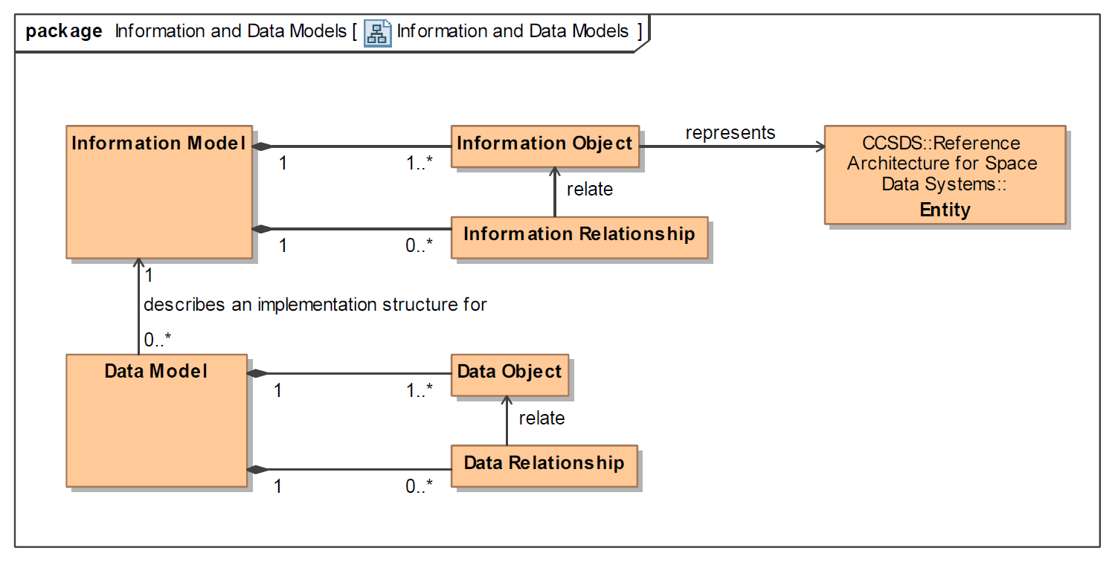
A Sketch of “Information and Data” ontology
Recommendation:
In accordance with the Internet Research Task Force (IRTF) https://tools.ietf.org/html/rfc3444
“The main purpose of an IM is to model managed objects at a conceptual level, independent of any specific implementations.
DMs, conversely, are defined at a lower level of abstraction and include many details. They are intended for implementors and include protocol-specific constructs.”
Note that “object” on this diagram corresponds to the concept of “class” in object-oriented modeling.

Slide 13
Examples of Terminology Differences, contd
  data object (SDSO SFDU: SIA 610.0‑G‑5; SFDU: SCR 620.0‑B‑2; SFDU: T 621.0‑G‑1)
  A collection of data elements that are aggregated for or by a specific application.
  data object (RASDS 311.0-M-1)
  Data objects are the basic information objects, either physical or digital.
  data object (RASIM 312.0-G-1; RMOAIS 650.0‑M‑2; PAIMAS 651.0‑M‑1)
  Data objects are either physical objects or digital objects.
  data object (XFDU SCR 661.0‑B‑1)
  Object that contains some file content and any data required to allow the information consumer to reverse any transformations that have been performed on the object and restore it to the byte stream intended for the original designated community and described by the Representation metadata pointed to by the repID attribute of the data object.
  DISCUSSION:
  The first term is more generic, the next two are equivalent as they both imply a representation for physical or digital objects, the last is a very specific definition for XFDU.
  These definitions are not mutually exclusive and could be considered different facets or specializations of the same kind of entity.

Slide 14
Examples of Terminology Differences, contd
  binding (CSRM SLES 910.4‑B‑2)
  The act of establishing an association between two ports of the same type such that a service can be provided.
  binding (MORM 520.1‑M‑1)
  The access mechanism for a Service. Bindings are used to locate and access Service Interfaces. Services use bindings to describe the access mechanisms that consumers have to use to call the Service. The binding specifies unambiguously the protocol stack required to access a Service Interface. Bindings may be defined statically at compile time or they may use a variety of dynamic run-time mechanisms (DNS, ports, discovery).
  interface binding (SCCS-ADD 901.0-G-1)
  The technical means by which a user of the service locates, accesses, configures, and utilizes the service itself. This binding includes not just the address of the platform that hosts the service element and the address of the port for the service, it also includes a description of the stack of protocols that the service expects to respond to.
  DISCUSSION:
  These MORM and SCCS-ADD standards are in general agreement for the definition of "binding" as an access mechanism but not exactly the same. A more complete definition would include a union of these two definitions.
  However, CSRM SLES standard describes a binding as the "act" of connecting ports for establishing a service, rather than a service access "mechanism".

Slide 15
Examples of Terminology Differences, contd
  domain (MOSC 520.0‑G‑3)
  A namespace that partitions separately addressable entities (e.g., actions, parameters, alerts) in the space system. The space system is decomposed into a hierarchy of domains within which entity identifiers are unique.
  domain (RASDS 311.0-M-1)
  A Domain (e.g., NASA Code Y) is a type of Community that is under single organizational, administrative, or technical control. A domain may have resources, policies, access control, and possibly constraints on quality of service. A Domain may be subdivided into Subdomains. Multiple independent Domains may be organized into a Federation.
  domain (AMS 735.1‑B‑1)
  The set of modules to which a service request pertains. It comprises all of the modules that are members of the venture in which the operative module is itself a member, with some defined exceptions.
  DISCUSSION:
  These are entirely different concepts.
  The MOSC definition is a namespace, the one for RASDS is a type of community / enterprise object, and the one for AMS refers to a group of communicating entities.

Slide 16
Examples of Terminology Differences, contd
  channel (DELTA-DOR OPS 506.0‑M‑1; DELTA-DOR RDEF 506.1‑B‑1)
  A slice of the frequency spectrum containing a spacecraft or quasar signal.
  channel (SOIS 850.0-G-2; SOIS-SPS 851.0‑M‑1; SOIS-SMAS 852.0‑M‑1; SOIS-SSS 853.0‑M‑1; SOIS-SDDS 854.0‑M‑1; SOIS-TAS 855.0‑M‑1)
  Identifier for subnetwork resources associated with a resource reservation.
  DISCUSSION:
  Although these are entirely different concepts, a channel can be implemented by assigning a slice of the frequency spectrum in a frequency division multiplexed system. This could be a source of confusion.
  Could be resolved through use of namespaces or by adding a modifier to either or both names.

Slide 17
Examples of Terminology Differences, contd
  protocol data unit (SOIS 850.0‑G‑2)
  A unit of data specified in a protocol and consisting of protocol-control-information and possibly user data.
  protocol data unit (RASDS 311.0‑M‑1)
  A unit of data specified in an (N-layer)-protocol, consisting of (N-layer)-protocol-control-information and possibly (N-layer)-user-data; the actual data objects that are exchanged between peer protocol entities.
  protocol data unit (MOSC 520.0‑G‑3)
  Elemental data message for exchange between peer service layers of two applications using a particular implementation protocol.
  DISCUSSION:
  All of these definitions refer to the same concept, although the descriptions are at different specificities. The first case more general, the second more specific, and the third most specialized.
  Could be resolved using generalizations or agreeing on a single definition for all cases.

