Slide 1
CCSDS Cloud-Based Interoperability Testing
Keith Scott
20150202

Slide 2
Background
CCSDS requires that all new Recommended Standards undergo interoperability testing
  In a relevant environment, either real or simulated
  Between at least two independently-developed prototypes
Interoperability testing can be carried out with both parties physically present in the same location
It may be more convenient in some situations to allow for remote interoperability testing, where the two (or more) parties are not co-located (e.g. testing over the Internet)
  In these cases, getting administrative permission to connect machines across the Internet to foreign partners can be difficult and time-consuming
  With the advent of commercially-available cloud computing offerings, it is possible to ‘rent’ a computer or computers with Internet access and to use those for interoperability testing

Slide 3
Example CCSDS Use Cases
(Assumed) typical application:
  Instantiate some number of virtual machines ‘in the cloud’ and use them for interoperability testing of proposed CCSDS services

Slide 4
Executive Summary
A number of companies offer Infrastructure As A Service (IAAS)
  Rent machines and configure them to your liking (including network emulation (latency, loss, variable connectivity)) – Amazon Web Services is by far the largest at the moment
  Using these we can probably do anything at layer-3 and above that we could do in person (e.g. not viable for testing new modulation schemes)
Amazon Web Services (in particular their Elastic Compute Cloud, EC2)
  The AWS License Agreement seems reasonable
    Not hideously long or overly imbued with legalese
    Provides protection for user data content “… you or your licensors own all right, title, and interest in and to Your Content…”
  Security Procedures seem adequate
    Controlled access to machines from the machine AND from the AWS ‘console’, including restricting access from the Internet to particular subnets
    Isolation of machines (e.g. no packet sniffing between machines)
    Storage is wiped on decommission
Cost is not a particular issue
  O($20-$50) per use-month per machine; inactive machines are O($1-$5) a month
  Data transfer into / out of a machine is a component
What is your corporate policy on acquiring / using cloud resources?
  Agencies could acquire their own instances (on-demand or long-running)
  Secretariat could acquire and manage some number of instances for use by member agencies

Slide 5
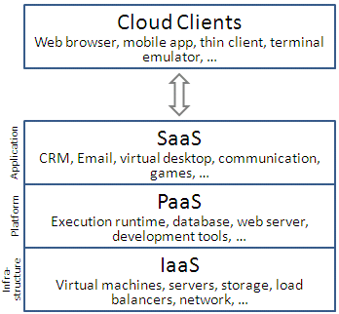
Cloud Service Models
Infrastructure as a service (IAAS)
  Rent a machine
  You get complete control over the machine (e.g. root access)
Platform as a service (PAAS)
  Rent a machine with some infrastructure on it (e.g. Web Server, Database, etc.)
  You can write applications against the infrastructure that’s on the machine
Software as a service (SAAS)
  Rent software (e.g. document / presentation / video editing software)
  You use the software to do stuff
http://en.wikipedia.org/wiki/Cloud_computing#Infrastructure_as_a_service_.28IaaS.29

Slide 6
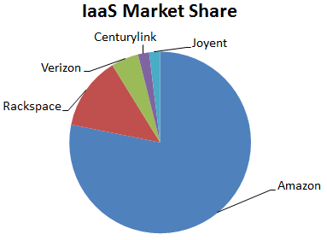
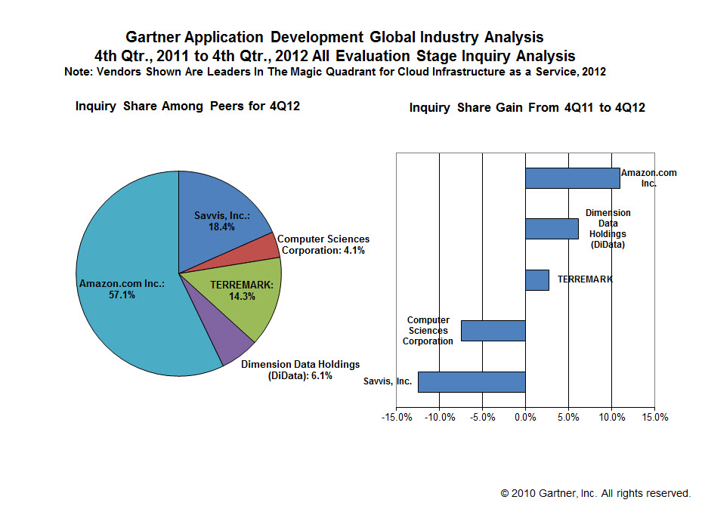
Some Providers
Some Cloud Providers:
  Amazon Web Services (AWS)
  Rackspace
  NASA Nebula Platform
  Google
  …
Single-Host Virtualization Options (not necessarily cloud-based)
  Multiple applications communicating over loopback
  Linux Containers
  VirtualBox
  VMWare
Notes:
Image Sources:
http://www.cloudcow.com/content/google-does-cloud-should-we-care
https://lcolumbus.files.wordpress.com/2013/05/cloud-iaas.jpg
NASA Nebula Platform:
http://www.nasa.gov/open/plan/nebula.html
http://nebula.nasa.gov

Slide 7
Possible Benefits to CCSDS
It MAY be easier to procure IAAS services and use them for interoperability testing than to do face-to-face testing or work to make machines accessible to the Internet
  This depends heavily on the specifics of various agencies’ ‘corporate policies’ with respect to access to cloud resources
CCSDS could set up and maintain ‘known good’ testing environments
  Implementations of CCSDS Data Links
  Sample environments (e.g. Earth-observing, Deep-Space) and configurations (e.g. lander control center, orbiter control center, DSN and other ground stations, all of CSTS and CSSM

Slide 8
Excerpts from AWS License Agreement
Introduction
  …You represent to us that you are lawfully able to enter into contracts (e.g., you are not a minor). If you are entering into this Agreement for an entity, such as the company you work for, you represent to us that you have legal authority to bind that entity.
Security and Data Privacy
  Data Privacy. We participate in the safe harbor programs described in the Privacy Policy. You may specify the AWS regions in which Your Content will be stored and accessible by End Users. We will not move Your Content from your selected AWS regions without notifying you, unless required to comply with the law or requests of governmental entities. You consent to our collection, use and disclosure of information associated with the Service Offerings in accordance with our Privacy Policy, and to the processing of Your Content in, and the transfer of Your Content into, the AWS regions you select.
Proprietary Rights: Your Content. As between you and us, you or your licensors own all right, title, and interest in and to Your Content. Except as provided in this Section 8, we obtain no rights under this Agreement from you or your licensors to Your Content, including any related intellectual property rights. You consent to our use of Your Content to provide the Service Offerings to you and any End Users. We may disclose Your Content to provide the Service Offerings to you or any End Users or to comply with any request of a governmental or regulatory body (including subpoenas or court orders).
Import and Export Compliance. In connection with this Agreement, each party will comply with all applicable import, re-import, export, and re-export control laws and regulations, including the Export Administration Regulations, the International Traffic in Arms Regulations, and country-specific economic sanctions programs implemented by the Office of Foreign Assets Control. For clarity, you are solely responsible for compliance related to the manner in which you choose to use the Service Offerings, including your transfer and processing of Your Content, the provision of Your Content to End Users, and the AWS region in which any of the foregoing occur.

Slide 9
Amazon Web Services Security
Using AWS Web Services Interface you can restrict which IP subnets on the Internet may talk to which instances / groups of instances
Network traffic is isolated; packet sniffing will NOT reveal data not destined for your machine; even two instances owned by the same customer and located on the same physical host cannot listen to each other’s traffic.
Decommissioned storage is wiped

Slide 10
What’s Your Corporate Policy on IAAS?
MITRE
  Essentially the same as if I wanted to put a machine on our corporate DMZ
    I can procure a cloud machine from MITRE corporate
      I can have root access, but MITRE corporate ALSO has access that they use for periodic security scans
    Very difficult to put anything developed as part of CCSDS work that is not open-source on the machine (have to get public release first)
NASA
  Access to Amazon GovCloud? Required to use it?
  NASA Nebula seems to have turned into commercial Nebula…
DLR
  Any ability to access?

Slide 11
Conclusions
Technically feasible
  Maintain CCSDS / agency intellectual property
  Ability to restrict access to machines and data
  Low cost impact
Administrative policies
  Is it any easier to use cloud resources than to allow communications for individual machines?
  Does the ability to commission and use ‘long-running’ cloud instances help?

Slide 12

Discussion

Slide 13
Backup

Slide 14
Security In Cloud-Based Services
From the outside of the machines: same security measures available to a machine on the open Internet, e.g.:
  Restrict access to ssh (including)
  Firewall rules
On the machine iteslf
  Can encrypt data at rest (e.g. encrypted filesystem)
What assurances that the cloud provider doesn’t walk off with the data?
  Amazon Web Services Customer Agreement

Slide 15
Simple Example
Machine 1
Administered by Organization_A
Not accessible
by Organization_B
(only via exposed
service interface)
Machine 2
As with Machine1
If needed, can configure IPSec on the link between machines to secure data in transit.
CCSDS Service Under Test
CCSDS Service Under Test
CCSDS Other
CCSDS Other
CCSDS Link
Exposed
Service
Interfaces
CCSDS Link
CCSDS Link Gateway
CCSDS Link Gateway
TCP / UDP
TCP / UDP
IPSec (optional)

Slide 16
Simple Example
Protocol Under Test (e.g. LTP)
Protocol Under Test (e.g. LTP)
CCSDS Encap
CCSDS Space
CCSDS Encap
CCSDS Space
UDP / TCP
UDP / TCP

Slide 17
More Complex Example
Orbiter
Ground Station
Ground Station
Prox-1
Lander Control Center
Mission Operations Center
CSSM
Ground Station
CSTS
Lander

Slide 18
Other Resources
Amazon Web Services – Overview of Security Processes
A Survey on Cloud Provider Security Measures

Slide 19
