Slide 1

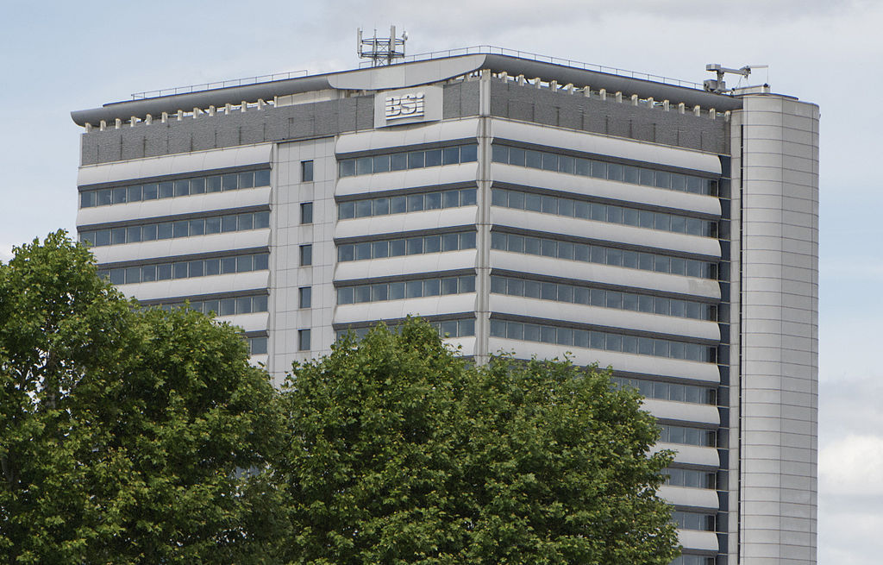
CCSDS Opening Plenary |  | 10 November 2014 BSI, London, UK
08:45 | Opening remarks | Nestor Peccia, CESG Chair
08:50 | Welcoming remarks from UKSA / BSI | N. N.
08:55 | CCSDS meeting overview: Administrative, Boot Camp, Meetings | Nick Tongson, Tom Gannet
0900 | CCSDS Management Topics | Mike Kearney
09:05 | CESG Open Issues & More | Nestor Peccia
09:13 | Systems Engineering Area objectives | Peter Shames, SEA Area Director
09:21 | Mission Ops and Information Mgt Services Area objectives | Nestor Peccia, MOIMS Area Director
09:29 | Cross Support Services Area objectives | Erik Barkley, CSS Area Director
09:37 | Space Link Services Area objectives | Gian-Paolo Calzolari, SLS Area Director
09:45 | Space Internet Services Area objectives | Keith Scott, SIS Area Director
09:53 | Spacecraft Onboard Interface Services Area objectives | Chris Taylor, SOIS Area Director
10:00 | Closing remarks; Adjourn

Slide 2
Administrative Overview
Registration will be outside the Asamblea Room.
Meeting and break schedules:
    Start time 08:45
    Coffee break 10:30-10:45
    Lunch Break 12:30-13:30
    Coffee Break 15:30-15:45
    End time 17:30
Coffee breaks will be at a central location near the Erasmus rooms.
No host lunch available in the restaurant.
  If you purchased a lunch voucher in advanced, please present it to the cashier. Vouchers can be paid directly at the hotel reception or charged to your room.
Please let the Secretariat staff know as soon as possible if you will not be using your meeting room at your scheduled time.
Basic/free wireless internet is available in the meeting rooms and throughout the hotel (network: Swisscom; obtain vouchers at front desk). High speed internet is also available by purchasing a €9.90 voucher (24 hour period) also at the front desk.
Nick to update
Notes:
2

Slide 3



CCSDS Technical Editors:
“Boot Camp”
Tom Gannett - CCSDS Chief Technical Editor
Peter Shames – CCSDS SEA Area Director
Tom to update
Add Peter to presenters
The purpose of the technical editor “boot camp” is to improve overall quality and enable faster processing of documents submitted to the Secretariat by familiarizing working group technical editors with CCSDS requirements for technical content, publication style and procedures for document submission.
IT IS MANDATORY THAT ANY PERSON WHO IS ASSIGNED TO BE THE EDITOR OF A CCSDS DOCUMENT MUST ATTEND A BOOT CAMP.
This week, Boot Camp sessions are scheduled as follows:
Session
Room
Monday, 13:30 - 17:30
Thursday, 13:30 - 17:30
Erasmus 121
Erasmus 121

Slide 4
Upcoming Meetings
Date | WG/CMC | Host | Location | Date | Comments
Spring 2014 | WG/CESG | ESA | ESTEC – Noordwijkerhout, NL | 31 Mar – 4 Apr
 | CMC/SC13 | ESA | ESTEC – Noordwijkerhout, NL | 7 – 9 Apr
Fall 2014 | WG | UKSA | London, UK | 10-14 Nov
 | CESG/CMC/SC13 | UKSA | London, UK | 17-20 Nov
Spring 2015 | WG/CESG | NASA | CalTech, JPL, California, USA | 23-27, 30 Mar
 | CMC/SC13 | JAXA | Japan | 19-21 May
Fall 2015 | WG/CESG | ESA | Darmstadt, Germany | 9-13 Nov
 | CMC/SC13 | ESA | Darmstadt, Germany | 16-18 Nov
Spring 2016 | WG/CESG | NASA | USA | TBD Date
 | CMC/SC13 | INPE | Brazil | TBD Date
Fall 2016 | WG/CESG | ASI | Italy | TBD Date
 | CMC/SC13 | ASI | Italy | TBD Date
Spring 2017 | WG/CESG | NASA | USA | TBD Date
 | CMC/SC13 | FSA | Russia | TBD Date
Fall 2017 | WG/CESG | ESA | Europe | TBD Date
 | CMC/SC13 | ESA | Europe | TBD Date
Spring 2018 | WG/CESG | NASA | USA | TBD Date
 | CMC/SC13 | CNSA | CNSA | TBD Date
5-Day
5-Day
4-Day
Visa letters: now being provided for the next meeting. Available 6 months in advance – get yours NOW for Spring 2015 from Nick Tongson (CCSDS Secretariat) at the registration desk

Slide 5
CCSDS Overview
Currently Active Publications: 139 Normative (Blue & Magenta): 86
Informative (Green): 53
Downloadable for free from www.ccsds.org
All major pubs since 1982: ~285
(Some were historical mission needs
or superseded technology)
Active Publications
718 space missions have adopted and used various CCSDS standards
Missions

Slide 6
CCSDS Mgt – Framework & Profile System
New Framework page is a good asset:
  Access through Framework tab at the top of the CWE.
  Green highlight indicates publically available resources.
New profile system successfully deployed
  Saves your information from one meeting cycle to the next
  Old CWE ID’s without profiles have now been deleted
New user process
  When a new user requests a CWE ID/Profile, they identify WGs they want to support.
  One of the WG Chairs that they cite is asked to approve their access to CWE materials (Private folders, mail list).
  In some cases, WG chairs may need to ask them a few questions.
  The space agency that they are affiliated with will be asked to verify that they are a valid participant from their country (see A02x1y4, Sec 5.2.4.4)
  We don’t want to discourage new participants, but we want to have a cursory check to insure they are valid contributors.

Slide 7
CCSDS Mgt – Rapporteurs and Mgt. Coord
Rapporteur lists now online
  For agencies that have designated them, currently ESA, NASA, CNES, DLR
  Rapporteurs are lead representatives and POCs for their agency in that WG.
Management-technical coordination topics
  When identifying necessary resources, WG chairs discuss agency contributions (BE, Prototypes) in their WG meetings
  Someone (either Rapporteur/lead from agency or the WG chair) should let the CMC member know what roles/resources are expected
  CMC member will get an “alert” from the Framework, but direct coordination is better.

Slide 8
CCSDS Mgt – SANA and Shirts
SANA News:
  SANA is developing programmatic interfaces for application access to SANA registries.
  SANA is also developing a registry at the request of the IOAG that documents Ground Comm Station information (location and technical specs)
  Result: STK is interested in incorporating that into their modeling applications for mission design.
  SEA is undertaking an active project to create a formal ontology from the current CCSDS Glossary.
  Other creative applications for SANA registry access may be possible… put your thinking caps on!
Team Spirit Shirts: (Announced in CCSDS-All broadcast)
  You can now order CCSDS logos on shirts and other apparel items from Land’s End.
  Must use the Land’s End link on the CCSDS.org website.
  Internationals must call. Advice on what to have ready for a phone order is available by email.

Slide 9
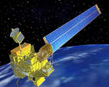
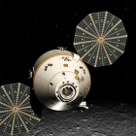
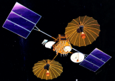
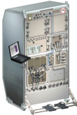



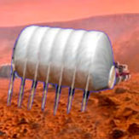

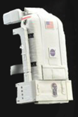






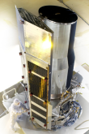
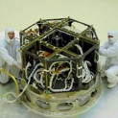

CCSDS Overview
End-to-End Architecture
Six Technical Areas,
Twenty-Seven Teams
Systems Engineering
Working Group (producing standards)
Birds-Of-a-Feather stage (pre-approval)
Special Interest Group (integration forum)
Security
Delta-DOR
Timeline Data Exchange
XML Standards and Guidelines
System Architecture WG
MISSION CONTROL
CENTER
End Users
Applications/Archives
MISSION CONTROL
CENTER
End Users
Spacecraft Onboard
Interface Services
Space Link
Services
Cross Support
Services
Space Internetworking
Services
Mission Ops &
Info Mgt Services
Onboard Wireless WG
Application Supt Services (incl. Plug-n-Play)
RF & Modulation
Space Link Coding & Sync.
Multi/Hyper Data Compress.
Space Link Protocols
Next Generation Uplink
Space Data Link Security
Optical Coding and Mod
CS Service Management
CS Transfer Services
Cross Supt Service Arch.
Motion Imagery & Apps
Delay Tolerant Networking
Voice
CFDP over Encap
CFDP Revisions
Data Archive Ingestion
Navigation
Spacecraft Monitor & Control
Digital Repository Audit/Certification
Telerobotics
9

Slide 10
CESG Open Issues & more
Project resources in the FW CWE 104 Projects currently in CWE FW
  Please add resources still missing, check inconsistencies(Monitor/Contributor)
  Please adjust your schedule (in particular for “behind schedule” projects)
CESG meeting on Friday 4th April – Main topics
  CCSDS Strategic Plan (!!! comments received from CMC !!!)
  Organization & Procedures YB (Update under discussion between CESG / CMC)
  ICPA (IOAG CCSDS Product Agreement) Please check at WG level
  Potential overlaps issues
  XML findings from SIG
  Potential liaison with OGC (Open Geospatial Consortium)
  Reference Implementation (Is SW downloadable from CCSDS qualified ?)
  CCSDS tutorial at GSAW 2015
  New Project creation / inclusion of Concept Paper within poll documentation
  IT Priority: RID System vs. Poll improvement AD to check with WG Chairs
  CCSDS wiki: at CESG, Area, and / or WG level ?
  Feasibility of Open Source SW Repository within CCSDS
  Ontologies, CCSDS-wide, coordination with SC14 ?
Nestor to update

Slide 11
CESG Open Issues & more
WG Chairs are encouraged to be more active at recruiting membership
  CCSDS encourages Observer Agencies to actively participate in WGs
  Go to CWE and find an exciting new standards and technology area that your experts can help with
  Even if you can not travel, you can participate electronically
Nestor to update

Slide 12
CESG / CMC Poll Statistics
CESG Polls since last meeting (October 2013)
  Publication
    5 GBs, 7 BBs, 2 Technical corrigendum (BB), 4 MBs
  Agency Review
    1 Pink Sheet
  Org & Proc YB reviewed by CESG
  CCSDS Strategic Plan issued by CESG
  Completion of SEA SANA WG
  Nomination of new MOIMS DAI WG Chair (D. Boucon, CNES)
  Creation of SLS Optical Communications WG
CMC Polls since last meeting (October 2013)
  Publication
    5 GBs, 7 BBs, 3 MBs, 3 Tech. Corrigendum (BB)
  Reconfirmation of DAI WG BBs / GBs
  Agency Review
    1 RBs, 1 Pink Sheet
  Org & Proc YB reviewed by CMC
  CCSDS Strategic Plan reviewed by CMC
  Completion of SEA SANA WG
  Nomination of new MOIMS DAI WG Chair (D. Boucon, CNES)
  Creation of SLS Optical Communications WG
  Projects / Charters approved
    CSS SM, MOIMS NAV, SEA DDOR, SIS DTN SLS C&S / RFM / MDCH / OPT,
Next Generation Uplink GB
Space Comms Protocols GB
MO Common Object Model BB
Producer-Archive I/F Spec BB
CFDP over Encapsulation MB
Nestor to update
CSA Architecture Description GB
MO Common Object Model BB
Producer-Archive I/F Spec BB
CFDP over Encapsulation MB

Slide 13
SEA Meeting Objectives
Security WG
  Link Layer Security (BB) Joint with SLS, RID processing
  Key Management (GB, MB) MB draft in work, details worked in DLS
  Network Layer Security WP, work just begun
  Security Green Books Algorithms out for review, others in revision now
  Standard security section Mandatory
Delta-DOR WG
  Overview document (GB) GB, published May 2013
  Data Exchange standard (BB) BB, published Jun 2013
  Quasar catalog MB, in development
  Delta-Differential One Way Ranging (Delta-DOR) MB, in discussion
  Operations MB
SANA Steering Group (SSG)
  SANA Steering Group (SSG) Active, meeting this week
  CCSDS Candidate Registries SANA is official registrar for CCSDS SCID and MACAO
XML Standards & Guidelines (XSG SIG) SIG active
  CCSDS RFC & XML guidelines Active, meeting this week
Timeline Data Exchange (TDE) BoF BoF initiated
  TDE Charter & White Paper Active, meeting this week
System Architecture (SAWG) BoF BoF initiated
  RASDS refresh Active, meeting this week
  CCSDS Ontology
  Other related architecture projects
Peter updated

Slide 14
MOIMS Meeting Objectives
DAI WGs (physically meeting this time)
  PAIS GB draft and test case examples Review
  LTDP – Long Term Data Preservation Process Discussion
NAV WG
  Navigation Green Book V.4 Discussion
  TDM 5-year Review Discussion
  Pointing Requests Message (PRM) White Book Review
  Navigation Hardware Messages (NHM) White Book Review
  Spacecraft Maneuver Message (SMM) Requirements / White Book Review
  Attitude Data Messages / Orbit Data Message 5 Year Review Discussion
SM&C WG
  MO Service Tool Kit Discussion
  M&C Service Early RIDs Discussion
  Workplan for Common Services Discussion
  XML Editors Demo Discussion
  C++ Language API Discussion
  OPS-SAT and MO Services Discussion
  MO Roadmap & Benefits Discussion
  Best technology mapping for ground based MO Services Discussion
  Liaison with SLS SLP (SPP), File Transfer and Timeline BoFs
RAC WG (physically meeting this time)
  Requirements for Bodies Providing Audit and Certification of … Digital Repositories GB discussion Discussion
Telerobotics BOF
  Telerobotics GB (Service concept / FW, Use Cases) Discussion
    All WGs: Review of Charters, 5 Year Roadmap, Long Term Strategy
Nestor to update

Slide 15
CSS Meeting Objectives
Cross Support Architecture WG
  Architecture Book (MB) Update; plan for completion
Cross Support Transfer Services WG
  Cross Support Transfer Service Framework (BB) Agency Review Requested
  Monitored Data Service (BB) Review updates; determine agency review
  Tracking Data Service (BB) Review updates; determine agency review
  Framework and Monitoring Service Prototypes Discuss, Plan
  Forward Frame, Return Unframed Telemetry (BBs) Discuss, Plan
  Concept + Guielines (GBs) Discuss, Plan
  SLE API Books (MBs) Agency Review Requested
Cross Support Service Management WG
  Extensible Service Management Concept (GB) CESG Review Requested
  Schedule of Services Publication Format (BB) Agency Review Requested
  Schedule of Service Prototypes Finalize test report
  Planning Information Data Formats (BB) Review, discuss, development plan
  Configuration Profile/Service Agreement (BB) Review, discuss
  Event Sequence (BB) Review, discuss
  Service Request/Service Package (BB) Review, discuss
CSS (Area Level)
  Generic File Transfer BOF Discuss – concept paper for potential WG, standardization
Erik to update
Notes:
15

Slide 16
SLS Meeting Objectives: 1/2
RF & Modulation WG
  401.0-B RF & Modulation:
  Modulation for high rate TM & PN ranging: Finalization of Red Sheets to start Agency Review
  Modulation for 26 GHz Earth Exploration-Satellite Service (ESSS) downlinks: First White Sheets
  Pink Sheets 23.1 to 401-0 Disposition of RIDs to Pink Sheets
  Planetary Communications Green Book Discussion and check on inputs
  ACHIEVEMENTS: 211.1-B Proximity-1 Physical Layer, Issue 4: Published; 414.1-B Pseudo-Noise (PN) Ranging Systems, Issue 2: Published; 414.0-G Pseudo-Noise (PN) Ranging Systems Green Book, Issue 2: Published;
Space Link Code/Sync WG
  New Project: Uplink standard (update 231.0-B) Focus on TC code selection
  New Project: LDPC Slicing (update 131.0-B) Start drafting Pink Sheets
  New Project: Best Practice for VCM/ACM Start drafting (with RFM)
  Orange Book Short LDPC uplink Codes (NASA+DLR) Progress and update
  Orange Book Long Erasure Codes (DLR) Progress and update (with SIS)
  SCCC and DVB-S2 Green Book s Progress and update
  ACHIEVEMENTS: 211.2-B Proximity-1 Coding, Issue 2: Published
Space Link Protocols WG
  TM, TC, AOS Blue Books Finalization of Agency review to integrate SDLS Protocol and 5-year cycle
  NASA Proposal for Common Space Data Link Protocol (NGSLP) - Target: Achieve consensus to start Project (Concept paper available, interfaces being discussed with SLS-C&S, SLS-SDLS, SLS-OPT, and CSS)
  ACHIEVEMENTS: 211.0-B Proximity-1 Space Data Link Protocol, Issue 5: Published; 210.0-G Proximity-1 Green Book, Issue 2: Published; 130-0-G Overview of Space Data Link Communication Green Book, Issue 3: (Started CESG Poll, to be) Published; 133.1-B-2 Encapsulation Service, Blue Book, Issue 2, Technical Corrigendum 2 (Started CESG Poll, to be) Published;
Next Generation Uplink WG
  ACHIEVEMENTS: 230.2-G Next Generation Uplink Application Profiles: (Started CESG Poll, to be) Published
Gippo to update

Slide 17
SLS Meeting Objectives: 2/2
Multispectral & Hyperspectral Data Compression (MHDC) WG
  Lossy Compression
    Review Issue 2 revisions to CCSDS-122.0-B (2D image compressor)
    Review White Book for CCSDS-122.1-B Transform-stage extension to CCSDS-122.0-B
    Discuss proposed new format for data unit within the compressed image structure
  Lossless Compression
    Review revised draft Lossless M&H Image Compression Green Book 120.2‐G
Space Data Link Security WG
  SDLS Core Protocol
    Blue Book Finalization of agency review for SDLS and SLP books (TM/TC/AOS)
    Yellow Book Status of simulators for interoperability testing, and
    elaboration of test plan
    Green Book Review of inputs and assembly of a complete draft
  SDLS Extended Protocol Specifications of services & directives
  Progress towards a white book
Optical Communications WG (First official Meeting)
  Blue Books for “Optical Communications Physical Layer” and “Optical Communications Coding & Synchronization”:
    Reach consensus on High and Low Photon Flux scenarios ➔ dedicated chapters in each Blue Book
    Agree technically on best approach for Blue Books preparation
    Evaluation of proposed technologies
  Optical Communications Concepts and Terminologies Green Book Determine & Agree Contents
  Real Time Weather and Atmospheric Characterization Data Green Book Determine & Agree Contents
Gippo to update

Slide 18
SIS Meeting Objectives
CFDP Revisions WG – Monday PM
Review draft of modified CFDP Blue Book, posted 11 December 2013.
Develop plan for revising the draft, modifying existing CFDP implementations accordingly, and initiating interoperability testing.
Review proposed Green Book revisions. Any other business.
Motion Imagery & Applications WG – Tues and Wed AM
  Review & revise interoperability test plan Yellow Book
  Document plan for MJPEG2000 testing
  Joint meeting with SIS-DTN on streaming service over DTN
Voice WG – Tues PM, Wed PM, Thurs AM
  Review updates to voice specification
  Agree with the WG if the many points moved from chapter 3 to 2 are according to the ideas of the WG
  Review chapter 1.1, 1.6 and 1.7
  Review of the restructured chapters 2 and 3
Keith to update
Notes:
18
18

Slide 19
SIS Meeting Objectives
Delay Tolerant Networking WG – Tues AM & PM, Wed AM
  Document status review (BP, LTP, SSI Arch)
  NASA DTN Project Status
  Interoperability Test Plans and Execution
  Future documents (e.g. routing, network management, security)
  Joint meeting with SIS-MIA on streaming service over DTN
DTN Interoperability Testing, Wed PM
  Review on-going experimentation and operations
  Status of NASA HOSC DTN gateway
  Discuss interoperability and/or testing opportunities on ISS
  Interactions / experiments with ESA METERON and DLR
SIS Plenary – Thurs PM
  Review WG progress
  Identify issues/topics for CESG/CMC action
CFDP-over-Encapsulation – no formal meetings
  Conditions from CESG poll were addressed; book is out for CMC Poll.
Keith to update
Notes:
19
19

Slide 20
SOIS Meeting Objectives
Application Support Services WG
  Merge NASA/ESA XML schema to common CCSDS baseline Discussion
  Review example devices to ensure schema coverage Discussion
  Determine updates required to prototype tool chains Discussion
  Review draft dictionary of terms Discussion
  Update work plan accordingly Discussion
Wireless WG
  Re-activated
  Establish work plan (RFID coding standard +TBD) Discussion
Subnetwork WG
  Not active, all work completed
Cross Area – Special event Thursday afternoon (all welcome)
  Leads from SUMO, SAVOIR and RapidIO - joint session on potential synergy
  and possible collaboration
Chris to update

Slide 21
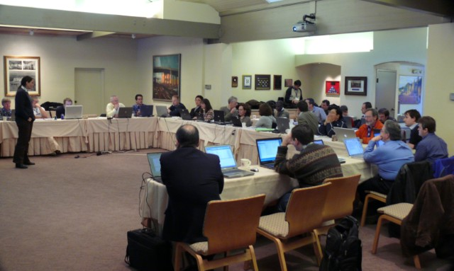





Have a great meeting week!
08:45
17:30
?

