Slide 1
CCSDS Plenary
Role of the CESG
Peter Shames, SEA AD
ESA, The Hague, Netherlands
Nov 2023

Slide 2
Agenda
An intro to CESG and AD guidelines and norms
Extracted from “the Bible”, Organization and Processes for the Consultative Committee for Space Data Systems. Yellow Book. Issue 4, Jan 2016.
Text in this font, in blue, is quoted directly from that document
Just what role is the CESG intended to play?
Explore expectations on CESG, ADs, and their WGs
Current definitions of guidelines, principles, and responsibilities
Consensus Process
Architectural Principles

Slide 3
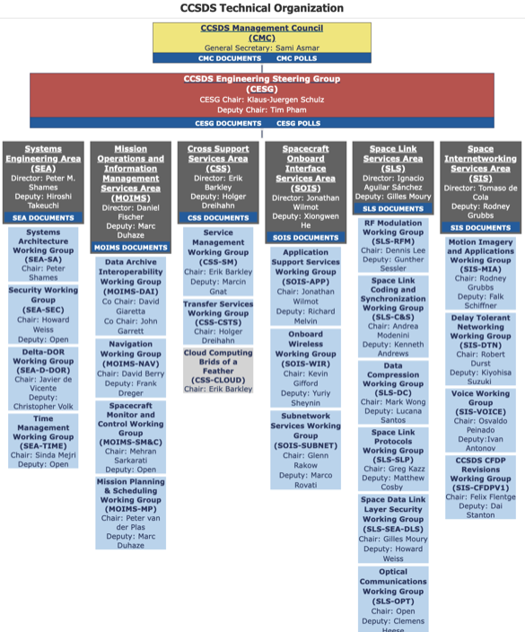
CCSDS Org Chart – Nov 23 (top down view)
CMC / Agency Approvals
CESG Technical Approvals
AD Approvals
Working Groups
Agency “Desirements”

Slide 4
CCSDS Organizational Responsibilities Top Down
CMC
Represent Member Agencies, approve observer agencies and associates from their countries
Provide CCSDS resources
Final approval to publish for most CCSDS documents
CESG
Senior technical architecture body across all CCSDS standards
Ensure consistency, integrity, functionality, and alignment of all CCSDS standards
Responsible for coordination across all Areas
Area Directors
Senior technical leader for a related body of work
Ensure consistency, integrity, functionality and alignment of all standards in their Area
Responsible for coordination across all WGs in their Area
CMC Agency Approvals
CESG Cross-Area Technical Approvals
Area & WG Approvals

Slide 5
CMC Responsibilities
From the revised “Organization and Processes for the Consultative Committee for Space Data Systems”. CCSDS A02.1-Y-4, Yellow Book. Issue 4. Jan 2016.
The CMC is specifically responsible for
a) being the final executive decision-making body of the organization;
b) identifying the different CCSDS stakeholder communities, developing good customer/provider relationships with each one, and making sure that their requirements are satisfied by developing and delivering standards that are responsive to their technical and schedule imperatives;
c) approving the program of work and products of the organization, resolving appeals in cases of disagreement, and authorizing the transition of documents from one designation to another as they move along the various document tracks, including verifying that Normative Track documents have been subjected to satisfactory formal review by the agencies;
d) making sure that adequate resources are provided to execute the approved CCSDS program of work;
h) promoting CCSDS activities by conducting outreach within their agencies to increase the adoption of CCSDS standards by missions, and also to recruit broader participation in CCSDS standards development by other agencies;

Slide 6
CESG Technical Oversight
The CCSDS Engineering Steering Group (CESG) is responsible for technical management across CCSDS domains and for the top-level coordination of the overall international standardization process.
The CESG adopts and applies uniform architectural views that guide the systems protocols, policies, and procedures used for international space mission cross support.
The CESG is directly responsible for executing the actions associated with entry into and movement along the CCSDS document tracks, including making recommendations to the CMC for approval of specifications as they progress through the various stages of standardization.
The CESG consists of a chair, deputy chair, the Area Directors (ADs), and their deputies, who are elected by the CMC. To avoid conflicts of interest and favor dedication to a single task, the chair and deputy chair should not be ADs.
(Note: This has, on occasion, not been adhered to…, it’s a “should” not a “shall”.)

Slide 7
CESG Operating Principles (1 of 2)
a) Area Directors. The ADs for a particular Area are expected to know more about the combined work of their WGs than anyone else. While they may on occasions draw upon expert assistance from WG members as necessary to resolve detailed issues at the CESG level, they are generally expected to be able to independently represent all work within their Area at CESG meetings.
b) Consensus. The entire CCSDS technical organization is run by a process of consensus, and it is the CESG that decides if the standardization process has come up with a result that reflects a real consensus. … The principle of consensus applies to all decisions made at the CESG level. (See 5.1.2 for a discussion of consensus.)
Working Groups must demonstrate that consensus processes were followed when drafting documents. The entire CESG must review each CCSDS document prior to its entering a track, and CESG consensus is required before that document can move forward.
One of the main reasons that the CESG might block something is that the WG was unable to show that true consensus was reached or that the result did not really gain consensus in the CCSDS as a whole, that is, among all of the WGs in all Areas.
For instance, the result of one WG might clash with a technology developed in another, or an AD might try to force through a “pet project” that has a negative effect on the rest of the CCSDS capability suite.
In the event that the process of reaching consensus was unusually contentious at either the WG or CESG level, the CESG chairman shall raise the proposed outcome for review by the CMC before making a final determination.

Slide 8
CESG Operating Principles (2 of 2)
c) Formal Review. Before they can be approved for final publication, Normative Track documents must be submitted to the member agencies of CCSDS for formal review. Observer agencies, CCSDS liaison organizations, and CCSDS Associates are invited to participate in these reviews.
The CESG will specifically look for evidence that all review comments have been properly dispositioned in a consensus environment before permitting such transitions.
d) Consistency. An important job of the CESG is to watch over the output of all of the WGs to help prevent CCSDS specifications that are at odds with each other. This is why ADs and DADs are required to review the drafts coming out of Areas other than their own as part of the consensus process leading up to their adoption into the program of work. The quality of the CCSDS Recommended Standards comes both from the review that they get in the WGs and the review that the WG products get from the CESG.
e) Anticipation. The CESG must be able to look ahead and anticipate new standards that stakeholders will most likely require, and begin prospective planning for their development so that there is sufficient time to complete them once a hard requirement emerges. This implies working with technology and experimental communities to vector research resources into the standardization process.

Slide 9
CESG Responsibilities (1 of 2)
The CESG is specifically responsible for the following:
a) maintaining and upholding the overall technical quality and consistency of the evolving set of CCSDS Recommended Standards and Practices;
b) providing the CCSDS-wide forum where the work programs of the Areas may be coordinated and synchronized in the context of an overall architecture for space- mission cross support and the needs of individual customers;
c) reviewing the proposed composition and program of work of all new WGs in each Area to ensure that they are technically consistent, contribute to a cohesive set of CCSDS architectural concepts, properly respect the need for smooth evolution of the large installed base of CCSDS-compatible systems, and are not otherwise disruptive to the needs of customers;
d) making recommendations to the CMC concerning which new WGs should be approved;
e) ensuring that the resource requirements of all WGs are addressed, identified, and approved by the CMC prior to initiating new work;
f) hearing appeals from any BOF whose proposal to form a WG was rejected by an AD;
g) deciding and recommending to the CMC the appropriate “track” assignment for a particular work item, and monitoring the work item’s progression through various stages of maturity;

Slide 10
CESG Responsibilities (2 of 2)
h) reviewing requests from ADs to advance specifications in their Areas along the various document tracks, and making consensus recommendations to the CMC when it feels that documents and related materials are ready for publication as CCSDS products, in their various interim and final stages of maturity;
i) periodically reviewing the technical work of each Area to ensure that it is progressing toward common goals, that the process of consensus is being observed and that the needs of CCSDS stakeholders (2.2) are being satisfied in a timely manner (the ADs shall be responsible for reporting on all work items within their Area);
j) identifying “red flag” items where technical work in a proposed CCSDS document is not of the required quality or nature, where technical work is not progressing satisfactorily, where resources are inadequate, or where significant issues exist, and raising these to the attention of the CMC for corrective action;
k) maintaining records of the status of all CCSDS work items, including completed WG deliverables that have been deployed into operational use;
l) making recommendations to the CMC concerning when to reconvene a WG to refresh a standard that has been finalized and deployed into operational use;
m) making recommendations to the CMC concerning when to retire a standard based on its obsolescence;
n) approving WG Chairs and Deputy Chairs;
NOTE – BOF and SIG chairs are not subject to CESG approval.
o) monitoring the need for and triggering periodic maintenance of published CCSDS documents.

Slide 11
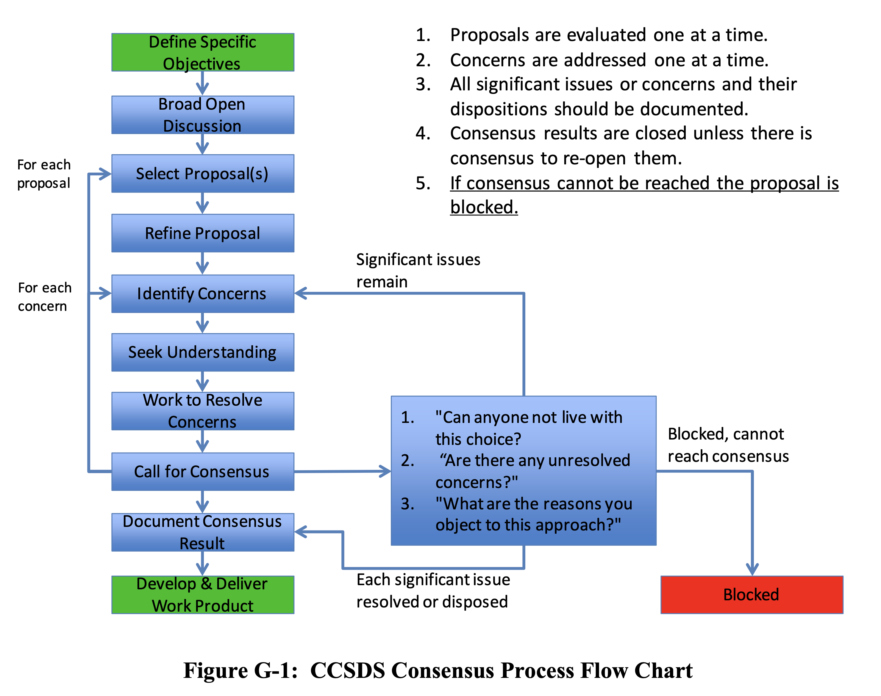
Consensus Process (Annex G)
The entire CCSDS technical organization is run by a process of consensus, and it is the CESG that decides if the standardization process has come up with a result that reflects a real consensus. Consensus does not necessarily mean that unanimous agreement has been reached, but that the result incorporates the best set of compromises that all parties can agree to. The principle of consensus applies to the decisions made at the CMC, CESG, and WG levels.
Coming to consensus is a matter of understanding, considering, eliminating disagreements, and arriving at the best set of compromises. Consensus is achieved when all significant issues are addressed, but not necessarily accommodated.

Slide 12
Architectural Principles (Annex A)
CESG Chair Responsibility, Sec 2.3.4.3.2
d) ensuring that all CCSDS work follows the agreed set of architectural principles and is properly synchronized with the smooth evolution of the large installed base of CCSDS-compatible mission support infrastructure;
A2 DEVELOP LEADING STANDARDS
Statement: Develop Leading Standards to Meet Aggregate Future Multi-Mission Requirements
A3 PROVIDE CROSS SUPPORT
Statement: Provide Cross Support Capabilities Among Different Organizations
A4 MINIMIZE DISRUPTIONS
Statement: Minimize Disruptions to Existing Standards and Installed Systems
A5 ADOPT, ADAPT, DEVELOP
Statement: Adopt, Adapt, Develop (i.e., only develop new standards when necessary)
A6 USE FREELY AVAILABLE TECHNOLOGY
Statement: Define Standards Using Unpatented or Royalty Free, Internationally Available, Free Technology Independent of Specific Agency or Vendor
A7 ADOPT NATURAL, MODULAR BOUNDARIES
Statement: Define Interfaces at Natural Boundaries, Adopt Modularity and Loose Coupling, Reduce Integration Complexity
A8 INTEROPERABILITY IS ESSENTIAL
Statement: Interoperability is Essential and Must Be Demonstrated, Use Testing for Early Standards Validation and Defect Elimination
A9 SEEK SCALABILITY AND EXTENSIBILITY
Statement: Seek Scalability and Extensibility Across Different Deployments (single mission / interdependent missions, near Earth / in Situ, Deep Space, low cost / flagship, robotic / manned)
A10 STRIVE FOR SIMPLICITY AND CLARITY
Statement: Strive for Simplicity and Clarity in Design and Documentation
A11 USE COMMON VOCABULARY AND DEFINITIONS
Statement: Develop and Utilize Common Vocabulary and Data Definitions

Slide 13
Some Definitions
Interoperability:
The technical capability of two or more systems or components to communicate, exchange information and to use the information that has been exchanged
Cross Support:
An agreement between two or more organizations to exploit the technical capability of interoperability for mutual advantage, such as one organization offering support services to another in order to enhance or enable some aspect of a space mission
Protocol
protocol: A set of rules and formats (semantic and syntactic) which determines the communication behavior of (N)-layer protocol entities in the performance of (N)-layer protocol functions.
A protocol is a convention or standard that controls or enables the connection, communication, and data transfer between two computing endpoints. In its simplest form, a protocol can be defined as the rules governing the syntax, semantics, and synchronization of communication.

Slide 14
References
Organization and Processes for the Consultative Committee for Space Data Systems. CCSDS A02.1-Y-4, Yellow Book. Issue 4, Corrigendum 2. Jan 2016.
CCSDS Publications Manual. CCSDS A20.0-Y-4, Yellow Book. Issue 4, Corrigendum 1. Feb 2015.
CCSDS Implementation Conformance Statements, CCSDS A20.1-Y-1, Yellow Book, Issue 1, April 2014.
Space Assigned Numbers Authority (SANA)—Role, Responsibilities, Policies, and Procedures, CCSDS 313.0-Y-3, Issue 3, Oct 2020.
CCSDS Registry Management Policy, CCSDS 313.1-Y-2, Issue 2, Oct 2020.
Procedures for SANA Registry Specification, CCSDS 313.2-Y-2, Issue 2, Oct 2020.

Slide 15
BACKUP SLIDES

Slide 16
Other Considerations
Reference Models & Architectures
These are distinguished in some contexts (OASIS, OMG), and there are real differences, but there is no need for CCSDS to emphasize these distinctions
Treat all of this class of documents as Magenta Books
APIs
APIs, in and of themselves, do not provide interoperability but are useful for application portability
The SLE model for developing and labeling of APIs seems appropriate and this maps into Magenta Book specifications
Portability specifications
Other specifications, such as the JMS, or similar “shims” provide portability
These do not meet CCSDS (nor Internet or ECSS) requirements for standards, but do offer useful functionality
Include specifications of this sort as Magenta Books
CCSDS procedures
We currently have a number of CCSDS procedures that are Yellow Books and we may need a few more
Some Procedures “Yellow Books” are normative on the CCSDS processes and practices, this use is to be documented

Slide 17
Standardization Norms (1 of 3)
CCSDS Blue Book Norms
There are separate concrete specs for each layer from physical to link (and upper layer as well)
Each spec stands alone, can be interpreted and evaluated on its own, and unambiguously defines the standard service at that layer and what functions it must perform
Each spec defines the services it provides to an upper layer and the services it expects from a lower layer, usually abstractly
Each spec defines a wire protocol, with concrete PDUs and state machine (in some unambiguous form), but does not specify either a language binding nor any sort of API, these are implementation details that need not be bound in order to support interoperability
While each spec stands alone you need to select a compatible stack of them on each end (physical, modulation, coding, link, ...) in order to deliver end to end (link layer) data, but how you implement them (C, Java, hardware. software) at each end of the link need not be defined

Slide 18
Standardization Norms (2 of 3)
Internet Norms
There are separate concrete specs for each layer from link to network / transport, including service management
Each spec stands alone, can be interpreted and evaluated on its own, and unambiguously defines the standard service at that layer and what functions it must perform
Each spec defines the services it provides to an upper layer and the services it expects from a lower layer, usually abstractly
Each spec defines a wire protocol, with concrete PDUs and state machine (in some unambiguous form), but does not specify either a language binding nor any sort of API, these are implementation details that need not be bound in order to support interoperability
While each spec stands alone you need to select a compatible stack of them on each end (link, network, transport, routing exchange, ...) in order to deliver end to end (transport layer) data, but how you implement them (C, Java, hardware. software) at each end of the link need not be defined

