Slide 1
EDS/DoT Green Book
Graphics

Slide 2
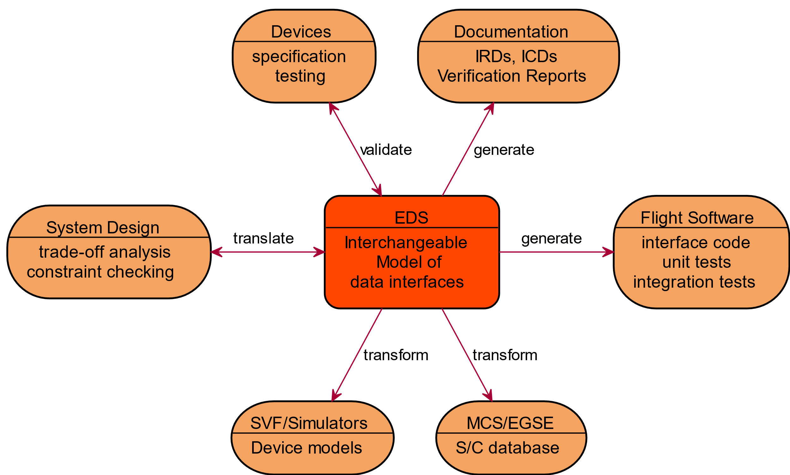
Figure 2-1
Reports\diagrams\use-case.svg

Slide 3
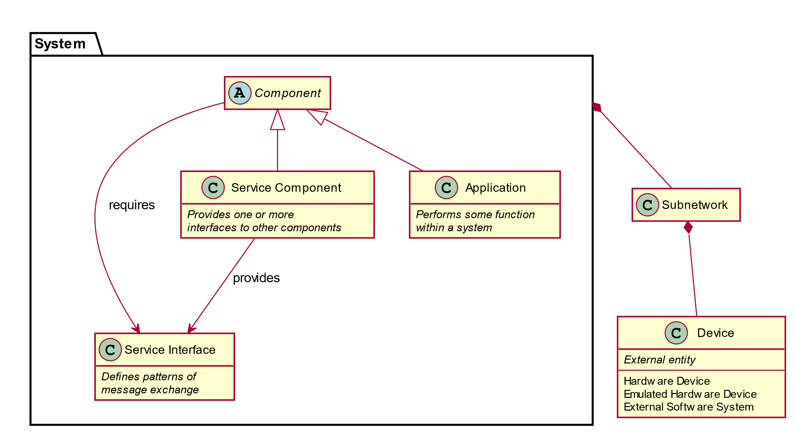
Figure 3-1
.svg file is missing.
Could be recovered by editing Reports\diagrams\terminology.md

Slide 4
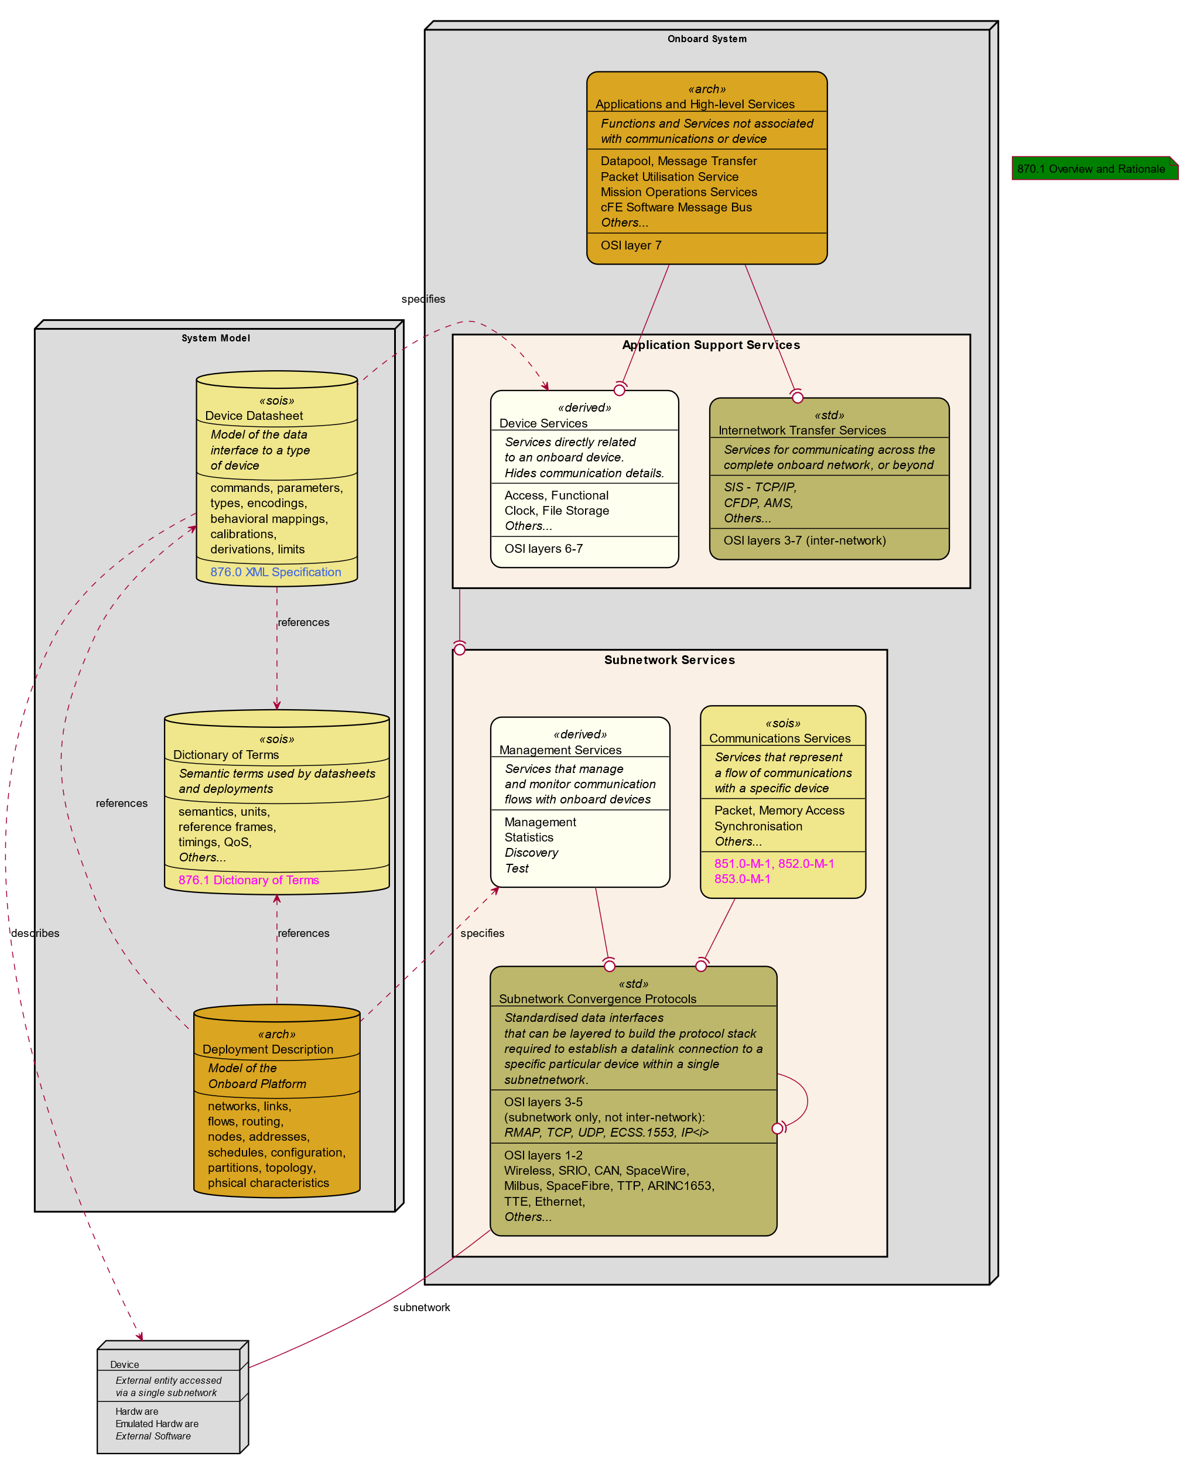
Figure 3-2
Reports\diagrams\architecture.svg

Slide 5
Figure 3-3

Slide 6
Deleted Figure

Slide 7
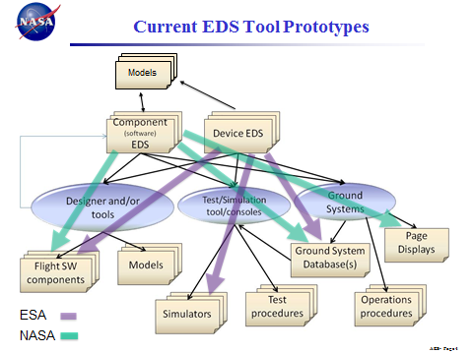
Replaced Figure

Slide 8
Figure 3-4 (replacement)
Models
Models
Models
Models
Models
Models
Models
Component (software) EDS
Device EDS
Designer and/or tools
Test/ simulation tool/ consoles
Ground Systems
Models
Models
Models
Models
Models
Models
Models
Models
Flight SW Components
Models
Ground System Databases
Page Displays
Models
Models
Models
Models
Models
Models
Simulations
Test Procedures
Operations Procedures

Slide 9
Figure 3-5
Parameterized SEDS instance
Project Parameters in SEDS instance
Pre-processor
Project Parameters in SEDS instance
SEDS instance
SEDS schema
DoT schema
Validating XML Reader
Validity Report
Project Terms schema
SEDS object in tool chain

Slide 10
Figure 4-1
generation flow
EDS for Device x
communication
interoperability
Tool Chain A
Tool Chain Z
Device Service for x on A
Device Service for x on Z
FSW for Vehicle A
FSW for Vehicle Z
Vehicle A
Device x
Device x
Vehicle Z

Slide 11
Figure 4-2
generation flow
EDS for Device x
EDS for Service y
Docked vehicles
communication
Tool Chain A
Tool Chain Z
Adapter for y on A
Device Service for y on A
Service y
Bridge
Device Service for x on A
Device Service for x on A
FSW for Vehicle A
FSW for Vehicle Z
Vehicle A
Device x
Vehicle Z

Slide 12
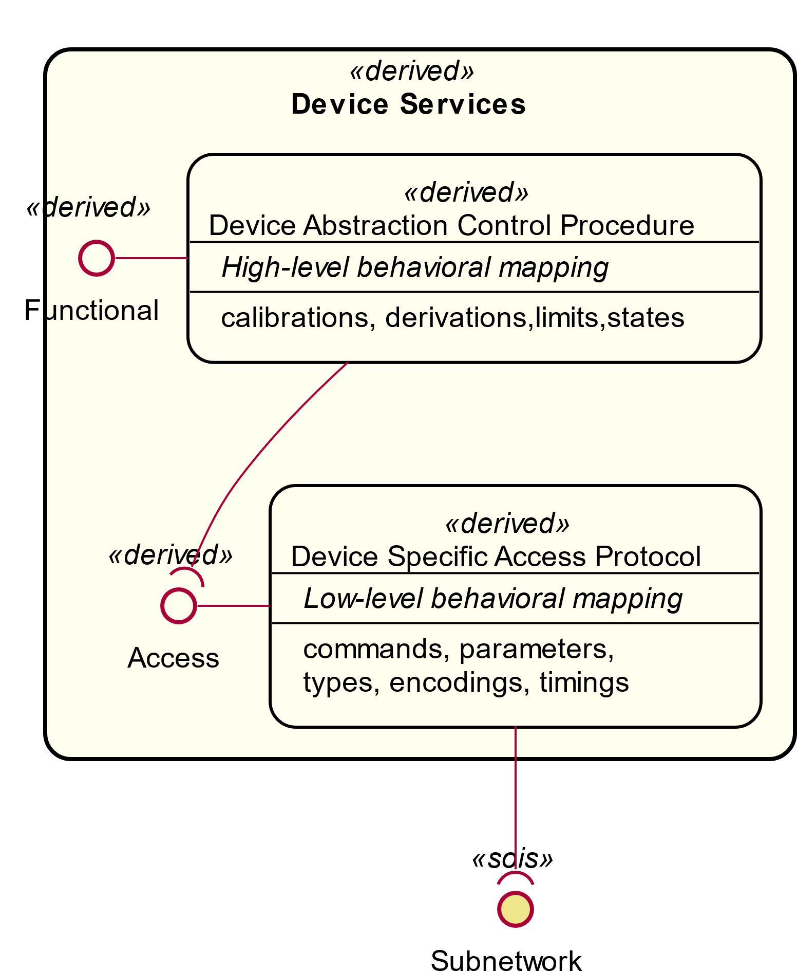
Figure 4-3
device_services.svg
replaces the smaller figure at lower left

Slide 13
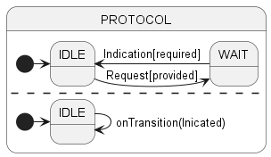
Figure 4-4
transactionStateMachines.svg

Slide 14
Figure 4-5
Red Book\images\parameterSequence.svg

Slide 15
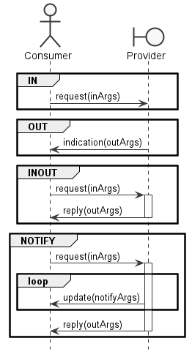
Figure 4-6
Red Book\images\commandPatterns.png

Slide 16
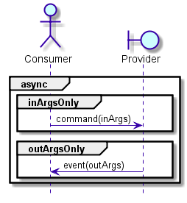
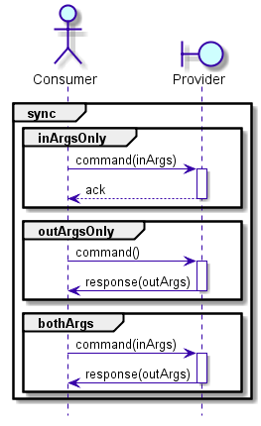
Deleted Figure

Slide 17
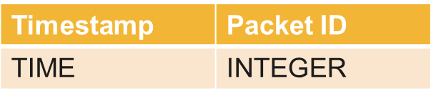
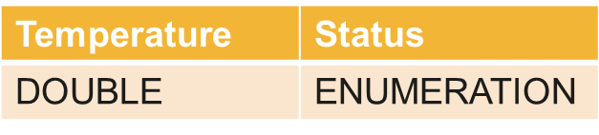
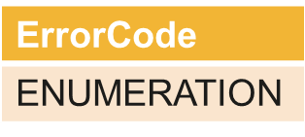
Figure 4-7
Packet ID = 3
Packet ID = 4

Slide 18
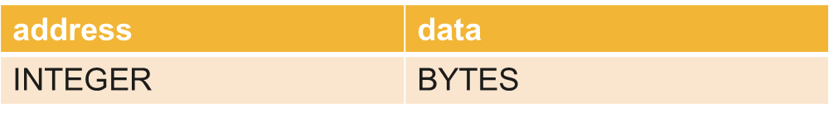
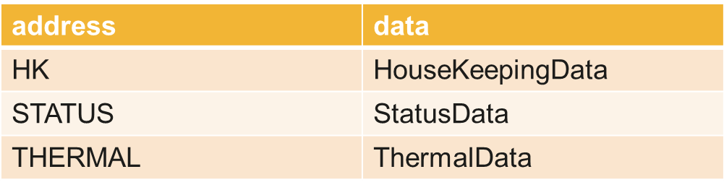
Figure 4-8
Example command on generic interface
Same command on interface usage within datasheet

Slide 19
Figure 4-9

Slide 20
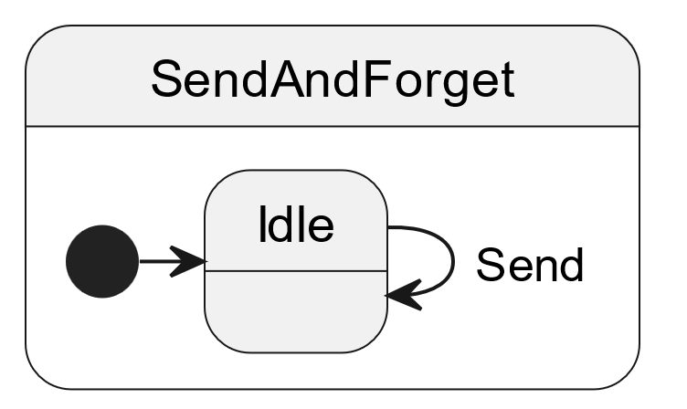
Figure 4-10
sendAndForget.svg

Slide 21
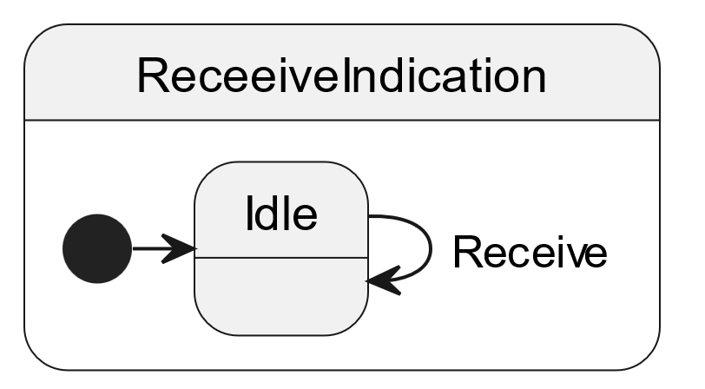
Figure 4-11
receiveIndication.svg

Slide 22
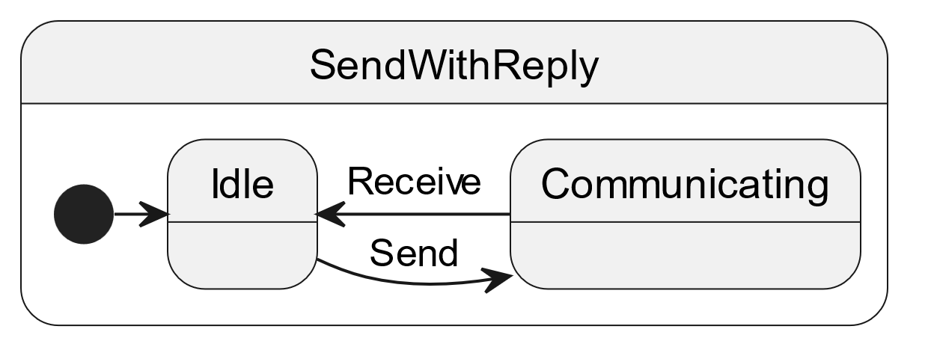
Figure 4-12
sendWithReply.svg

Slide 23
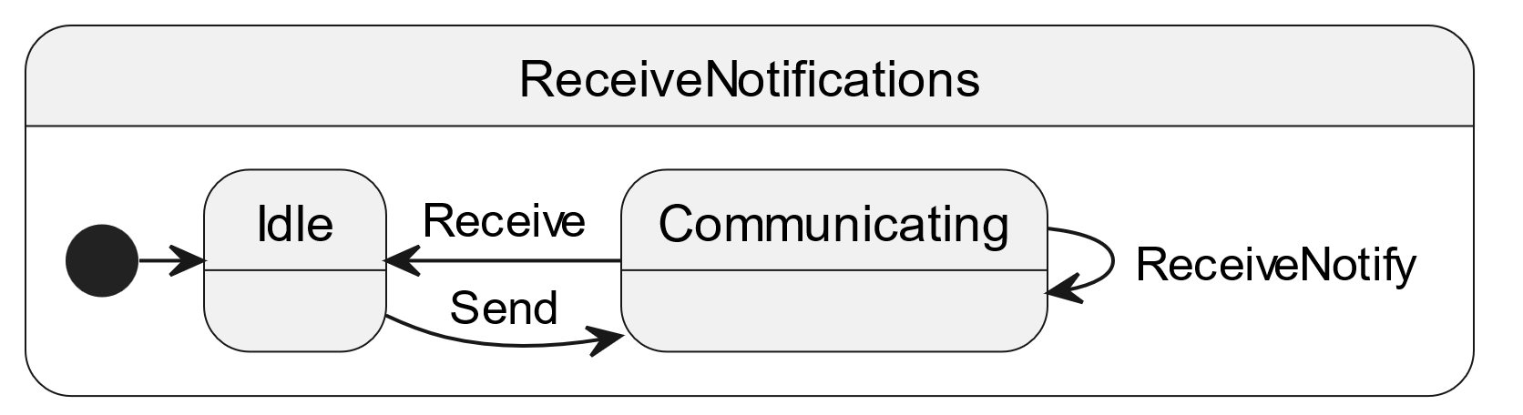
Figure 4-13
receiveNotifications.svg

Slide 24
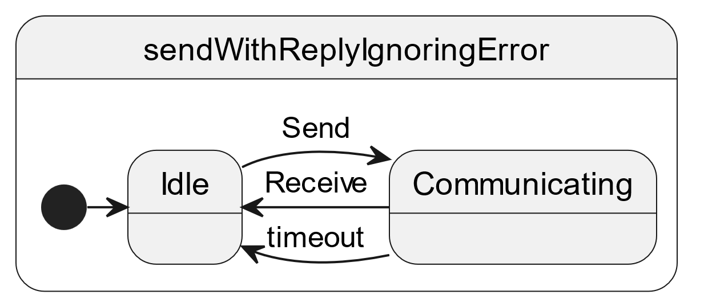
Figure 4-14
sendWithReplyIgnoringError.svg

Slide 25

Figure 4-15
sendWithReplyNotingError.svg

Slide 26
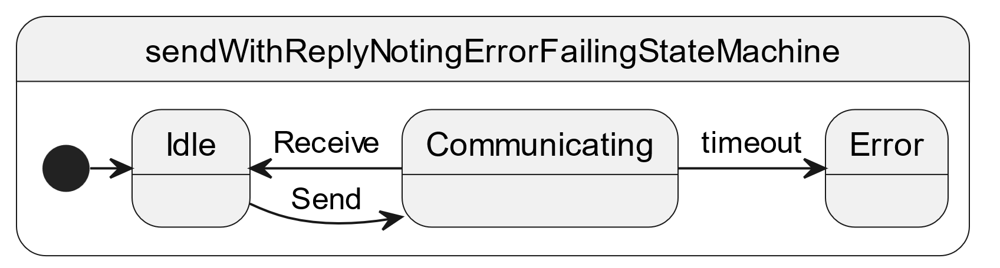
Figure 4-16
sendWithReplyNotingErrorFailingStateMachine.svg

Slide 27
Figure 5-1
EDS for Service
x
Tool Chain
Adapter for x
Service x
FSW
generation flow
communication

Slide 28
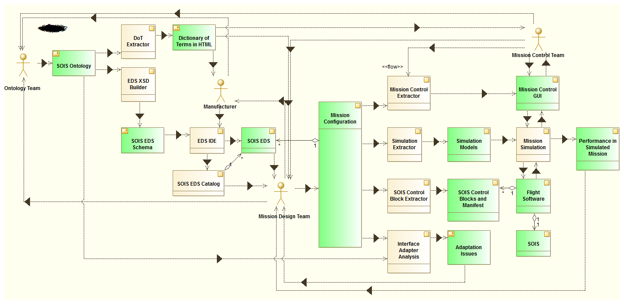
Figure 6-1

Slide 29
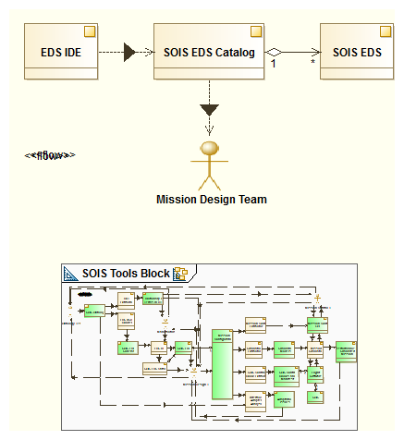
Figure 6-2

Slide 30
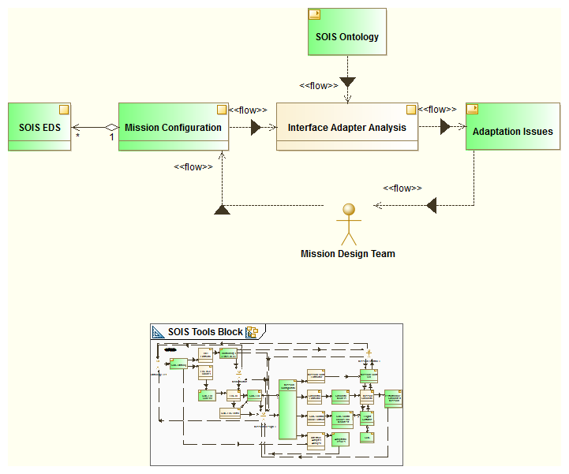
Figure 6-3

Slide 31
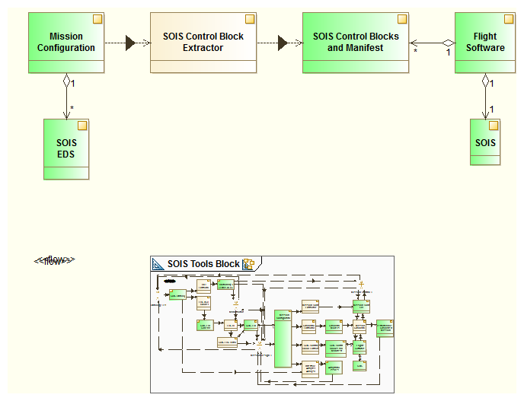
Figure 6-4

Slide 32
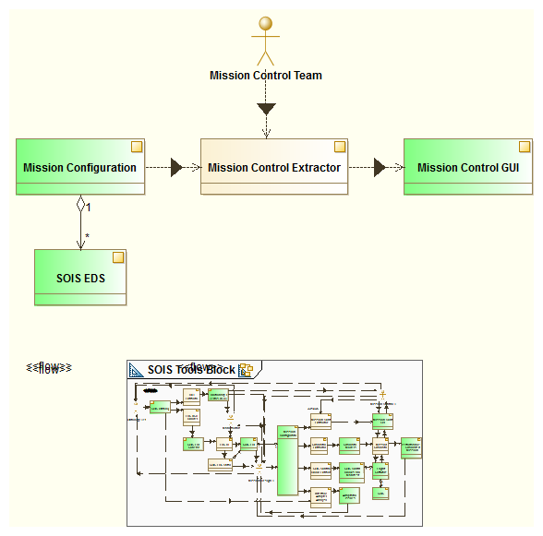
Figure 6-5

Slide 33
Figure 6-6
generation flow
EDS for Device x
EDS for Service y
communication
Tool Chain A
Adapter for y on A
MAL, XTCE for y
Service y
MAL, XTCE for x
Device Service for x on A
FSW for Vehicle A
GSW for Project A
Vehicle A
Device x
MOC for Project A

Slide 34
Figure 6-7
generation flow
EDS for Device x
EDS for Service y
communication
Tool Chain A
MAL, ASN.1 for y
Adapter for y on A
Service y
FSW for Vehicle A
MAL, ASN.1 for x
SM&C for Vehicle A
Device Service for x on A
Vehicle A
Device x

Slide 35
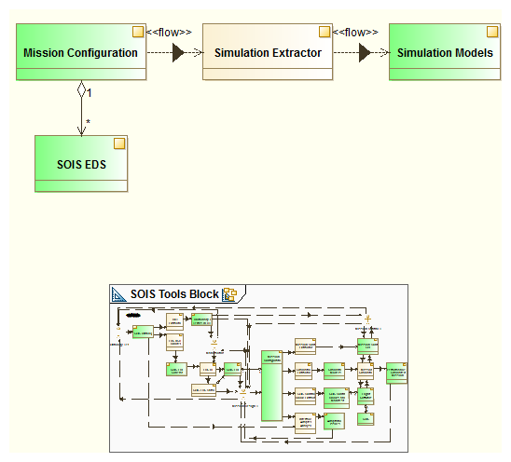
Figure 6-8

Slide 36
Figure 6-9
EDS for Device x
Device behavior
Tool Chain Z
Simulation for x

Slide 37
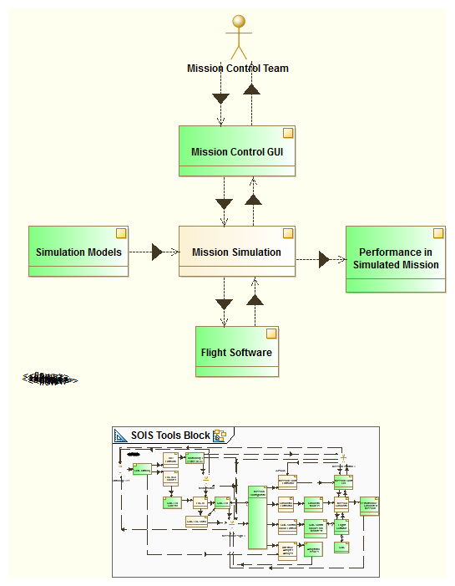
Figure 6-10

Slide 38
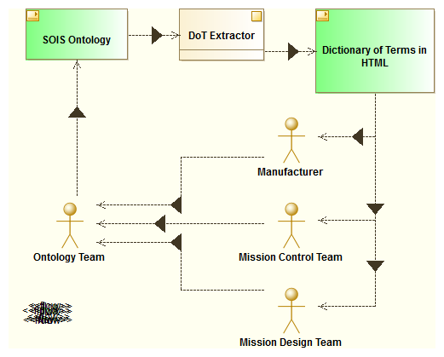
Figure 6-11

Slide 39
Figure 6-12
EDS for Device x
XSL
ICD for x

Slide 40
Not Used
EDS for Device x
Device Service behavior
Device behavior
Tool Chain A
Tool Chain Z
Device Service for x
Simulation for x
Bridge
generation flow
communication

