Slide 1
CCSDS Spring 2023 Meeting
CMC Spring 2022 Meeting
16 June 2022
Notes:
1
1
1

Slide 2
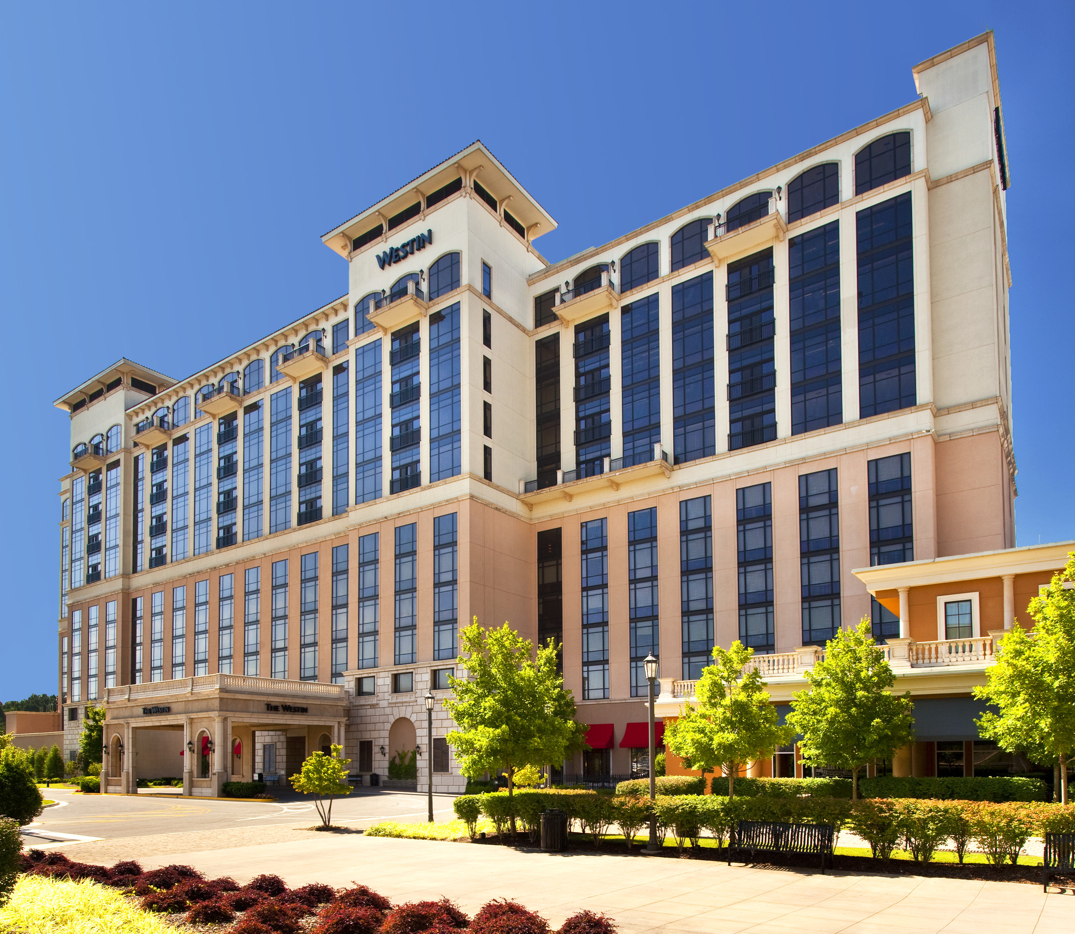
CCSDS Spring 2023 Meeting
The Spring 2023 CCSDS meetings will be hosted by Marshall Space Flight Center in Huntsville, AL.
  Technical Meetings: 8-12 May 2023
  CESG Meeting: 15 May 2023
The venue for the meetings is the Westin Hotel at Bridge Street Town Center: https://www.marriott.com/hotels/travel/hsvwi-the-westin-huntsville
  Bridge Street Town Center offers multiple options for dining and shopping and is a centrally located in Huntsville.

Slide 3
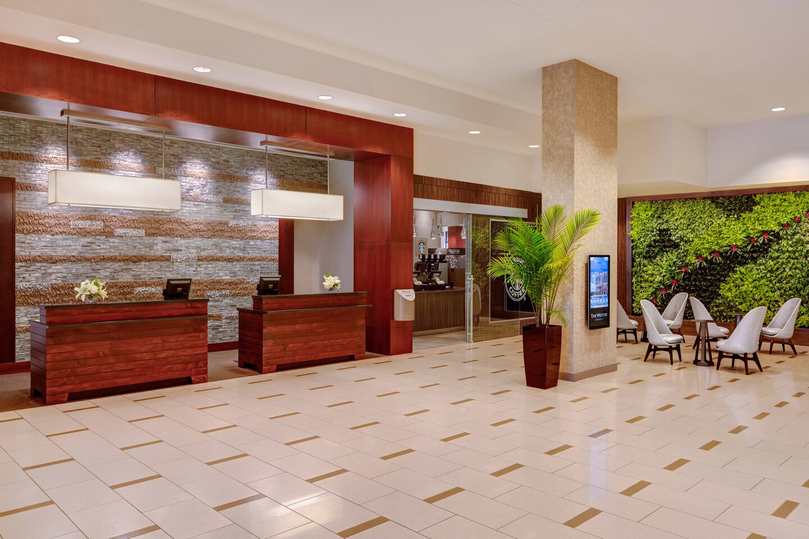
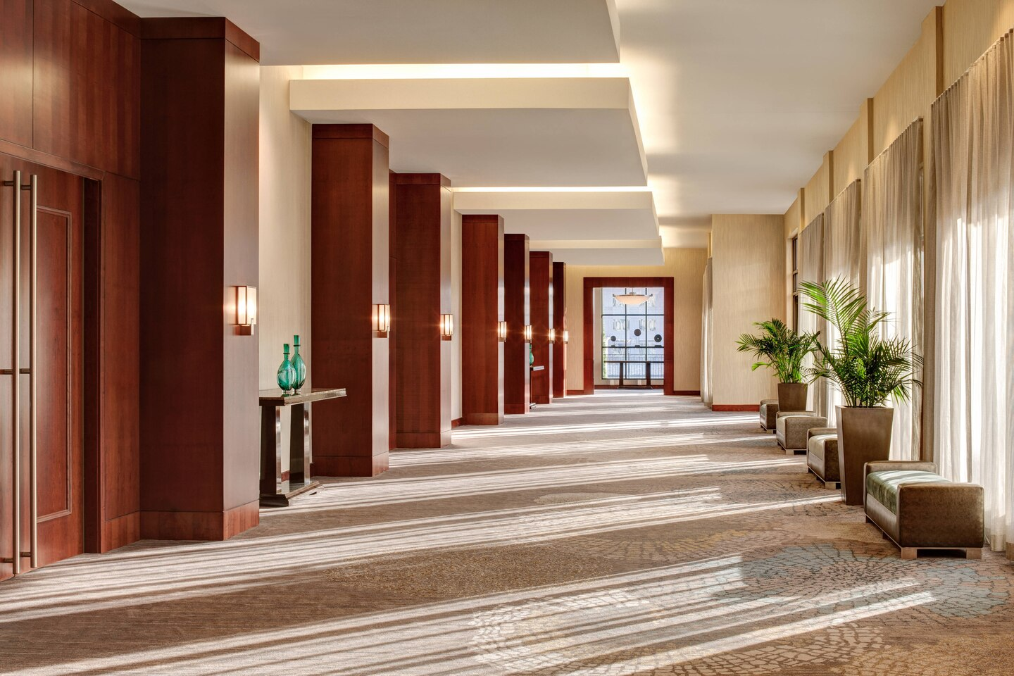
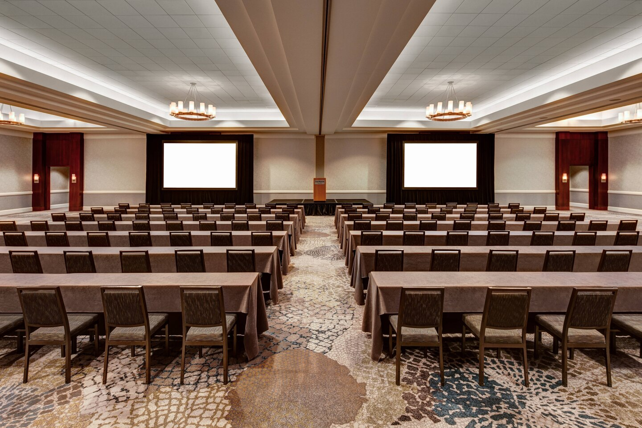
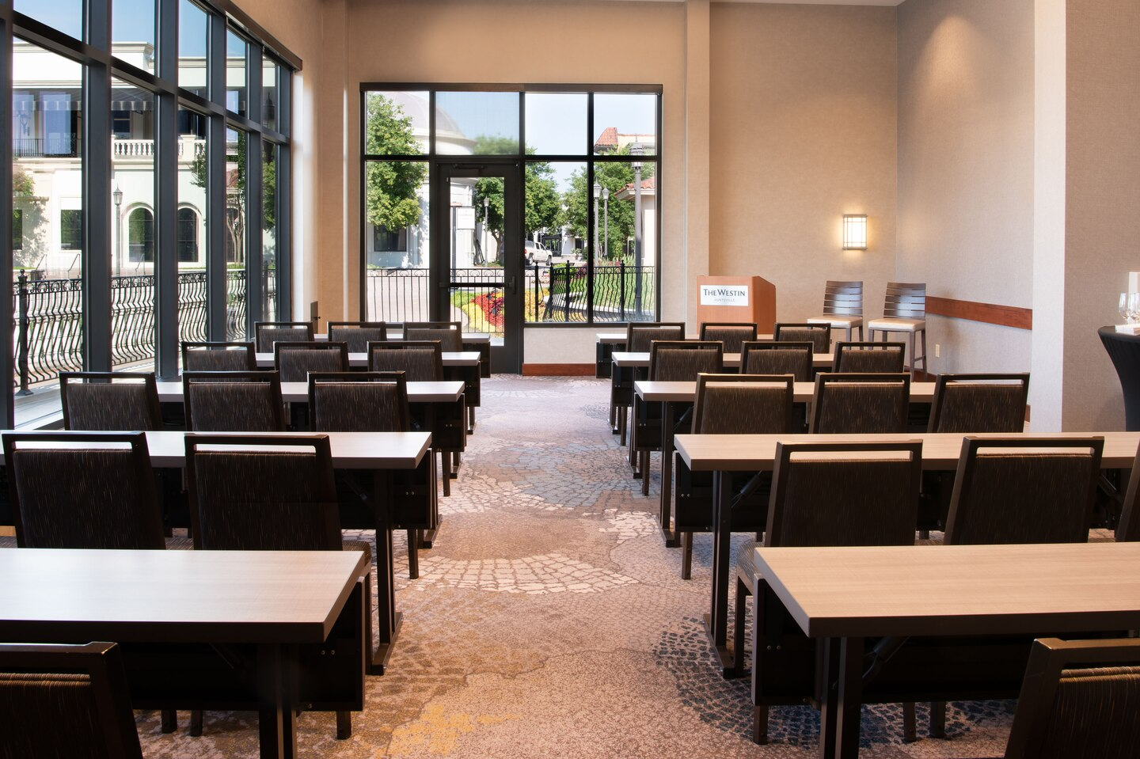

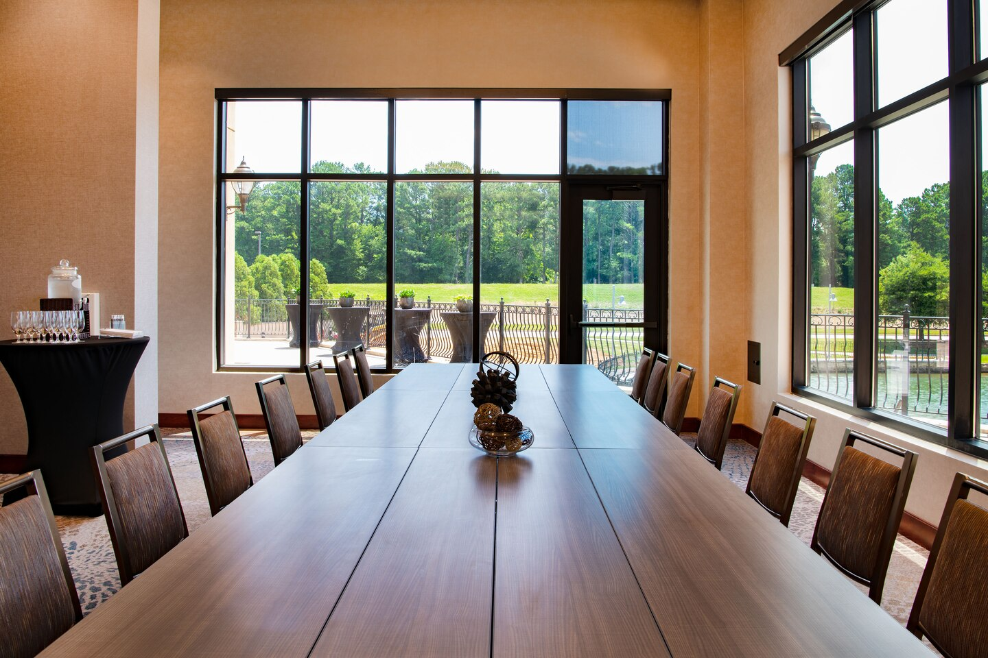
Westin Huntsville Photos

Slide 4
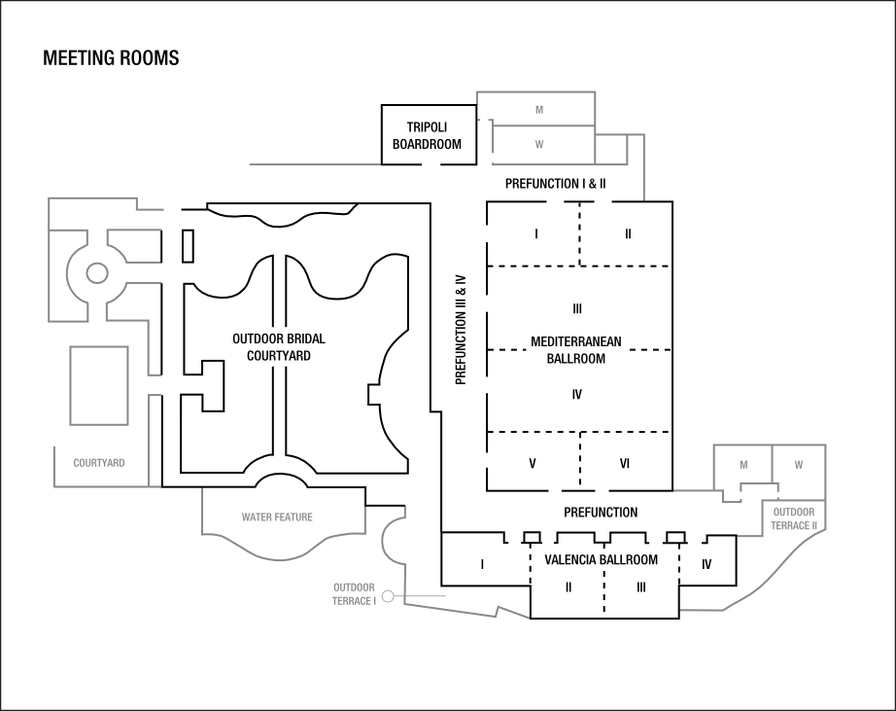
Westin Huntsville Layout

Slide 5
Bridge Street Town Center
Bridge Street Town Center info:
  https://www.bridgestreethuntsville.com/

Slide 6

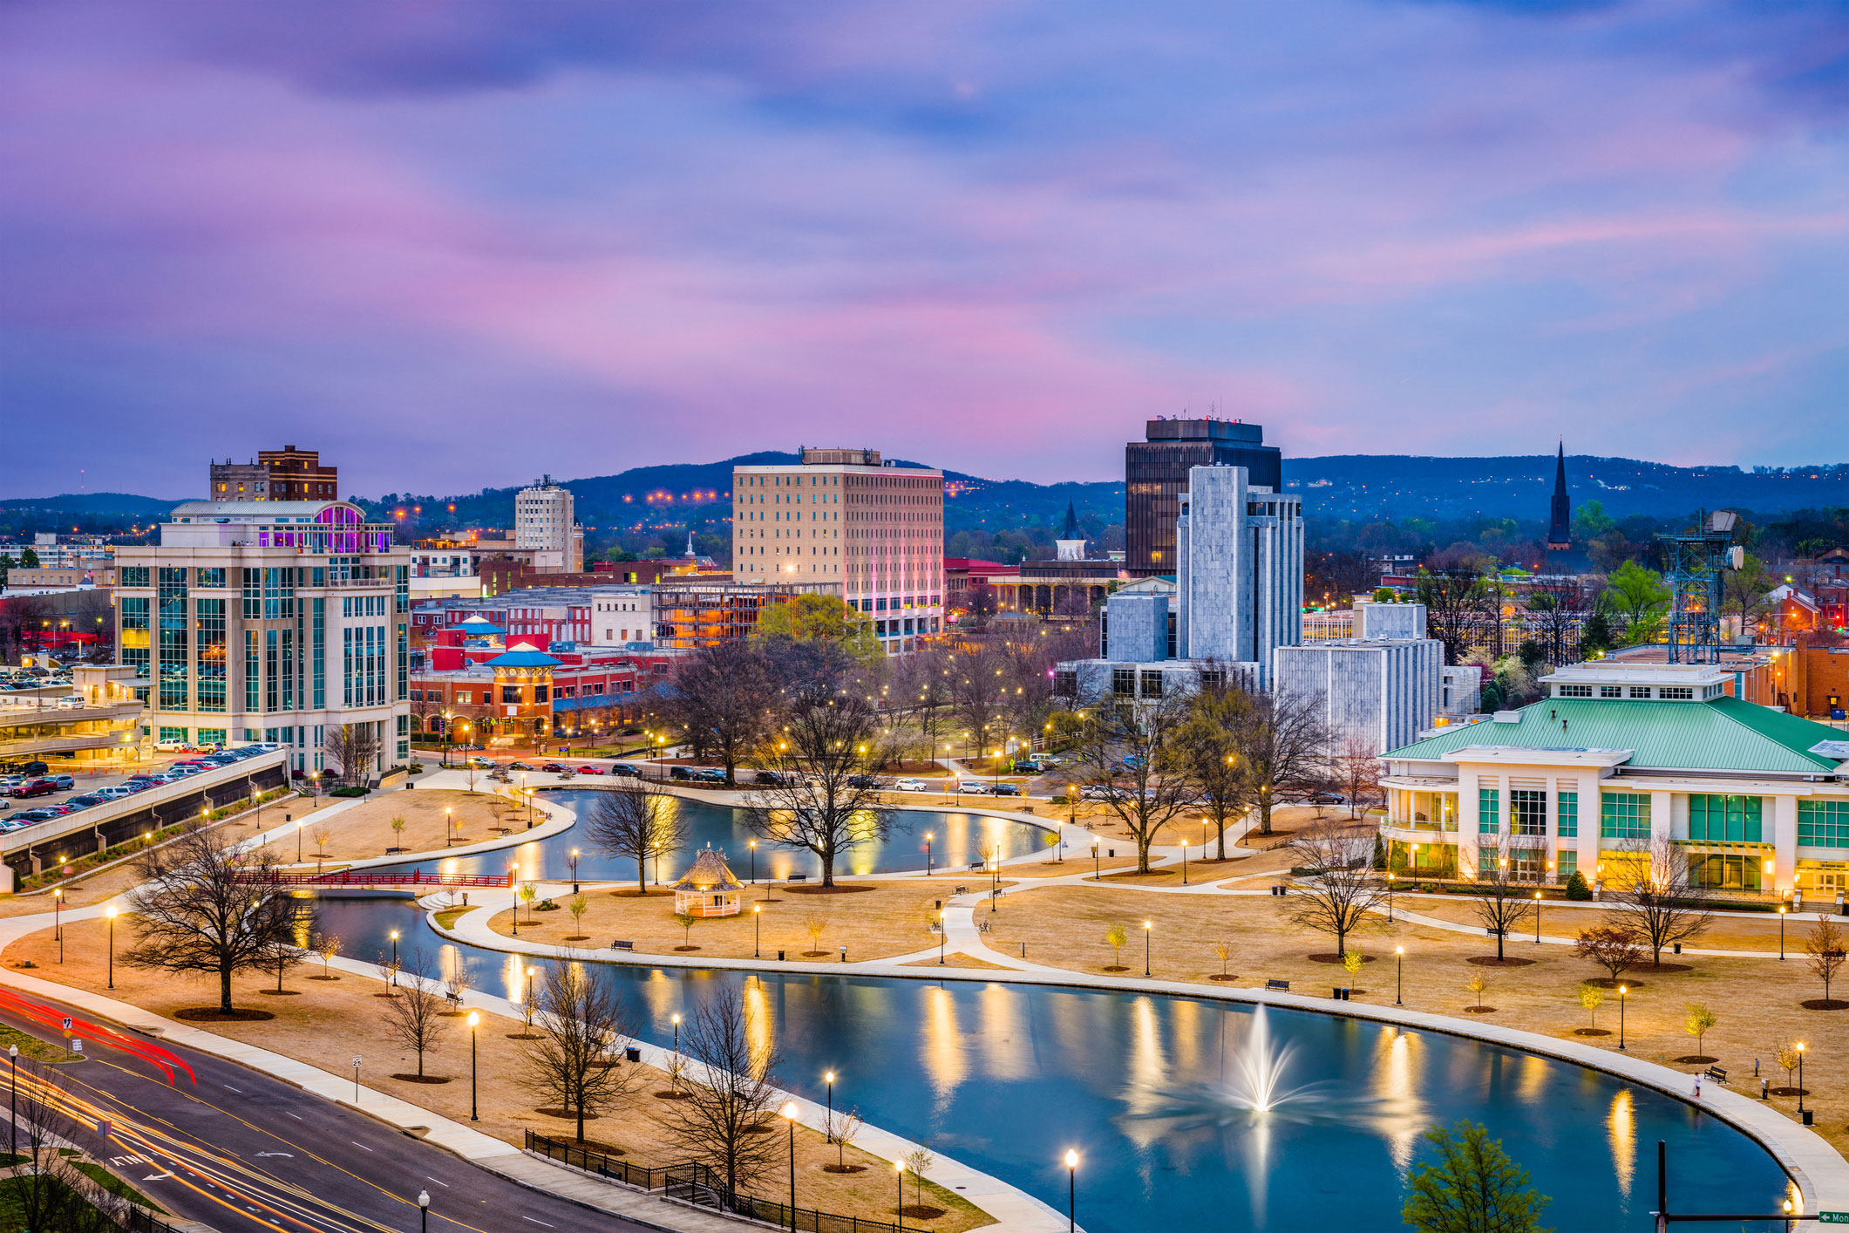
Huntsville, Alabama
Huntsville is a city centrally located in the northernmost part of the U.S. state of Alabama.
It is home to NASA’s Marshall Space Flight Center
  10 Best Places for STEM work
  Home to Boeing, Lockheed, US Army, L3, and Hudson Alpha BioTech
Bordered by the Smokey Mountains to the east and the Tennessee River on the south
Lots to see and do
  Art Museums
  Entertainment Districts
  Outdoor Spaces/Recreation
Videos about Huntsville:
  Huntsville - We've Got Space
  This is Huntsville

Slide 7
Travel Information
HUNTSVILLE INTERNATIONAL AIRPORT
HSV has nonstop service to ten destinations, including: Atlanta, Charlotte, Chicago, Dallas, Denver, Detroit, Houston, and two airports in Washington D.C. – Dulles and National. The airport is quick and easy to navigate, and very convenient to all the attractions and businesses located in North Alabama. HSV offers nonstop service to ten destinations through our carriers: American Airlines, Delta Air Lines, Frontier Airlines and United Airlines.
WESTIN TRANSPORTATION
We are located 15 minutes from Huntsville International Airport and offer transportation service to the hotel for a fee of $35.00 one-way & $5.00 additional for each extra person.
PARKING FACILITIES – Complimentary self-parking.

