Slide 1
CCSDS Specific GitHub or Git Server
CMC-A-2020-10-02
The CMC directs the Secretariat to initiate a survey for Area Directors and Working Group Chairs and ask about their current use of GitHub and their intended adoption of CCSDS GitHub Repository.

Slide 2
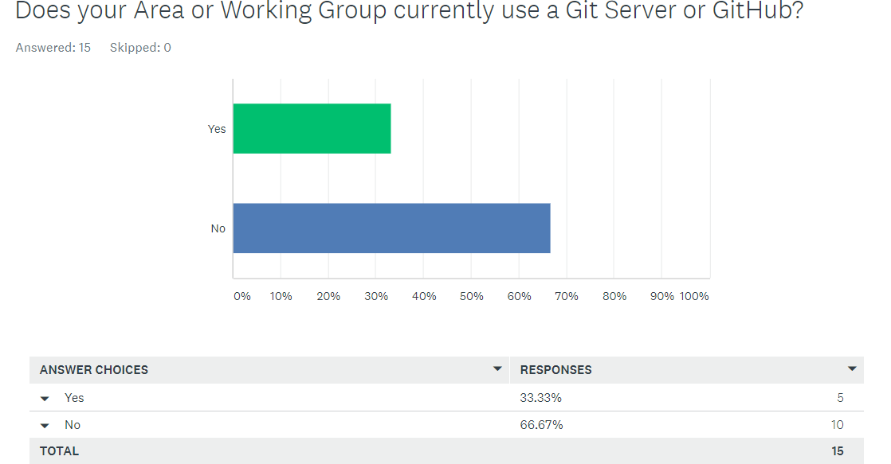

Slide 3
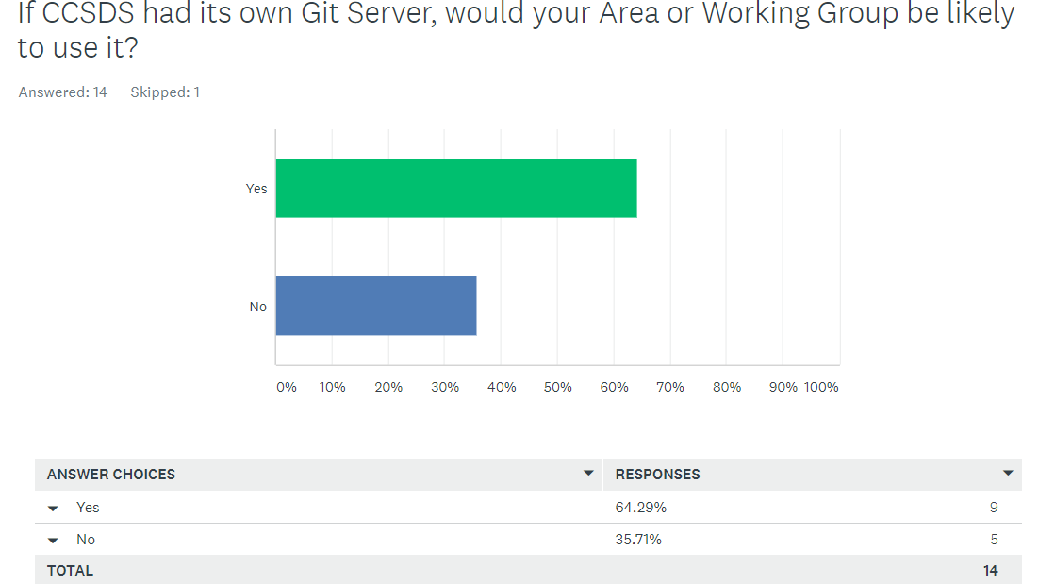

Slide 4
NASA Limitations and Restrictions
NASA employees and contractors cannot post software online where it will be accessible to individuals from proscribed countries*.
NASA employees and contractors may not host services that make software accessible to individuals from proscribed countries*.
*United States International Traffic in Arms Regulations (ITAR) - PROSCRIBED COUNTRIES LIST (22 CFR 126.1)
This is the interpretation of recent changes to United States law provided by NASA Goddard Space Flight Center. As this is a recent development and an evolving situation, it is possible that this guidance or the law itself will change in the future.

