Slide 1
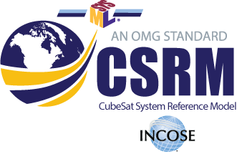
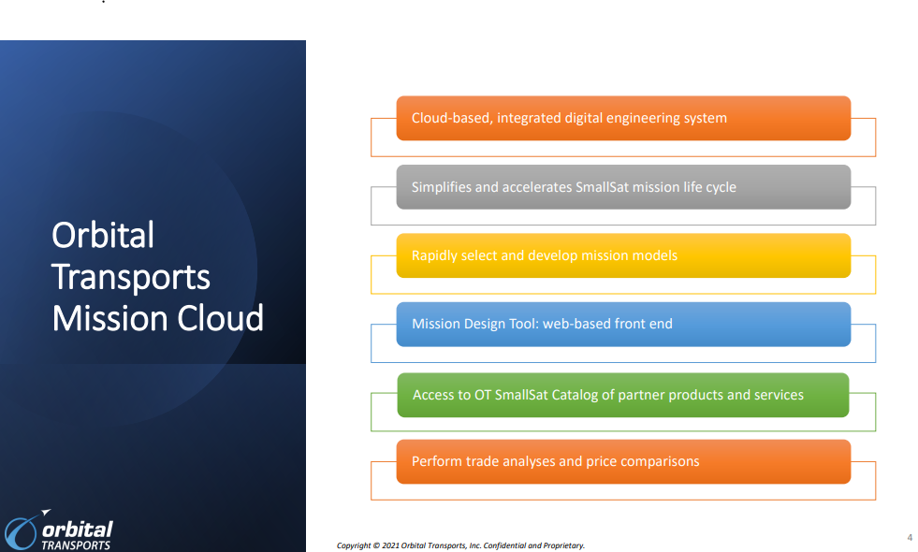
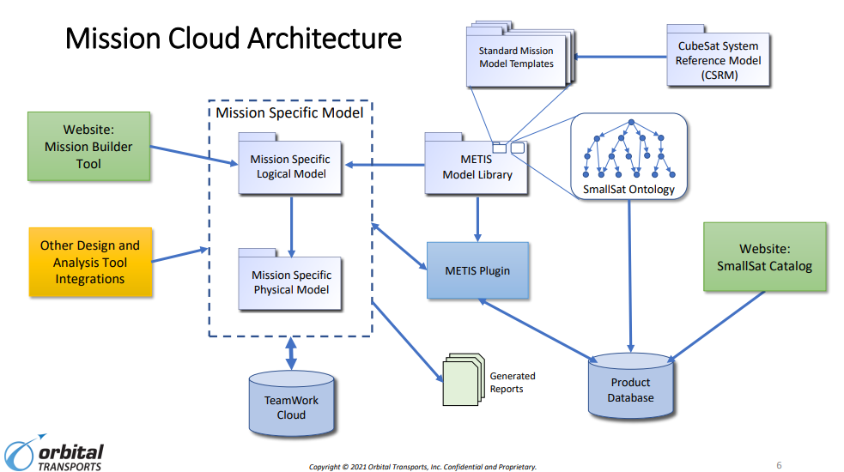
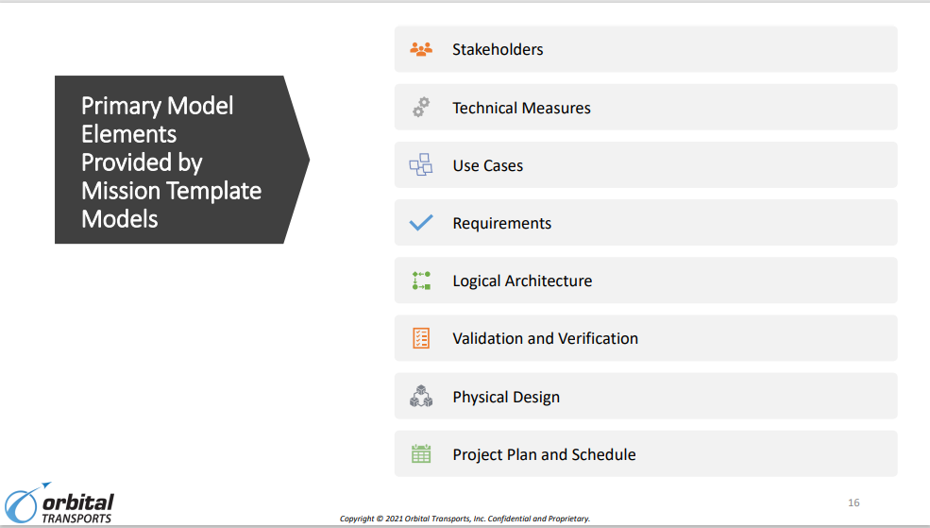
OT Work is built upon CSRM but extends CSRM significantly
2
1
3
}
CSRM
Notes:
OMG’s CubeSat Systems Reference Model TM (CSRMTM) is a logical model that is being used by Orbital Transports (OT) to create physical models for recommended CubeSat deployments and configurations.
OT utilizing its 6 step process, is using its Mission Cloud Architecture System to collect mission requirements, configure the individual smallsat components, compare pricing and assess launch options.

Slide 2
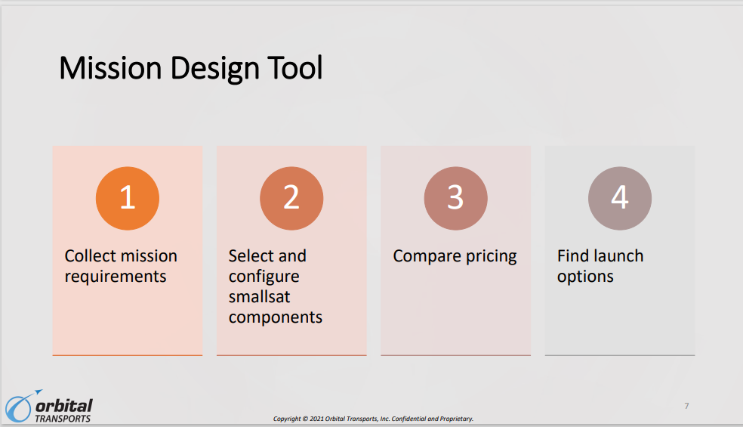
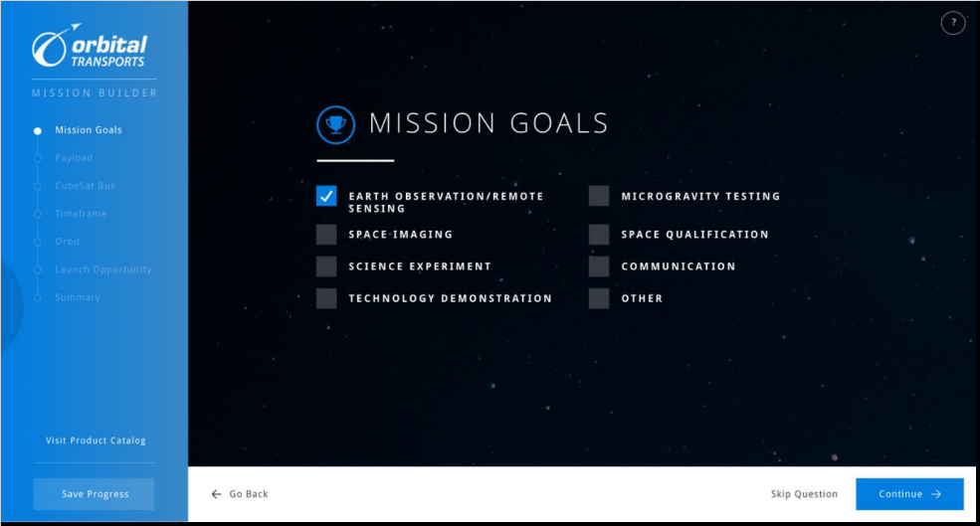
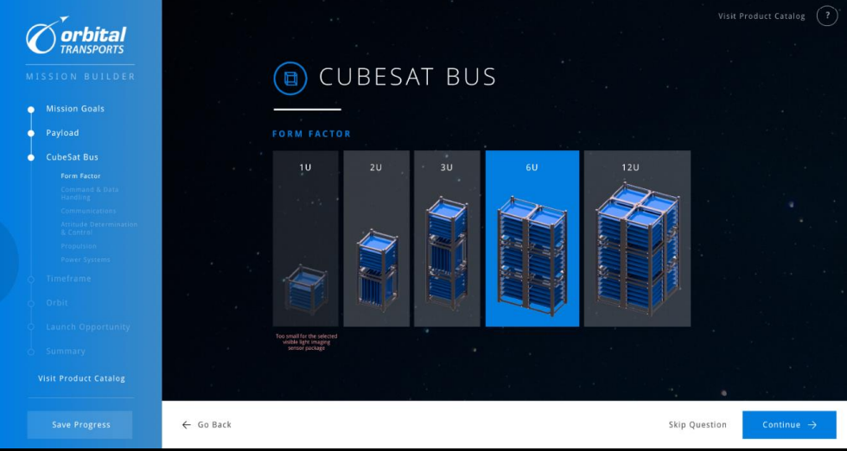
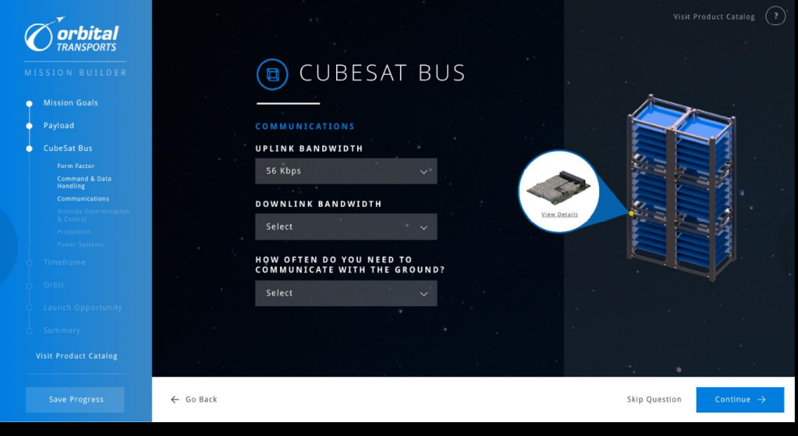
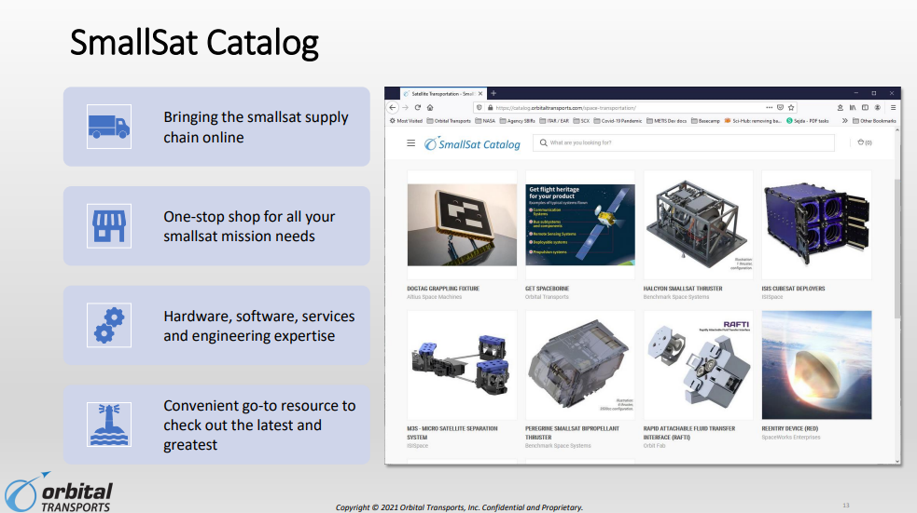
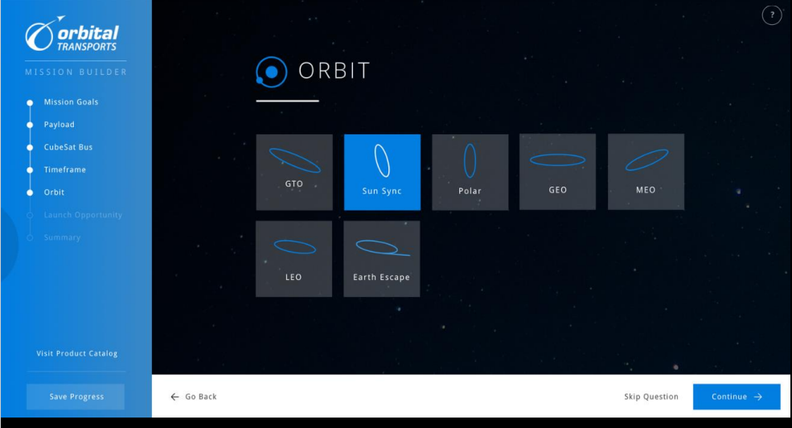
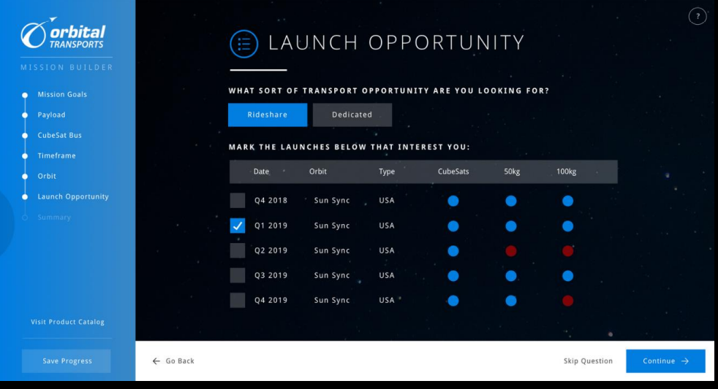
Orbital Transportation – Mission Cloud Concept – Transitioning from Logical to Physical Architecture
Notes:
Only 5 steps here because ?
The primary model elements are provided by the mission template models & are modified for each satellite and mission
Orbital has created a SmallSat Catelog to draw on asset characteristics & capabilities
The mission design tool is to capture the mission requirements desired by the customer (a customer facing web based interface).

Slide 3
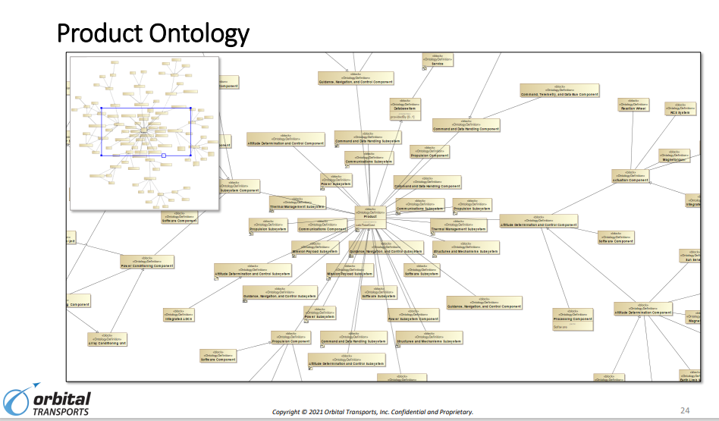
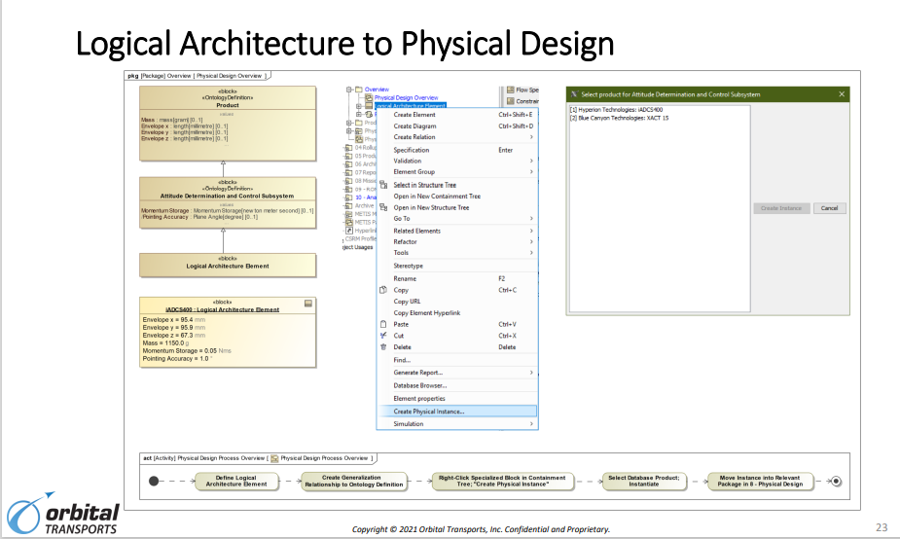
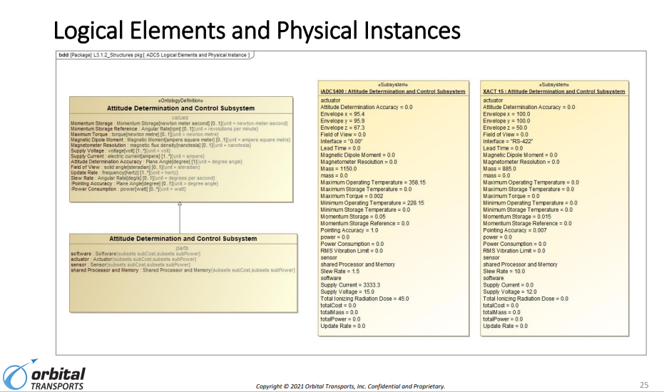
Process
Available Data Base Products
Containment
Tree
What is the story here ?
The logical architecture defines logical elements corresponding to an abstract architecture.
The block elements describe relatively generic subsystems and components (e.g. OBC, ADCS, etc.). These items are linked by generalization relationships to corresponding definitions in the Ontology, so they inherit the attributes and properties from the Ontology definitions.
Physical instances are created from the logical elements to represent a specific physical implementation (e.g. Hyperion iADCS 400). The instance properties are defined by the ontology definitions and their values are populated with data retrieved from the product database.
The Logical Architecture to Physical Design slide is representative of the process of selecting an element from the Logical Architecture, choosing a product from the product database corresponding to the selected architecture element, and automatically creating the physical instance using the product data retrieved from the database.
The Logical Elements and Physical Instances slide shows the ontology and logical architecture block defining the ADCS subsystem and two physical instances with the property values populated for two different products.
Notes:
The catalog allows OT to create the physical design from product data in the catalog based on elements in the logical architecture
Ontologies are a critical link between the logical model and the physical Model (instances) and important to create consistency between models and solutions.
Ontologies describe the attributes of logical architecture which defines the values associated with the physical instances.
OMG is coordinating with Orbital Transport to create standardized satellite ontologies.
OMG Space DTF is evaluating merit of the effort.
Patricia (Patty) Lew - LtCol MacKenzie Burchenough (Burkenow) – Rapid Deployment

Slide 4
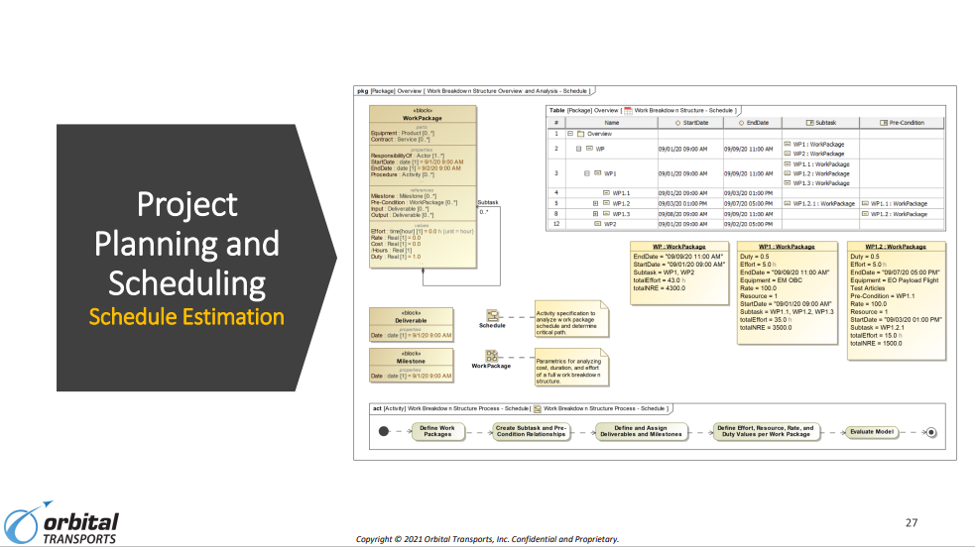
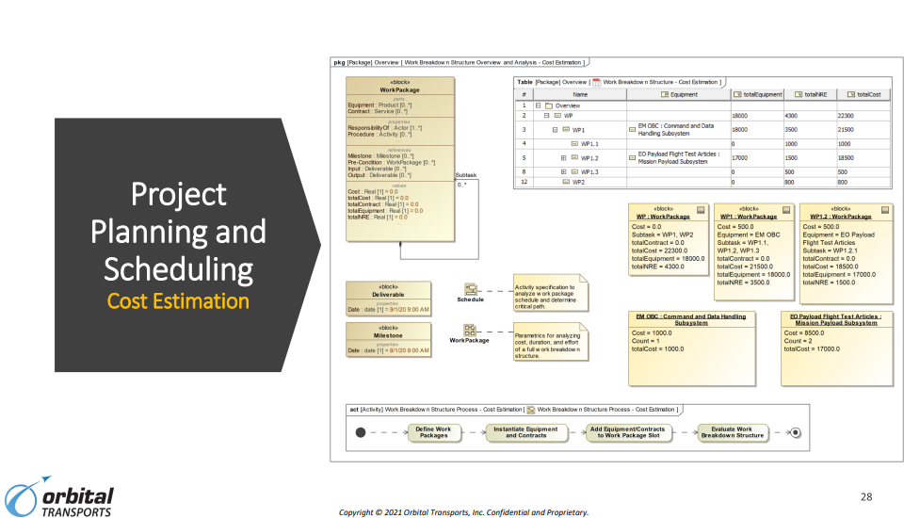
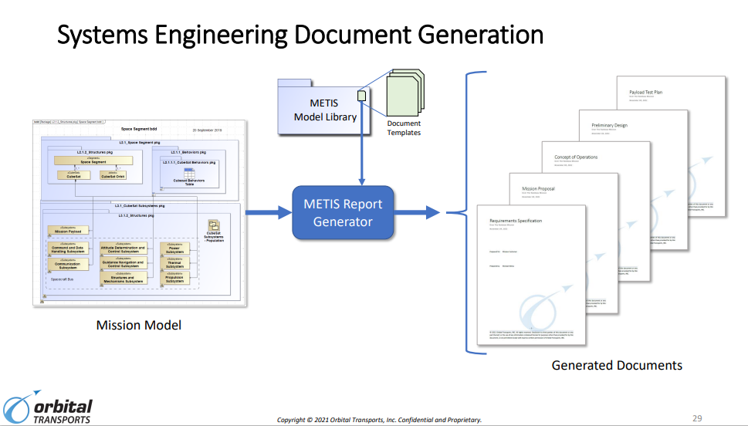
The Model is the Source of Truth
Once the previous SE steps are completed, then cost & schedule are estimated, Document Generation is printed for review
OT’s Mission Model Drives
the Documents
(Docs do NOT Drive the Process)
Notes:
Once the OT Design and tradeoff phase is completed, the Schedule Estimating Phase begins followed by the Cost Estimation Phase.
Finally, the Systems Engineering Document Generation is initiated and the entire package is sent for a Quality Assurance Evaluation Counsel Review before being sent to the customer.

Slide 5
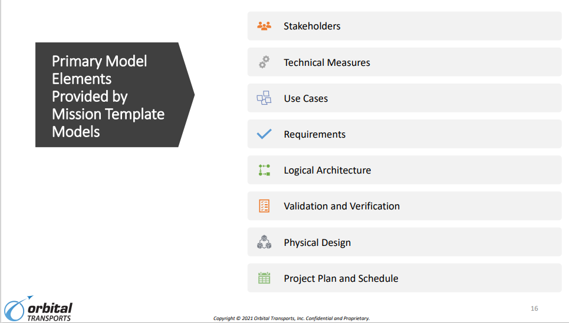
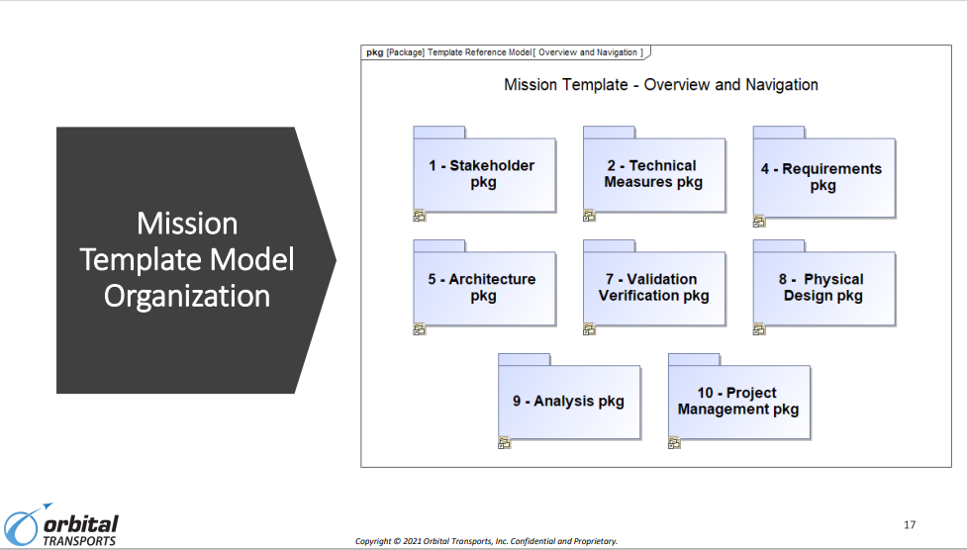

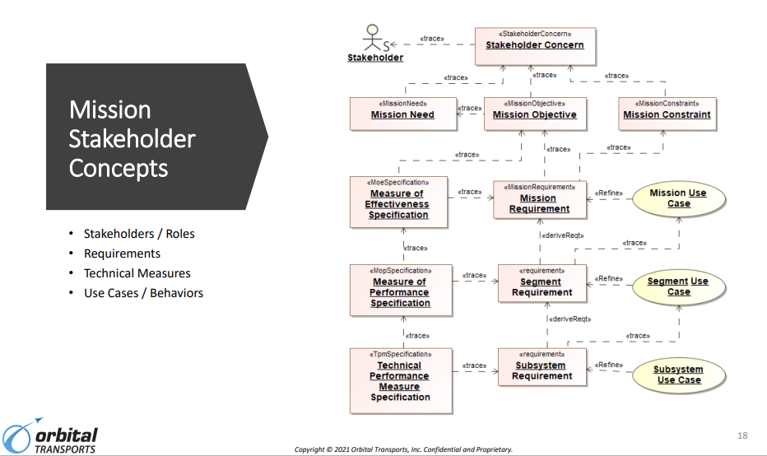
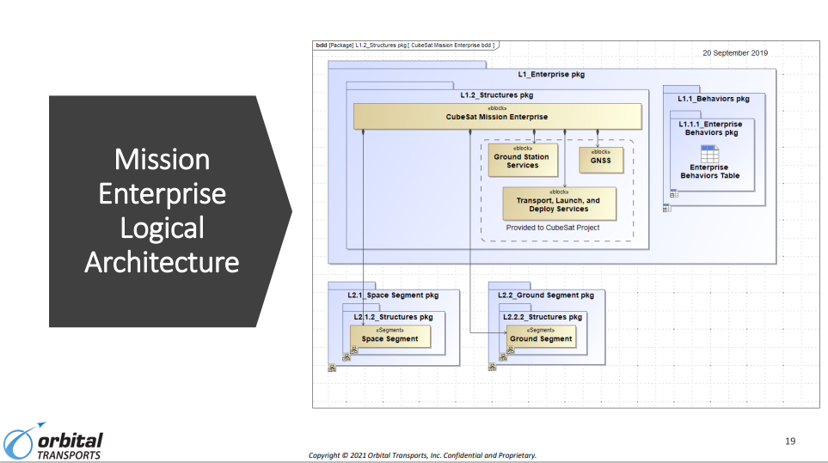
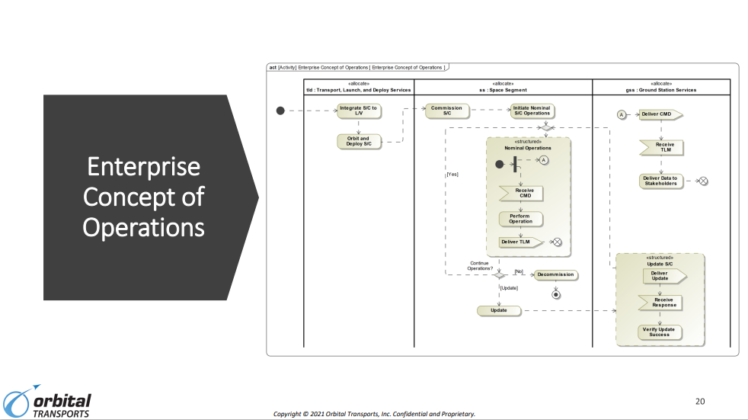
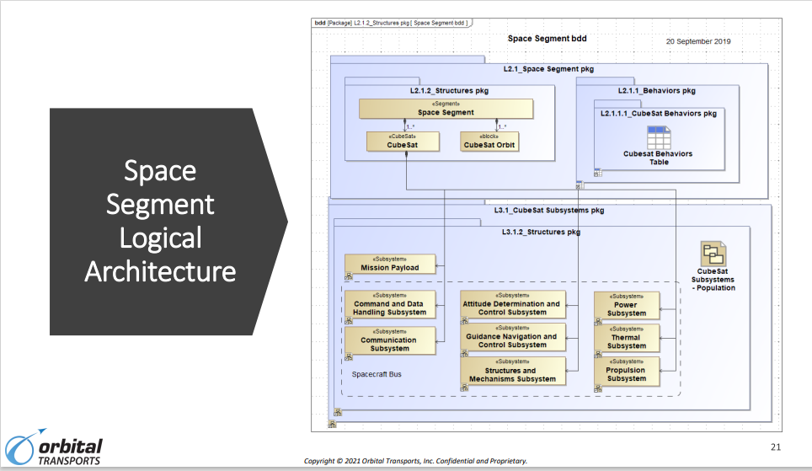
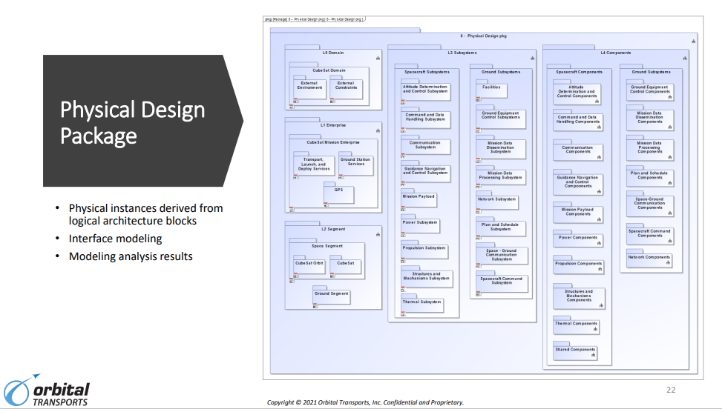

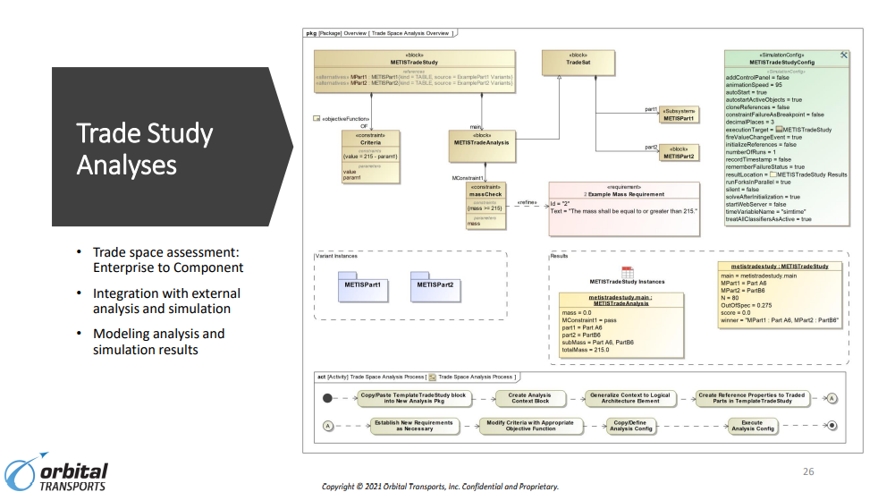
Once QAE Council Review Completed – Documents are Submitted to Customer
Notes:
This is a top level summary of how OT steps through the Cloud Architecture Process to arrive a final solution.
The CSRM Logo is placed on the charts to identify where the CSRM Logical Model Standard is utilized in OT’s process. On chart 2 it provides the majority of the packages but has OT extensions to meet OT’s needs.
Clients are provided tradeoffs for cost, schedule & performance trades as well as launch opportunities as well after an internal Quality Assurance Evaluation (QAE) is completed before releasing documentation to the customer.

Slide 6


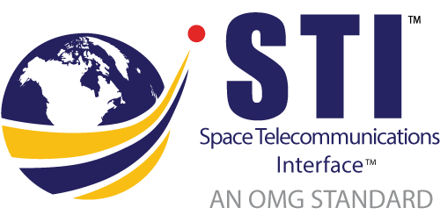

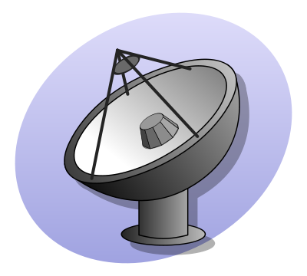
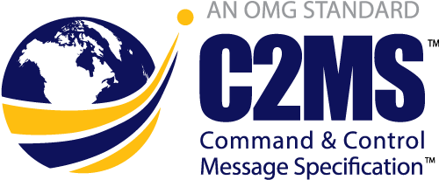

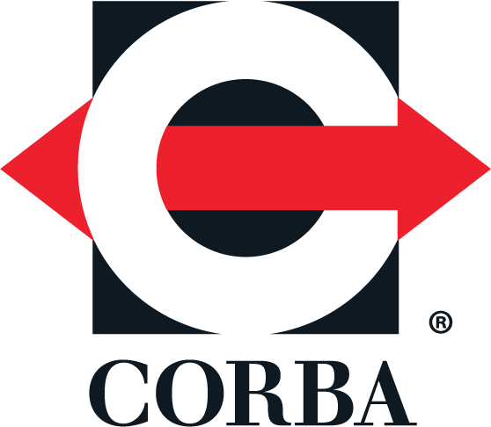

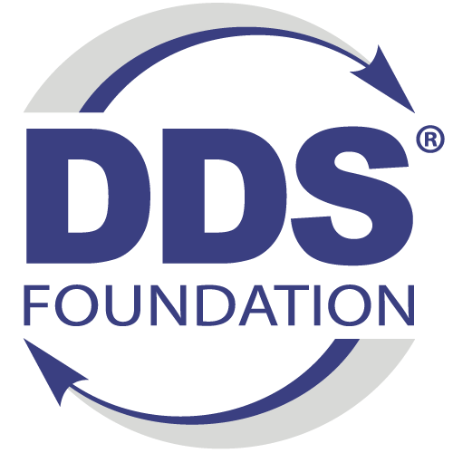

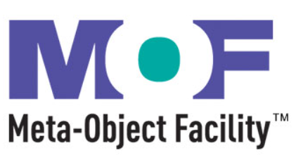

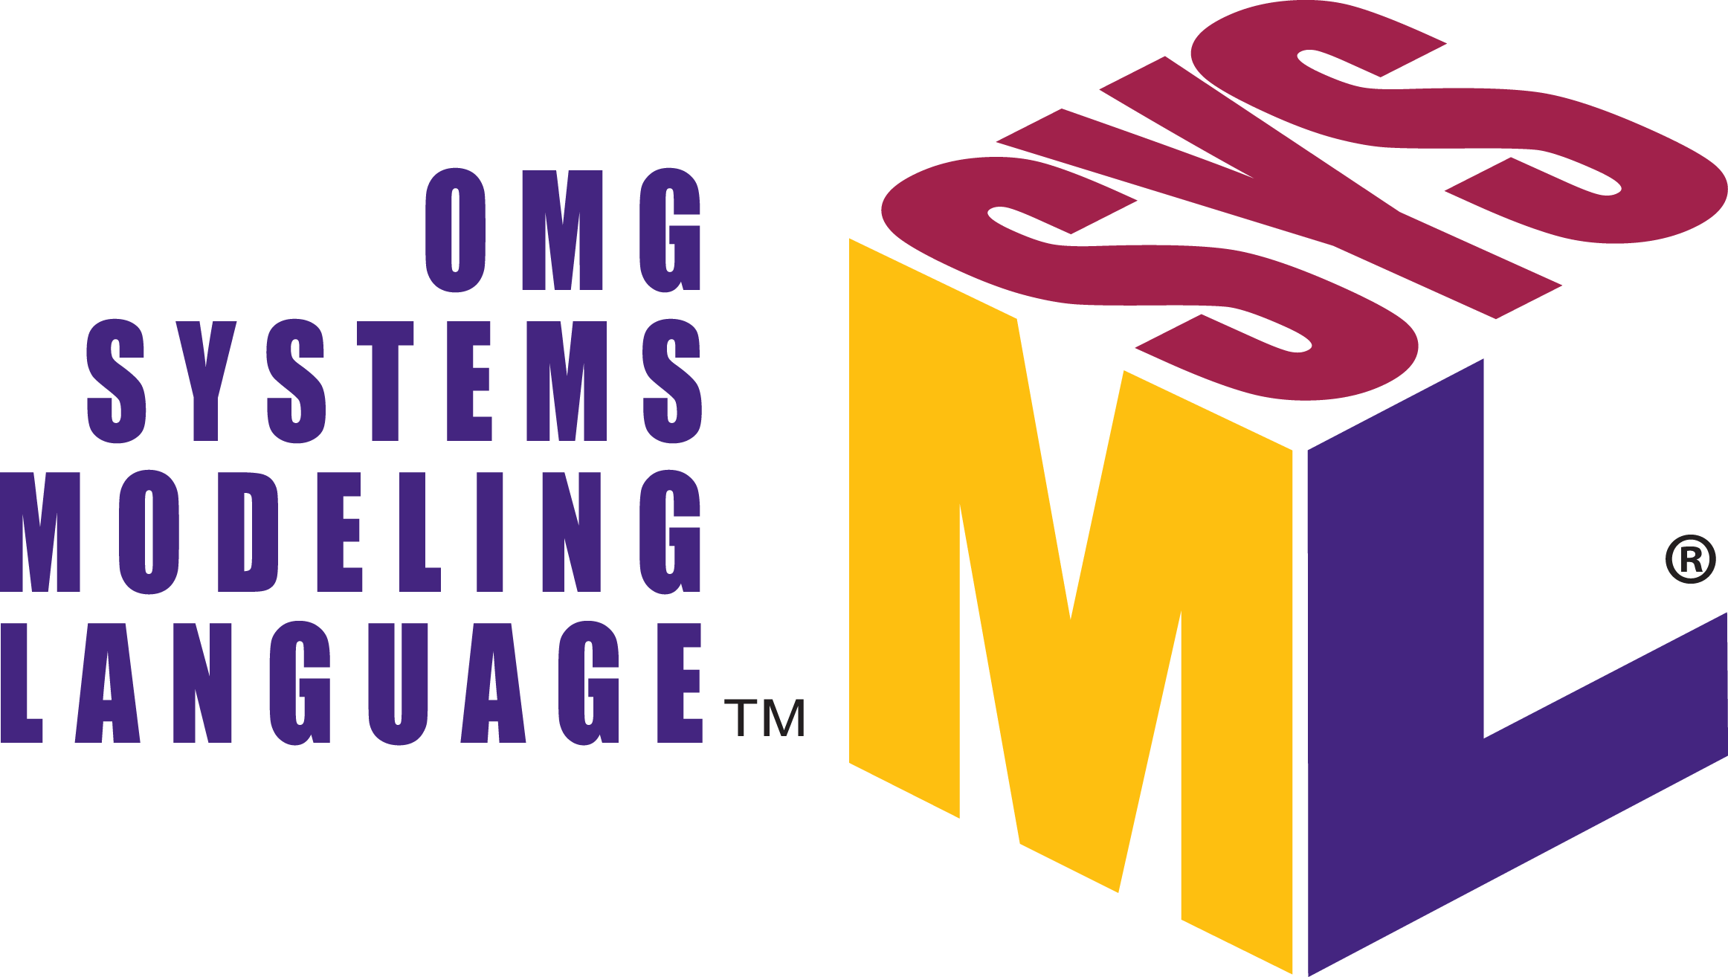





Where Do OMG Standards Fit ?
Satellite link (commands & telemetry)
Ground Equipment Monitor and Control
Inter-center real-time messaging
Other OMG Stds
of Choice
Intra-center real-time messaging
Operations artifacts
Common Object Request Broker Agent
Data Distribution Service
Information Exchange Framework
Meta Object Facility
Systems Modeling Language
Unified Architecture Framework
Alert Mgt Service
Open Architecture Radar Interface Standard
Ops Center 1
Ground Equipment
Satellite Factory
Ops Center 2
® 2022 Object Management Group. All Rights Reserved. Published by The Aerospace Corporation with permission

